Slide 1
Multi-threading

Slide 2
Objective
In this chapter learner able to understand:
What is Thread
Creating a Thread
Thread Lifecycle
Need of Synchronization
Concept of Object Locking

Slide 3
Where multi-threading can be useful…
Independent Tasks
Think of Parallel processing instead of linear.
Parallelizable Algorithms
Ex : parallelization of loops.

Slide 4
Process Based Multi-tasking
Operating System
Application #1
Local Memory
Application #2
Local Memory
Shared Memory
Application #3
Local Memory
Fig.: Processes in a multi-tasking environment

Slide 5
Thread Based Multitasking
Operating System
Application #1
Application #2
Java Virtual Machine
Local Variables
Thread#1
Thread#2
Local Variables
Global Memory
Thread#3
Local Variables
Fig.: Threads in a Multithreaded Environment

Slide 6
Ways of Creating a Thread : 2
Extend java.lang.Thread
Implement java.lang.Runnable
java.lang.Runnable
java.lang.Object
java.lang.Thread
A user defined class
A user defined class

Slide 7
Extending java.lang.Thread
class MyThread extends Thread
{
public void run() // overriding run
{
// code that the thread will execute
}
}
------------------------------------------------
public static void main(String[] args)
{
Thread t = new MyThread();
t.start(); // creating a thread executing a task parallel to others
// code the main thread will execute
}

Slide 8
Implementing java.lang.Runnable
class MyThread implements Runnable
{
public void run() // implementing run()
{
// code to be executed
}
}
---------------------------------
public static void main(String[] args)
{
Thread t = new Thread(new MyThread(),”Thread2”);
t.start();
// Let main thread do something else
}

Slide 9
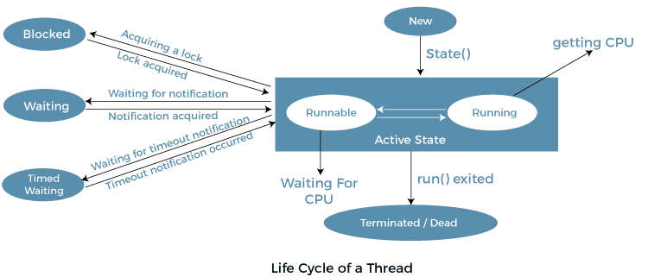
Thread Life Cycle

Slide 10
Let your thread participate in the race: call start()
A thread exists once it has been constructed, but at that point it is not executing any code. The thread is in a waiting state.
Thread t = new MyThread();
Once start() is invoked, the thread is said to be alive.
Check the state of the thread before & after invoking start(). use isAlive()
Other threads can change the attributes of a waiting thread.

Slide 11
Terminating a Thread
Normal termination of life-cycle.
Abnormal or forced termination
Once a thread is started, it call only one method i.e., run(). When it completes run, the thread is said to be terminated.
What can cause abnormal termination of a thread?
Can run( ) throw a checked exception?
How can a thread be forced to terminate?

Slide 12
Pausing, Suspending & Resuming a Thread
A running thread can be told to pause or resume.
I’ll do the things first, I’m going to suspend t1.
Main thread
Thread t1
ti.suspend();
//main did its work
t1.resume();
A running thread can pause its own execution for a specified time using sleep()

Slide 13
Race Condition & Data Synchronization
Need of Synchronization
To remove inconsistency while an object is being shared by 2 or more threads.
class NewThread
{
Shared s;
NewThread( Shared s)
{
this.s = s;
}
public void run()
{
for( int i=4; i<s.arr.length; i++)
//insert more elements
// suspend execution for a while
}
}
public static void main(String[] args)
{
// start new Thread
// logic to sort, suspend main //thread for a while
// display array elements
}
class Shared
{
int arr[] = new int[10];
{
arr[0] = 10;
arr[1]=3;
arr[2]=4;
arr[3]=-29;
}
}

Slide 14
synchronized keyword: Helps eliminating race condition
In Java, every object has an associated Lock.
When a method is declared synchronized, the executing thread must grab
the lock associated with the object before it can continue. Upon completion of the method, the lock is automatically released.

Slide 15
Using synchronized method
class Shared
{
int arr[] = new int[10];
synchronized void insert( int index, int num)
{
arr[index]=num;
}
synchronized void sort()
{
// code to sort}}
class NewThread
{
Shared s;
NewThread( Shared s)
{
this.s = s;
}
public void run()
{
for( int i=4; i<s.arr.length; i++)
s.insert( i, (int)(Math.random()*10)
// suspend execution for a while
}
}
public static void main(String[] args)
{
Shared s = new Shared();
new NewThread(s).start();
s.sort();}

Slide 16
Synchronized block
Synchronizing the access to an object when the respective class hasn’t been designed with synchronization in mind.
synchronized( object )
{
// statement to be synchronized
}
where object : object being synchronized
Synchronized block ensures that the methods belonging to object will only be invoked when the thread enters the lock.

Slide 17
join() method
It’s useful when a thread wants to wait until one or more thread terminates.
public static void main(String[] args)
{
Thread t1,t2,t3;
t1 = new NewThread();
t2 = new NewThread();
t3 = new NewThread();
t1.join();
t2.join();
t3.join();
System.out.println(“main terminated”);
}
class NewThread
{
public void run()
{
// code to execute
}
}

Slide 18
interthread communication using wait, notify & notifyAll
Object class has 3 final methods that we use in interthread communication. Those are :
wait()
notify()
notifyAll()
These can only be invoked from within a synchronized code.
Rules for using these methods:
wait() tells the calling thread to give up the monitor and go to sleep until some other thread enters the same monitor and calls notify().
notify() wakes up the first thread that called wait() on the object.
notifyAll() wakes up all the threads waiting on the object. The highest priority thread will run first.

