Slide 1


GIT

Slide 2
GITHUB
GitHub is a Git repository hosting service. GitHub also facilitates with many of its features, such as access control and collaboration. It provides a Web-based graphical interface.
GitHub is an American company. It hosts source code of your project in the form of different programming languages and keeps track of the various changes made by programmers.
It offers both distributed version control and source code management (SCM) functionality of Git. It also facilitates with some collaboration features such as bug tracking, feature requests, task management for every project.

Slide 3
GITHUB Features
Collaboration
Integrated issue and bug tracking
Graphical representation of branches
Git repositories hosting
Project management
Team management
Code hosting
Track and assign tasks
Conversations
Wikisc

Slide 4
GIT HUB Benefits
GitHub can be separated as the Git and the Hub. GitHub service includes access controls as well as collaboration features like task management, repository hosting, and team management.
The key benefits of GitHub are as follows.
It is easy to contribute to open source projects via GitHub.
It helps to create an excellent document.
You can attract recruiter by showing off your work. If you have a profile on GitHub, you will have a higher chance of being recruited.
It allows your work to get out there in front of the public.
You can track changes in your code across versions.

Slide 5
GIT vs GITHUB
Why Git needed?
When a team works on real-life projects, git helps ensure no code conflicts between the developers. Furthermore, the project requirements change often. So a git manages all the versions. If needed, we can also go back to the original code. The concept of branching allows several projects to run in the same codebase

Slide 6
GIT vs GITHUB
GITHUB
By the name, we can visualize that it is a Hub, projects, communities, etc. GitHub is a Git repository hosting service that provides a web-based graphical interface.

Slide 7
GIT vs SVN
Apache Subversion or SVN is one of the most popular centralized version control systems.
Now, SVN's popularity is on the decrease, but there are still millions of projects stored in it.
It can continue to be actively maintained by an open-source community.
In SVN, you can check out a single version of the repository. It stores data in a central server.

Slide 8
GIT vs SVN
While, Git is a popular distributed version control system, which means that you can clone your repository. Thus you can get a complete copy of your entire history of that project. This means you can access all your commits.
Git has more advantages than SVN. It is much better for those developers who are not always connected to the master repository. Also, it is much faster than SVN.

Slide 9
Git version control system
A version control system is a software that tracks changes to a file or set of files over time so that you can recall specific versions later. It also allows you to work together with other programmers.
The version control system is a collection of software tools that help a team to manage changes in a source code. It uses a special kind of database to keep track of every modification to the code.
Developers can compare earlier versions of the code with an older version to fix the mistakes.

Slide 10
Benefits of the Version Control System
The Version Control System is very helpful and beneficial in software development; developing software without using version control is unsafe. It provides backups for uncertainty. Version control systems offer a speedy interface to developers.
It also allows software teams to preserve efficiency and agility according to the team scales to include more developers.

Slide 11
Benefits of the Version Control System
Some key benefits of having a version control system are as follows.
Complete change history of the file
Simultaneously working
Branching and merging
Traceability

Slide 12
Types of Version Control System
Localized version Control System
Centralized version control systems
Distributed version control systems

Slide 13
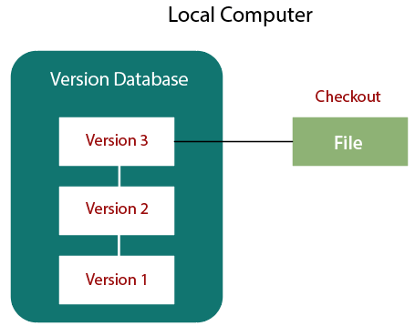
Localized Version Control Systems

Slide 14
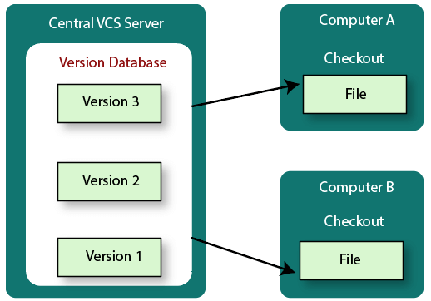
Central version Control system

Slide 15
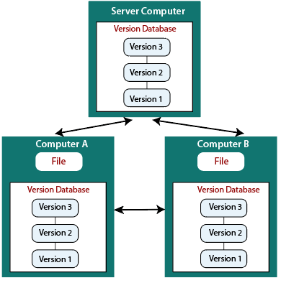
Distributed Version Control System

Slide 16
GIT Config
git config --global user.name ”avinash"
git config --global user.email avinashreddy911@gmail.com
git config –list

Slide 17
Git configuration levels
local
global
system
--local
It is the default level in Git. Git config will write to a local level if no configuration option is given. Local configuration values are stored in .git/config directory as a file.
--global
The global level configuration is user-specific configuration.
--system
The system-level configuration is applied across an entire system. The entire system means all users on an operating system and all repositories. The system-level configuration file stores in a gitconfig file off the system directory.

Slide 18
GIT Tools
GIT Bash
Command line
GIT GUI
git gui command on git bash

Slide 19
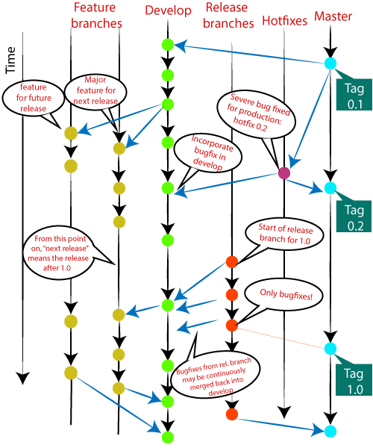
Git Flow / Git Branching Model
Git flow is the set of guidelines that developers can follow when using Git. We cannot say these guidelines as rules. These are not the rules; it is a standard for an ideal project. So that a developer would easily understand the things.
It is referred to as Branching Model by the developers and works as a central repository for a project. Developers work and push their work to different branches of the main repository.

Slide 20
Git Flow / Git Branching Model
There are different types of branches in a project. According to the standard branching strategy and release management, there can be following types of branches:
Master
Develop
Hotfixes
Release branches
Feature branches

Slide 21
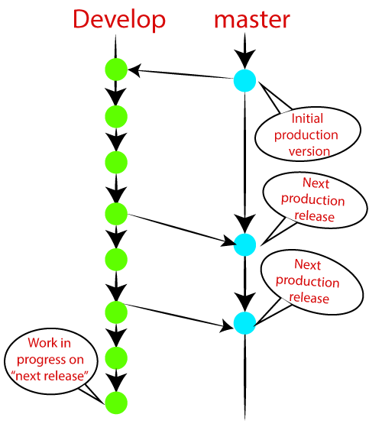
Main Branches

Slide 22
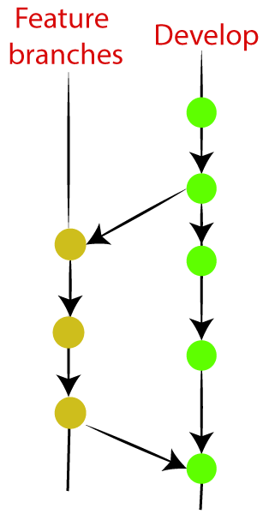
Supportive Branches
Feature branches
Release branches
Hotfix branches

Slide 23
Release Branches
The release branch is created for the support of a new version release. Senior developers will create a release branch. The release branch will contain the predetermined amount of the feature branch. The release branch should be deployed to a staging server for testing.
Developers are allowed for minor bug fixing and preparing meta-data for a release on this branch. After all these tasks, it can be merged with the develop branch.

Slide 24
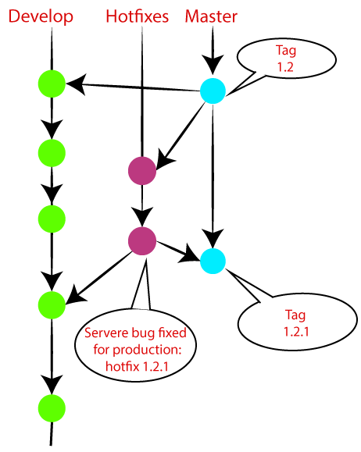
Hotfix Branches

Slide 25
GIT staging and Commits
Git init
To create a repository for new project
Touch filename
To create a new file
Git add filename
Add files to repository
Git status
List untracked files
Git init newDirectory
- Create directory and repository

Slide 26
GIT staging and Commits
Git add
The git add command is used to add file contents to the Index (Staging Area).This command updates the current content of the working tree to the staging area. It also prepares the staged content for the next commit. Every time we add or update any file in our project, it is required to forward updates to the staging area.
git add <File name> $ git add newfile.txt
$ touch newfile.txt $ git add .
$ git status

Slide 27
GIT staging and Commits
$ git add *.java
$ git reset <filename>
$ git add -u
To stage all modified and deleted files only,

Slide 28
Git Commit
It is used to record the changes in the repository. It is the next command after the git add. Every commit contains the index data and the commit message. Every commit forms a parent-child relationship. When we add a file in Git, it will take place in the staging area. A commit command is used to fetch updates from the staging area to the repository.
$ git commit

Slide 29
Git Commit
The staging and committing are co-related to each other. Staging allows us to continue in making changes to the repository, and when we want to share these changes to the version control system, committing allows us to record these changes.
Commits are the snapshots of the project. Every commit is recorded in the master branch of the repository. We can recall the commits or revert it to the older version. Two different commits will never overwrite because each commit has its own commit-id. This commit-id is a cryptographic number created by SHA (Secure Hash Algorithm) algorithm.

Slide 30
Git statging and commit
$ git commit -a
This option only consider already added files in Git. It will not commit the newly created file
$ git commit --m "Commit message."
$ git commit --am "Commit message."
$ git commit --amend
The amend option lets us to edit the last commit. If accidentally, we have committed a wrong commit message, then this feature is a savage option for us.

Slide 31
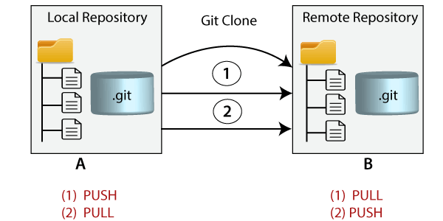
Git Clone
In Git, cloning is the act of making a copy of any target repository. The target repository can be remote or local. You can clone your repository from the remote repository to create a local copy on your system. Also, you can sync between the two locations.

Slide 32
Git clone
$ git clone <repository URL>
$ git clone -b <Branch name><Repository URL>
$ git clone -b <Branch name><Repository URL>

Slide 33
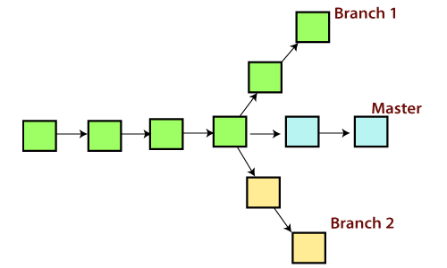
GIT Branch
A branch is a version of the repository that diverges from the main working project. It is a feature available in most modern version control systems. A Git project can have more than one branch. These branches are a pointer to a snapshot of your changes. When you want to add a new feature or fix a bug, you spawn a new branch to summarize your changes. So, it is complex to merge the unstable code with the main code base and also facilitates you to clean up your future history before merging with the main branch.

Slide 34
Git Master Branch
The master branch is a default branch in Git. It is instantiated when first commit made on the project. When you make the first commit, you're given a master branch to the starting commit point. When you start making a commit, then master branch pointer automatically moves forward. A repository can have only one master branch.
Master branch is the branch in which all the changes eventually get merged back. It can be called as an official working version of your project.

Slide 35
Git branch command
$ git branch <branch name>
$ git branch --list
$ git branch -d<branch name>
$ git push origin -delete <branch name>
$ git checkout<branch name>
$ git branch -m master
$ git branch - <old branch name><new branch name>
$ git merge <branch name>
$ git checkout branchname
$ git merge commitid

Slide 36
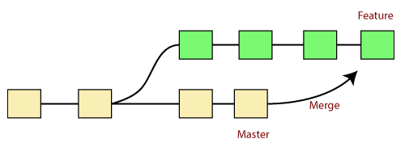
Git Merge and Merge Conflict
In Git, the merging is a procedure to connect the forked history. It joins two or more development history together. The git merge command facilitates you to take the data created by git branch and integrate them into a single branch. Git merge will associate a series of commits into one unified history. Generally, git merge is used to combine two branches.

Slide 37
Git Merge and Merge Conflict
It is used to maintain distinct lines of development; at some stage, you want to merge the changes in one branch. It is essential to understand how merging works in Git.
In the above figure, there are two branches master and feature. We can see that we made some commits in both functionality and master branch, and merge them. It works as a pointer. It will find a common base commit between branches. Once Git finds a shared base commit, it will create a new "merge commit." It combines the changes of each queued merge commit sequence.

Slide 38
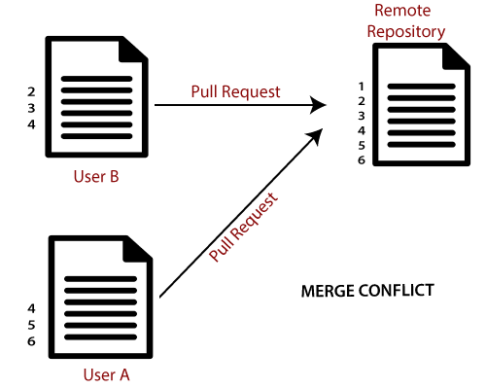
Git Merge Conflict
When two branches are trying to merge, and both are edited at the same time and in the same file, Git won't be able to identify which version is to take for changes. Such a situation is called merge conflict. If such a situation occurs, it stops just before the merge commit so that you can resolve the conflicts manually.

Slide 39
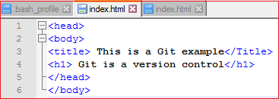
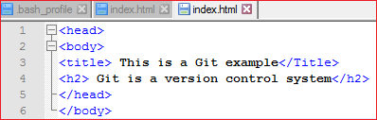
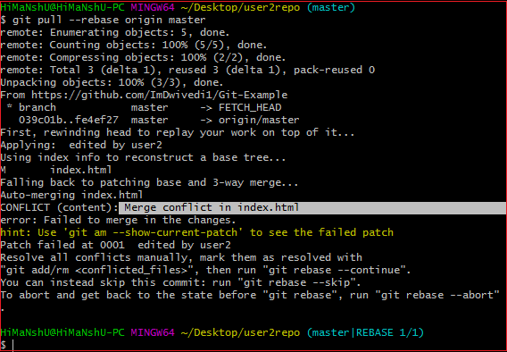
Git merge conflict

Slide 40
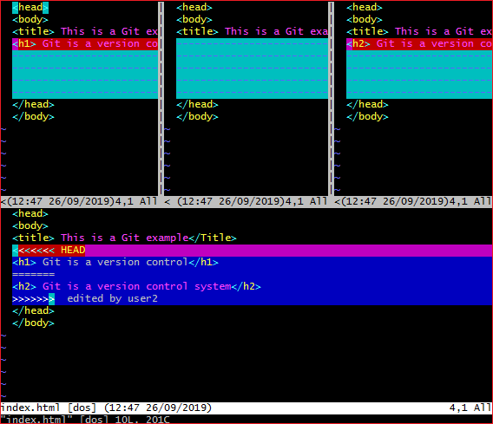
Resolve Conflict
git mergetool
The above output shows the status of the conflicted file. To resolve the conflict, enter in the insert mode by merely pressing I key and make changes as you want. Press the Esc key, to come out from insert mode. Type the: w! at the bottom of the editor to save and exit the changes. To accept the changes, use the rebase command.
$ git rebase --continue

Slide 41
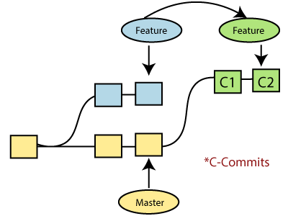
Git Rebase
Rebasing is a process to reapply commits on top of another base trip. It is used to apply a sequence of commits from distinct branches into a final commit. It is an alternative of git merge command. It is a linear process of merging.
In Git, the term rebase is referred to as the process of moving or combining a sequence of commits to a new base commit. Rebasing is very beneficial and it visualized the process in the environment of a feature branching workflow.
It is good to rebase your branch before merging it.

Slide 42
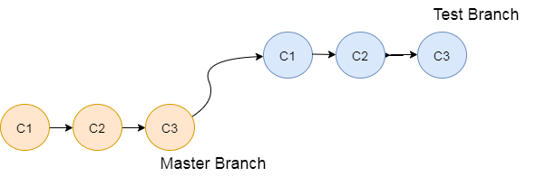
Git rebase
Generally, it is an alternative of git merge command. Merge is always a forward changing record. Comparatively, rebase is a compelling history rewriting tool in git. It merges the different commits one by one.
Suppose you have made three commits in your master branch and three in your other branch named test. If you merge this, then it will merge all commits in a time. But if you rebase it, then it will be merged in a linear manner. Consider the below image:

Slide 43
Git rebase
$git rebase <branch name>
If there are some conflicts in the branch, resolve them, and perform below commands to continue changes:
$git status
$git rebase --continue
$git rebase --skip
$git log --oneline

Slide 44
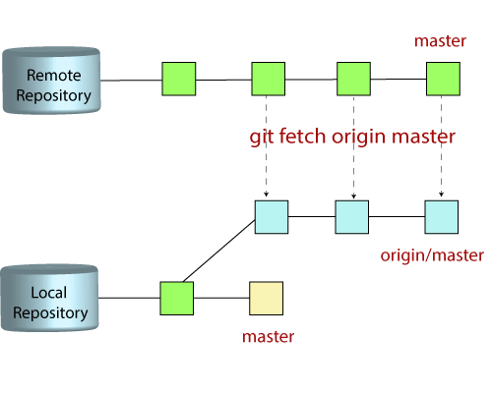
Collaborating
Git fetch
Git "fetch" Downloads commits, objects and refs from another repository. It fetches branches and tags from one or more repositories. It holds repositories along with the objects that are necessary to complete their histories to keep updated remote-tracking branches.
git fetch< repository Url>
git fetch <branch URL><branch name>
$ git fetch -all
git pull = git fetch + git merge

Slide 45
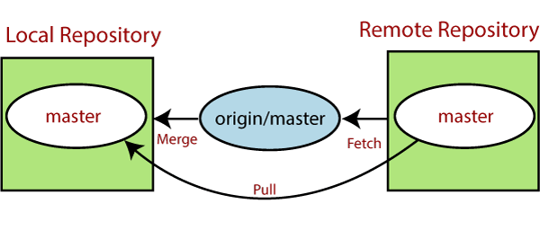
Git Pull / Pull Request
The term pull is used to receive data from GitHub. It fetches and merges changes from the remote server to your working directory. The git pull command is used to pull a repository.

Slide 46
Git pull
Git pull
git pull <remote branch URL>
$ git pull origin main
git remote -v

Slide 47
Git push
$ git push origin master
$ git push <remote><branch> -force
$ git push --verbose
$ git push origin -delete branchname

Slide 48
Inspecting changes
$ git log
$ git log --oneline
$ git log --stat (Modified files)
$ git log --after="yy-mm-dd" $ git log --after="2019-11-01" --before="2019-11-08 "
$ git log --author="Author name"
$ git log --grep=" Commit message."

Slide 49
Git diff
Git diff is a command-line utility. It's a multiuse Git command. When it is executed, it runs a diff function on Git data sources. These data sources can be files, branches, commits, and more. It is used to show changes between commits, commit, and working tree, etc.
Git diff
Git diff branch1 branch2

Slide 50
Undoing changes
$ git revert commitid
$ git rm <file Name>
$ git rm --cached <file name>
Sometimes you want to remove files from the Git but keep the files in your local repository. In other words, you do not want to share your file on Git. Git allows you to do so. The cached option is used in this case. It specifies that the removal operation will only act on the staging index, not on the repository
$ git rm --cached <file name>

Slide 51
Git cherry picking
Cherry-picking in Git stands for applying some commit from one branch into another branch. In case you made a mistake and committed a change into the wrong branch, but do not want to merge the whole branch. You can revert the commit and apply it on another branch.
$ git cherry-pick <commit id>

Slide 52
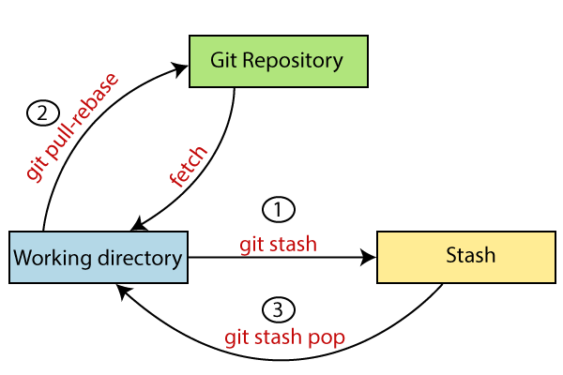
Git Stash
Sometimes you want to switch the branches, but you are working on an incomplete part of your current project. You don't want to make a commit of half-done work. Git stashing allows you to do so. The git stash command enables you to switch branches without committing the current branch.

Slide 53
Git stash
Generally, the stash's meaning is "store something safely in a hidden place." The sense in Git is also the same for stash; Git temporarily saves your data safely without committing.
$Git stash
$ git stash save "<Stashing Message>“
$ git stash list
$ git stash apply <stash id>
$git stash show $ git stash drop <stash id>
$ git stash clear
$ git stash branch <Branch Name>

Slide 54
Thank you

