Slide 1


Java Object Oriented Programming

Slide 2
Class
A class can also be defined as a blueprint from which you can create an individual object.
Fields
Methods
Constructors
Blocks
Nested class and interface

Slide 3
Object
An object is an instance of a class
State: represents the data (value) of an object.
Behavior: represents the behavior (functionality) of an object such as deposit, withdraw, etc.
Identity: An object identity is typically implemented via a unique ID. The value of the ID is not visible to the external user. However, it is used internally by the JVM to identify each object uniquely.

Slide 4
Java Naming conventions
Java naming convention is a rule to follow as you decide what to name your identifiers such as class, package, variable, constant, method, etc.
By using standard Java naming conventions, you make your code easier to read for yourself and other programmers. Readability of Java program is very important. It indicates that less time is spent to figure out what the code does.

Slide 5
Java Naming conventions
Class/Interface
It should start with the uppercase letter.
Method/Variable/Package
It should start with lowercase letter.
Constant
It should start with uppercase letter.
If the name contains multiple words, it should be separated by an underscore(_) such as MAX_PRIORITY.
CamelCase in java naming conventions
Java follows camel-case syntax for naming the class, interface, method, and variable.

Slide 6
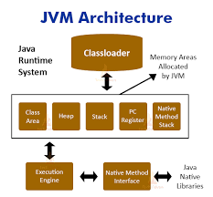
JVM Architecture

Slide 7
Method
A method is a block of code or collection of statements or a set of code grouped together to perform a certain task or operation. It is used to achieve the reusability of code.
We write a method once and use it many times. We do not require to write code again and again. It also provides the easy modification and readability of code, just by adding or removing a chunk of code. The method is executed only when we call or invoke it.
The most important method in Java is the main() method.

Slide 8
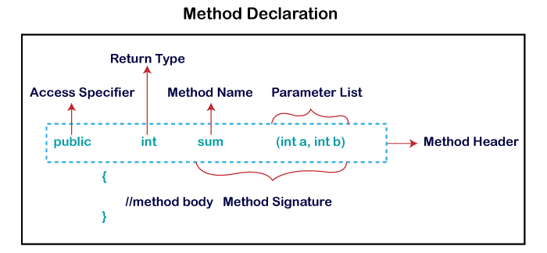
Method Declaration

Slide 9
Types of Method
Predefined Method
User-defined Method

Slide 10
Predefined Method
In Java, predefined methods are the method that is already defined in the Java class libraries is known as predefined methods. It is also known as the standard library method or built-in method. We can directly use these methods just by calling them in the program at any point. Some pre-defined methods are length(), equals(), compareTo(), sqrt(), etc. When we call any of the predefined methods in our program, a series of codes related to the corresponding method runs in the background that is already stored in the library.

Slide 11
User-defined Method
The method written by the user or programmer is known as a user-defined method. These methods are modified according to the requirement.

Slide 12
Static Method
A method that has static keyword is known as static method. In other words, a method that belongs to a class rather than an instance of a class is known as a static method. We can also create a static method by using the keyword static before the method name.
The main advantage of a static method is that we can call it without creating an object. It can access static data members and also change the value of it. It is used to create an instance method. It is invoked by using the class name. The best example of a static method is the main() method

Slide 13
Instance Method
The method of the class is known as an instance method. It is a non-static method defined in the class. Before calling or invoking the instance method, it is necessary to create an object of its class. Let's see an example of an instance method.

Slide 14
InstanceMethod
Accessor Method
Mutator Method

Slide 15
Abstract Method
The method that does not has method body is known as abstract method.
In other words, without an implementation is known as abstract method.
It always declares in the abstract class. It means the class itself must be abstract if it has abstract method.
To create an abstract method, we use the keyword abstract.

Slide 16
Factory Method
It is a method that returns an object to the class to which it belongs.
All static methods are factory methods.
For example, NumberFormat obj = NumberFormat.getNumberInstance();

Slide 17
Constructors in Java
A constructor is a block of codes similar to the method. It is called when an instance of the class
is created. At the time of calling constructor, memory for the object is allocated in the memory.
It is a special type of method which is used to initialize the object.
Every time an object is created using the new() keyword, at least one constructor is called.
It calls a default constructor if there is no constructor available in the class. In such case, Java compiler provides a default constructor by default.

Slide 18
Rules for creating Java constructor
Constructor name must be the same as its class name
A Constructor must have no explicit return type
A Java constructor cannot be abstract, static, final, and synchronized

Slide 19
Types of Java constructors
Default constructor (no-arg constructor)
Parameterized constructor
The default constructor is used to provide the default values to the object like 0, null, etc., depending on the type.

Slide 20
Java Parameterized Constructor
A constructor which has a specific number of parameters is called a parameterized constructor.
Why use the parameterized constructor?
The parameterized constructor is used to provide different values to distinct objects. However, you can provide the same values also.

Slide 21
Constructor Overloading in Java
Is a technique of having more than one constructor with different parameter lists.
They are arranged in a way that each constructor performs a different task.
They are differentiated by the compiler by the number of parameters in the list and their types.

Slide 22
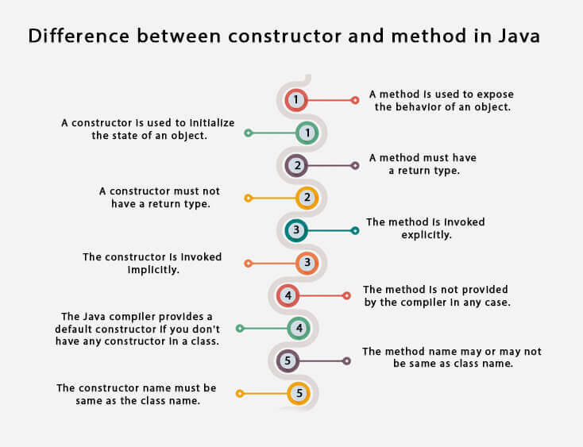
Constructor vs method

Slide 23
Java static keyword
The static keyword in Java
is used for memory management mainly. We can apply static keyword with variables
, methods, blocks and nested classes
. The static keyword belongs to the class than an instance of the class.

Slide 24
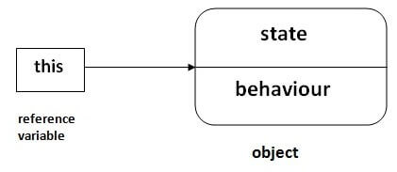
this keyword in Java

Slide 25
Usage of this keyword
this can be used to refer current class instance variable.
this can be used to invoke current class method (implicitly)
this() can be used to invoke current class constructor.
this can be passed as an argument in the method call.
this can be passed as argument in the constructor call.
this can be used to return the current class instance from the method.

Slide 26
Inheritance in Java
Inheritance in Java is a mechanism in which one object acquires all the properties and behaviors of a parent object. It is an important part of OOPs
Inheritance represents the IS-A relationship which is also known as a parent-child relationship.
For Method Overriding
(so runtime polymorphism
can be achieved).
For Code Reusability.

Slide 27
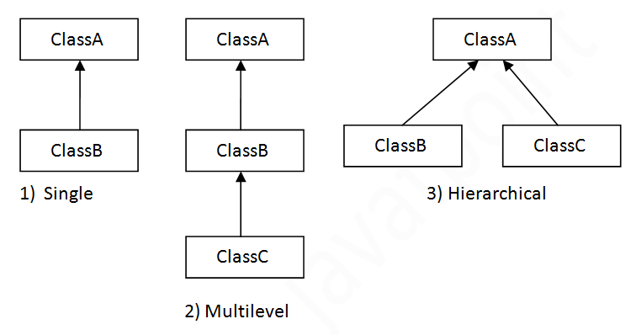
TypesofInheritance

Slide 28
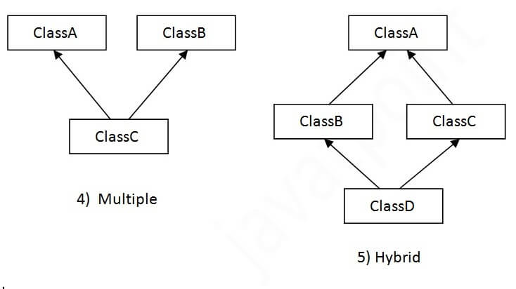
TypesofInheritance

Slide 29
Why Multiple Inheritance is not supported
Consider a scenario where A, B, and C are three classes. The C class inherits A and B classes. If A and B classes have the same method and you call it from child class object, there will be ambiguity to call the method of A or B class.
Since compile-time errors are better than runtime errors, Java renders compile-time error if you inherit 2 classes. So whether you have same method or different, there will be compile time error.

Slide 30
Aggregation in Java
If a class have an entity reference, it is known as Aggregation. Aggregation represents HAS-A relationship.
Consider a situation, Employee object contains many informations such as id, name, emailId etc. It contains one more object named address, which contains its own informations such as city, state, country, zipcode etc. as given below.
class Employee{
int id;
String name;
Address address;//Address is a class
...
}

Slide 31
Encapsulation in Java
Encapsulation in Java is a process of wrapping code and data together into a single unit, for example, a capsule which is mixed of several medicines. We can create a fully encapsulated class in Java by making all the data members of the class private. Now we can use setter and getter methods to set and get the data in it.
The Java Bean class is the example of a fully encapsulated class.

Slide 32
Advantage of Encapsulation in Java
It provides you the control over the data. Suppose you want to set the value of id which should be greater than 100 only, you can write the logic inside the setter method. You can write the logic not to store the negative numbers in the setter methods.
It is a way to achieve data hiding in Java because other class will not be able to access the data through the private data members.
The encapsulate class is easy to test. So, it is better for unit testing.

Slide 33
Abstraction in Java
Abstraction is a process of hiding the implementation details and showing only functionality to the user.
Another way, it shows only essential things to the user and hides the internal details, for example, sending SMS where you type the text and send the message. You don't know the internal processing about the message delivery.

Slide 34
Abstraction in Java
Ways to achieve Abstraction
There are two ways to achieve abstraction in java
Abstract class (0 to 100%)
Interface (100%)

Slide 35
Interface in Java
There can be only abstract methods in the Java interface, not method body.
It is used to achieve abstraction and multiple inheritance in Java.
It cannot be instantiated just like the abstract class.
Since Java 8, we can have default and static methods in an interface.
Since Java 9, we can have private methods in an interface.

Slide 36
Marker Interface
//How Serializable interface is written?
public interface Serializable{
}
An interface which has no member is known as a marker or tagged interface, for example, Serializable, Cloneable, Remote, etc. They are used to provide some essential information to the JVM so that JVM may perform some useful operation.

Slide 37
Nested Interface
When interface has another interface
interface printable{
void print();
interface MessagePrintable{
void msg();
}
}

Slide 38
Method Overloading in Java
If a class has multiple methods having same name but different in parameters, it is known as Method Overloading
1) Method Overloading: changing no. of arguments
2) Method Overloading: changing data type of arguments

Slide 39
Method Overriding in Java
If subclass (child class) has the same method as declared in the parent class, it is known as method overriding in Java.

Slide 40
Super Keyword in Java
The super keyword in Java is a reference variable which is used to refer immediate parent class object.
super can be used to refer immediate parent class instance variable.
super can be used to invoke immediate parent class method.
super() can be used to invoke immediate parent class constructor.

Slide 41
Final keyword
final keyword in java is used to restrict the user. The java final keyword can be used in many context. Final can be:
variable
method
class

Slide 42
Binding
Static Binding (also known as Early Binding).
Dynamic Binding (also known as Late Binding).

Slide 43
Thank you
Notes:
Trainer Notes
Brainstorm: what is equity trading?

