Slide 1


Java Collections

Slide 2
Collections
Collection in Java is a framework that provides an architecture to store and manipulate the group of objects.
Java Collections can achieve all the operations that you perform on a data such as searching, sorting, insertion, manipulation, and deletion.

Slide 3
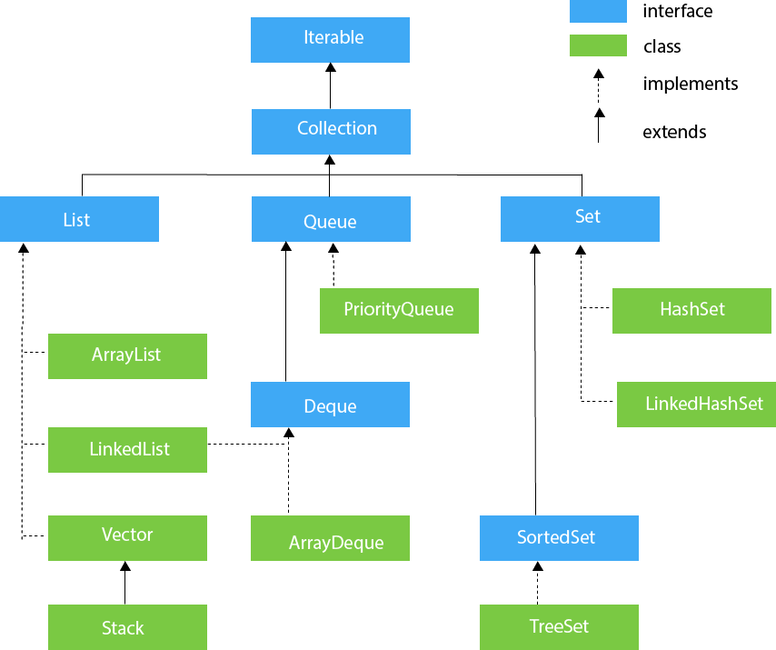
Collections

Slide 4
Java ArrayList
Java ArrayList class uses a dynamic array
for storing the elements. It is like an array, but there is no size limit. We can add or remove elements anytime. So, it is much more flexible than the traditional array. It is found in the java.util package. It is like the Vector in C++.
The ArrayList in Java can have the duplicate elements also. It implements the List interface so we can use all the methods of List interface here. The ArrayList maintains the insertion order internally.
It inherits the AbstractList class and implements List interface
.

Slide 5
ArrayList
Java ArrayList class can contain duplicate elements.
Java ArrayList class maintains insertion order.
Java ArrayList class is non synchronized
.
Java ArrayList allows random access because array works at the index basis.
In ArrayList, manipulation is little bit slower than the LinkedList in Java because a lot of shifting needs to occur if any element is removed from the array list.

Slide 6
Iterating Elements in Collections
By Iterator interface.
By for-each loop.
By ListIterator interface.
By for loop.
By forEach() method.
By forEachRemaining() method.

Slide 7
Java LinkedList class
Java LinkedList class uses a doubly linked list to store the elements. It provides a linked-list data structure. It inherits the AbstractList class and implements List and Deque interfaces.
Java LinkedList class can contain duplicate elements.
Java LinkedList class maintains insertion order.
Java LinkedList class is non synchronized.
In Java LinkedList class, manipulation is fast because no shifting needs to occur.
Java LinkedList class can be used as a list, stack or queue.

Slide 8
ArrayList vs LinkedList
ArrayList | LinkedList
1) ArrayList internally uses a dynamic array to store the elements. | LinkedList internally uses a doubly linked list to store the elements.
2) Manipulation with ArrayList is slow because it internally uses an array. If any element is removed from the array, all the bits are shifted in memory. | Manipulation with LinkedList is faster than ArrayList because it uses a doubly linked list, so no bit shifting is required in memory.
3) An ArrayList class can act as a list only because it implements List only. | LinkedList class can act as a list and queue both because it implements List and Deque interfaces.
4) ArrayList is better for storing and accessing data. | LinkedList is better for manipulating data.

Slide 9
Java List
List in Java provides the facility to maintain the ordered collection. It contains the index-based methods to insert, update, delete and search the elements. It can have the duplicate elements also. We can also store the null elements in the list. The List interface is found in the java.util package and inherits the Collection interface. It is a factory of ListIterator interface. Through the ListIterator, we can iterate the list in forward and backward directions. The implementation classes of List interface are ArrayList, LinkedList, Stack and Vector. The ArrayList and LinkedList are widely used in Java programming. The Vector class is deprecated since Java 5.

Slide 10
HashSet
Java HashSet class is used to create a collection that uses a hash table for storage. It inherits the AbstractSet class and implements Set interface.
HashSet stores the elements by using a mechanism called hashing.
HashSet contains unique elements only.
HashSet allows null value.
HashSet class is non synchronized.
HashSet doesn't maintain the insertion order. Here, elements are inserted on the basis of their hashcode.
HashSet is the best approach for search operations.

Slide 11
Java LinkedHashSet class
Java LinkedHashSet class is a Hashtable and Linked list implementation of the set interface. It inherits HashSet class and implements Set interface.
Java LinkedHashSet class contains unique elements only like HashSet.
Java LinkedHashSet class provides all optional set operation and permits null elements.
Java LinkedHashSet class is non synchronized.
Java LinkedHashSet class maintains insertion order.

Slide 12
Java TreeSet class
Java TreeSet class implements the Set interface that uses a tree for storage. It inherits AbstractSet class and implements the NavigableSet interface. The objects of the TreeSet class are stored in ascending order.
Java TreeSet class contains unique elements only like HashSet.
Java TreeSet class access and retrieval times are quiet fast.
Java TreeSet class doesn't allow null element.
Java TreeSet class is non synchronized.
Java TreeSet class maintains ascending order.

Slide 13
Java Queue Interface
Java Queue interface orders the element in FIFO(First In First Out) manner. In FIFO, first element is removed first and last element is removed at last.
The PriorityQueue class provides the facility of using queue. But it does not orders the elements in FIFO manner. It inherits AbstractQueue class.

Slide 14
Java Deque Interface
Java Deque Interface is a linear collection that supports element insertion and removal at both ends. Deque is an acronym for "double ended queue".
The ArrayDeque class provides the facility of using deque and resizable-array. It inherits AbstractCollection class and implements the Deque interface.
Unlike Queue, we can add or remove elements from both sides.
Null elements are not allowed in the ArrayDeque.
ArrayDeque is not thread safe, in the absence of external synchronization.
ArrayDeque has no capacity restrictions.
ArrayDeque is faster than LinkedList and Stack.

Slide 15
Java Map Interface
A map contains values on the basis of key, i.e. key and value pair. Each key and value pair is known as an entry. A Map contains unique keys.
A Map is useful if you have to search, update or delete elements on the basis of a key. A Map doesn't allow duplicate keys, but you can have duplicate values. HashMap and LinkedHashMap allow null keys and values, but TreeMap doesn't allow any null key or value.

Slide 16
Map Interface

Slide 17
Map
Class | Description
HashMap | HashMap is the implementation of Map, but it doesn't maintain any order.
LinkedHashMap | LinkedHashMap is the implementation of Map. It inherits HashMap class. It maintains insertion order.
TreeMap | TreeMap is the implementation of Map and SortedMap. It maintains ascending order.

Slide 18
Java HashMap
Java HashMap class implements the Map interface which allows us to store key and value pair, where keys should be unique. If you try to insert the duplicate key, it will replace the element of the corresponding key. It is easy to perform operations using the key index like updation, deletion, etc. HashMap class is found in the java.util package.
HashMap in Java is like the legacy Hashtable class, but it is not synchronized. It allows us to store the null elements as well, but there should be only one null key. Since Java 5, it is denoted as HashMap<K,V>, where K stands for key and V for value. It inherits the AbstractMap class and implements the Map interface.

Slide 19
Java HashMap
Java HashMap contains values based on the key.
Java HashMap contains only unique keys.
Java HashMap may have one null key and multiple null values.
Java HashMap is non synchronized.
Java HashMap maintains no order.

Slide 20
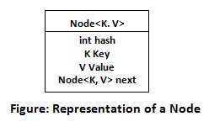
Working of HashMap
Hashing
It is the process of converting an object into an integer value. The integer value helps in indexing and faster searches. HashMap is a part of the Java collection framework. It uses a technique called Hashing. It implements the map interface. It stores the data in the pair of Key and Value. HashMap contains an array of the nodes, and the node is represented as a class. It uses an array and LinkedList data structure internally for storing Key and Value. There are four fields in HashMap.

Slide 21
Working of HashMap
equals(): It checks the equality of two objects. It compares the Key, whether they are equal or not. It is a method of the Object class. It can be overridden. If you override the equals() method, then it is mandatory to override the hashCode() method.
hashCode(): This is the method of the object class. It returns the memory reference of the object in integer form. The value received from the method is used as the bucket number. The bucket number is the address of the element inside the map. Hash code of null Key is 0.
Buckets: Array of the node is called buckets. Each node has a data structure like a LinkedList. More than one node can share the same bucket. It may be different in capacity.

Slide 22
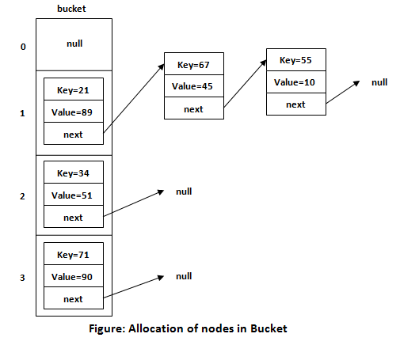
Working of HashMap

Slide 23
Insert Key, Value pair in HashMap
We use put() method to insert the Key and Value pair in the HashMap. The default size of HashMap is 16 (0 to 15).
HashMap<String, Integer> map = new HashMap<>();
map.put("Aman", 19);
map.put("Sunny", 29);
map.put("Ritesh", 39);

Slide 24
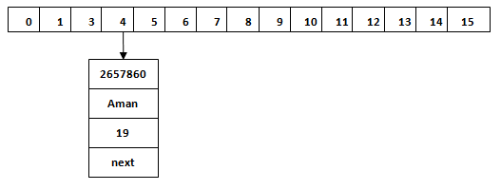
Calculating Index
Index = hashcode(Key) & (n-1)
Index = 2657860 & (16-1) = 4

Slide 25
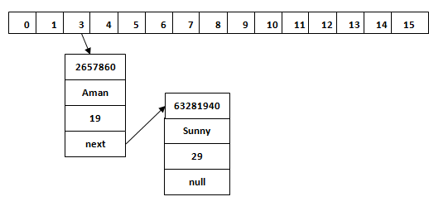
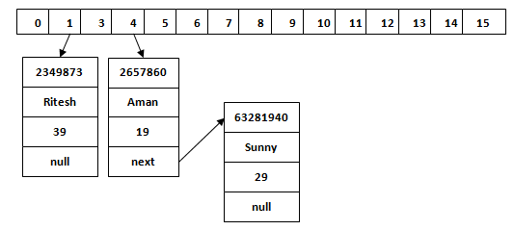
Hash Collision
Index=63281940 & (16-1) = 4

Slide 26
Java LinkedHashMap class
Java LinkedHashMap class is Hashtable and Linked list implementation of the Map interface, with predictable iteration order. It inherits HashMap class and implements the Map interface.
Java LinkedHashMap contains values based on the key.
Java LinkedHashMap contains unique elements.
Java LinkedHashMap may have one null key and multiple null values.
Java LinkedHashMap is non synchronized.
Java LinkedHashMap maintains insertion order.

Slide 27
Java TreeMap class
Java TreeMap class is a red-black tree based implementation. It provides an efficient means of storing key-value pairs in sorted order.
Java TreeMap contains values based on the key. It implements the NavigableMap interface and extends AbstractMap class.
Java TreeMap contains only unique elements.
Java TreeMap cannot have a null key but can have multiple null values.
Java TreeMap is non synchronized.
Java TreeMap maintains ascending order.

Slide 28
Java Hashtable class
Java Hashtable class implements a hashtable, which maps keys to values. It inherits Dictionary class and implements the Map interface.
A Hashtable is an array of a list. Each list is known as a bucket. The position of the bucket is identified by calling the hashcode() method. A Hashtable contains values based on the key.
Java Hashtable class contains unique elements.
Java Hashtable class doesn't allow null key or value.
Java Hashtable class is synchronized.

Slide 29
Differences
 | HashMap | ConcurrentHashMap
Synchronized | HashMap is not synchronized. | ConcurrentHashMap is synchronized.
Thread Safe | HashMap is not thread safe. | ConcurrentHashMap is thread safe.
Iterator type | HashMap iterator is fail-fast and ArrayList throws ConcurrentModificationException if concurrent modification happens during iteration. | ConcurrentHashMap is fail-safe and it will never throw ConcurrentModificationException during iteration.
Null values | HashMap allows key and value to be null. | ConcurrentHashMap does not allow null key/value. It will throw NullPointerException.
Performance | HashMap is faster. | ConcurrentHashMap is slower than HashMap.
Since Java Version | 1.1 | 1.5

Slide 30
Java Comparable interface
Java Comparable interface is used to order the objects of the user-defined class. This interface is found in java.lang package and contains only one method named compareTo(Object).
It provides a single sorting sequence only, i.e., you can sort the elements on the basis of single data member only.
For example, it may be rollno, name, age or anything else.

Slide 31
compareTo(Object obj) method
public int compareTo(Object obj): It is used to compare the current object with the specified object. It returns
positive integer, if the current object is greater than the specified object.
negative integer, if the current object is less than the specified object.
zero, if the current object is equal to the specified object.

Slide 32
Java Comparator interface
Java Comparator interface is used to order the objects of a user-defined class.
This interface is found in java.util package and contains 2 methods compare(Object obj1,Object obj2) and equals(Object element).
It provides multiple sorting sequences, i.e., you can sort the elements on the basis of any data member, for example, rollno, name, age or anything else.

Slide 33
Comparator
Comparable | Comparator
1) Comparable provides a single sorting sequence. In other words, we can sort the collection on the basis of a single element such as id, name, and price. | The Comparator provides multiple sorting sequences. In other words, we can sort the collection on the basis of multiple elements such as id, name, and price etc.
2) Comparable affects the original class, i.e., the actual class is modified. | Comparator doesn't affect the original class, i.e., the actual class is not modified.
3) Comparable provides compareTo() method to sort elements. | Comparator provides compare() method to sort elements.
4) Comparable is present in java.lang package. | A Comparator is present in the java.util package.
5) We can sort the list elements of Comparable type by Collections.sort(List) method. | We can sort the list elements of Comparator type by Collections.sort(List, Comparator) method.

Slide 34
Java Vector
Vector is like the dynamic array which can grow or shrink its size. Unlike array, we can store n-number of elements in it as there is no size limit. It is a part of Java Collection framework since Java 1.2. It is found in the java.util package and implements the List interface, so we can use all the methods of List interface here.
It is recommended to use the Vector class in the thread-safe implementation only. If you don't need to use the thread-safe implementation, you should use the ArrayList, the ArrayList will perform better in such case.

Slide 35
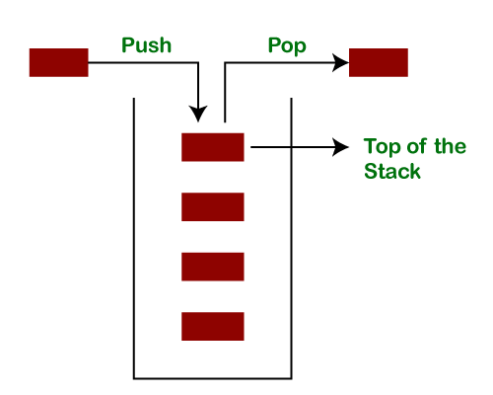
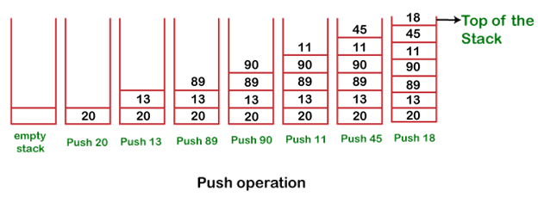
Java Stack
The stack is a linear data structure that is used to store the collection of objects. It is based on Last-In-First-Out (LIFO)

Slide 36
Thank you
Notes:
Trainer Notes
Brainstorm: what is equity trading?

