Slide 1


Java Database Connectivity

Slide 2
JDBC Driver
JDBC Driver is a software component that enables java application to interact with the database. There are 4 types of JDBC drivers:
JDBC-ODBC bridge driver
Native-API driver (partially java driver)
Network Protocol driver (fully java driver)
Thin driver (fully java driver)

Slide 3
1) JDBC-ODBC bridge driver
The JDBC-ODBC bridge driver uses ODBC driver to connect to the database. The JDBC-ODBC bridge driver converts JDBC method calls into the ODBC function calls. This is now discouraged because of thin driver.

Slide 4
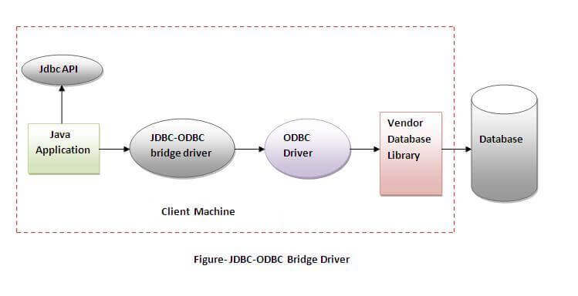
1) JDBC-ODBC bridge driver
Oracle does not support the JDBC-ODBC Bridge from Java 8. Oracle recommends that you use JDBC drivers provided by the vendor of your database instead of the JDBC-ODBC Bridge.
Advantages:
easy to use.
can be easily connected to any database.
Disadvantages:
Performance degraded because JDBC method call is converted into the ODBC function calls.
The ODBC driver needs to be installed on the client machine.

Slide 5
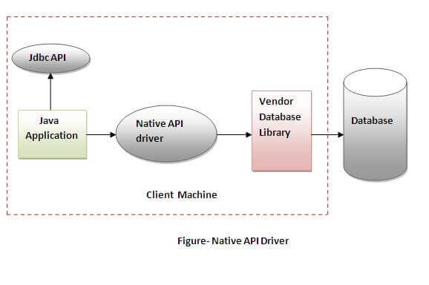
2) Native-API driver
The Native API driver uses the client-side libraries of the database. The driver converts JDBC method calls into native calls of the database API. It is not written entirely in java.
Advantage:
performance upgraded than JDBC-ODBC bridge driver.
Disadvantage:
The Native driver needs to be installed on the each client machine.
The Vendor client library needs to be installed on client machine.

Slide 6
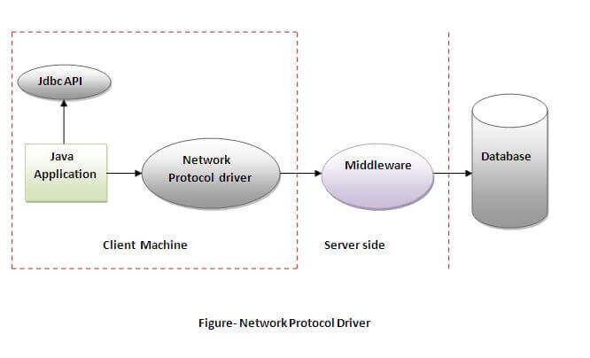
3) Network Protocol driver
Advantage:
No client side library is required because of application server that can perform many tasks like auditing, load balancing, logging etc.
Disadvantages:
Network support is required on client machine.
Requires database-specific coding to be done in the middle tier.
Maintenance of Network Protocol driver becomes costly because it requires database-specific coding to be done in the middle tier.
The Network Protocol driver uses middleware (application server) that converts JDBC calls directly or indirectly into the vendor-specific database protocol. It is fully written in java.

Slide 7
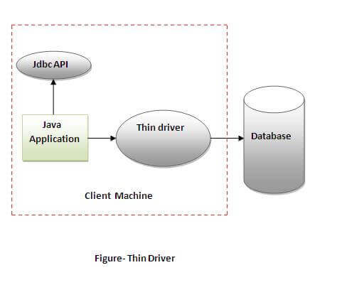
4)Thin driver
The thin driver converts JDBC calls directly into the vendor-specific database protocol. That is why it is known as thin driver. It is fully written in Java language.
Advantage:
Better performance than all other drivers.
No software is required at client side or server side.
Disadvantage:
Drivers depend on the Database.

Slide 8
Java Database Connectivity with 5 Steps
There are 5 steps to connect any java application with the database using JDBC. These steps are as follows:
Register the Driver class
Create connection
Create statement
Execute queries
Close connection

Slide 9
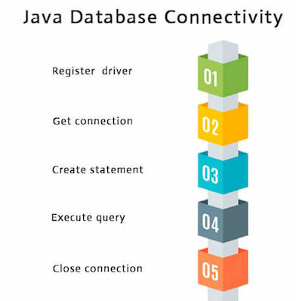
Java Database Connectivity with 5 Steps

Slide 10
Java Database Connectivity with MySQL
import java.sql.*;
class MysqlCon{
public static void main(String args[]){
try{
Class.forName("com.mysql.jdbc.Driver");
Connection con=DriverManager.getConnection(
"jdbc:mysql://localhost:3306/sonoo","root","root"); //here sonoo is database name, root is username and password

Slide 11
Java Database Connectivity with MySQL
Statement stmt=con.createStatement();
ResultSet rs=stmt.executeQuery("select * from emp");
while(rs.next())
System.out.println(rs.getInt(1)+" "+rs.getString(2)+" "+rs.getString(3));
con.close();
}catch(Exception e){ System.out.println(e);}
}
}

Slide 12
DriverManager class
The DriverManager class acts as an interface between user and drivers.
It keeps track of the drivers that are available and handles establishing a connection between a database and the appropriate driver.
The DriverManager class maintains a list of Driver classes that have registered themselves by calling the method DriverManager.registerDriver().

Slide 13
Useful methods of DriverManager class
Method | Description
1) public static void registerDriver(Driver driver): | is used to register the given driver with DriverManager.
2) public static void deregisterDriver(Driver driver): | is used to deregister the given driver (drop the driver from the list) with DriverManager.
3) public static Connection getConnection(String url): | is used to establish the connection with the specified url.
4) public static Connection getConnection(String url,String userName,String password): | is used to establish the connection with the specified url, username and password.

Slide 14
Connection interface
A Connection is the session between java application and database. The Connection interface is a factory of Statement, PreparedStatement, and DatabaseMetaData i.e. object of Connection can be used to get the object of Statement and DatabaseMetaData. The Connection interface provide many methods for transaction management like commit(), rollback() etc.
1) public Statement createStatement(): creates a statement object that can be used to execute SQL queries.
2) public Statement createStatement(int resultSetType,int resultSetConcurrency): Creates a Statement object that will generate ResultSet objects with the given type and concurrency.
3) public void setAutoCommit(boolean status): is used to set the commit status.By default it is true.
4) public void commit(): saves the changes made since the previous commit/rollback permanent.
5) public void rollback(): Drops all changes made since the previous commit/rollback.
6) public void close(): closes the connection and Releases a JDBC resources immediately.

Slide 15
Statement interface
The Statement interface provides methods to execute queries with the database. The statement interface is a factory of ResultSet i.e. it provides factory method to get the object of ResultSet.
1) public ResultSet executeQuery(String sql): is used to execute SELECT query. It returns the object of ResultSet.
2) public int executeUpdate(String sql): is used to execute specified query, it may be create, drop, insert, update, delete etc.
3) public boolean execute(String sql): is used to execute queries that may return multiple results.
4) public int[] executeBatch(): is used to execute batch of commands.

Slide 16
ResultSet interface
The object of ResultSet maintains a cursor pointing to a row of a table. Initially, cursor points to before the first row.
By default, ResultSet object can be moved forward only and it is not updatable.
But we can make this object to move forward and backward direction by passing either TYPE_SCROLL_INSENSITIVE or TYPE_SCROLL_SENSITIVE in createStatement(int,int) method as well as we can make this object as updatable by:
Statement stmt = con.createStatement(ResultSet.TYPE_SCROLL_INSENSITIVE,
ResultSet.CONCUR_UPDATABLE);

Slide 17
Commonly used methods of ResultSet interface
5) public boolean absolute(int row): | is used to move the cursor to the specified row number in the ResultSet object.
6) public boolean relative(int row): | is used to move the cursor to the relative row number in the ResultSet object, it may be positive or negative.
7) public int getInt(int columnIndex): | is used to return the data of specified column index of the current row as int.
8) public int getInt(String columnName): | is used to return the data of specified column name of the current row as int.
1) public boolean next(): | is used to move the cursor to the one row next from the current position.
2) public boolean previous(): | is used to move the cursor to the one row previous from the current position.
3) public boolean first(): | is used to move the cursor to the first row in result set object.
4) public boolean last(): | is used to move the cursor to the last row in result set object.
9) public String getString(int columnIndex): | is used to return the data of specified column index of the current row as String.
10) public String getString(String columnName): | is used to return the data of specified column name of the current row as String.

Slide 18
PreparedStatement interface
The PreparedStatement interface is a subinterface of Statement. It is used to execute parameterized query.
Let's see the example of parameterized query:
String sql="insert into emp values(?,?,?)";
As you can see, we are passing parameter (?) for the values. Its value will be set by calling the setter methods of PreparedStatement.

Slide 19
PreparedStatement interface
Improves performance: The performance of the application will be faster if you use PreparedStatement interface because query is compiled only once.
How to get the instance of PreparedStatement?
The prepareStatement() method of Connection interface is used to return the object of PreparedStatement. Syntax:
public PreparedStatement prepareStatement(String query)throws SQLException{}

Slide 20
Methods of PreparedStatement interface
Method | Description
public void setInt(int paramIndex, int value) | sets the integer value to the given parameter index.
public void setString(int paramIndex, String value) | sets the String value to the given parameter index.
public void setFloat(int paramIndex, float value) | sets the float value to the given parameter index.
public void setDouble(int paramIndex, double value) | sets the double value to the given parameter index.
public int executeUpdate() | executes the query. It is used for create, drop, insert, update, delete etc.
public ResultSet executeQuery() | executes the select query. It returns an instance of ResultSet.

Slide 21
Java ResultSetMetaData Interface
The metadata means data about data i.e. we can get further information from the data.
If you have to get metadata of a table like total number of column, column name, column type etc. , ResultSetMetaData interface is useful because it provides methods to get metadata from the ResultSet object.

Slide 22
Java ResultSetMetaData Interface
Method | Description
public int getColumnCount()throws SQLException | it returns the total number of columns in the ResultSet object.
public String getColumnName(int index)throws SQLException | it returns the column name of the specified column index.
public String getColumnTypeName(int index)throws SQLException | it returns the column type name for the specified index.
public String getTableName(int index)throws SQLException | it returns the table name for the specified column index.

Slide 23
Java DatabaseMetaData interface
DatabaseMetaData interface provides methods to get meta data of a database such as database product name, database product version, driver name, name of total number of tables, name of total number of views etc.

Slide 24
Java DatabaseMetaData interface
public String getDriverName()throws SQLException: it returns the name of the JDBC driver.
public String getDriverVersion()throws SQLException: it returns the version number of the JDBC driver.
public String getUserName()throws SQLException: it returns the username of the database.
public String getDatabaseProductName()throws SQLException: it returns the product name of the database.
public String getDatabaseProductVersion()throws SQLException: it returns the product version of the database.
public ResultSet getTables(String catalog, String schemaPattern, String tableNamePattern, String[] types)throws SQLException: it returns the description of the tables of the specified catalog. The table type can be TABLE, VIEW, ALIAS, SYSTEM TABLE, SYNONYM etc.

Slide 25
Java CallableStatement Interface
CallableStatement interface is used to call the stored procedures and functions.
We can have business logic on the database by the use of stored procedures and functions that will make the performance better because these are precompiled.
Suppose you need the get the age of the employee based on the date of birth, you may create a function that receives date as the input and returns age of the employee as the output.

Slide 26
What is the difference between stored procedures and functions.
Stored Procedure | Function
is used to perform business logic. | is used to perform calculation.
must not have the return type. | must have the return type.
may return 0 or more values. | may return only one values.
We can call functions from the procedure. | Procedure cannot be called from function.
Procedure supports input and output parameters. | Function supports only input parameter.
Exception handling using try/catch block can be used in stored procedures. | Exception handling using try/catch can't be used in user defined functions.

Slide 27
Transaction Management in JDBC
Transaction represents a single unit of work.
The ACID properties describes the transaction management well. ACID stands for Atomicity, Consistency, isolation and durability.
Atomicity means either all successful or none.
Consistency ensures bringing the database from one consistent state to another consistent state.
Isolation ensures that transaction is isolated from other transaction.
Durability means once a transaction has been committed, it will remain so, even in the event of errors, power loss etc.

Slide 28
Transaction Management in JDBC
Method | Description
void setAutoCommit(boolean status) | It is true bydefault means each transaction is committed bydefault.
void commit() | commits the transaction.
void rollback() | cancels the transaction.

Slide 29
JDBC Data types
The JDBC driver converts the Java data type to the appropriate JDBC type, before sending it to the database. It uses a default mapping for most data types. For example, a Java int is converted to an SQL INTEGER. Default mappings were created to provide consistency between drivers.

Slide 30
JDBC Data types
SQL | JDBC/Java | setXXX | updateXXX
VARCHAR | java.lang.String | setString | updateString
CHAR | java.lang.String | setString | updateString
LONGVARCHAR | java.lang.String | setString | updateString
BIT | Boolean | setBoolean | updateBoolean
NUMERIC | java.math.BigDecimal | setBigDecimal | updateBigDecimal
TINYINT | byte | setByte | updateByte

Slide 31
JDBC Data types
SMALLINT | short | setShort | updateShort
INTEGER | int | setInt | updateInt
BIGINT | long | setLong | updateLong
REAL | float | setFloat | updateFloat
FLOAT | float | setFloat | updateFloat
DOUBLE | double | setDouble | updateDouble

Slide 32
JDBC Data types
VARBINARY | byte[ ] | setBytes | updateBytes
BINARY | byte[ ] | setBytes | updateBytes
DATE | java.sql.Date | setDate | updateDate
TIME | java.sql.Time | setTime | updateTime
TIMESTAMP | java.sql.Timestamp | setTimestamp | updateTimestamp

Slide 33
JDBC Data types
CLOB | java.sql.Clob | setClob | updateClob
BLOB | java.sql.Blob | setBlob | updateBlob
ARRAY | java.sql.Array | setARRAY | updateARRAY
REF | java.sql.Ref | SetRef | updateRef

Slide 34
Handling null value
Statement stmt = conn.createStatement( );
String sql = "SELECT id, first, last, age FROM Employees";
ResultSet rs = stmt.executeQuery(sql);
int id = rs.getInt(1);
if( rs.wasNull( ) ) {
id = 0;
}

Slide 35
JDBC - Exceptions Handling
Exception handling allows you to handle exceptional conditions such as program-defined errors in a controlled fashion.
When an exception condition occurs, an exception is thrown. The term thrown means that current program execution stops, and the control is redirected to the nearest applicable catch clause. If no applicable catch clause exists, then the program's execution ends.
JDBC Exception handling is very similar to the Java Exception handling but for JDBC, the most common exception you'll deal with is java.sql.SQLException.

Slide 36
SQL Exceptions
Method | Description
getErrorCode( ) | Gets the error number associated with the exception.
getMessage( ) | Gets the JDBC driver's error message for an error, handled by the driver or gets the Oracle error number and message for a database error.
getSQLState( ) | Gets the XOPEN SQLstate string. For a JDBC driver error, no useful information is returned from this method. For a database error, the five-digit XOPEN SQLstate code is returned. This method can return null.

Slide 37
SQL Exceptions
getNextException( ) | Gets the next Exception object in the exception chain.
printStackTrace( ) | Prints the current exception, or throwable, and it's backtrace to a standard error stream.
printStackTrace(PrintStream s) | Prints this throwable and its backtrace to the print stream you specify.
printStackTrace(PrintWriter w) | Prints this throwable and it's backtrace to the print writer you specify.

Slide 38
Batch Processing in JDBC
Instead of executing a single query, we can execute a batch (group) of queries. It makes the performance fast.
The java.sql.Statement and java.sql.PreparedStatement interfaces provide methods for batch processing.

Slide 39
Batch Processing in JDBC
Method | Description
void addBatch(String query) | It adds query into batch.
int[] executeBatch() | It executes the batch of queries.

Slide 40
JDBC
Create Database
Select Database
Drop Database
Create Tables
Drop Tables
Insert Records

Slide 41
Thank you
Notes:
Trainer Notes
Brainstorm: what is equity trading?

