Slide 1

Dijkstra’s algorithm
Housing Prediction: An Exploratory Data Analysis
Author Name: Naga Avinash Matta
Mail-id: nm55284n@pace.edu
school of Seidenberg, pace university
Course : Practical Data science
Month, Date, and year: NOV-05-2024

Slide 2
Agenda
Project Overview
Data
Exploratory Data Analysis (EDA)
Modeling Methods
Findings
Recommendations & Technical Next Steps
Q&A

Slide 3
Executive summary slide:
Problem summary:
The goal of this project is to predict housing prices based on various property features, helping stakeholders make data-driven decisions in the real estate market.
Predicting housing prices to enable data-driven decisions in real estate. This sets the context for the audience, emphasizing the value of accurate price prediction.
Solution summary:
Conducted EDA to identify influential features.
Built a predictive model focusing on major factors impacting housing prices.
Identified key insights into feature-price relationships (e.g., area, bedrooms).
Developed actionable recommendations based on insights, supporting business strategies.

Slide 4
Project plan Recap slide:
Overview of Phases:
Each topic represents a major project phase: Data Collection, EDA, Model Development, Findings & Interpretation, and Recommendations. This gives a quick overview of the workflow.
Duration and Timeline:
The chart’s x-axis displays hypothetical project weeks, making it clear how long each phase took or is expected to take. It provides transparency on time allocation, helping stakeholders understand the project timeline.
Purpose of the Slide:
This slide summarizes the project’s progress, helping stakeholders quickly identify which phases are completed and what remains. This recap aids in managing expectations and setting realistic next steps for the remaining tasks.

Slide 5
Data: Housing Dataset
Data Source:
The housing dataset was collected from a simulated real estate database. It includes various property attributes and sale prices, simulating typical housing data in the market.
Sample Size:
The dataset contains 9 observations and 13 variables. Each row represents a unique property listing, while columns represent characteristics (features) like area, bedrooms, bathrooms, etc.
Time Period:
Since this is a simulated dataset for analysis, it does not cover a specific time period. However, it is structured to resemble real-world housing data trends.
Inclusions and Exclusions:
Included:
Key property features relevant to pricing, such as size, rooms, amenities (e.g., guest room, basement, air conditioning), furnishing status, and access to main roads.
Excluded:
Data on property age, neighborhood quality, and local market conditions were not included, which may limit the depth of market insights but keeps the dataset focused on generalizable property attributes.

Slide 6
Data: Housing Dataset – Classifications & Assumptions
Classification:
Categorical variables, like "furnishing status" and "main road access," are encoded as binary or categorical values to ensure consistency in analysis.
Assumptions:
Property Licensing:
We assume that all properties meet local zoning and licensing requirements, as external market data typically verifies property validity and legality.
Housing Demand and market conditions:
It’s assumed that market trends influencing housing prices, such as seasonal demand fluctuations, remain consistent across the sample.
Uniform Data Quality:
Assumes the dataset accurately captures real estate attributes relevant to price. Any missing data has been treated or imputed to maintain completeness for modeling.

Slide 7
EDA: Housing Dataset Visualizations
The visualizations builds on the relationship between housing features and price, establishing a coherent narrative for modeling house prices based on size, amenities, and structure. This setup aids in identifying and selecting features critical to accurate predictions, tying back to the business goal of understanding and forecasting housing prices effectively.
Visualization 1: Distribution of House Prices
Visualization 2: House Price vs. Area (sq ft)
Visualization 3: House Prices by Number of Bedrooms
Visualization 4: Correlation Heatmap of Housing Features
Visualization 5: Average House Price by Number of Stories

Slide 8
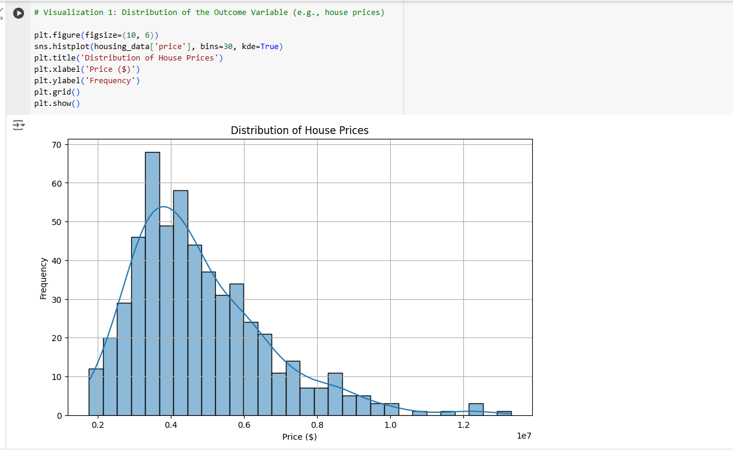
EDA: Visualization 1
Visualization 1: Distribution of House Prices
Title: Distribution of House Prices in the Dataset
Axes:
X-axis: Price (in currency)
Y-axis: Frequency
Summary:
This histogram displays the distribution of house prices across the dataset. The visualization helps us understand the range and central tendency of house prices, which is essential in predicting house values. A concentration in certain price ranges may suggest areas of the market where demand is highest or where our model could face challenges in prediction due to limited price variance.

Slide 9
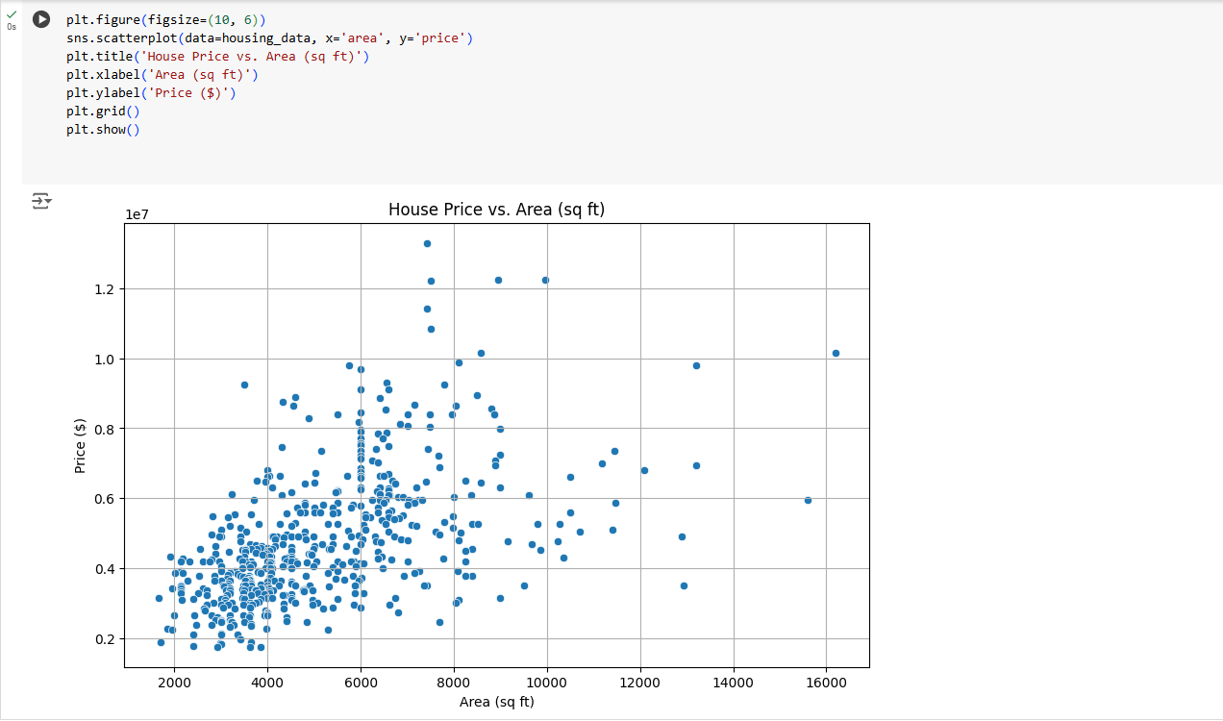
EDA: Visualization-2
Visualization 2: House Price vs. Area (sq ft)
Title: Relationship Between House Price and Area
Axes:
X-axis: Area (in square feet)
Y-axis: Price (in USD)
Summary:
This scatter plot illustrates a positive relationship between the area of a house and its price. Larger homes tend to have higher prices, reinforcing that square footage is an essential predictor. This relationship suggests that increasing area may drive up property values, which is key to predicting house prices.

Slide 10
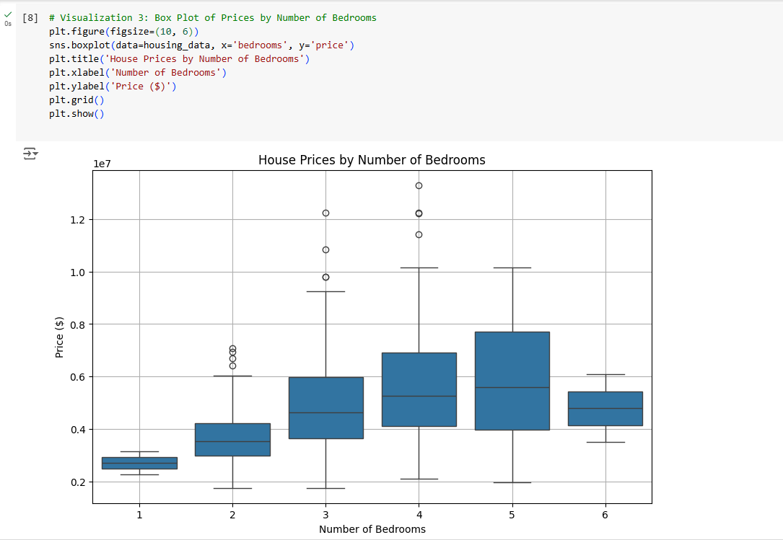
EDA: Visualization 3
Visualization 3: House Prices by Number of Bedrooms
Title: House Prices by Number of Bedrooms
Axes:
X-axis: Number of Bedrooms
Y-axis: Price (in USD)
Summary: This box plot shows the distribution of house prices based on the number of bedrooms. Houses with more bedrooms generally command higher prices. This insight underlines the importance of bedrooms as a feature in the model since families or buyers seeking larger homes may pay a premium.

Slide 11
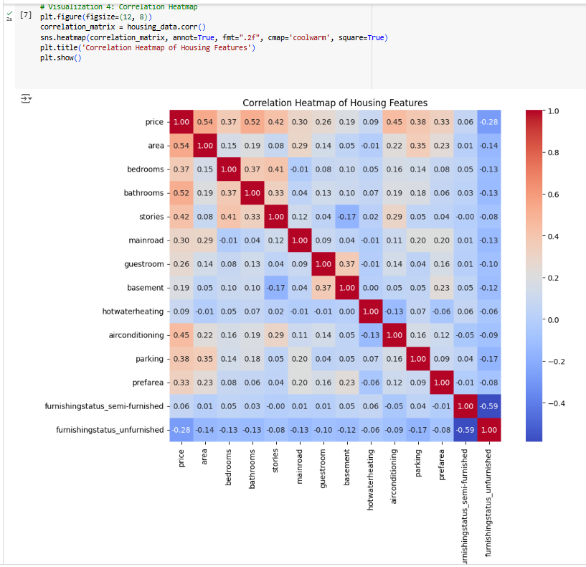
EDA: Visualization 4
Visualization 4: Correlation Heatmap of Housing Features
Title: Correlation Heatmap of Key Housing Features
Summary:
This heatmap visualizes the correlation between features such as area, number of bedrooms, air conditioning, and price. Strong positive correlations between price and factors like area, number of bedrooms, and stories highlight these as significant predictors. This heatmap aids in feature selection, helping focus on high-impact variables for modeling.

Slide 12
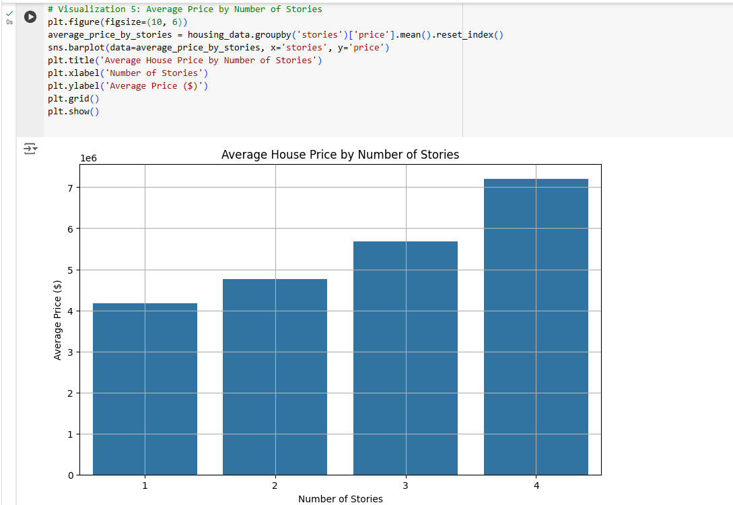
EDA: Visualization 5
Visualization 5: Average House Price by Number of Stories
Title: Average House Price by Number of Stories
Axes:
X-axis: Number of Stories
Y-axis: Average Price (in USD)
Summary:
This bar chart shows the average price for houses based on the number of stories. Multi-story houses tend to have higher average prices, suggesting that additional stories are valued in this market. Including the number of stories in the model can capture the added value of multi-story properties, refining predictions.

Slide 13
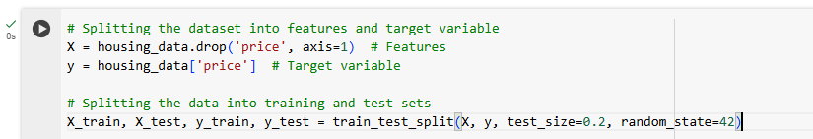
Modeling Methods:
Outcome Variable:
Outcome Variable (Target):
Our target variable, price, represents the predicted housing price. The goal is to accurately forecast housing prices based on various features of each property, supporting insights into factors that influence house valuations. All selected features connect back to this “so what” variable, with the goal of guiding decision-making related to pricing strategies, market assessment, and investment opportunities.

Slide 14
Modeling Methods: Features
2. Features:
Feature Selection:
The features used here were chosen based on their relevance to housing price predictions. Each feature potentially contributes to price prediction, and our code excludes price from the feature set X as it's the target. These features can be grouped as follows:
Physical Attributes:
Includes features like area, number of bedrooms, and bathrooms, as these are directly associated with a property's structure and usability.
Amenities and Extras:
Binary variables such as mainroad, guestroom, basement, hotwaterheating, airconditioning, parking, and prefarea indicate desirable amenities and access points, which often increase property value.
Furnishing Status:
Encoded into dummy variables, furnishingstatus reflects whether a property is fully, semi, or unfurnished. Homes with different furnishing levels appeal to varying buyer needs and budgets.

Slide 15
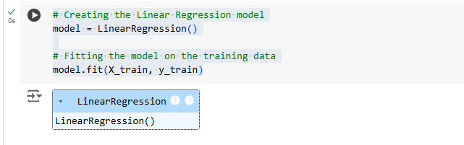
Modeling Methods: Model Type and Rationale
3. Model Type and Rationale:
Model Choice:
We opted for Linear Regression due to its interpretability and ease of application for predicting a continuous variable like house price. Linear regression is useful in this context as it provides an estimation of how each feature impacts the target variable (price) linearly, making it easy to interpret for business decisions.
In simple terms, linear regression is a model that looks at how each characteristic of a home (e.g., number of bedrooms, area, amenities) affects its price. Think of it as a rule where each factor adds or subtracts value from the price, similar to a recipe where each ingredient contributes to the final taste. For example, adding square footage generally raises the price, while the presence of certain amenities like air conditioning or parking may also increase value. This straightforward relationship allows us to see what drives prices up or down, guiding property-related decisions.

Slide 16
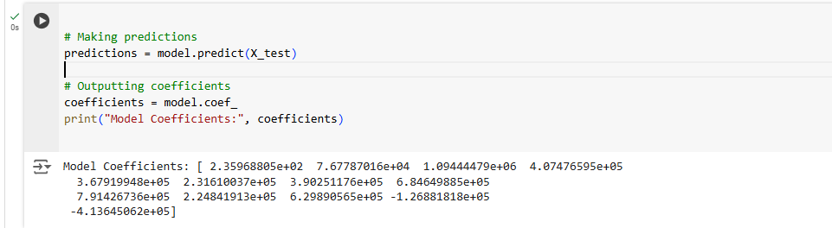
Modeling Methods: Model Training and Predictions
Model Training and Prediction Code :
After defining the features X and target variable Y, we split the data into training and testing sets. The model is then trained on x_train and y_train, learning the relationship between features and price. Once trained, we use x_test data to make predictions and evaluate model performance. This split ensures our model can generalize well to new data, important for accuracy in real-world applications.
Feature Coefficients Interpretation: Printing out the model's coefficients provides insights into each feature's impact on price. Positive coefficients indicate features that tend to increase price, while negative coefficients show those that decrease it. For example, area may have a high positive coefficient, suggesting larger homes correlate strongly with higher prices.

Slide 17
Findings: “Key Drivers of Housing Prices”
Main Finding:
Present a bar chart or table of the model’s coefficients to identify the most influential factors on housing prices.
Interpretation:
Features like area (sq ft), number of stories, and presence of amenities (e.g., air conditioning, guest rooms) may display significant positive coefficients, meaning they contribute meaningfully to higher property prices.
Business Insight:
These results suggest that investment in increasing property size or enhancing amenities could add substantial value, guiding development and renovation decisions.

Slide 18
Findings: “Impact of Square Footage on Housing Price”
Main Finding:
Display a scatter plot showing the positive correlation between area (sq ft) and price.
Interpretation:
Square footage consistently increases housing prices, indicating that buyers prioritize larger living spaces.
Business Insight:
Focus on promoting larger properties or additions to existing homes as a reliable way to enhance market value. Additionally, this could suggest adjusting pricing models to account more directly for square footage.

Slide 19
Findings: “Role of Amenities on House Value”
Main Finding:
Coefficients for features like air conditioning, guest room availability, and basement reveal how specific amenities impact price.
Interpretation:
Significant coefficients for these amenities indicate that houses with these features are valued higher. For example, air conditioning could increase comfort and attractiveness in warmer regions, adding to property appeal.
Business Insight:
Stakeholders could focus on upgrading properties with popular amenities to capture higher valuations. Marketing strategies can also highlight these features to attract a premium buyer segment.

Slide 20
Findings: “Unexpected Findings: Features with Low Impact”
Main Finding:
Some features, like proximity to the main road or furnishing status, may show little to no statistical significance in affecting prices.
Interpretation:
These results are counterintuitive if previous assumptions suggested these features would impact valuation. It may indicate that in this market, buyers prioritize other features more.
Business Insight:
This slide could encourage further investigation. It might involve gathering additional data on location or re-evaluating assumptions about consumer preferences, which could reveal shifts in market demands or dataset limitations.

Slide 21
Recommendations & Technical Next Steps
Key Recommendations:
Invest in Expanding Square Footage:
Finding: Square footage has a significant positive correlation with housing price, meaning larger homes are consistently valued higher.
Actionable Recommendation: For properties under development or renovation, prioritize expansion projects that increase living space, particularly in areas where buyers value larger homes. Marketing campaigns should emphasize square footage as a major selling point.
Enhance Key Amenities:
Finding: Amenities such as air conditioning, guest rooms, and basements add notable value to a property’s price.
Actionable Recommendation: Focus on upgrading or adding popular amenities to properties where feasible. These upgrades should also be featured in property listings and marketing materials to attract buyers willing to pay a premium for these conveniences.

Slide 22
Recommendations & Technical Next Steps
Technical Next Steps:
Build a More Advanced Model:
Rationale: A linear regression model offers basic insights, but more advanced techniques like Random Forest or Gradient Boosting could capture non-linear relationships and interactions between features, potentially enhancing prediction accuracy.
Implementation: Evaluate additional models to compare against the current linear regression approach and assess if they yield better predictions. This could involve hyperparameter tuning and cross-validation to optimize performance.
Expand Data Collection:
Rationale: Additional data, such as neighborhood crime rates, proximity to schools, or environmental factors, could provide more context and improve the model’s prediction capability by including factors buyers might value.
Implementation: Collaborate with data collection teams to incorporate external datasets that expand the current feature set. Future analyses can investigate how these factors impact housing prices, addressing business questions about emerging market trends.

Slide 23
Appendix:
Project Code Repository:
Git hub Link:
Technical Model Overview: Linear Regression
Model Type and Choice:
Linear regression was chosen for its interpretability and because it directly connects features (like area, number of bedrooms, etc.) to the outcome variable (house price).
Model Details:
The model was fit on a training dataset split from the original data, with an 80-20 training-to-test ratio.
The model coefficients represent the effect each feature has on the price. For instance, the area coefficient shows how each additional square foot impacts the price prediction.
Interpretation of Coefficients:
Coefficients can provide insights, such as whether area is a strong predictor of price. If statistically significant, it means the relationship is meaningful in predicting the price.

Slide 24
Appendix:
Supplemental Data Visualizations:
Additional charts, like:
Scatter plots to show relationships not initially highlighted.
Distribution plots for variables that may influence the housing market in subtle ways.
A bar plot of average price by neighborhood or other categorical data.

Slide 25


