Slide 1
I would build the camera-LiDAR tracker as an asynchronous, event-driven Bayesian multi-object tracker. Every sensor measurement is timestamped and transformed into a common ego or world coordinate frame using calibrated extrinsics and ego-motion compensation. LiDAR supplies accurate 3D geometry, while camera contributes semantic classification, image-space constraints, and appearance embeddings. Existing tracks are propagated to each measurement timestamp using a CV, CA, or CTRV motion model. The predicted covariance defines a statistical Mahalanobis gate, after which candidate associations are scored using motion consistency, 3D IoU, class compatibility, and camera appearance. Hungarian matching is sufficient for simpler scenes, while JPDA or MHT handles ambiguous dense scenes. Matched observations update the state using KF/EKF/UKF, and an IMM can combine multiple motion models. Finally, explicit tentative, confirmed, coasting, reacquired, and deleted states maintain track continuity through false detections and temporary occlusions. The output is a persistent object ID with position, velocity, acceleration, heading, dimensions, class probabilities, trajectory history, and covariance for prediction and planning
Camera and Lidar Fusion

Slide 2
Pose Estimation
For the camera/LiDAR system we've been building, this pose estimate is the geometric backbone of the entire stack: it lets you transform camera/LiDAR measurements into consistent frames, deskew individual LiDAR returns, accumulate multiple scans, estimate world-relative object velocity, compensate dynamic objects, and maintain persistent world-frame JPDA/MHT track

Slide 3
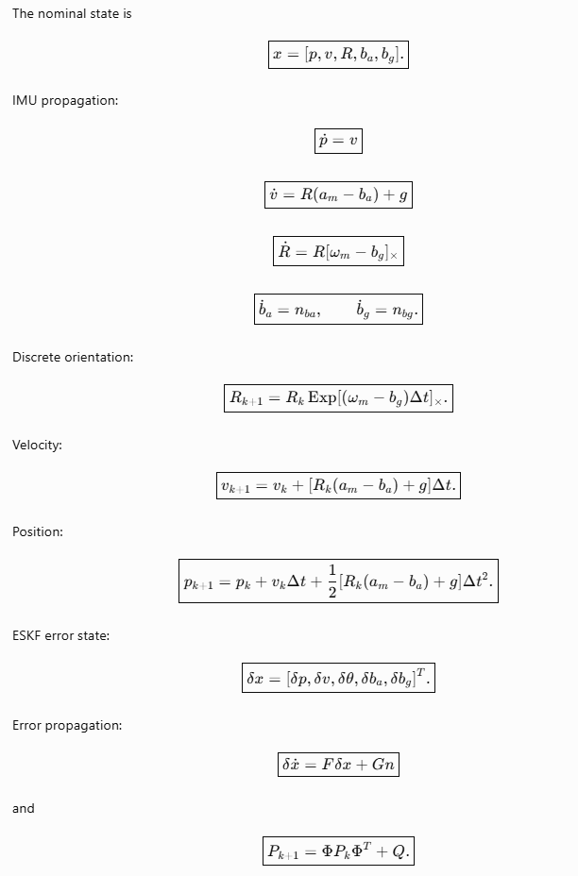
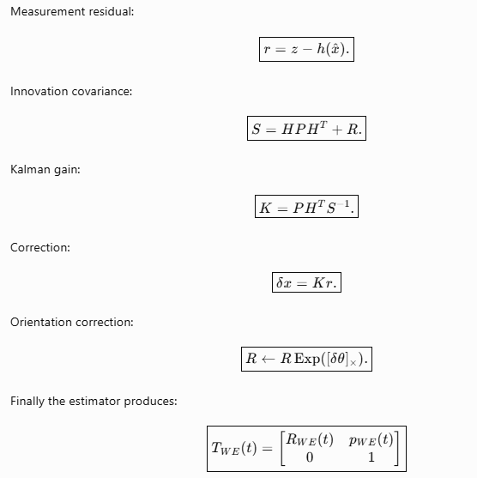
Pose Estimation: Mathematical Derivations

Slide 4
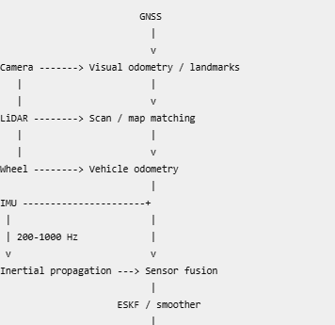
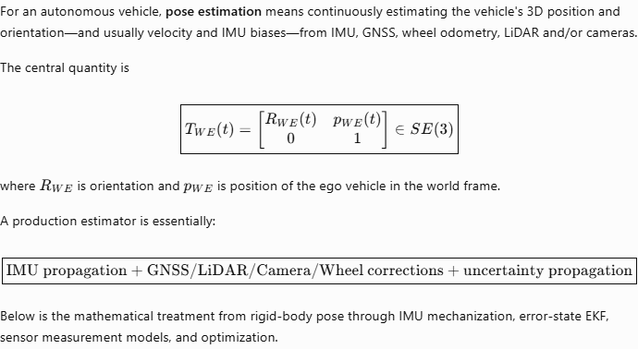
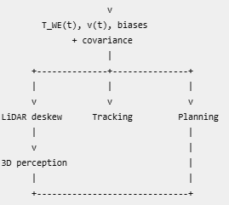
Pose Estimation: Mathematical Derivations

Slide 5
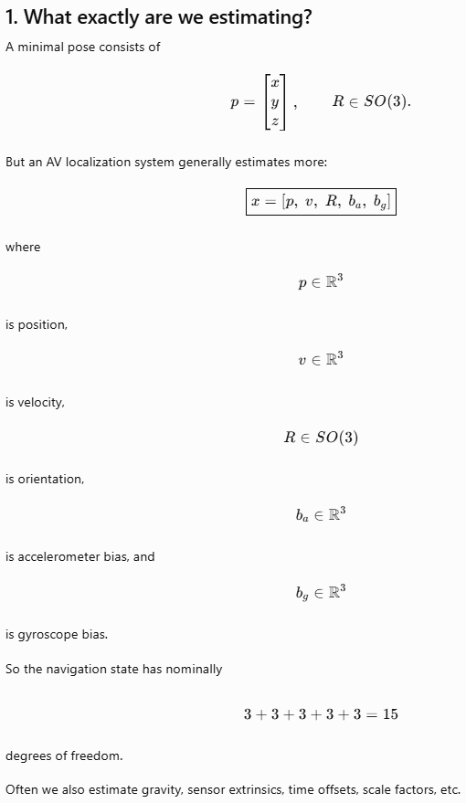
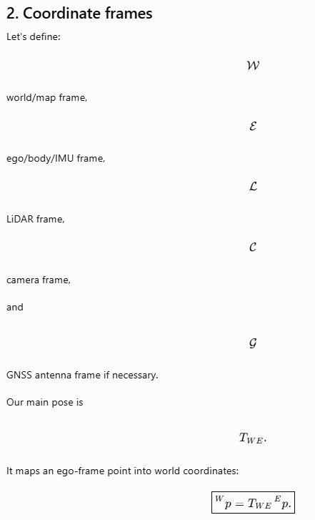

Slide 6
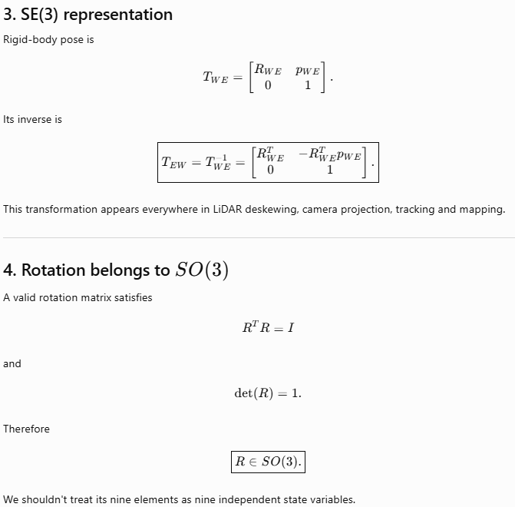
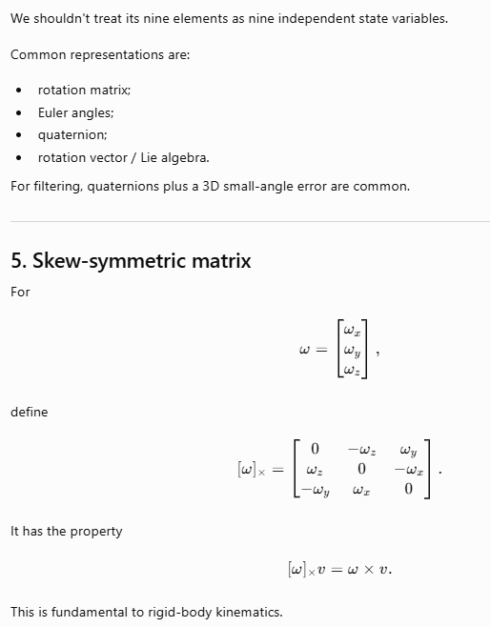

Slide 7
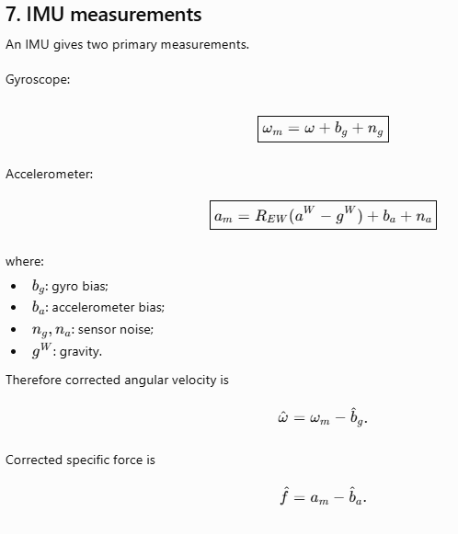
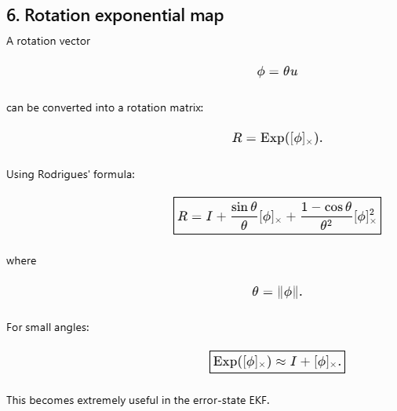

Slide 8
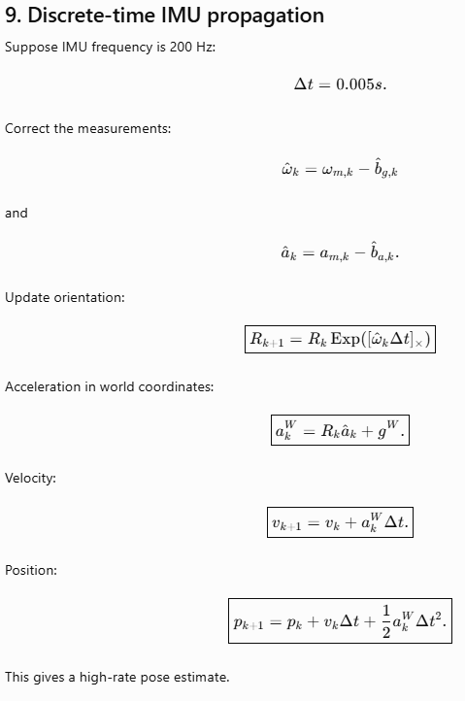
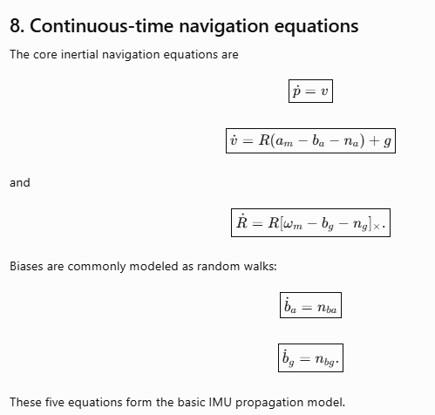

Slide 9
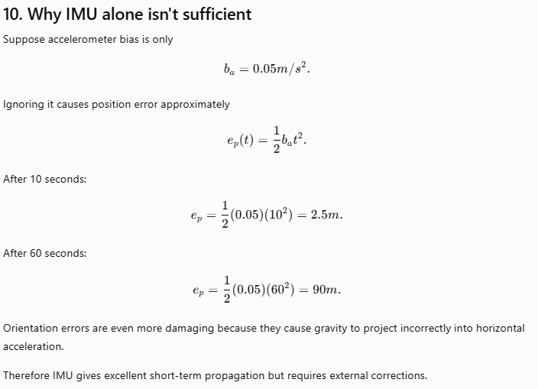
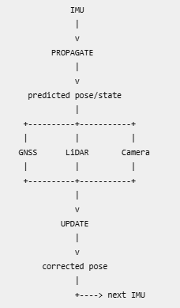
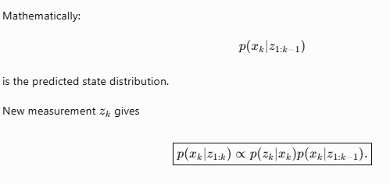

Slide 10
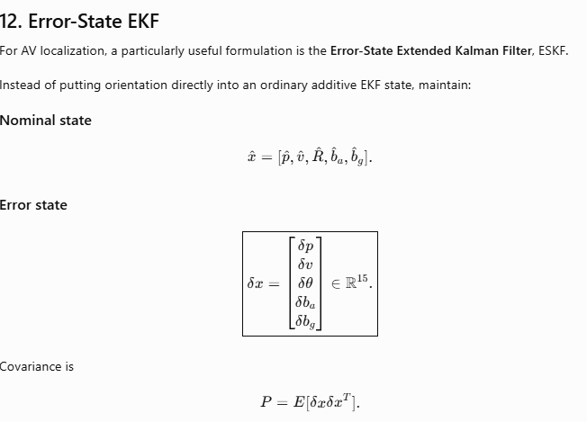
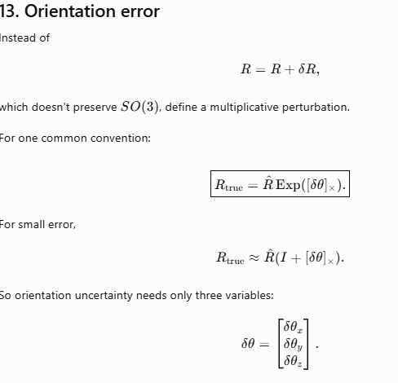

Slide 11
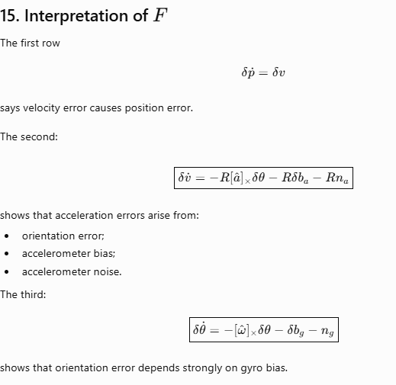
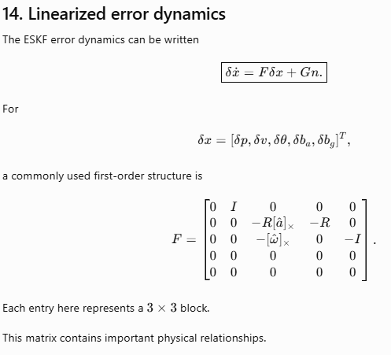

Slide 12
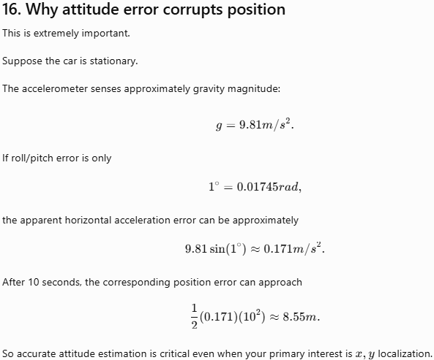
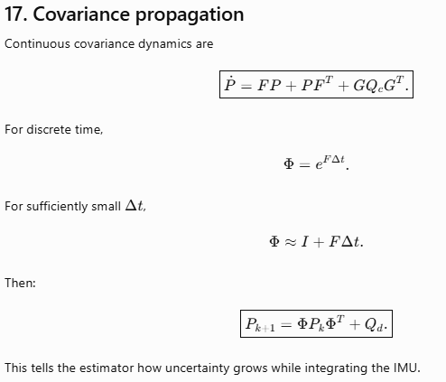

Slide 13
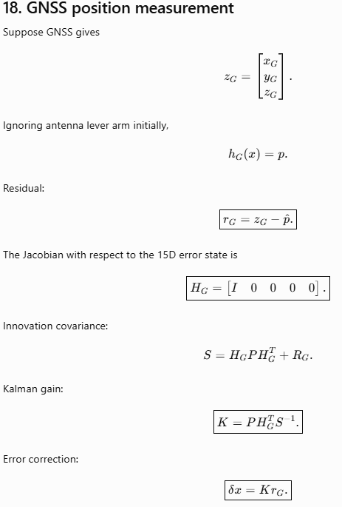
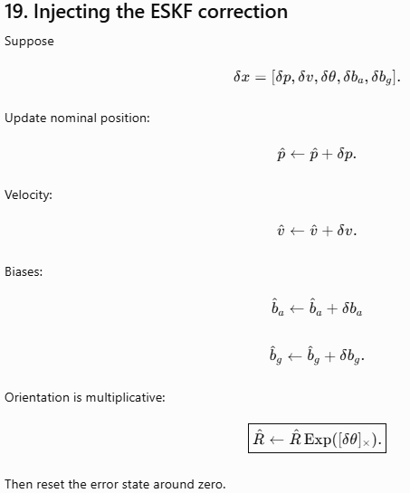

Slide 14
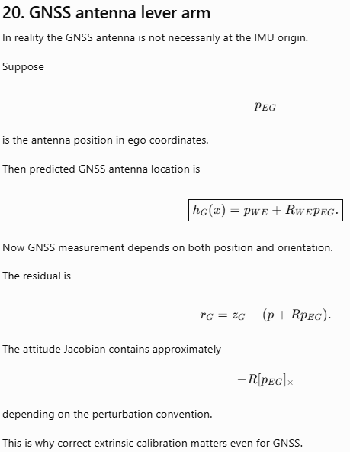
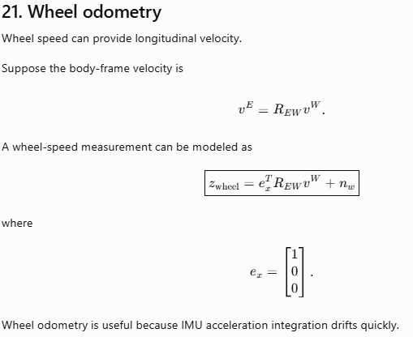

Slide 15
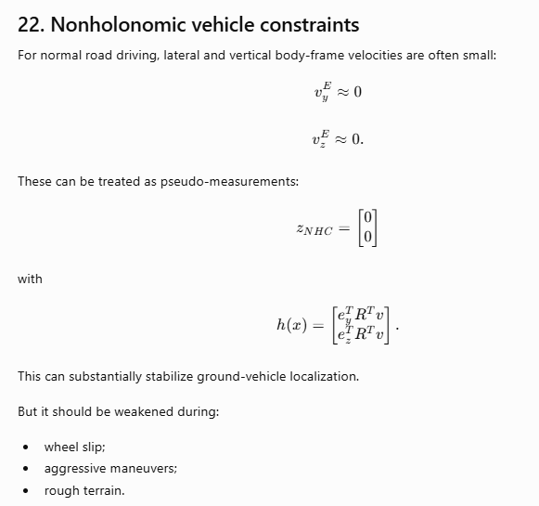
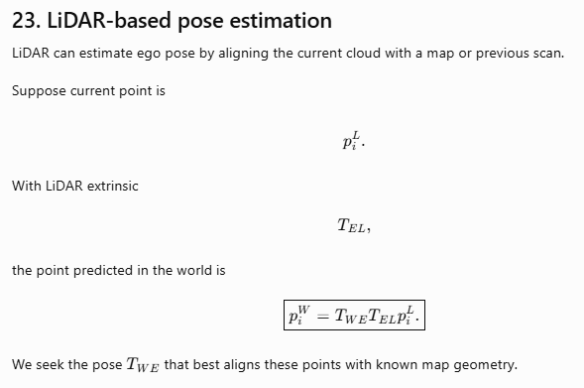

Slide 16
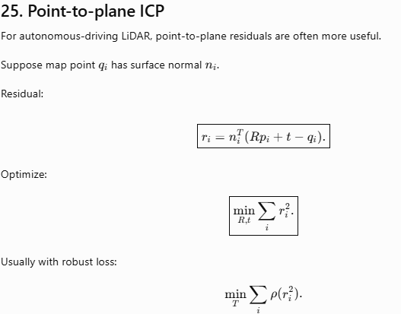
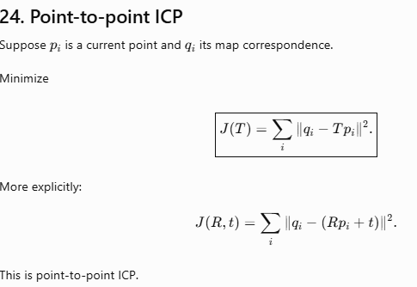

Slide 17
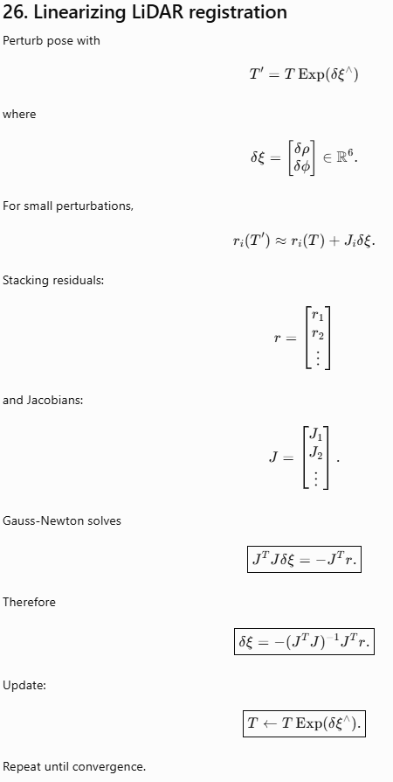
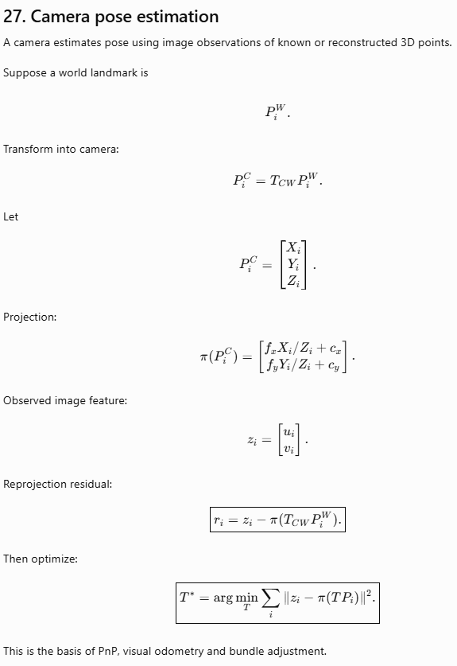

Slide 18
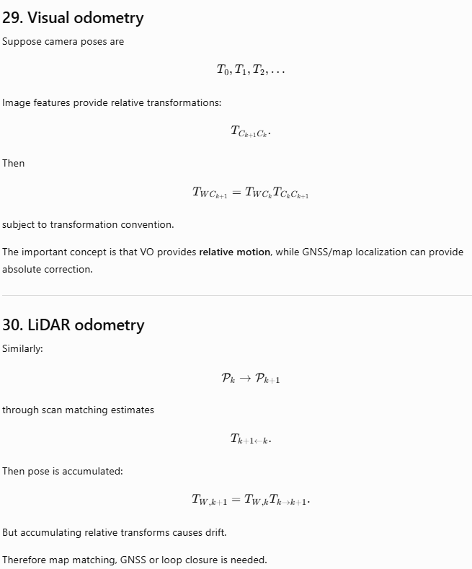
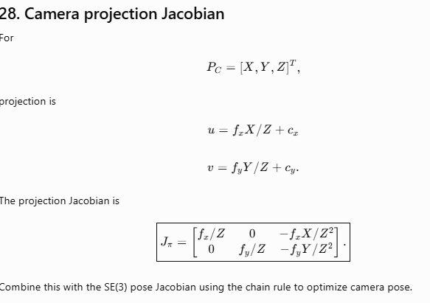

Slide 19
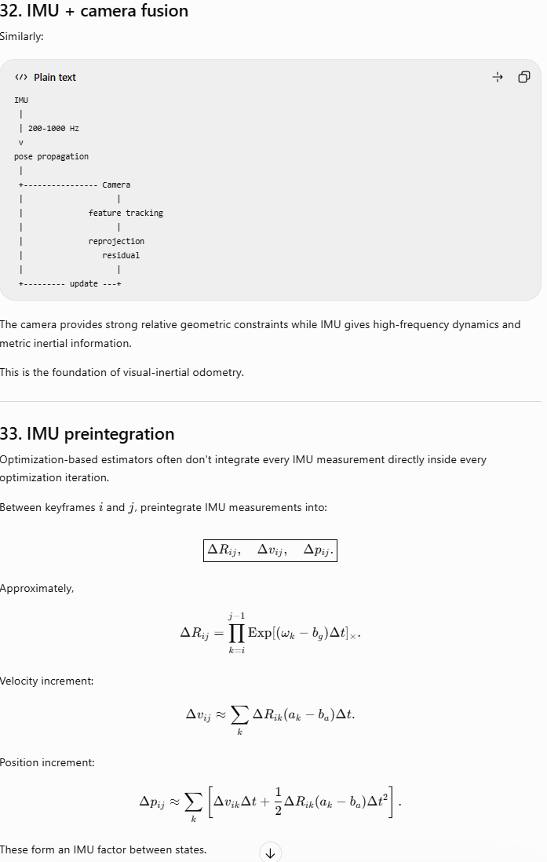
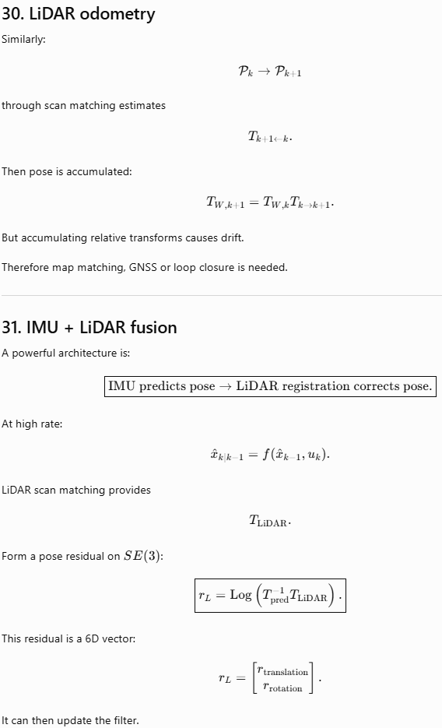

Slide 20
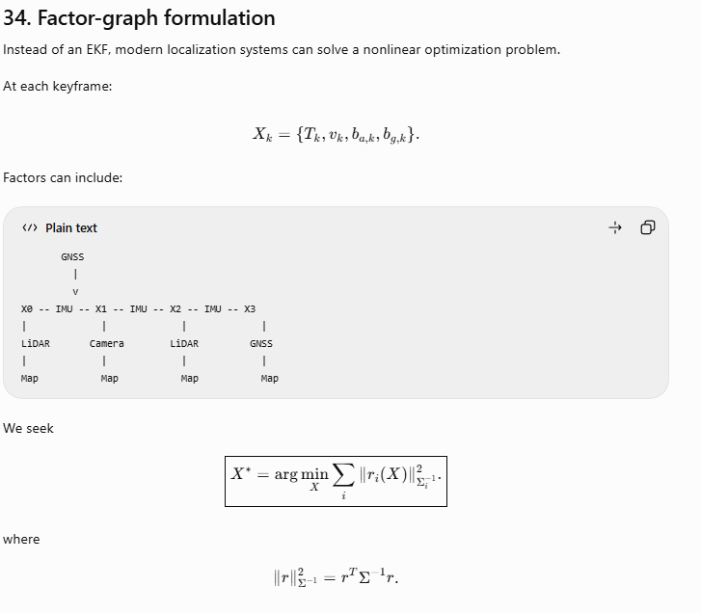
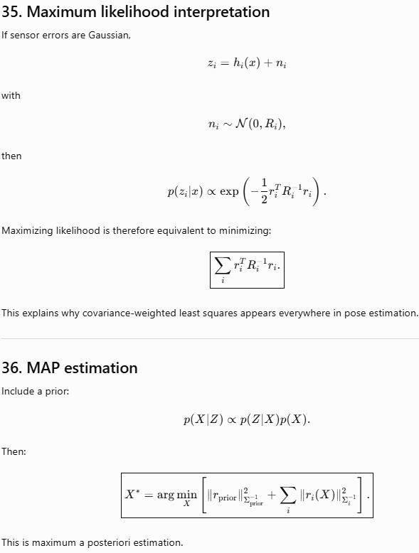

Slide 21
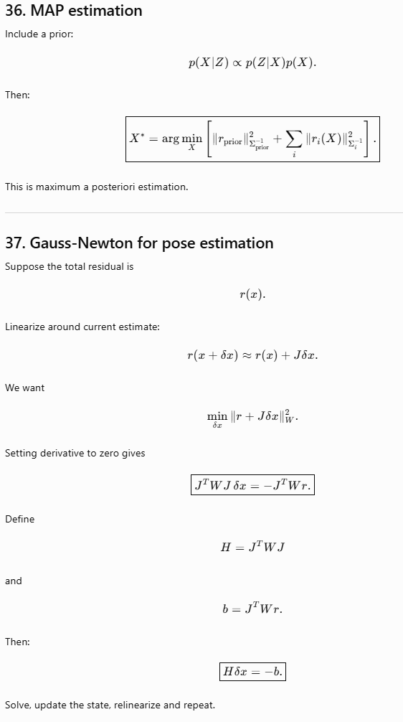
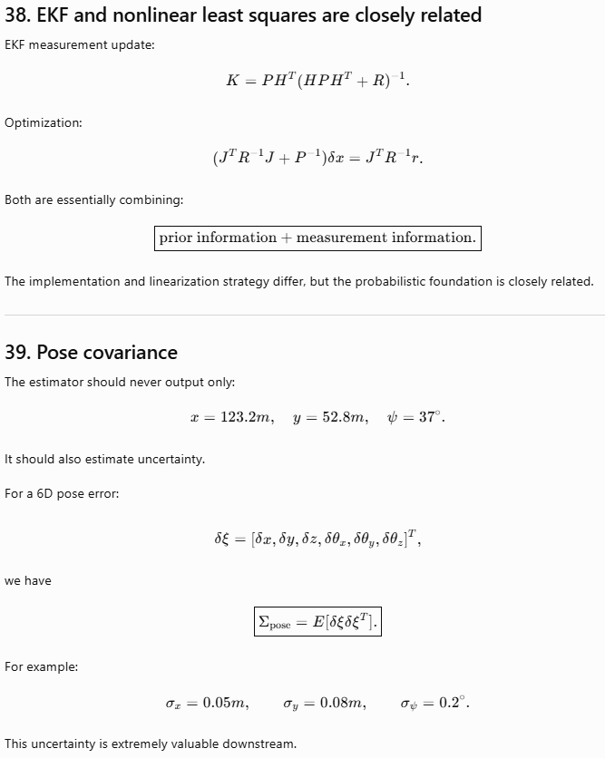

Slide 22
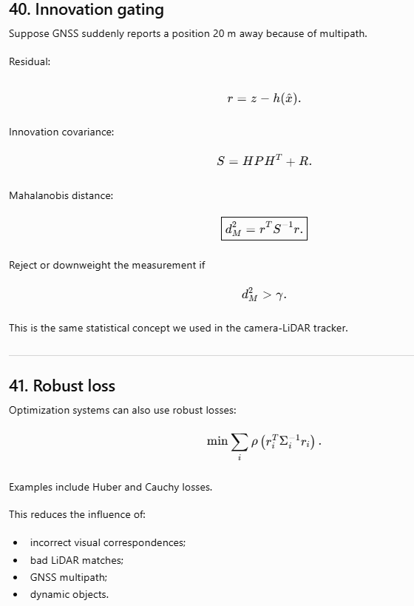
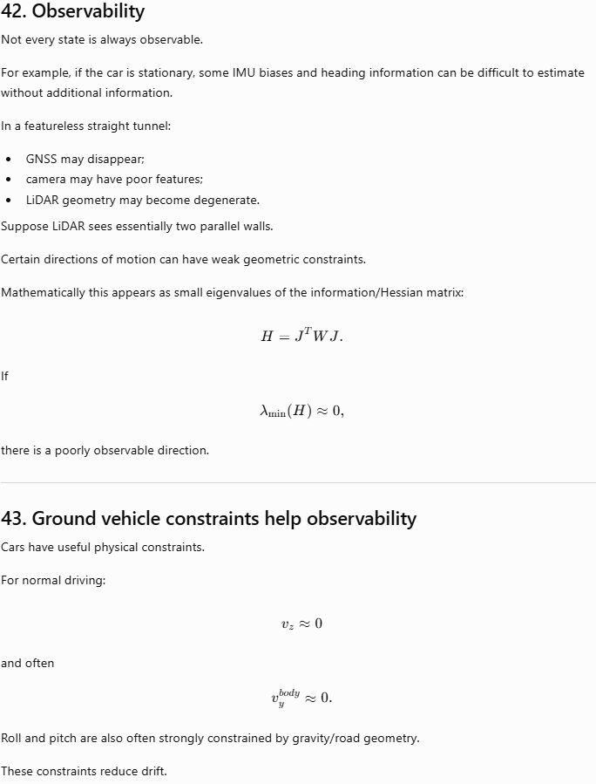

Slide 23
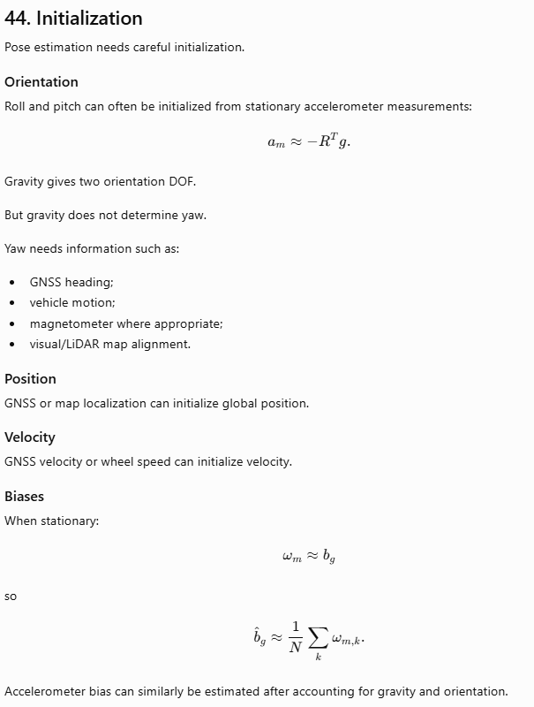
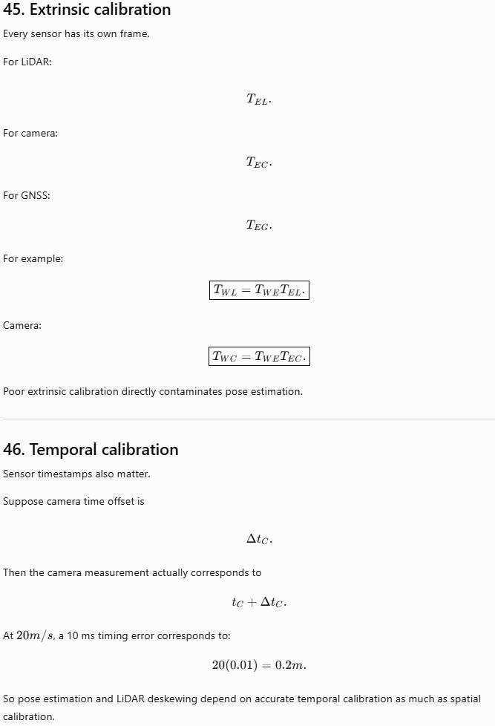

Slide 24
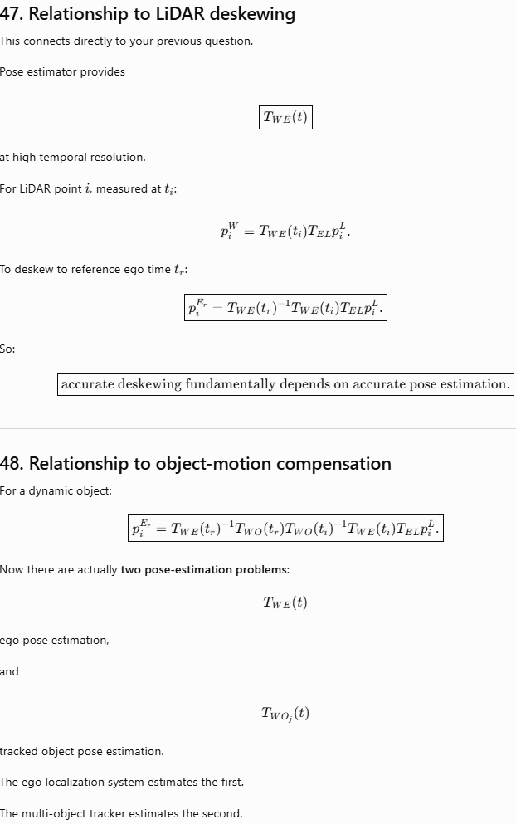
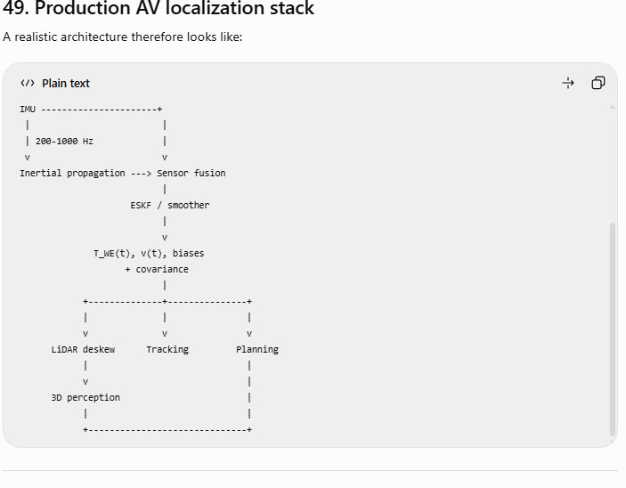

Slide 25


