Slide 1
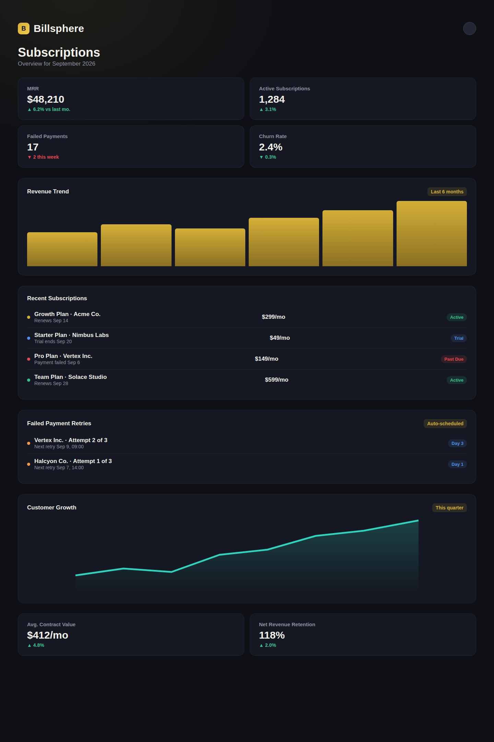
Recurring Payment, Subscription Management and Billing Automation Platform
Mentor: Belovedinla LG
Coordinator: Sri Gauri

Slide 2
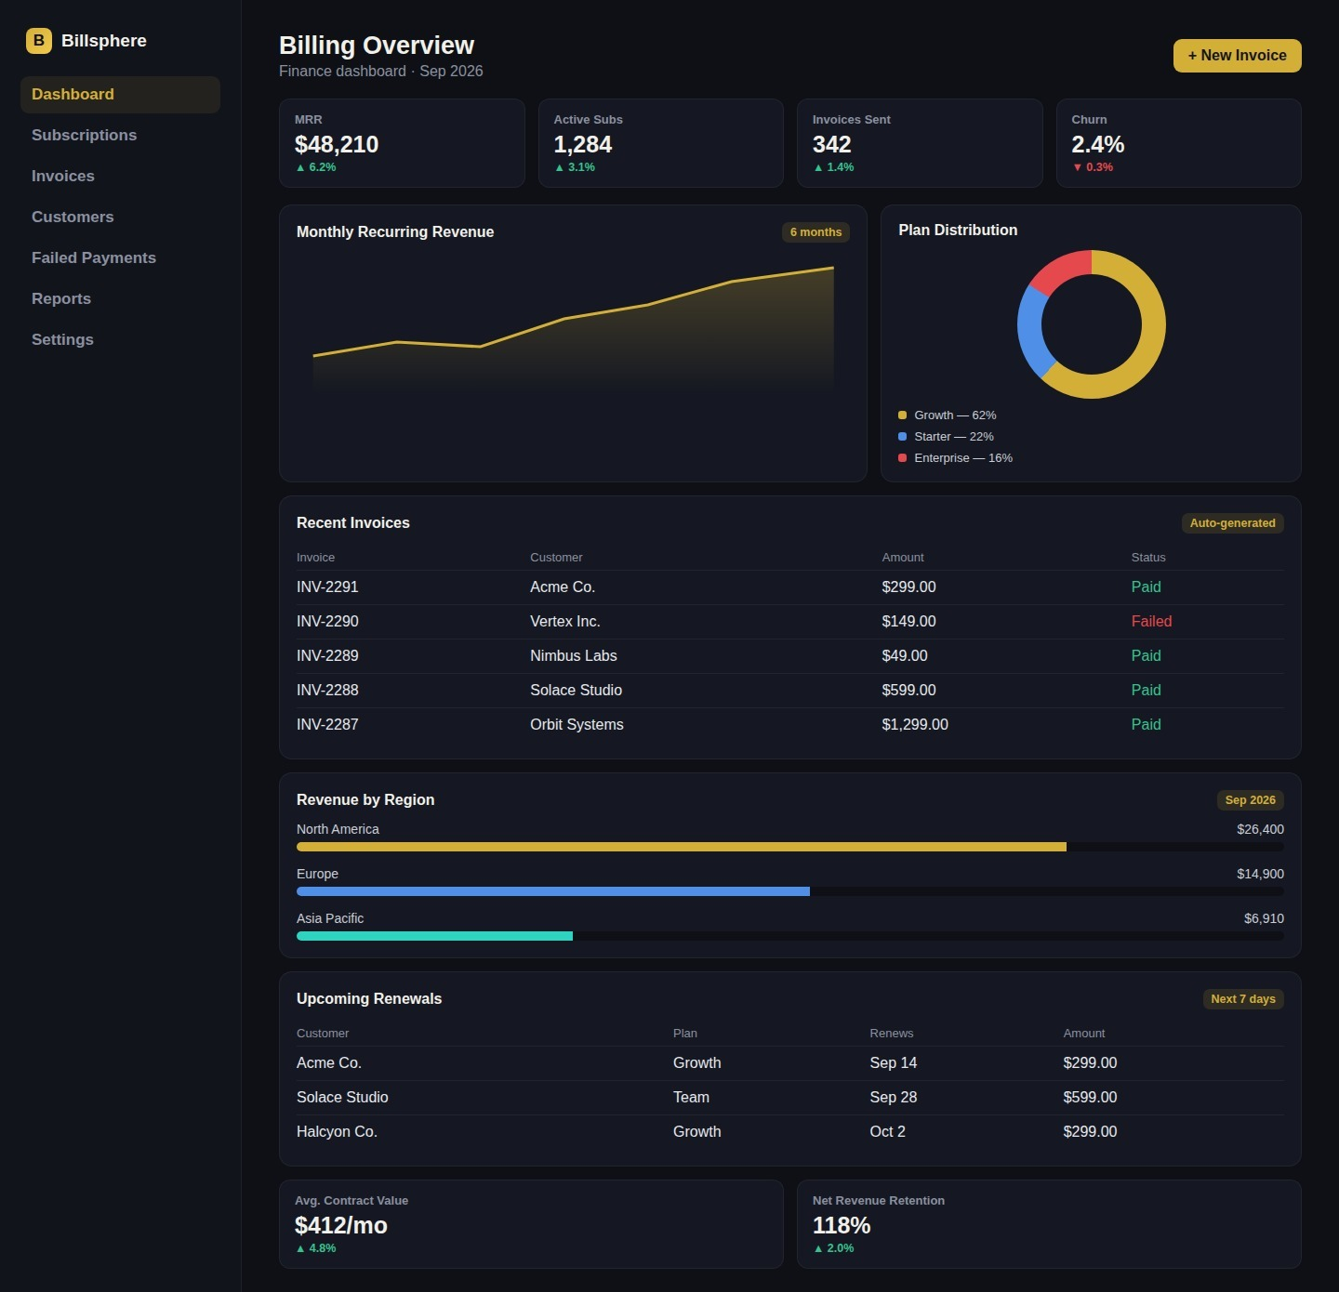
Project Objective
Build a fully functional billing management backend with APIs for plan management, customer subscription creation, billing cycle control, and invoice generation.
Develop a dashboard for finance teams to track active subscriptions, monthly recurring revenue (MRR), invoice status, and failed payment queues.
Implement comprehensive audit logging for financial compliance and regulatory requirements across all billing events.
Enable SaaS businesses to reliably manage subscription plans, automate recurring invoicing, and handle payment failures gracefully.

Slide 3











Tech Stack Used
HTML
CSS
Vanilla JS
FastAPI
PostgreSQL
Celery Beat
React.js
Recharts
ReportLab
Docker Compose
Mock Payment Gateway

Slide 4
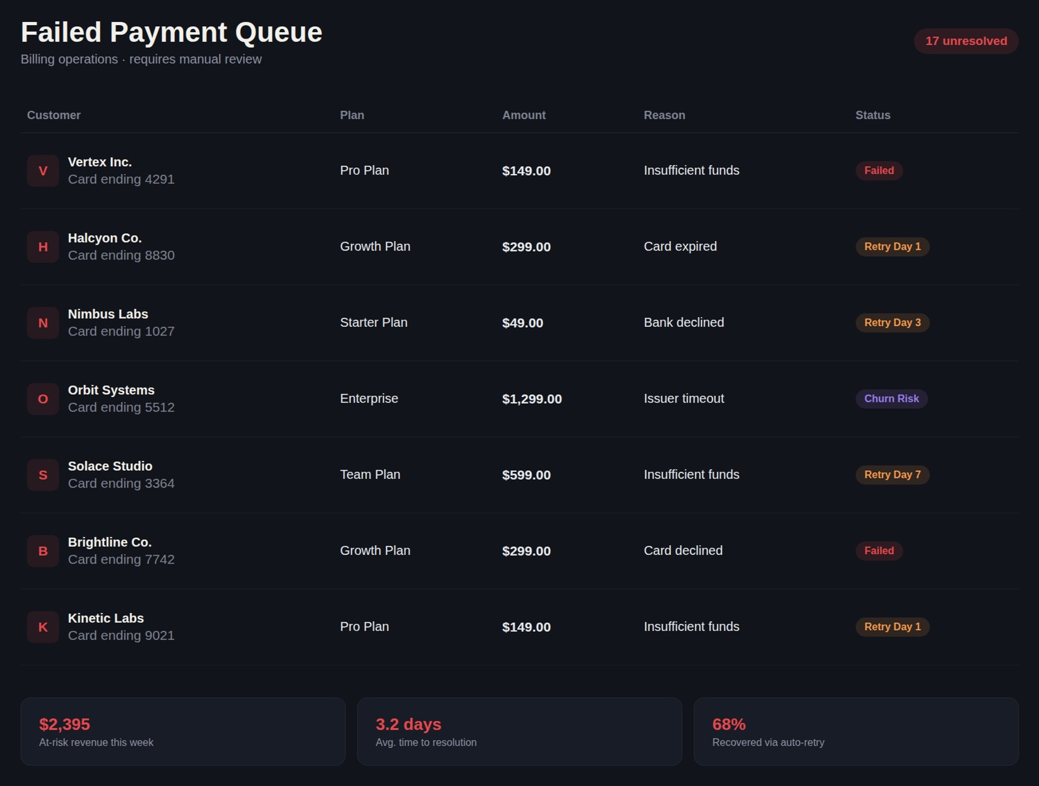

Problem Statement
No Reliable Billing Infrastructure
SaaS businesses lack the infrastructure to manage complex subscription lifecycles end-to-end.
Manual Errors & Proration Gaps
Manual billing exposes companies to errors in proration calculations, subscription state management, and payment retry logic.
Regulatory Compliance Risks
Accurate tax calculation, invoice formatting, and complete audit trails are required but rarely automated.
Complex State Transitions
Handling trial → active → past-due → cancelled transitions with failed payment recovery requires sophisticated automation.

Slide 5
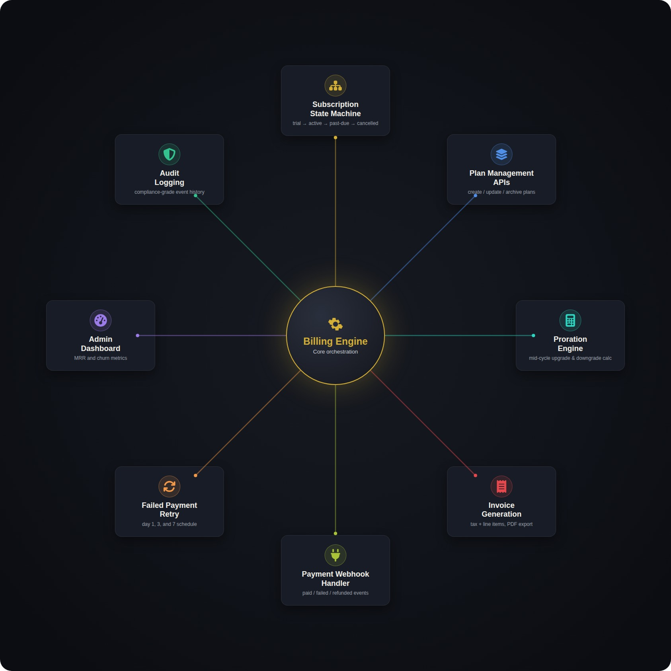
Proposed Solution
State Machine
Proration Engine
Trial → Active → Past-Due → Cancelled with timestamp tracking
Auto-calculates unused plan portions for mid-cycle upgrades & downgrades
Retry Logic
Audit Logging
Configurable schedule: Day 1 → Day 3 → Day 7 with auto status transitions
Complete billing event history per customer for compliance

Slide 6




Future Enhancements
Real Payment Gateways
Advanced Analytics
Multi-Currency Support
AI Payment Optimization
Integration with Stripe, PayPal, and Square for production-grade payment processing.
Cohort analysis, lifetime value (LTV) calculations, and predictive churn modeling.
Real-time exchange rate handling for global SaaS operations across regions.
Machine learning to predict optimal retry timing and intelligent dunning management strategies.

Slide 7


System Architecture & Key Features
Core Capabilities
1
Database Schema
PostgreSQL with enum-typed subscription status across plans, customers, invoices & audit_logs
Processing & Presentation
2
Tax, proration, PDF generation, React dashboard
Celery Beat Automation
Scheduler triggers invoice generation jobs at correct renewal dates for each active subscription
Automation
Celery Beat scheduler triggers billing jobs
3
Core Database
PostgreSQL: plans, customers, invoices, audit_logs
Tax & Refund Engine
Configurable tax rates by country/region; automatic refund calculation for cancellations
4
Dashboard Metrics
MRR tracking, churn rate, trial conversion, revenue by plan, and downloadable PDF invoices

Slide 8
Thank You

