Slide 1
AVINASH A GODI
B.E. (Mechanical)
EXCEL PROJECT

Slide 2
This project is based on sales of a company in their respective outlets as per the data set, and got some valuable insights for the company
This dataset consist of 11 columns & 8524 rows.
From this dataset, the fields which are used as follows:
Item identifier, Item weight, Item fat content, Item MRP, Outlet identifier, Outlet establishment year, Outlet Size, Outlet location type, Outlet type, Item outlet sales

Slide 3
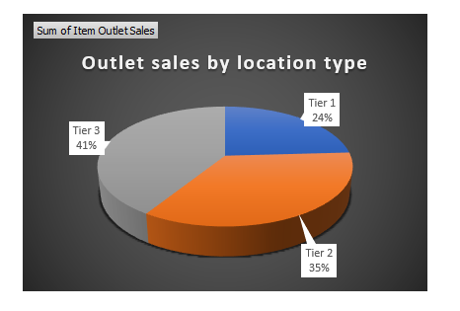
Which Location type has highest sale and lowest sale
Tier 3 with 41% as Highest
Tier 1 with 24% as Lowest

Slide 4
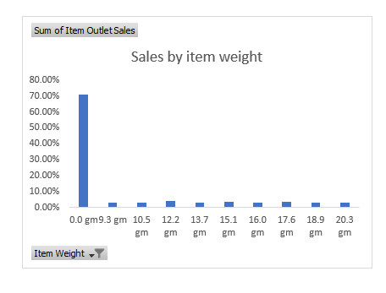
Sales by item weight

Slide 5
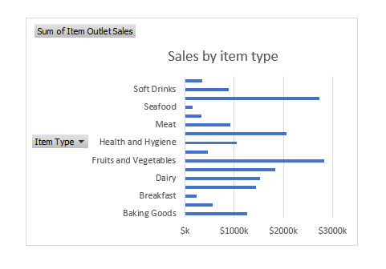
Which Item has highest sale and lowest sale
Fruit and vegetable as Highest with $2820k sale
Sea food as Lowest with $149k sale

Slide 6
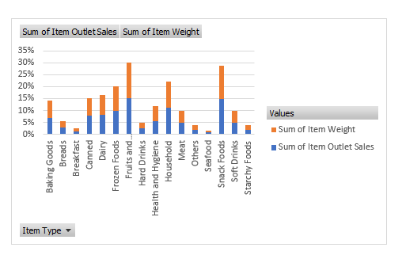
Sales by item weight and item type

Slide 7
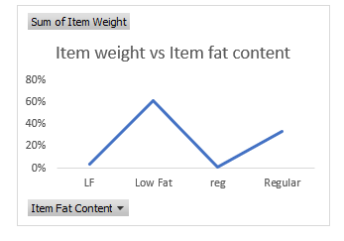
Sum of item weight vs item fat content

Slide 8
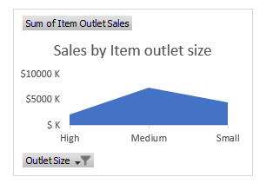
Sales by outlet size

Slide 9
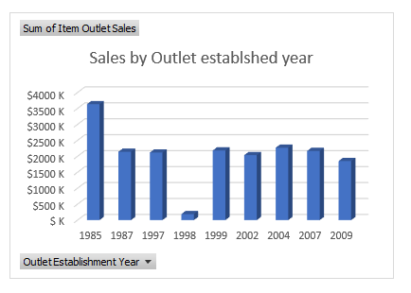
Sales by Outlet established year

Slide 10
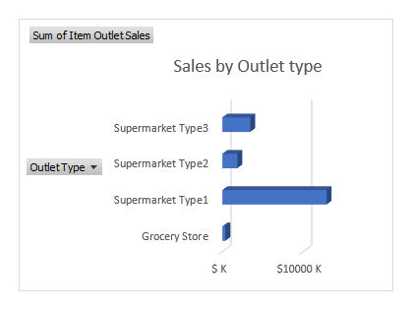
Which Outlet type has highest sale and lowest sale
Supermarket type 1 as Highest with $12917k sale
Grocery store as Lowest with $368k sale

Slide 11
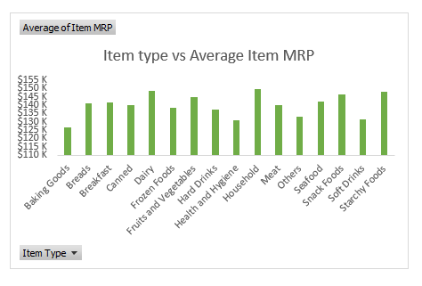
Item type vs Average item MRP

Slide 12
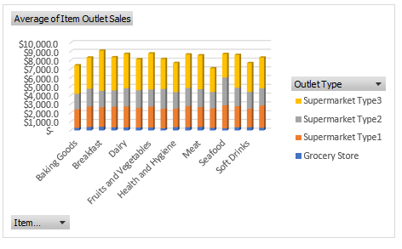
Item type average sales in outlet type

Slide 13
CONCLUSION
FROM THE DATA SET, IT IS EVIDENT THAT FRUIT AND VEGETABLE HAS THE HIGHEST SALES
IT IS OBSERVED THAT SUPERMARKET TYPE 1 AS HIGHEST WITH $12917K SALE
TIER 3 LOCATION TYPE WITH 41% AS HIGHEST SALE

Slide 14
SOURCE DATA
DATASET
https://www.kaggle.com/datasets?topic=businessDataset
VIDEO PRESENTATION LINK
https://drive.google.com/file/d/1aoRuRTeRJlKMddMpJPiHUxXJEW0oLxhz/view

Slide 15
DYNAMIC DASHBOARD

Slide 16
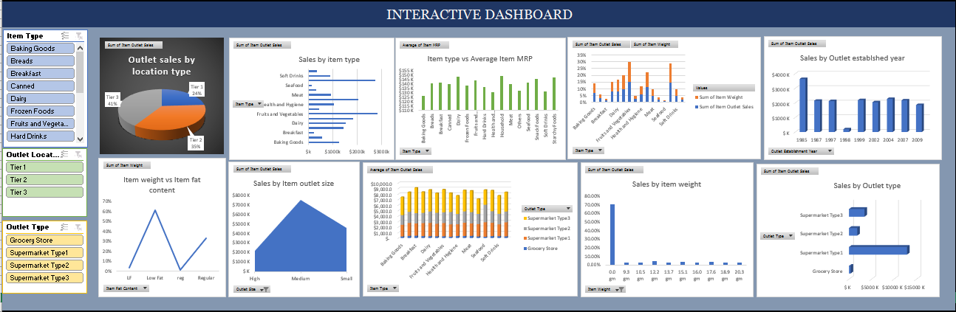

Slide 17
THANK YOU

