Slide 1

Slice
SER 502 -Languages And Programming Paradigms
Team : 30
Sanay Devi
Vaishak Vellore
Avinash Vijayakumar
Darshan Prakash

Slide 2
Introduction & Development Strategy
The design goal of Slice is to create a new language which is easy to learn and implement.
Slice is a user-friendly language which is written in Java and Python.
Operators:
Arithmetic: +, - , / , *, %
Relational: >,<,=<,=>,!=
Decision Control: If & If else
Looping Construct: While
Data Type: Num, Bool, Identifier
This project was done following an Agile Development process with everyday Sprint meetings.

Slide 3
Tools Used
Compiler: Built using JAVA
Lexer and Parser: Built using ANTLR v4.7 plugin in Intellij Idea
Grammar : A .txt file converted to .g4 file used as an input to ANTLR.
Runtime : Built using PYTHON
Systems Used : Mac OS X, Windows

Slide 4

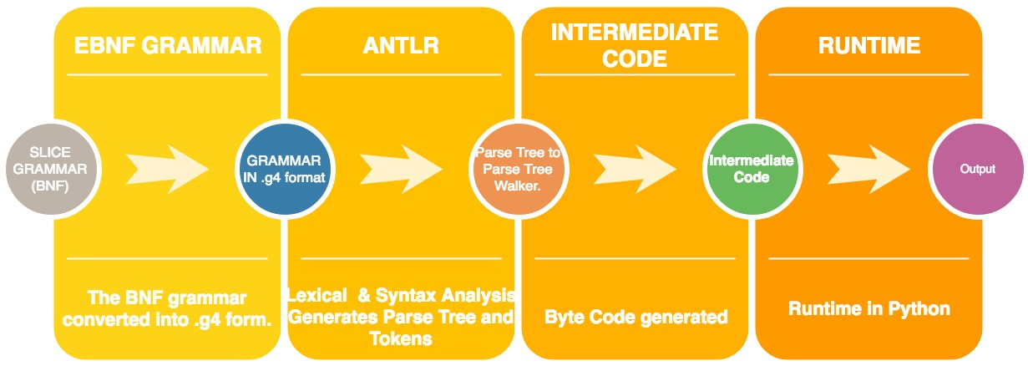



OVERVIEW

Slide 5
GRAMMAR
The first step was to write the grammar in simple BNF form.
The grammar was then refined to remove left recursion.
Then the grammar had to be converted to .g4 format to make it make it compatible with ANTLR.
Now we shall go through each part of our grammar.

Slide 6

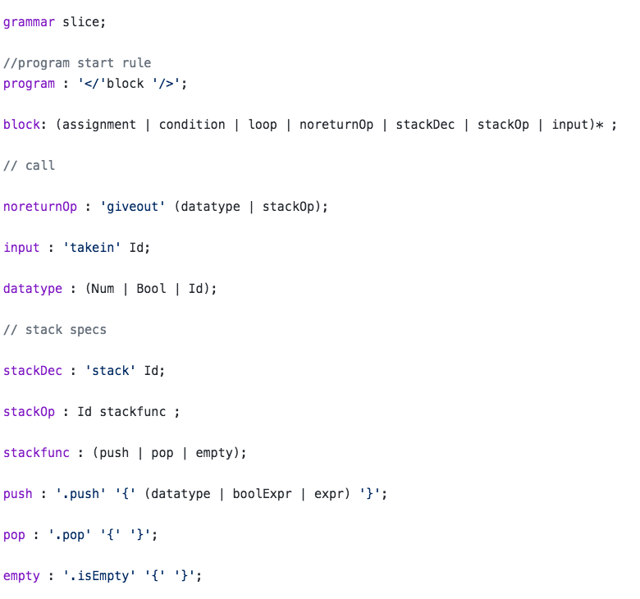

Slide 7
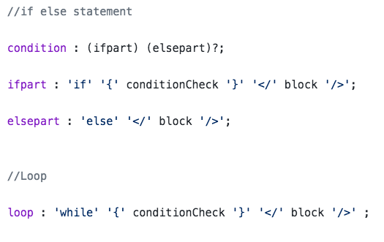

Slide 8
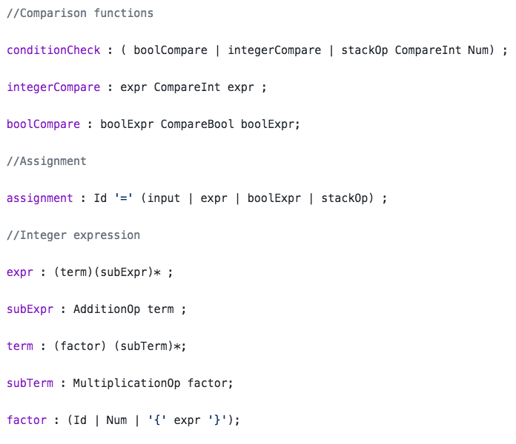

Slide 9
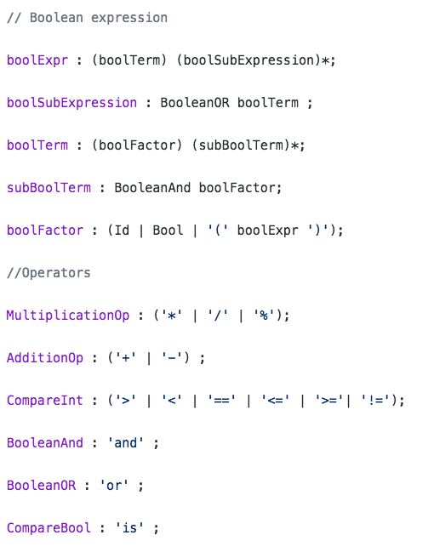

Slide 10
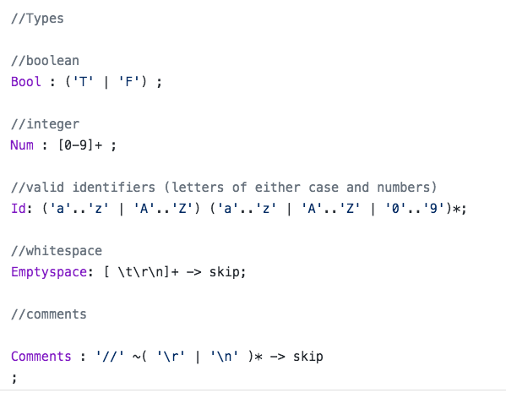

Slide 11
ANother Tool for Language Recognition (ANTLR)
Now, the .g4 grammar file is run through ANTLR to generate parser and lexer.
ANTLR is a powerful parser generator for reading, processing, executing or translating structured text.
For a grammar, ANTLR generates a parser that can build and walk parse trees.
Lexer tokens are generated which are used by the parser to generate the intermediate code and the parse tree.
This generated parse tree helped us analyze our grammar and check if it was defined properly.
Now we will see two parse tree examples generated by ANTLR

Slide 12
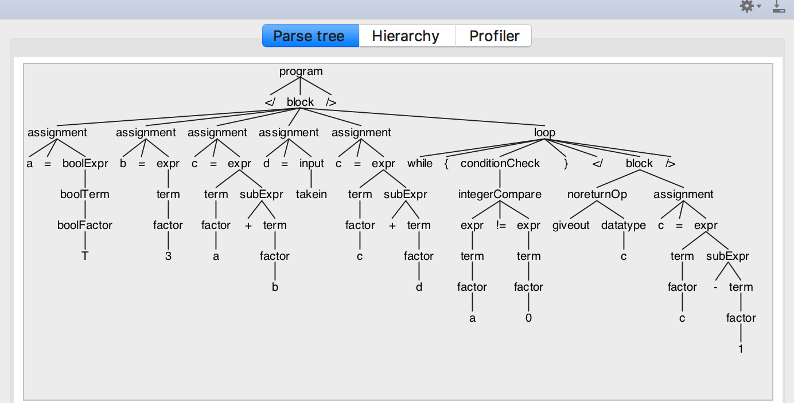
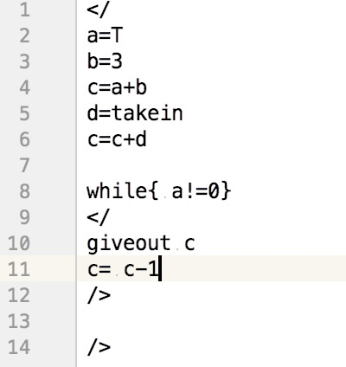
While Looping Construct

Slide 13
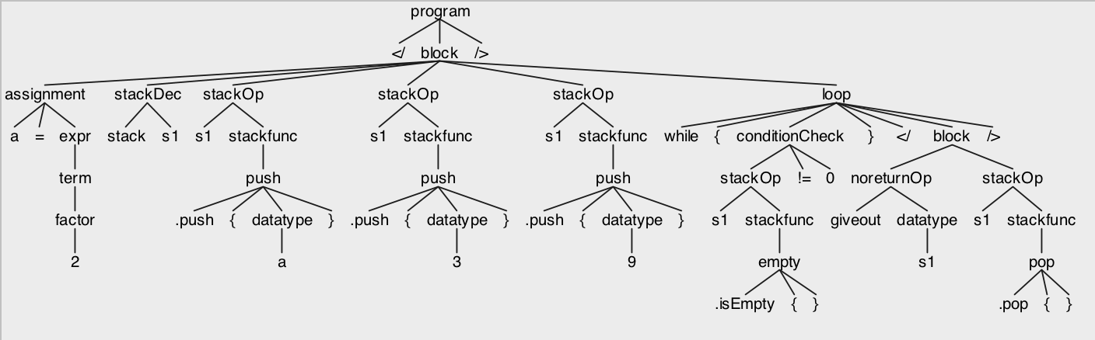
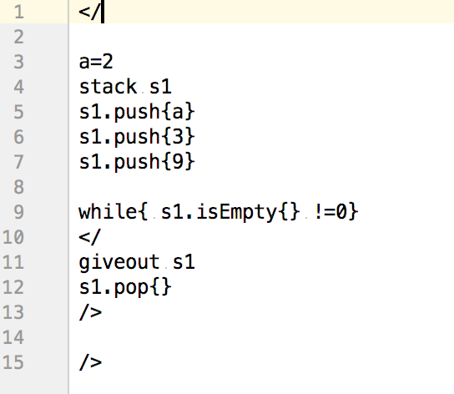
Stack Operations

Slide 14
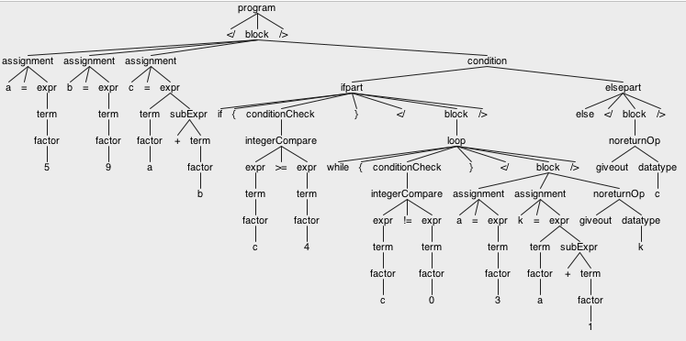
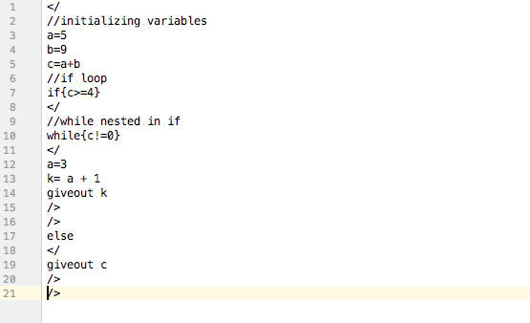
If along with While Construct

Slide 15
Intermediate Code Generation
The sliceBaseListener implements sliceListener and now we define the semantics of the intermediate language.
So the sliceBaseListener overrides the methods present in the sliceListener.
For example, in the input text when an ”IF” is encountered, the enterIf method gets called and certain specific operations are performed till the end of the loop is reached.
Now, we run the sliceRunner file which has the main method in it.
First the sliceRunner will generate the tokens by calling the lexer and the parser. These tokens using the sliceBaseListener generate the parse tree and the intermediate code.
A intermediate code is now generated.

Slide 16
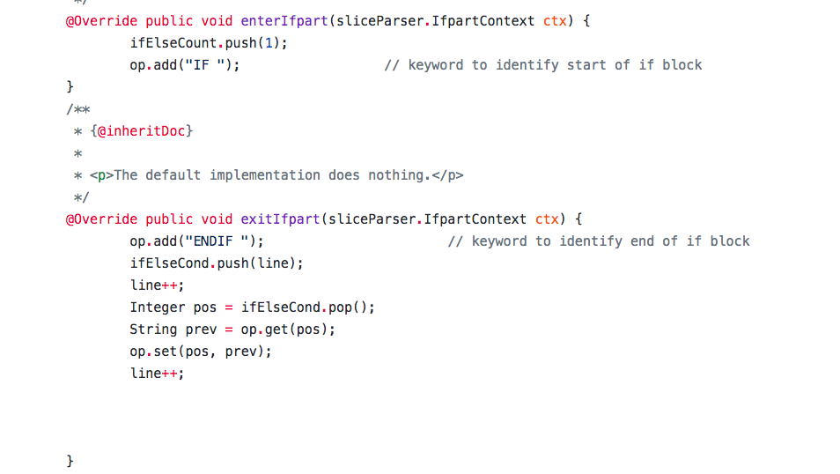

Slide 17
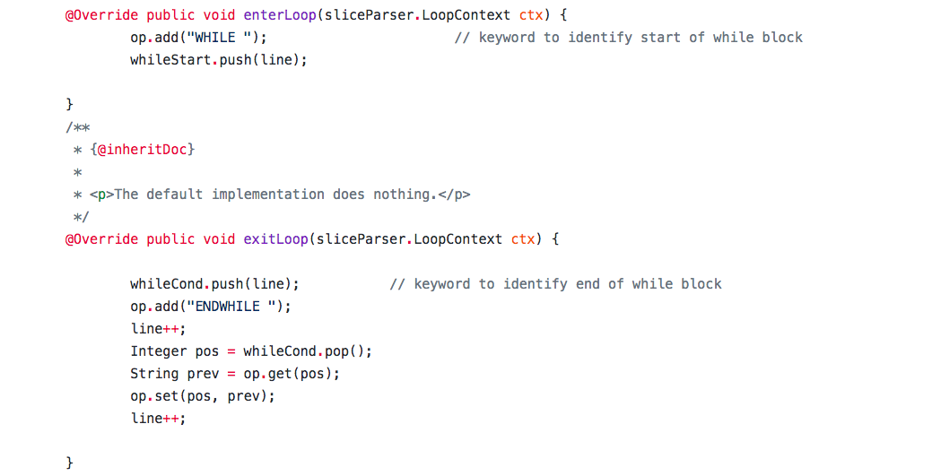

Slide 18
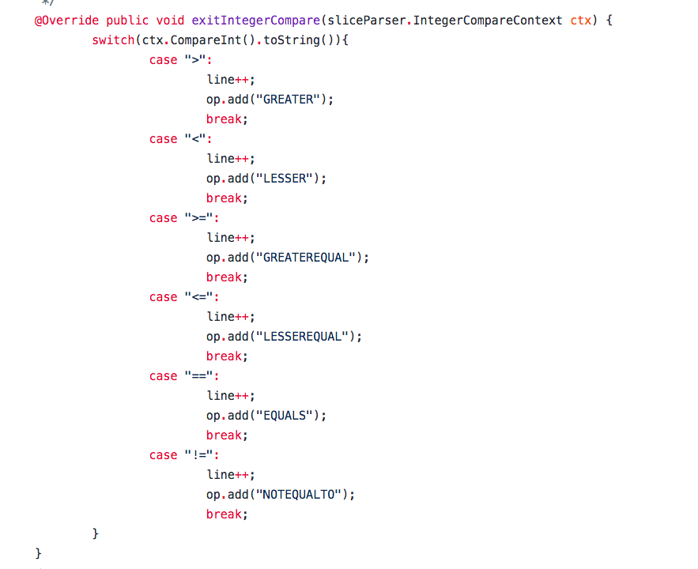

Slide 19
Intermediate Code Generation
The Intermediate Code Generation Keywords used are:
GIVEOUT
PUSH
STACK
STACKPOP, STACKPUSH, STACKISEMPTY
IF ENDIF, ELSE ENDELSE , WHILE ENDWHILE
PUSH true
GREATER,LESSER, GREATEREQUAL,LESSEREQUAL,EQUALS,NOTEQUALTO
STORE
ADDITION,SUBTRACTION,MULTIPLICATION,DIVISION,MODULUS
We now present two code snippets of sample input program and the intermediate code generated.

Slide 20
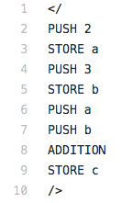
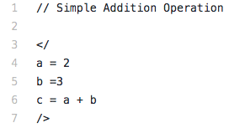
c

Slide 21
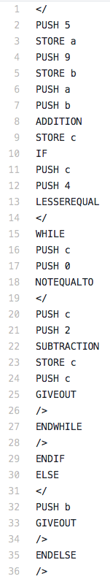
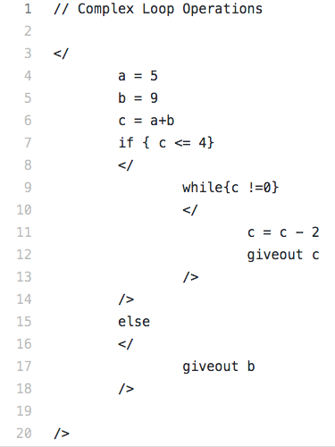

Slide 22
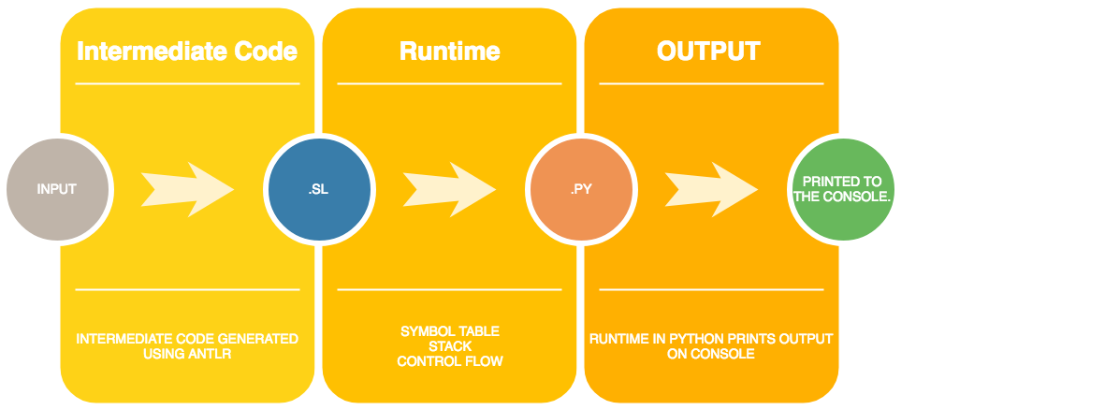
RUNTIME

Slide 23
RUNTIME
Interpreter is written in Python.
Intermediate Code is taken as input.
Symbol table (python dictionary).
Stack frame / Activation record.
Opcode to specific method.

Slide 24
Code Snippets For Runtime

Slide 25
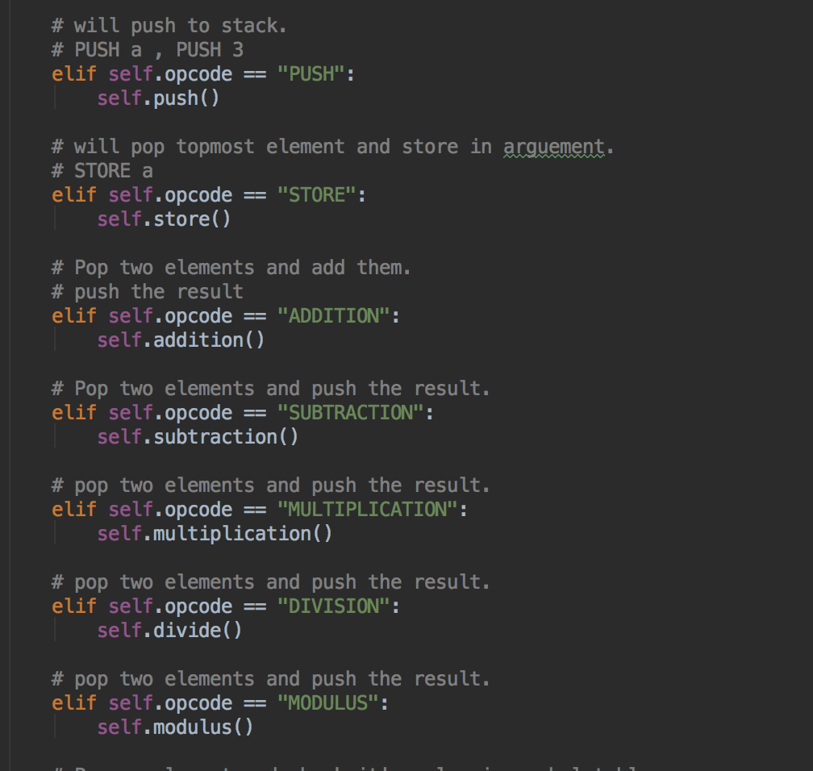

Slide 26
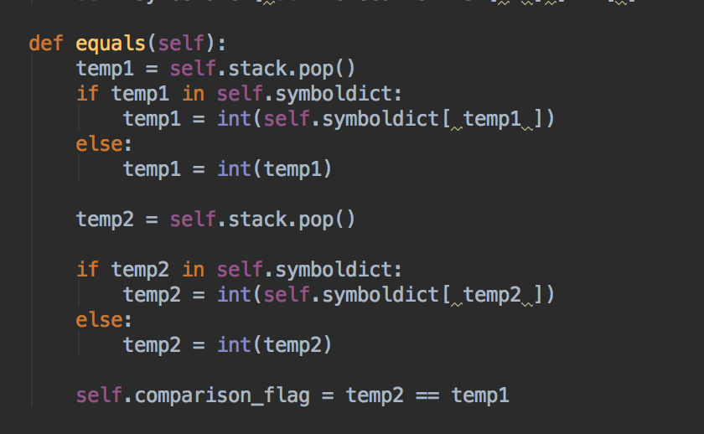

Slide 27
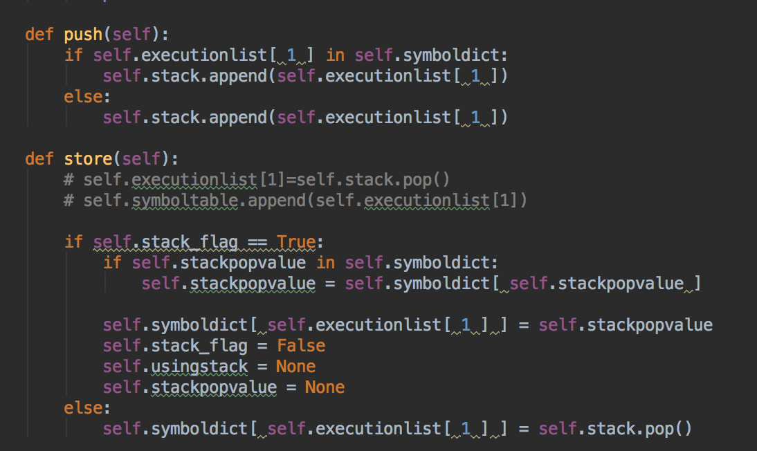

Slide 28
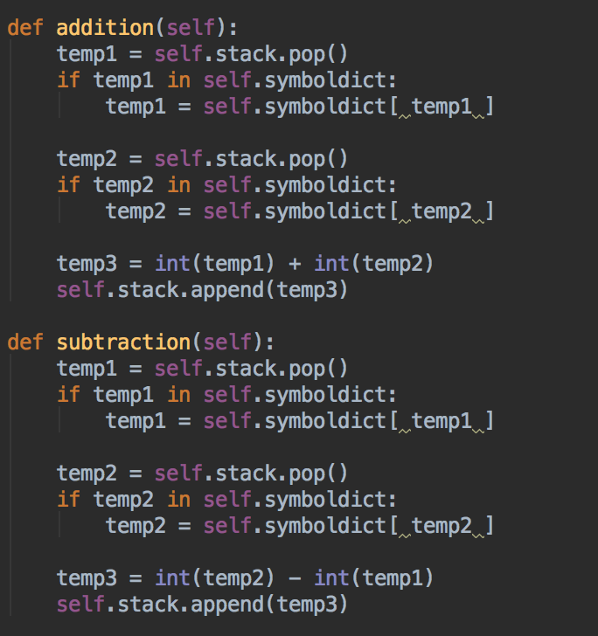

Slide 29
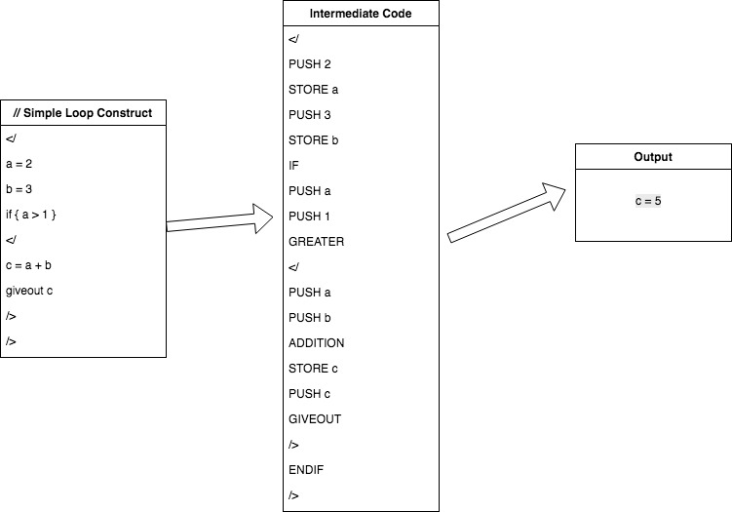

Slide 30
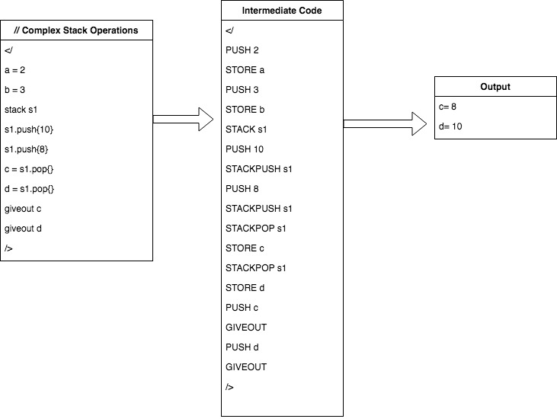

Slide 31
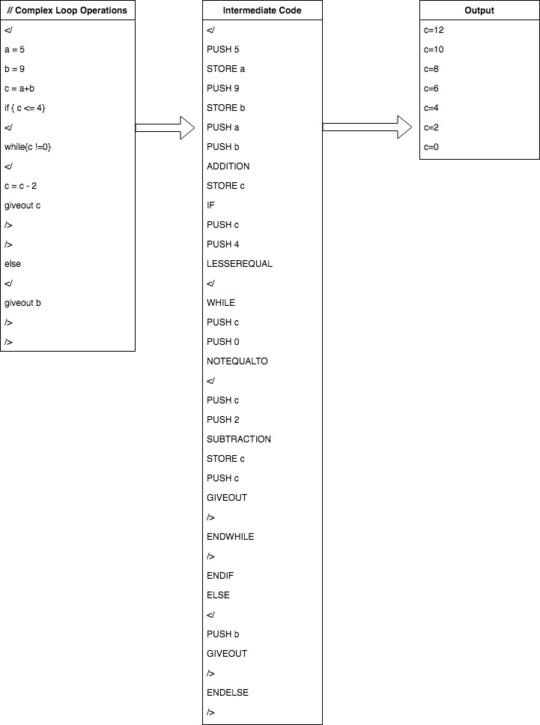

Slide 32
CONCLUSION
In the end, we would like to thank Dr Ajay Bansal for giving us this opportunity to create our own programming language.
By doing this project we understood the basics of every programming language and hope to add more additional complexity in the upcoming months.

