Slide 1


"Image-based Animal Type Classification for Cattle and Buffaloes "
Project Review – II Presentation
on
Presented By: Guided By:
1. Avadhut Patil Dr. Nilesh Mali
2. Dnyaneshwar Tupe
3. Avinash Markad

Slide 2
Table of Contents
Introduction
Literature Survey
Motivation
Problem Statement
Objectives
Feasibility and Scope
Requirement Analysis
Methodology
Datasets
Results
Conclusion
Research Paper Publication
References

Slide 3
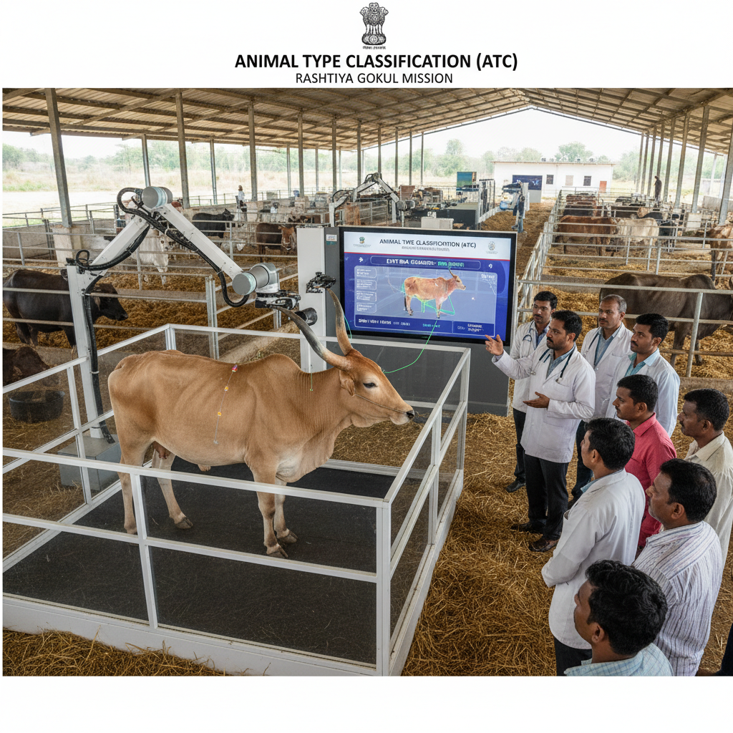
Introduction
This project aims to enhance the productivity of native cattle and buffalo breeds through breed identification.
It focuses on Animal Type Classification (ATC) — evaluating animals’ physical traits to identify elite females for breeding programs like Progeny Testing and Pedigree Selection.
The project develops an AI-based system that automatically analyzes cattle and buffalo images for ATC, replacing manual, subjective evaluations with a data-driven, objective process.

Slide 4
Literature Survey
Sr. No | Paper and Author’s Name | Publication & year | Description | Challenges
1. | Computer-Vision-Based Sensing Technologies... | MDPI Sensors, 2024 | Body measurement using RGB/depth images and DL. | Needs controlled environment.
2. | Meta-analysis on body weight prediction... | Journal of Advanced Veterinary and Animal Research, 2023 | Correlates image traits with body weight. | Dataset variability.
3. | Automatic Cattle Identification using YOLOv5… | arXiv, 2022 | Muzzle-based cattle identification. | Not for cattle-buffalo classification.
4. | Livestock Monitoring Using CV and DL | Abdelrahman et al., 2024 | Animal monitoring and identification using DL. | Requires large datasets.
5. | EfficientNet-Based Breed Classification | Kumar et al..2024 | Breed classification with transfer learning. | Breed-focused only.
6. | Lightweight CNN for Livestock Identification | Ary et al..2025 | Mobile-friendly livestock recognition. | Limited dataset testing.

Slide 5
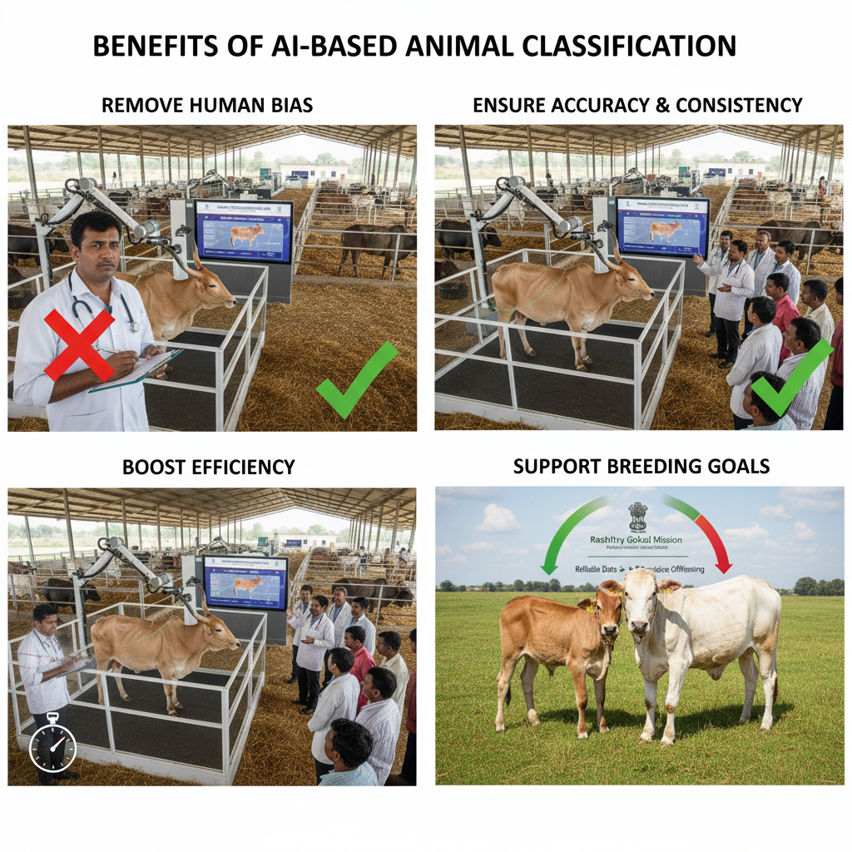
Motivation
Remove Human Bias: Replace manual, error-prone scoring with automated, objective analysis.
Ensure Accuracy & Consistency: AI ensures uniform, repeatable evaluations for every animal.
Boost Efficiency: Automation saves time and effort, enabling faster field assessments.

Slide 6
Problem Statement
Existing ATC systems rely heavily on manual inspection, leading to subjective evaluations, inconsistent results, and increased processing time.
An automated image-based classification system is required to improve accuracy, consistency, and scalability in livestock management programs.

Slide 7
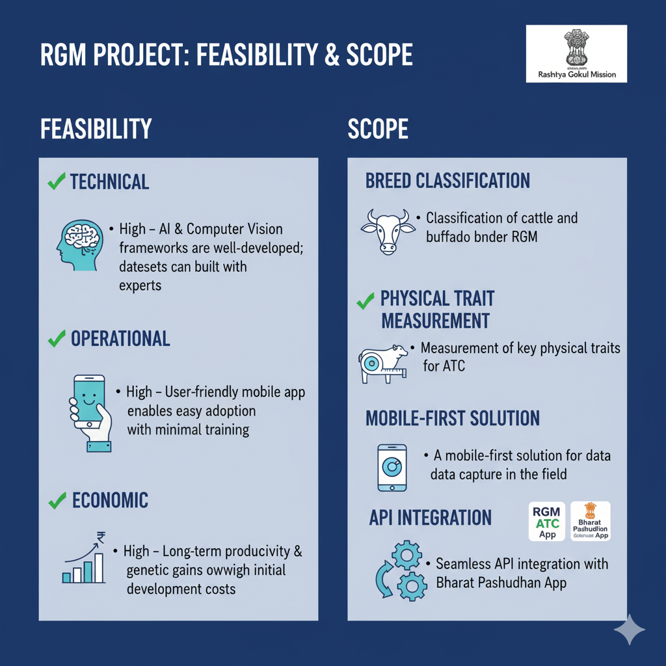
Feasibility and Scope
Feasibility
  AI and computer vision frameworks are well-developed; datasets can be built with experts.
  A user-friendly mobile app enables easy adoption with minimal training.
Scope
  Classification of cattle and buffalo breeds under RGM.
  Seamless API integration with Bharat Pashudhan App (BPA).

Slide 8
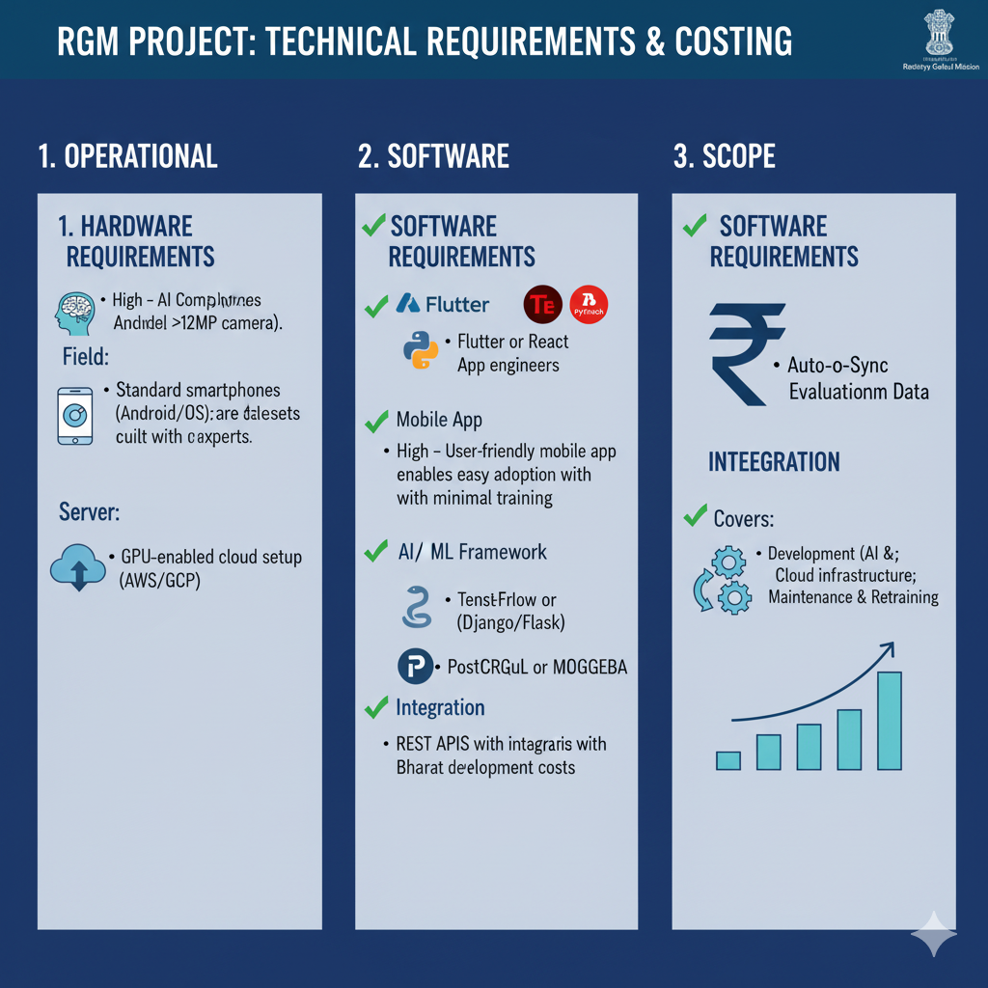
Requirement Analysis
Hardware Requirements:
  Field: Standard smartphones (Android/iOS) with a good quality camera (>12MP).
Software Requirements:
  Backend: Python FastApi for server-side logic.
  AI/ML Framework: TensorFlow for model development.

Slide 9
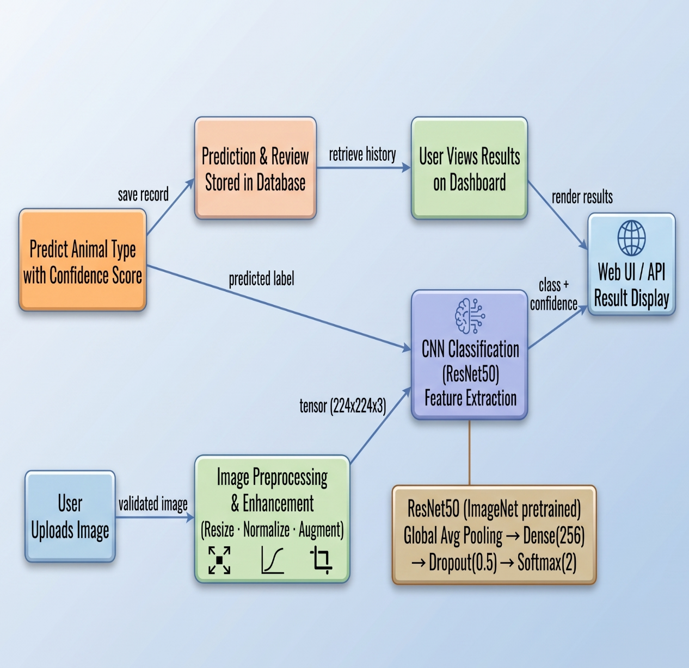
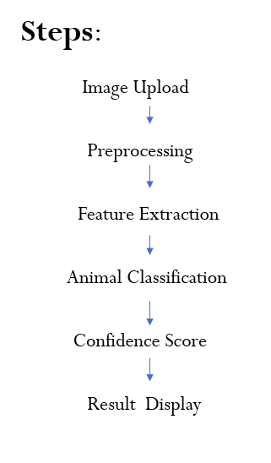
Methodology
.

Slide 10
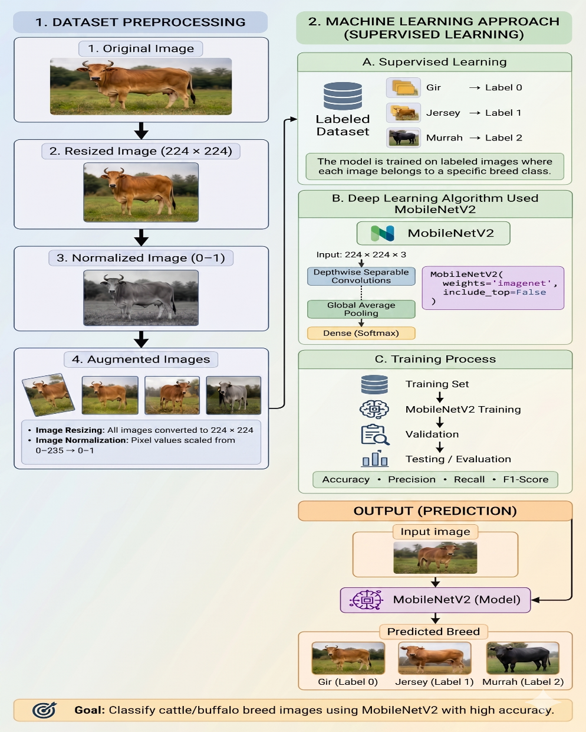
Study Design & Analysis:
Dataset Preprocessing
Image Resizing
All images converted to:
224 × 224
Why?
MobileNetV2 requires fixed input size.
Image Normalization
img_array = img_array / 255.0
Range:
0-255 → 0-1

Slide 11
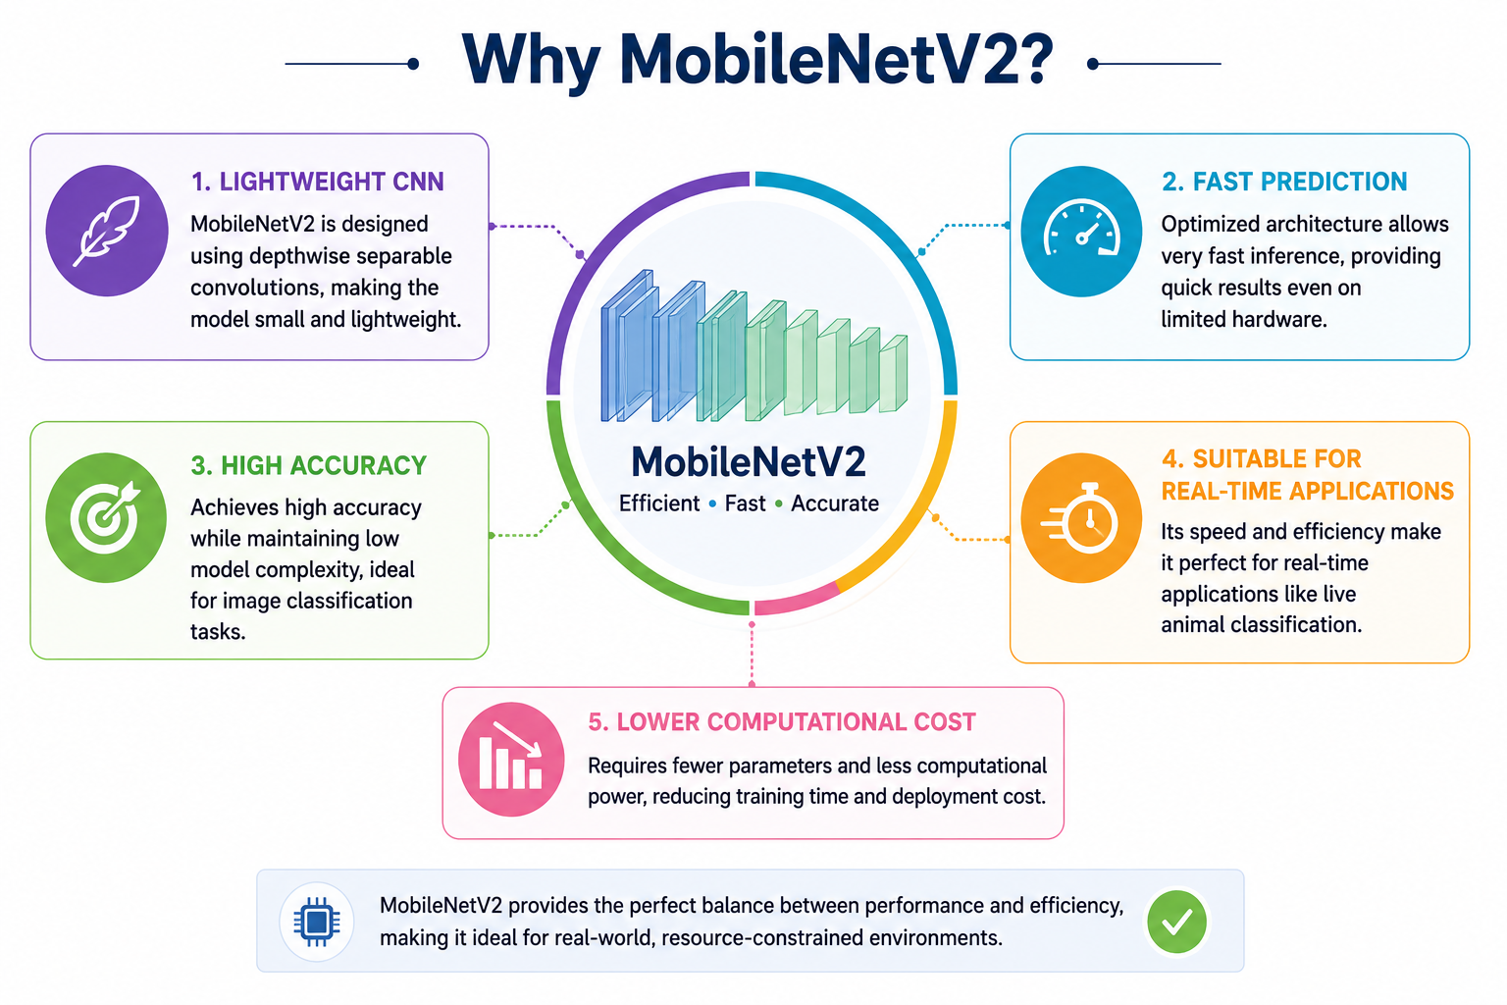
Study Design & Analysis:
Machine Learning Approach:
Type of Learning
1. Supervised Learning:
  The model is trained on labeled images where each image belongs to a specific breed class.
  Example:
    Gir → Label 0
    Jersey → Label 1
    Murrah → Label 2
2. Deep Learning Algorithm Used
  MobileNetV2
  Your project uses:
  MobileNetV2(
  weights='imagenet',
  include_top=False)

Slide 12
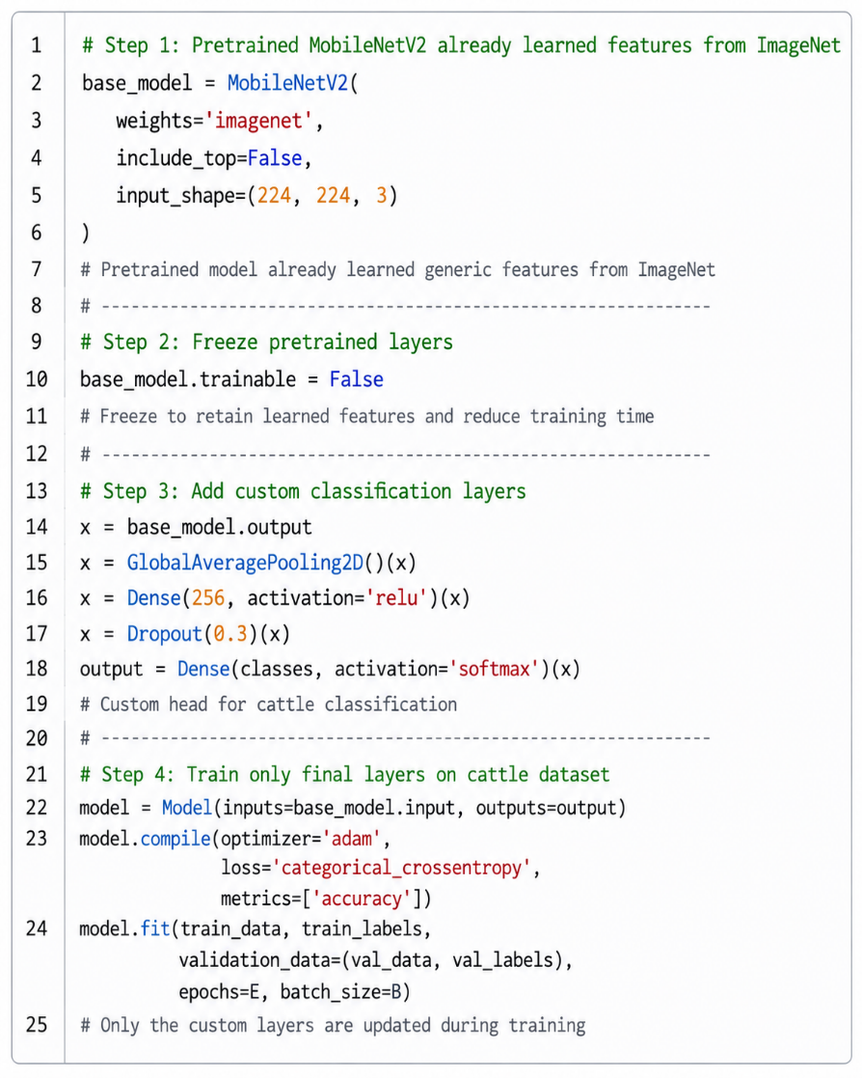
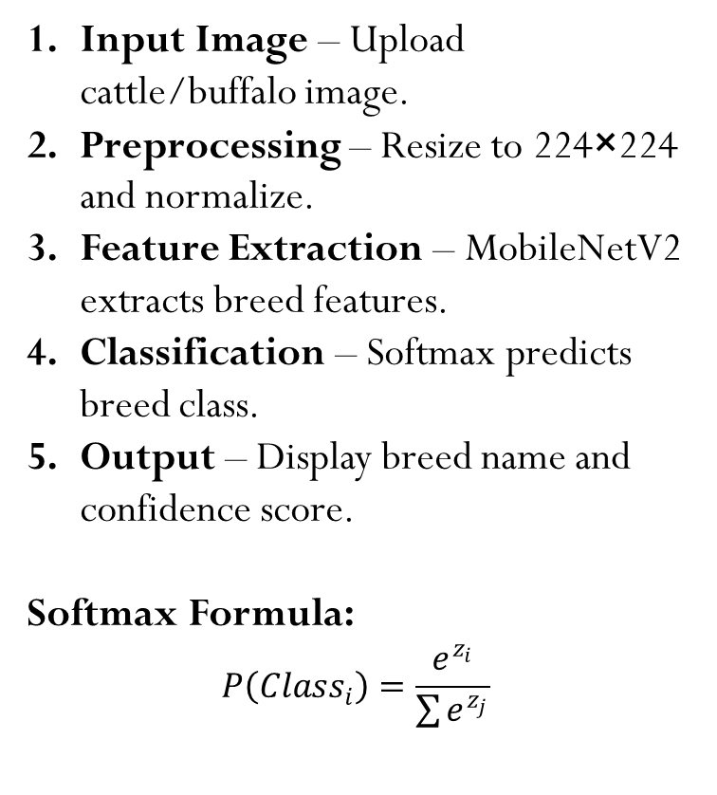
Main Algorithm: MobileNetV2-Based Animal Breed Classification
Input Image – Upload cattle/buffalo image.
Preprocessing – Resize to 224×224 and normalize.
Feature Extraction – MobileNetV2 extracts breed features.
Classification – Softmax predicts breed class.
Output – Display breed name and confidence score.
Softmax Formula:
$$P\left(Class_{i}\right)=\frac{e^{z_{i}}}{\sum{e^{z_{j}}}}$$

Slide 13
Datasets
Breed/Class | Train Images | Valid Images | Test Images | Total Images
Gir | 300+ | 20+ | 30+ | 350+
Holstein Friesian | 300+ | 20+ | 30+ | 350+
Jaffrabadi | 300+ | 20+ | 30+ | 350+
Murrah | 300+ | 20+ | 30+ | 350+
Sahiwal | 300+ | 20+ | 30+ | 350+
Jarsi | 300+ | 20+ | 30+ | 350+
Total | 1800+ | 120+ | 180+ | 2100+
Dataset Description
  Contains animal breeds with 2,100+ images.
  Split into training, validation, and testing datasets.
  Balanced image distribution across all classes.

Slide 14
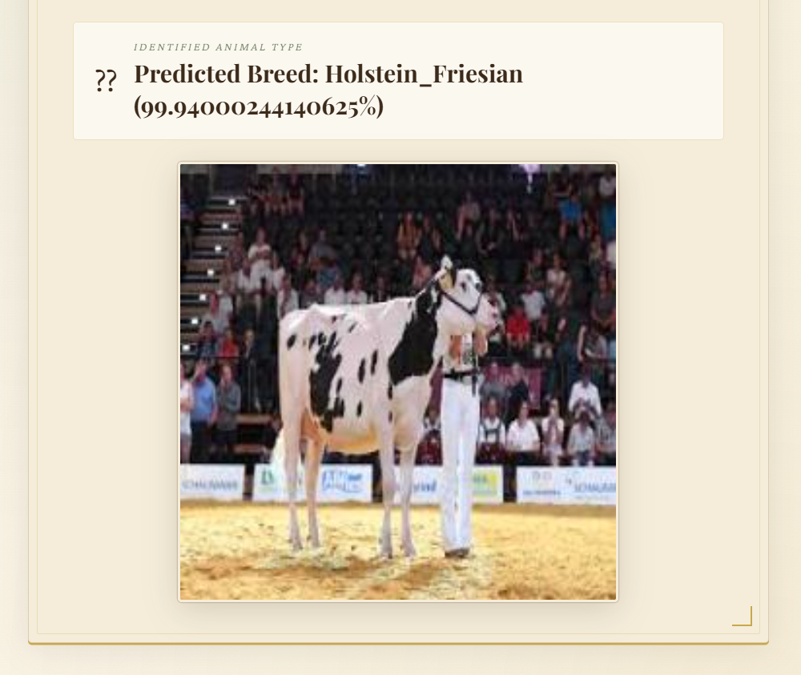
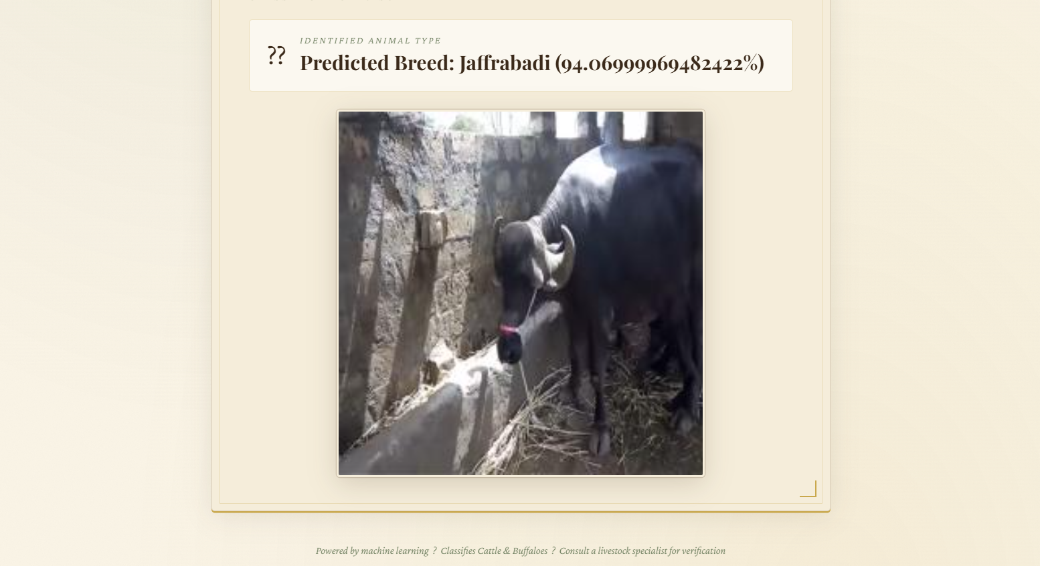
Results
Sample Prediction Results
Holstein Friesian: 99.94%
Jaffrabadi: 94.06%

Slide 15
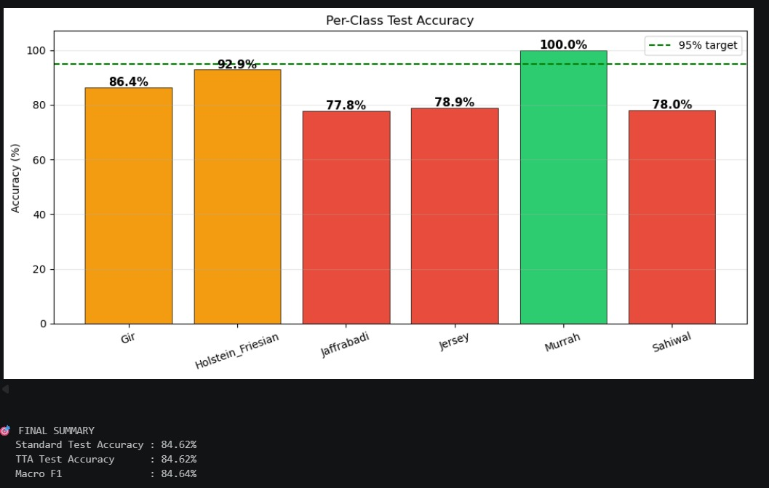
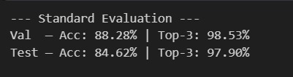
Test Accuracy:
Test Accuracy: 84.62%
Top-3 Accuracy: 97.90%
Murrah Accuracy: 100%
High-performance breed classification using MobileNetV2.

Slide 16
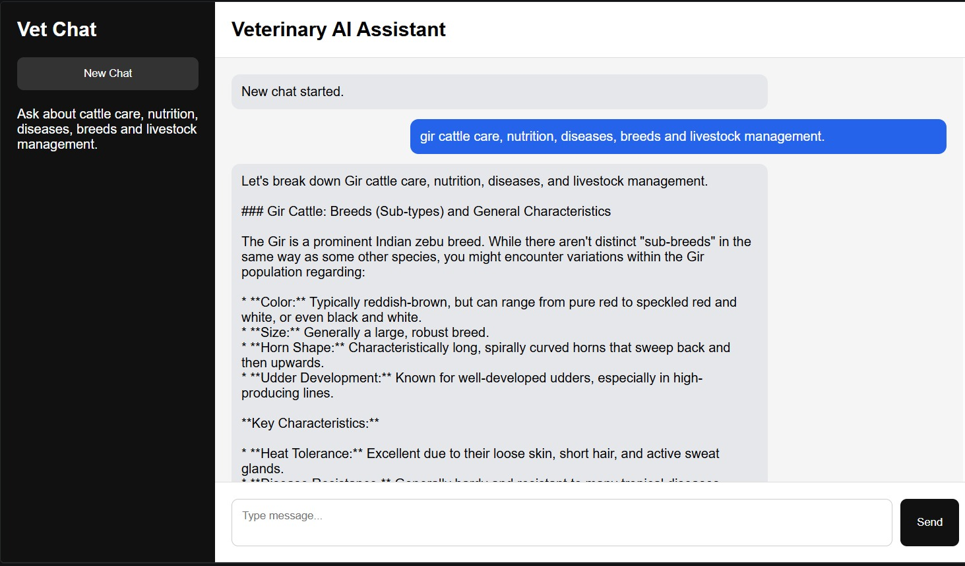
AI Assistant Result:

Slide 17
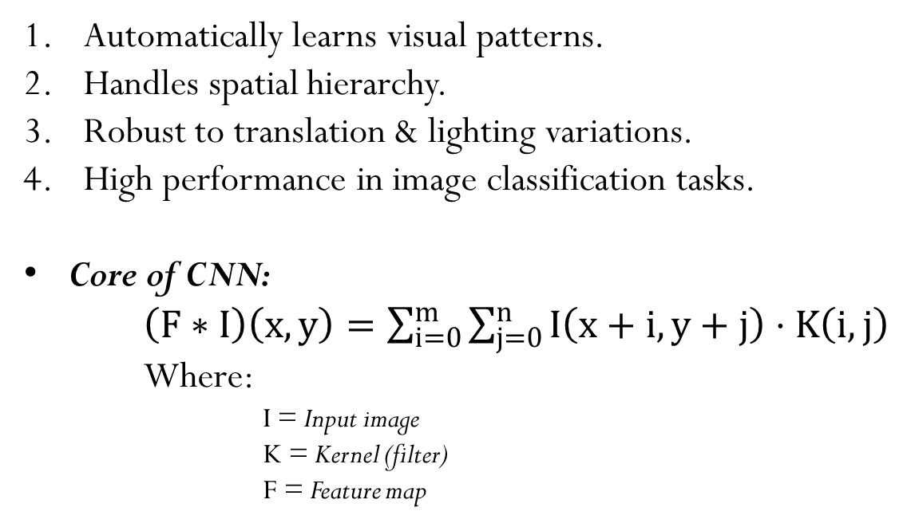
Why CNN is suitable for our problem?
Automatically learns visual patterns.
Handles spatial hierarchy.
Robust to translation & lighting variations.
High performance in image classification tasks.
Core of CNN:
$\left(F∗I\right)\left(x,y\right)=\sum_{i=0}^{m}{\sum_{j=0}^{n}{I\left(x+i,y+j\right)}}⋅K\left(i,j\right)$
Where:
I = Input image
        K = Kernel (filter)
        F = Feature map

Slide 18
Conclusion
This AI-driven ATC system marks a significant advancement for India’s dairy sector.
By delivering reliable, data-driven evaluations, it supports the Rashtriya Gokul Mission’s goals of improving genetics, increasing milk yield, and enhancing farmer income.
The project stands as a scalable, tech-enabled solution to a vital agricultural challenge.

Slide 19
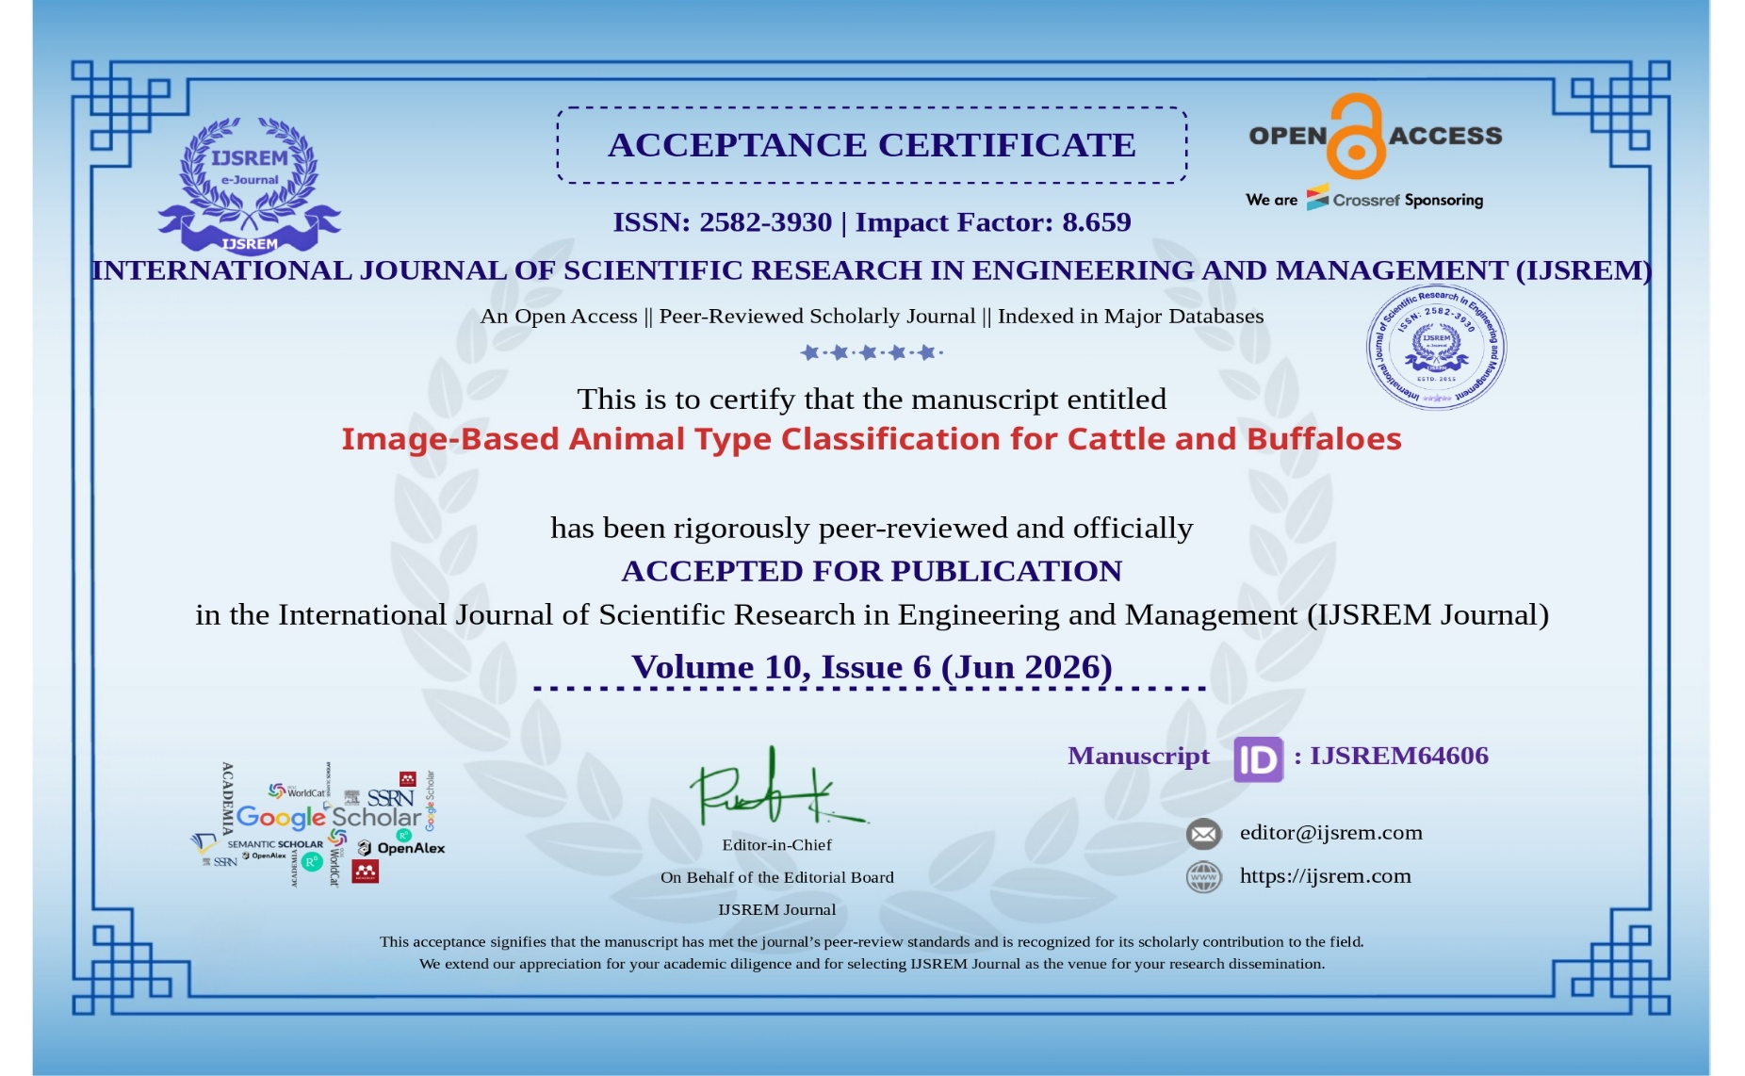
Research Paper Publication

Slide 20
References
Hossain, M. E., et al. A systematic review of machine learning techniques for cattle identification using Machine Learning (ML) and Deep Learning (DL). 2022.
Mon, S. L., et al. AI-enhanced real-time cattle identification system through camera-based RGB images. 2024.
Li, D., Li, B., Qi, L., Wang, Y., Yang, M., Han, M., et al. “Cattle identification based on multiple feature decision-layer fusion.” Scientific Reports, 2024.
Pan, Y., Jin, H., Gao, J., Rauf, H. T. “Identification of Buffalo Breeds Using Self-Activated-Based Improved Convolutional Neural Networks.” Agriculture, 2022.
Ermetin, O. & Örnek, H. K. “Deep-learning-based buffalo identification through muzzle pattern images.” Archives of Animal Breeding, 2025.
“Improving artificial breeding of cattle and buffalo in Asia.” IAEA Publication TE-1480. Focuses on type classification, breed standards, and genetic improvement.

Slide 21
Continue…
Computer-Vision-Based Sensing Technologies for Livestock Body Dimension Measurement: A Survey, MDPI Sensors, 2024.
A First Meta-Analysis Study on Body Weight Prediction Method for Beef Cattle Based on Digital Image Processing, Journal of Advanced Veterinary and Animal Research, 2023.
Automatic Cattle Identification Using YOLOv5 and Mosaic Augmentation: A
Comparative Analysis, arXiv, 2022.
10. Howard, A. et al., “MobileNetV2: Inverted Residuals and Linear Bottlenecks,”
Proceedings of CVPR, 2018.
11. TensorFlow Documentation, Google Developers, Available:
https://www.tensorflow.org
12. Chollet, F., “Keras: Deep Learning for Humans” Available: https://keras.io

Slide 22

Thank You!

