Slide 1

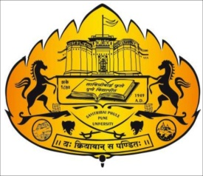
Image-based Animal Type Classification for Cattle and Buffaloes
Project Review- II Presentation
on
Presented by:
1. Avadhut Patil
2. Dnyaneshwar Tupe
3. Avinash Markad
Guided by:
Dr. Nilesh Mali
Department of Computer Engineering
Ajeenkya D Y Patil School of Engineering, Lohegaon
Savitribai Phule Pune University, Pune

Slide 2

Agenda
Introduction
Problem Statement
Motivation
Objectives
Literature Survey
Feasibility and Scope
System Architecture
System Design Demo
Requirement Analysis
(H/W and S/W with costing)
Conclusion
References

Slide 3
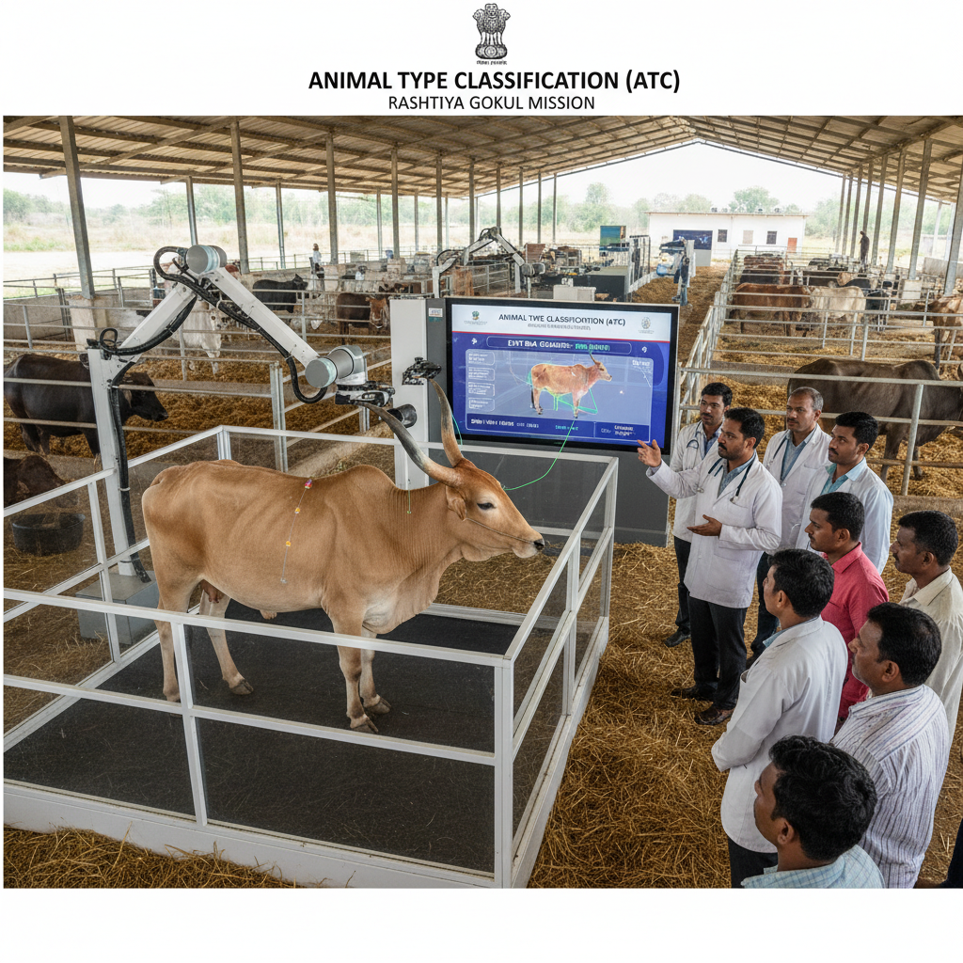
Introduction
This project supports the Rashtriya Gokul Mission (RGM), which aims to enhance the productivity of native cattle and buffalo breeds.
It focuses on Animal Type Classification (ATC) — evaluating animals’ physical traits to identify elite females for breeding programs like Progeny Testing and Pedigree Selection.
The project develops an AI-based system that automatically analyzes cattle and buffalo images for ATC, replacing manual, subjective evaluations with a data-driven, objective process.

Slide 4
Literature Survey
Sr. No | Paper and Author’s Name | Publication & year | Description | Challenges
1 | Computer-Vision-Based Sensing Technologies... | MDPI Sensors, 2024 | Body measurement using RGB/depth images and DL. | Needs controlled environment.
2 | Meta-analysis on body weight prediction... | Journal of Advanced Veterinary and Animal Research, 2023 | Correlates image traits with body weight. | Dataset variability.
3 | Automatic Cattle Identification using YOLOv5… | arXiv, 2022 | Muzzle-based cattle identification. | Not for cattle-buffalo classification.
Notes:
4

Slide 5
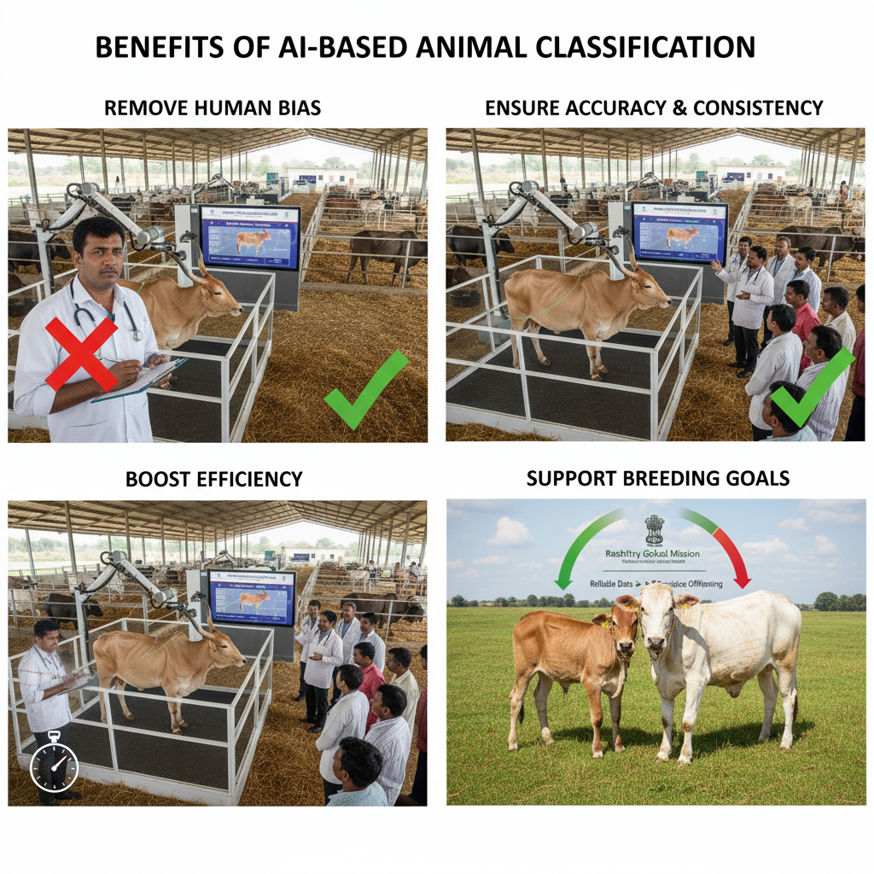
Motivation
Remove Human Bias: Replace manual, error-prone scoring with automated, objective analysis.
Ensure Accuracy & Consistency: AI ensures uniform, repeatable evaluations for every animal.
Boost Efficiency: Automation saves time and effort, enabling faster field assessments.

Slide 6

Problem Statement
The core challenge is that the manual process of Animal Type Classification (ATC) for cattle and buffaloes is subjective and prone to inconsistencies.
This inaccuracy compromises the data quality for crucial national breeding programs under the Rashtriya Gokul Mission. This creates a critical need for an AI-driven, automated system that can analyze animal images, extract key physical parameters, and generate objective classification scores with minimal human intervention.

Slide 7
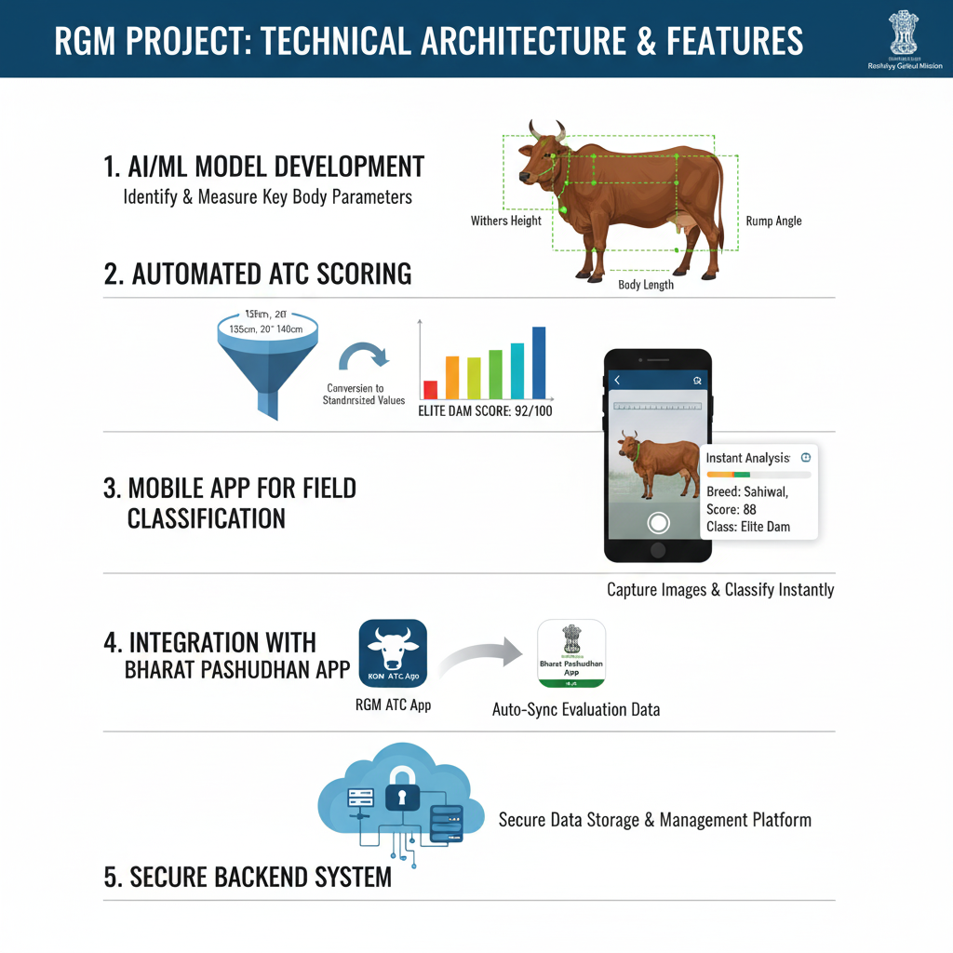
Objectives
Develop an AI/ML model to identify and measure key animal body parameters (withers height, rump angle, body length).
Automate ATC scoring by converting measurements into standardized values.
Create a mobile app for instant image capture and classification in the field.

Slide 8
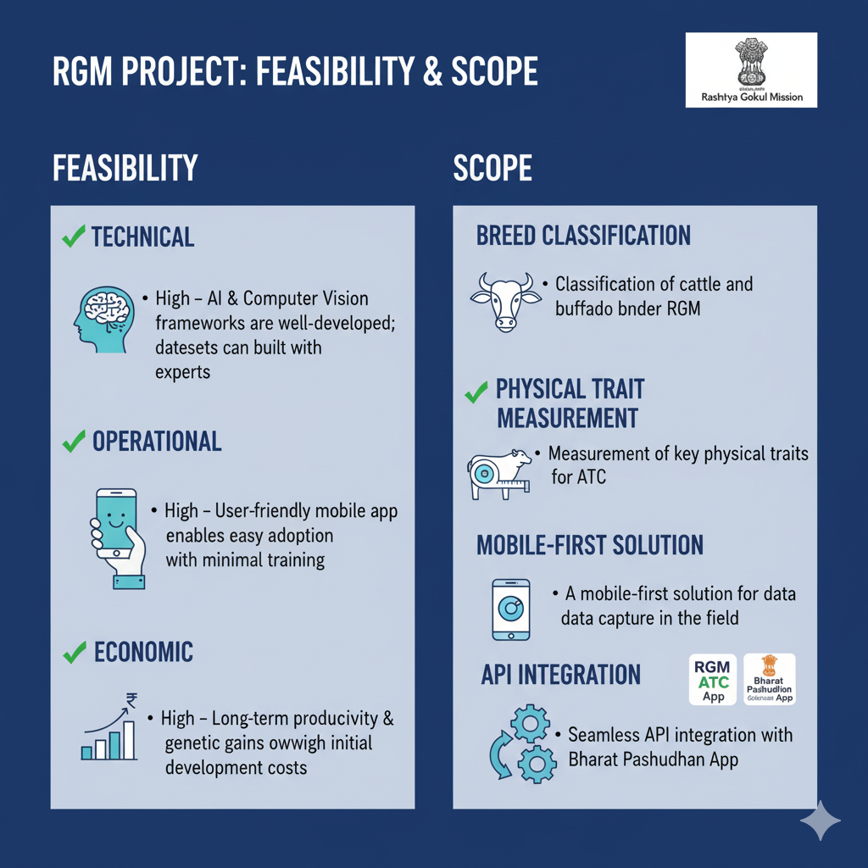
Feasibility and Scope
Feasibility
  AI and computer vision frameworks are well-developed; datasets can be built with experts.
  A user-friendly mobile app enables easy adoption with minimal training.
Scope
  Classification of cattle and buffalo breeds under RGM.
  Seamless API integration with Bharat Pashudhan App (BPA).

Slide 9
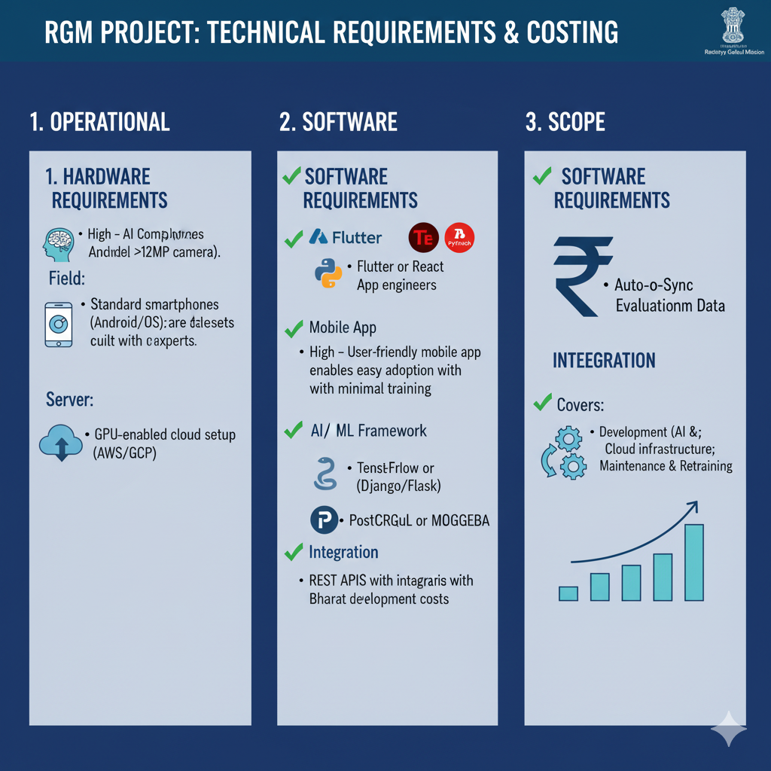
Requirement Analysis
Hardware Requirements:
  Field: Standard smartphones (Android/iOS) with a good quality camera (>12MP).
Software Requirements:
  Mobile App: Built using Flutter or React Native.
  Backend: Python (Django/Flask) for server-side logic.
  AI/ML Framework: TensorFlow or PyTorch for model development.

Slide 10
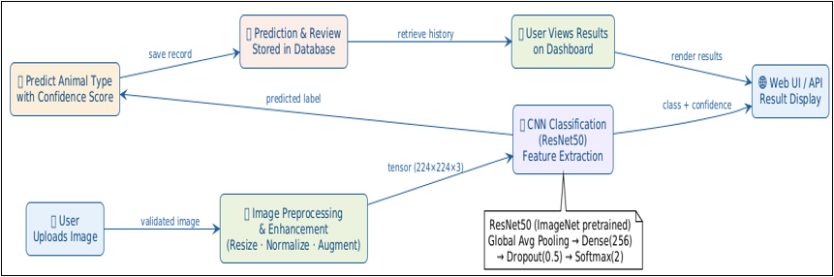
Methodology
Steps:
Image Upload
Preprocessing
ResNet50 Feature Extraction
Animal Classification
Confidence Score
Result Display

Slide 11
Technologies Used
Technology | Purpose
Python | Backend Development
TensorFlow | Deep Learning Framework
Keras | Neural Network API
MobileNetV2 | Pretrained CNN Model
NumPy | Numerical Computation
Matplotlib | Accuracy Visualization
FastAPI | Web Framework
HTML/CSS | Frontend
Jinja2 | Dynamic Templates
ImageDataGenerator | Data Augmentation

Slide 12
Dataset Preprocessing
Image Resizing
All images converted to:
224 × 224
Why?
MobileNetV2 requires fixed input size.
Image Normalization
img_array = img_array / 255.0
Range:
0-255 → 0-1
Benefits:
Faster convergence
Stable training

Slide 13
Machine Learning Approach
Type of Learning
Supervised Learning
The model is trained on labeled images where each image belongs to a specific breed class.
Example:
Gir → Label 0
Jersey → Label 1
Murrah → Label 2
etc.

Slide 14
Deep Learning Algorithm Used
MobileNetV2
Your project uses:
MobileNetV2(
weights='imagenet',
include_top=False
)
Why MobileNetV2?
Lightweight CNN
Fast prediction
High accuracy
Suitable for real-time applications
Lower computational cost

Slide 15
Main Algorithm
Transfer Learning
The most important algorithm in your project.
Working
Step 1:
Pretrained MobileNetV2 already learned features from ImageNet.
Step 2:
Freeze pretrained layers.
base_model.trainable = False
Step 3:
Add custom classification layers.
GlobalAveragePooling2D()
Dense(256, activation='relu')
Dropout(0.3)
Dense(classes, activation='softmax')
Step 4:
Train only final layers on cattle dataset.

Slide 16
Dataset
Breed/Class | Train Images | Valid Images | Test Images | Total Images
Gir | 300+ | 20+ | 30+ | 350+
Holstein Friesian | 300+ | 20+ | 30+ | 350+
Jaffrabadi | 300+ | 20+ | 30+ | 350+
Murrah | 300+ | 20+ | 30+ | 350+
Sahiwal | 300+ | 20+ | 30+ | 350+
Total | 1800+ | 120+ | 180+ | 2100+

Slide 17
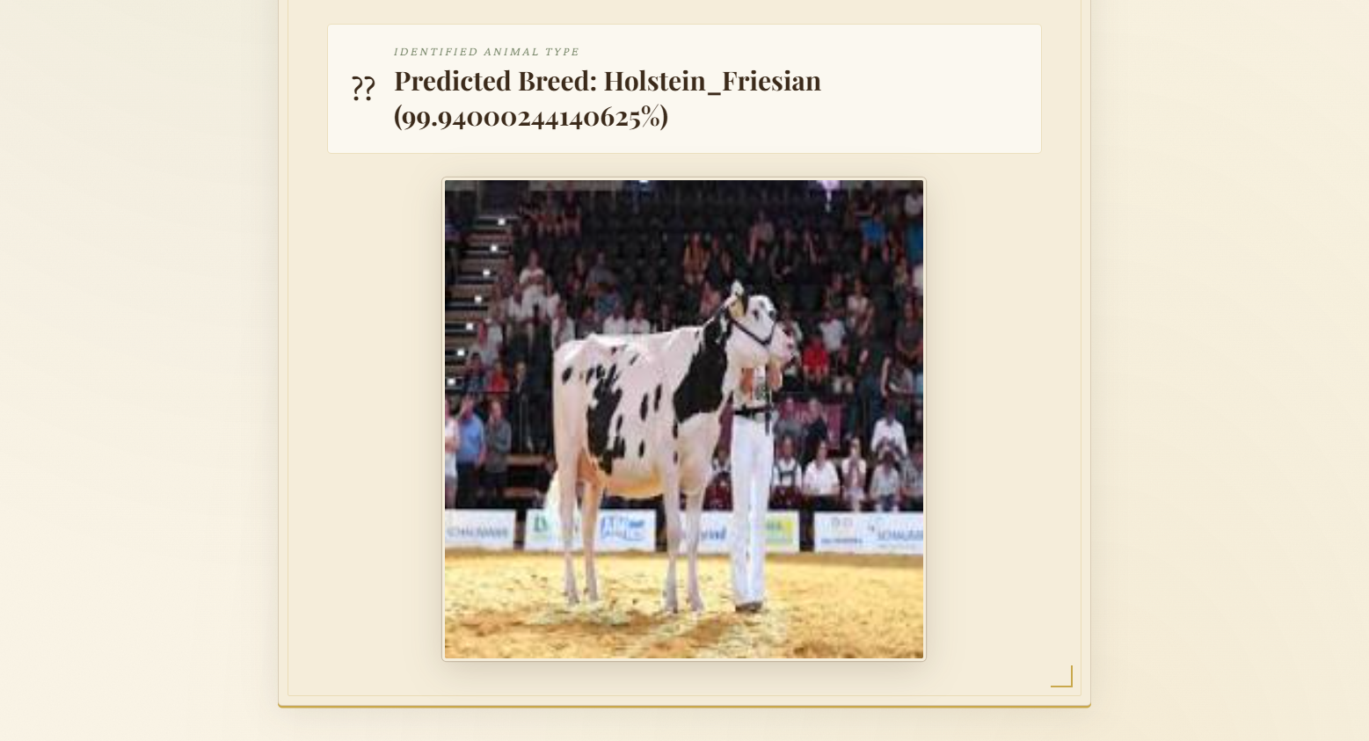
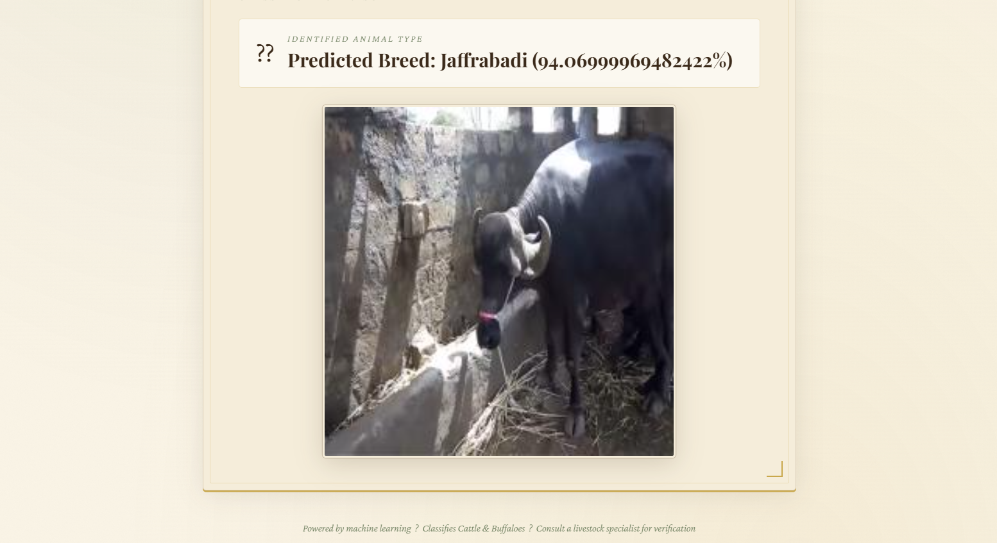
Results

Slide 18
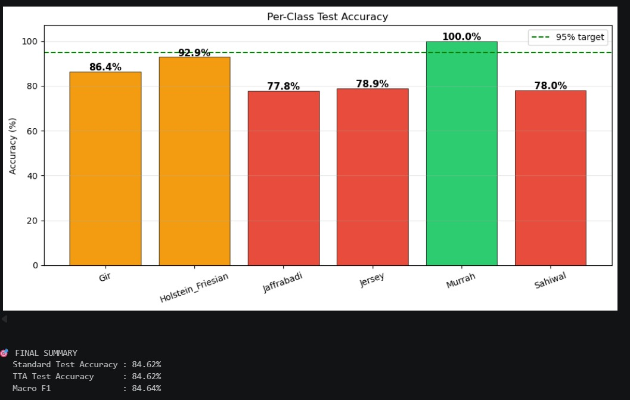
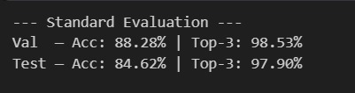
Results

Slide 20
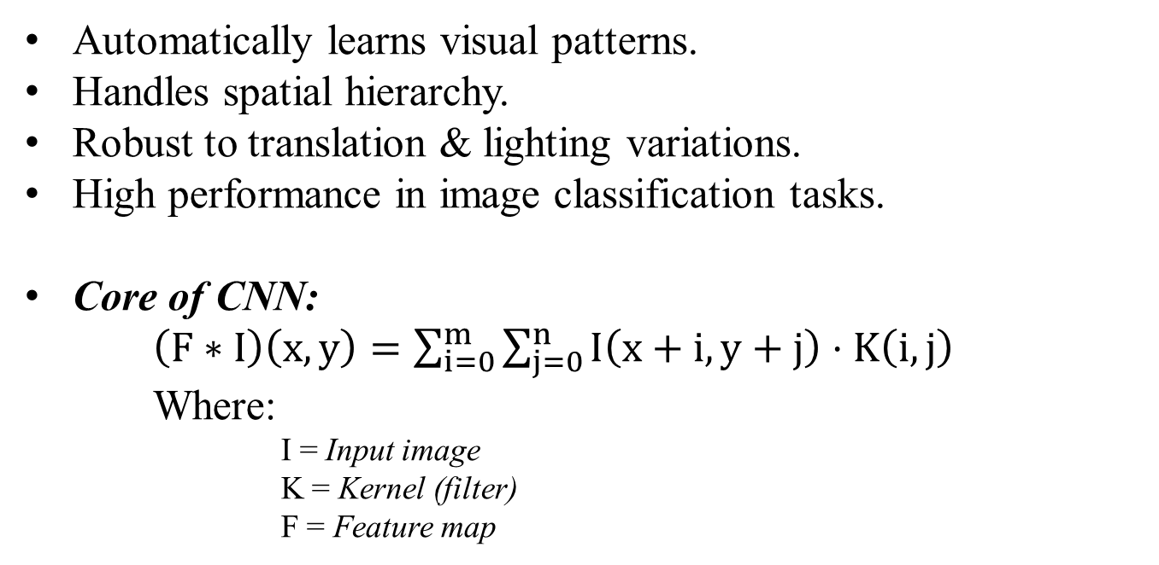
Why CNN is suitable for our problem ?
Automatically learns visual patterns.
Handles spatial hierarchy.
Robust to translation & lighting variations.
High performance in image classification tasks.
Core of CNN:
$\left(F∗I\right)\left(x,y\right)=\sum_{i=0}^{m}{\sum_{j=0}^{n}{I\left(x+i,y+j\right)}}⋅K\left(i,j\right)$
Where:
I = Input image
        K = Kernel (filter)
        F = Feature map

Slide 21
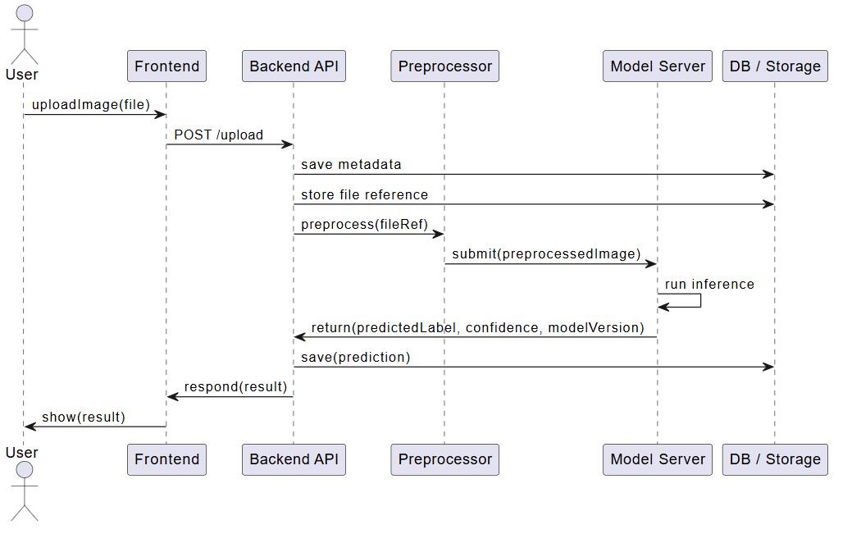
System workflow
Users upload an image, which is preprocessed and enhanced for analysis.
A CNN model analyzes the image and identifies the animal type.
The system predicts the class with a confidence score.

Slide 22
Conclusion
This AI-driven ATC system marks a significant advancement for India’s dairy sector.
By delivering reliable, data-driven evaluations, it supports the Rashtriya Gokul Mission’s goals of improving genetics, increasing milk yield, and enhancing farmer income.
The project stands as a scalable, tech-enabled solution to a vital agricultural challenge.

Slide 23
Communication or acceptance in journal

Slide 24

References
Hossain, M. E., et al. A systematic review of machine learning techniques for cattle identification using Machine Learning (ML) and Deep Learning (DL). 2022.
Mon, S. L., et al. AI-enhanced real-time cattle identification system through camera-based RGB images. 2024.
Li, D., Li, B., Qi, L., Wang, Y., Yang, M., Han, M., et al. “Cattle identification based on multiple feature decision-layer fusion.” Scientific Reports, 2024.
Pan, Y., Jin, H., Gao, J., Rauf, H. T. “Identification of Buffalo Breeds Using Self-Activated-Based Improved Convolutional Neural Networks.” Agriculture, 2022.
Ermetin, O. & Örnek, H. K. “Deep-learning-based buffalo identification through muzzle pattern images.” Archives of Animal Breeding, 2025.
“Improving artificial breeding of cattle and buffalo in Asia.” IAEA Publication TE-1480. Focuses on type classification, breed standards, and genetic improvement.

Slide 25
Thank You!

