Slide 1
Lab: Setup Environment

Slide 2
Agenda
Installation
Verify `travel-sample` bucket is available
Use the web console and cbq lightly to explore

Slide 3
Installation

Slide 4





Install Locally
Run installer or copy the .app over or run the OS package manager to install the package.
Set up the cluster
Install the sample buckets
ensure you have `travel-sample`

Slide 5
Download and Install 4.0 beta candidate build
http://packages.couchbase.com/releases/4.0.0-beta/couchbase-server-enterprise_4.0.0-beta-windows_amd64.exe
http://packages.couchbase.com/releases/4.0.0-beta/couchbase-server-enterprise_4.0.0-beta-macos_x86_64.zip
http://packages.couchbase.com/releases/4.0.0-beta/couchbase-server-enterprise_4.0.0-beta-ubuntu12.04_amd64.deb
http://packages.couchbase.com/releases/4.0.0-beta/couchbase-server-enterprise-4.0.0-beta-centos6.x86_64.rpm

Slide 6
Setup New Single Node Cluster
Include query and indexing services
Install sample buckets
Create new default bucket
Set password
Open the cbq console and run some queries!

Slide 7
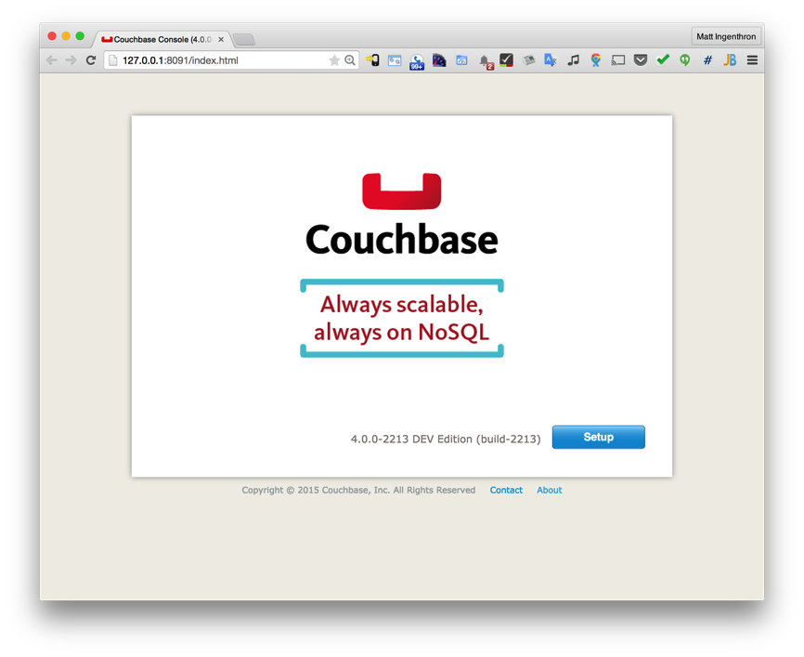
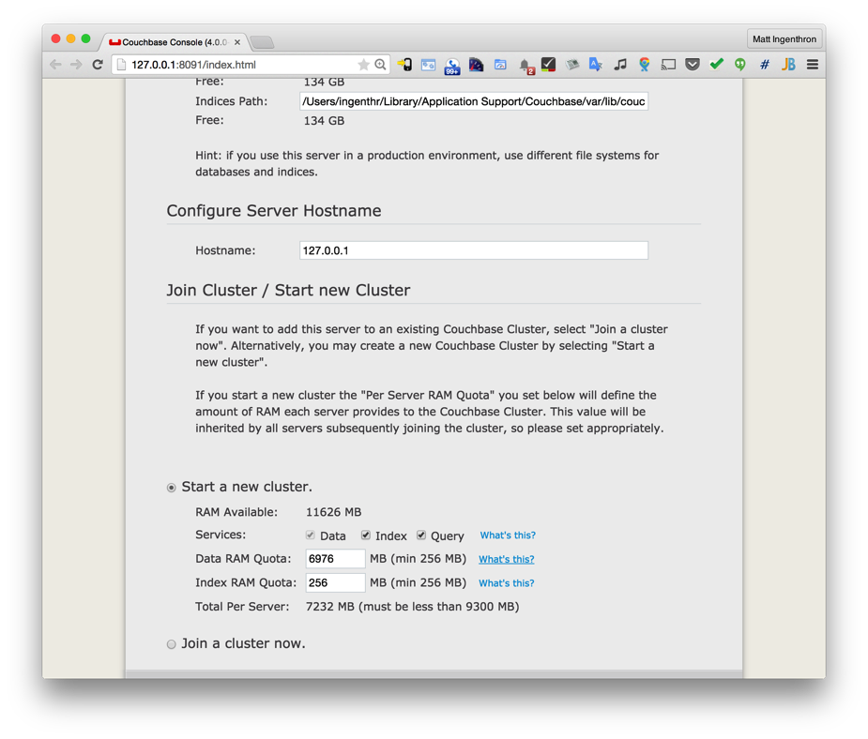
Step 1
Click “Setup”
Important: Check the box next to Index and Query Services.

Slide 8
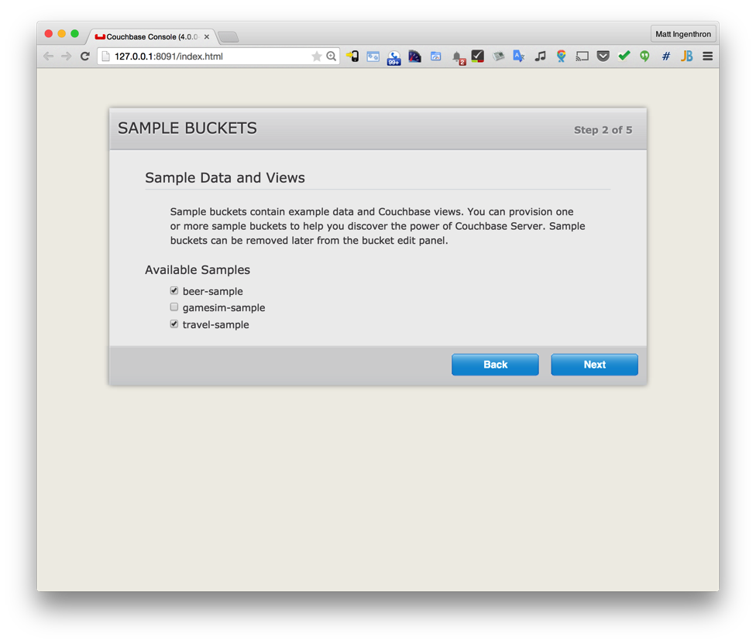
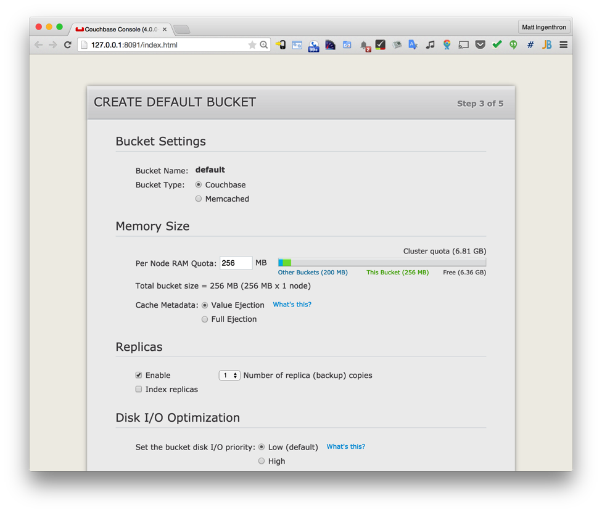
Steps 2 & 3
Check the boxes next to beer-sample and travel-sample.
Create a Couchbase Default Bucket with memory between 256MB and 1024MB.

Slide 9
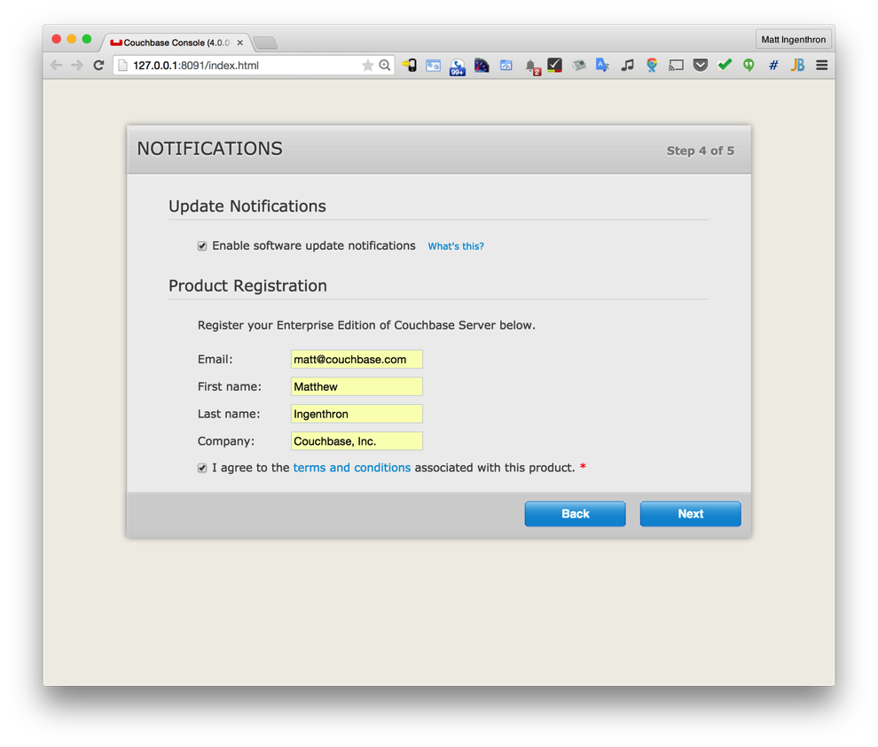
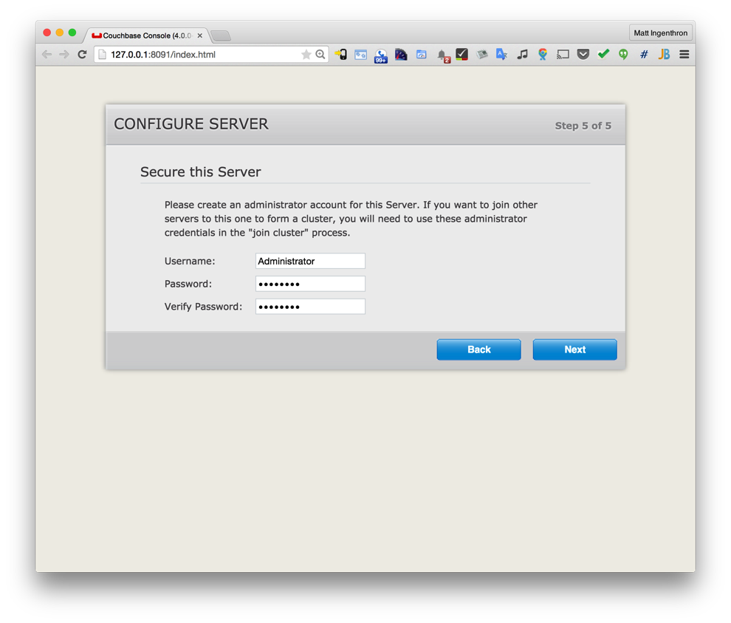
Steps 4 & 5
Register for update notifications and do product registration.
Set a password. Any will do but be sure you remember it.

Slide 10
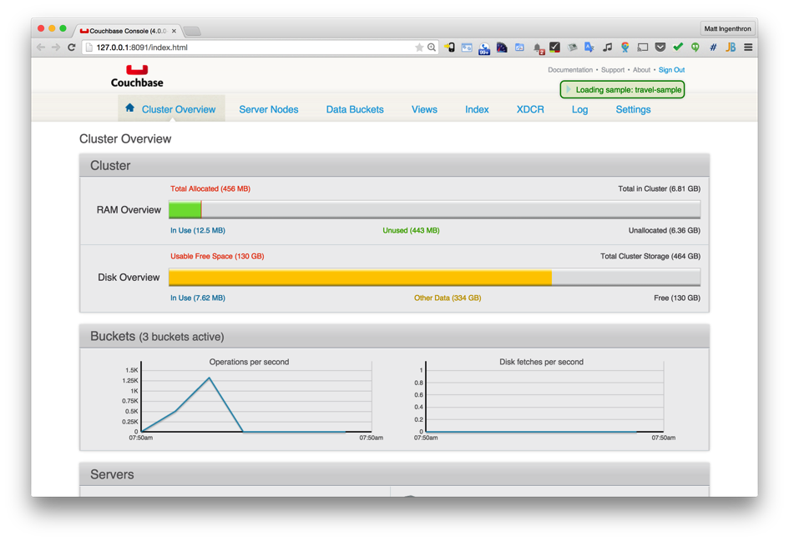
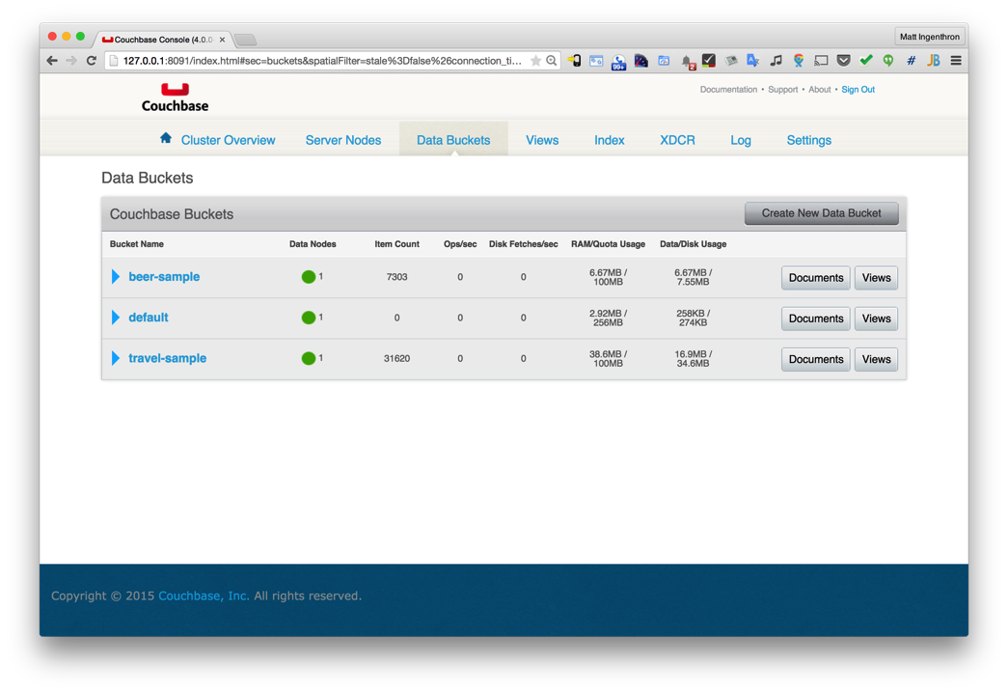
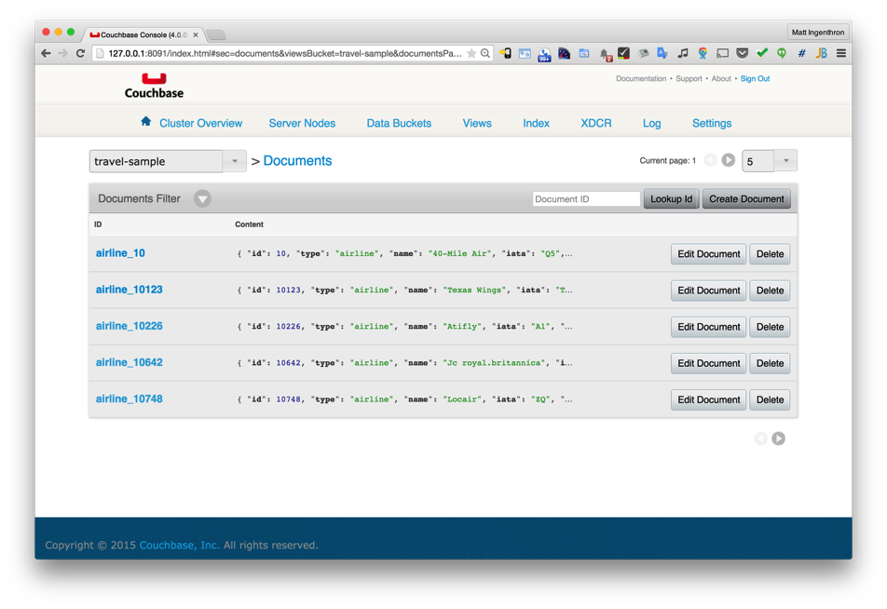
Explore, Verify and Study Documents
Explore the console.
Verify you have the travel-sample bucket.
Study the documents in the travel-sample bucket.

Slide 11
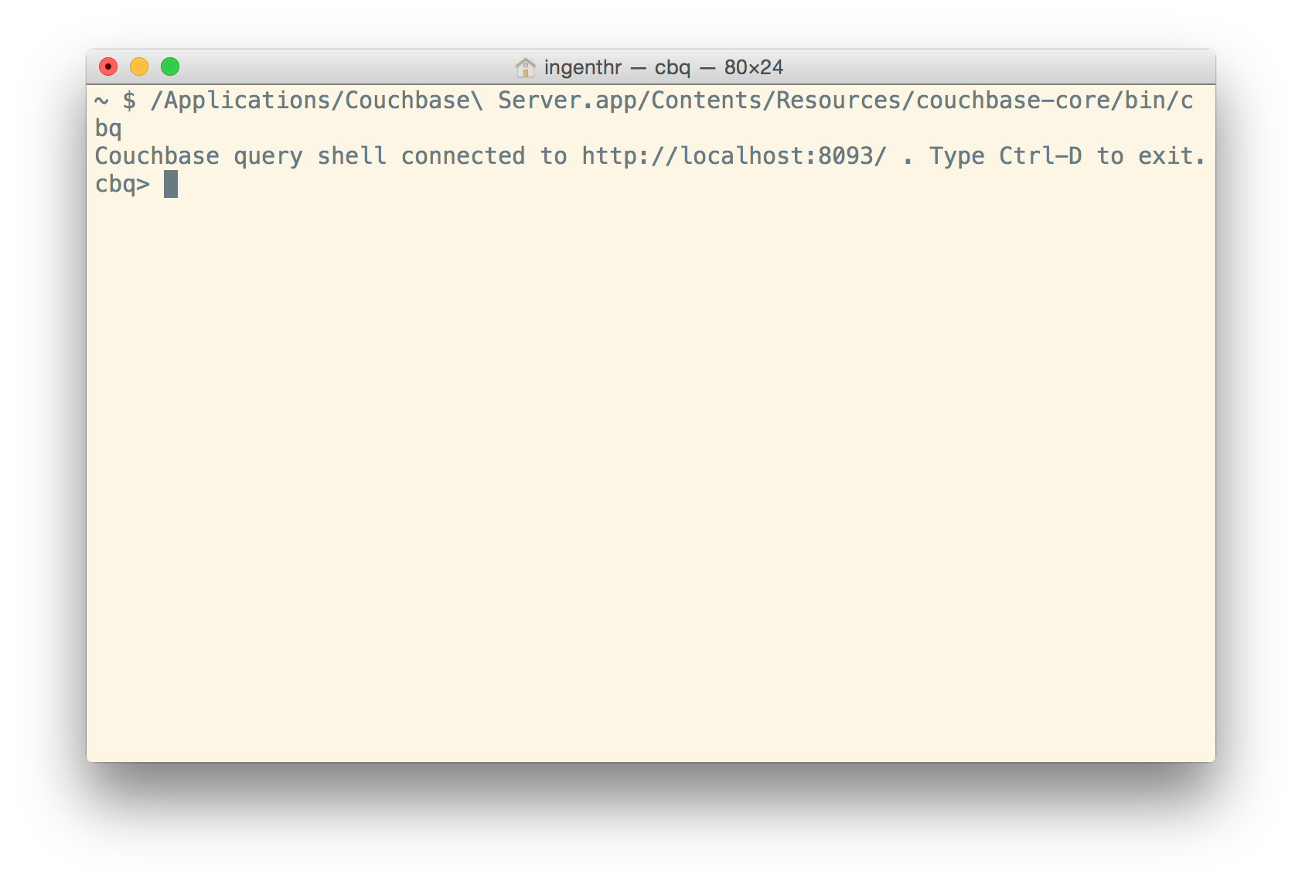
Try the `cbq` command line tool.
Windows:
shell> //TODO
Mac OS X:
shell> /Applications/Couchbase\ Server.app/Contents/Resources/couchbase-core/bin/cbq
Linux:
shell> //TODO
Notes:
TODO: add instructions for Linux and Windows.

Slide 12
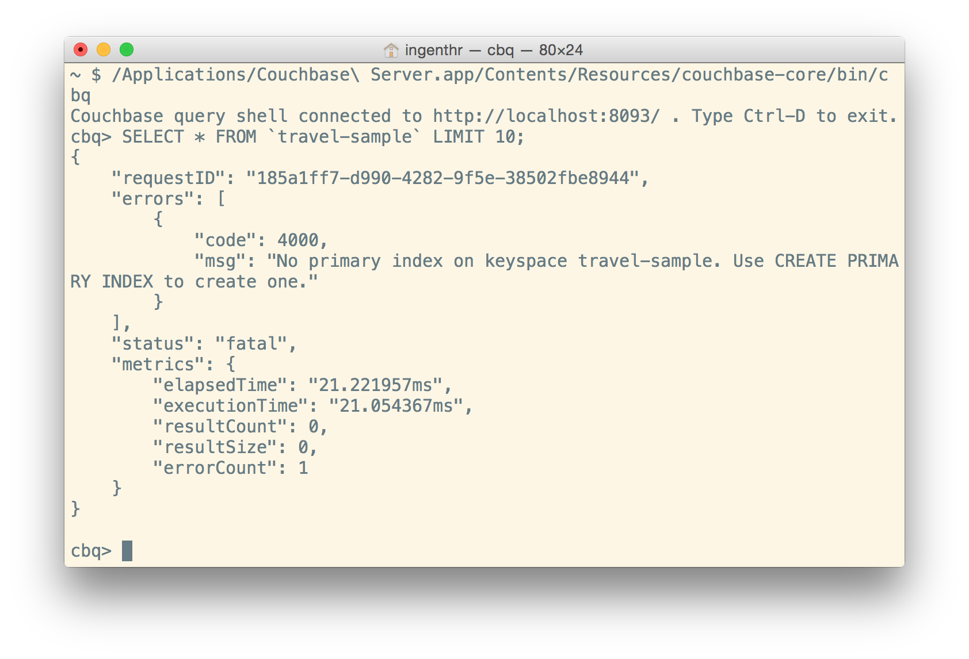
Try a simple select statement
Execute a simple select:
shell> SELECT * FROM `travel-sample` LIMIT 10;
Note the backticks (`) are required around the bucket name to escape it in N1QL’s syntax.
Also, note that the capitals are not required on key words such as SELECT, FROM and LIMIT.

Slide 13
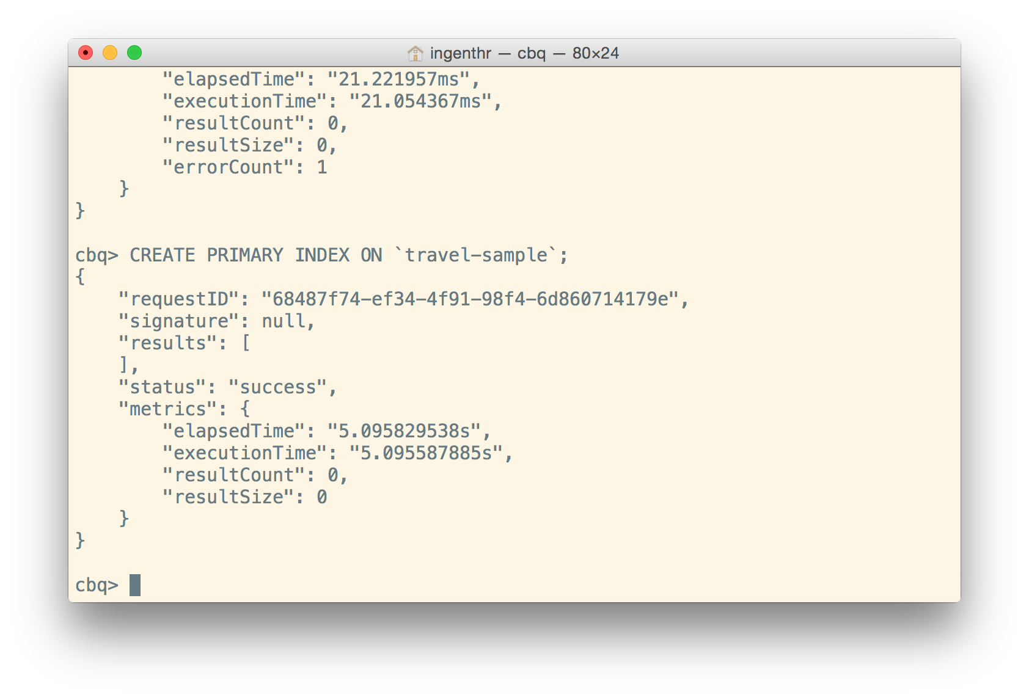
Create an index and try a select again
Execute a simple select:
shell> CREATE PRIMARY INDEX on `travel-sample`;
This will create a global secondary index (a.k.a. “GSI index”) over the primary key for the data in this keyspace (a.k.a. bucket in the current release).
Execute a simple select:
shell> SELECT * FROM `travel-sample` LIMIT 10;

Slide 14
Some Queries to Try
How many airports are in the `travel-sample`?
What are the different distinct document “types” in the `travel-sample?
What are the “names” of places one can eat as an “activity” in the “city” of London?

Slide 15
Some Queries to Try
How many airports are in the `travel-sample`?
SELECT COUNT(airportname) FROM `travel-sample` WHERE type="airport";
What are the different distinct document “types” in the `travel-sample?
select DISTINCT type FROM `travel-sample`;
What are the “names” of places one can eat as an “activity” in the “city” of London?
SELECT name FROM `travel-sample` WHERE activity = "eat" AND city = "London";

Slide 16
Questions?

Slide 17
Thank you.

