Slide 1

Couchbase Mobile Introduction

Slide 2
The Question
So why don’t today’s mobile apps always work?
©2014 Couchbase, Inc.

Slide 3


Today’s Mobile Apps
No Internet
Try again later.
please wait…
©2014 Couchbase, Inc.

Slide 4
How does this affect what people think about your app?
Doesn’t work a lot of the time and when it does it’s slow.
©2014 Couchbase, Inc.

Slide 5
The Problem
Data location is the problem.
©2014 Couchbase, Inc.

Slide 6
Data Location Options & Effects
1
2
3
4
5
Data Location | Network Requirement | Application Availability | Application Responsiveness | Enabling Technology
Remote Only | Always Connected | Sometimes Available | Variable | REST Services (JSON)
Local Only | Never Connected | Always Available | Always Fast | SQLite
Local & Remote | Occasionally Connected | Always Available | Always Fast | Sync
©2014 Couchbase, Inc.

Slide 7
Data Location Options & Effects
1
2
3
4
5
Data Location | Network Requirement | Application Availability | Application Responsiveness | Enabling Technology
Remote Only | Always Connected | Sometimes Available | Variable | REST Services (JSON)
Local Only | Never Connected | Always Available | Always Fast | SQLite
Local & Remote | Occasionally Connected | Always Available | Always Fast | Sync
©2014 Couchbase, Inc.

Slide 8
The Solution: Local Data + Sync
©2014 Couchbase, Inc.

Slide 9
Couchbase Mobile

Slide 10

Couchbase Mobile
Couchbase Lite
On-device, lightweight, native embedded JSON database
Sync Gateway
Synchronize on-device Couchbase Lite with Couchbase Server in the cloud
Couchbase Server
High performance, scalable, always-on JSON database in the cloud

Slide 11









Couchbase Lite
Full Featured
JSON
Native
Lightweight
Secure
Beta
Couchbase Lite

Slide 12
Sync Gateway
Replication
Access Control
Filtering
Validation
Sync Gateway

Slide 13
Channels
Nature
Admin
Sports
San Francisco

Slide 14
Replication
Pure
Peer-to-Peer
Peer-to-Peer
Scale Out

Slide 15
Access Control, Filtering, and Validation
Pluggable Authentication
Javascript sync function runs on all mutations.
Access/Filtering
channel(…): Routes the document to the named channel
access(…): Grants access to a channel to a specified user, list of users, or a role
role(…): Grants a user a role
Validation
throw(…): Prevents a document mutation from persisting
requireUser/Role/Access(…): Validates the user, their role assignments, or their access privileges.

Slide 16
Sync Function
function (doc, oldDoc) {
if (doc.published) {
channel ("public");
}
access (”joe", ”public");
role (”joe", "role:admin");
throw ({forbidden : "read only!"})
requireUser(doc.owner);
requireRole("admin");
requireAccess(”public");
}
Notes:
Capabilities:
Enforce document validity (schema)
Enforce specific user ID or role membership
Tag document with channels
Grant users access to channels

Slide 17
Couchbase Server
JSON
Highly Scalable
High Performance
Always On
Couchbase Server

Slide 18
Customers

Slide 19


Infinite Campus
Education / Social Interaction
Selectively push out learning modules / multimedia lessons to individual students
Teachers and students use custom mobile chat apps for real-time Q&A during lectures
Homework assignments can be completed offline anywhere
“We needed to provide an educational experience as engaging as the apps students love to use everyday. The ability to work online/offline and seamlessly sync across devices and between users was critical to delivering the experience they need for both in the classroom, and off campus. We investigated the market for an ultra-lightweight NoSQL mobile database with easy sync and Couchbase was the only choice.”
Mike Lamb, Principal Software Engineer, Infinite Campus

Slide 20
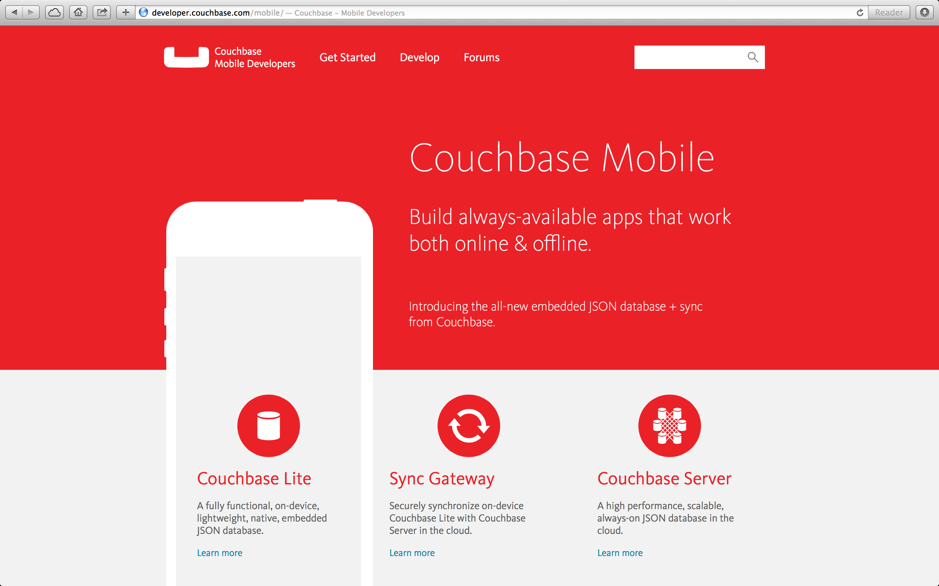

Slide 21
Some Upcoming Couchbase Lite Features
ForestDB storage engine
Enhanced query APIs
Database encryption
Subsetting a remote DB

Slide 22
Thanks!

