Slide 2
Your first Android App with Couchbase Lite
Developer Advocates @ Couchbase

Slide 3
Setting up the Project github.com/couchbaselabs/CouchbaseLite-DevDay-StarterKit

Slide 4
Clone
$ git clone https://github.com/couchbaselabs/CouchbaseLite-DevDay-StarterKit.git

Slide 5
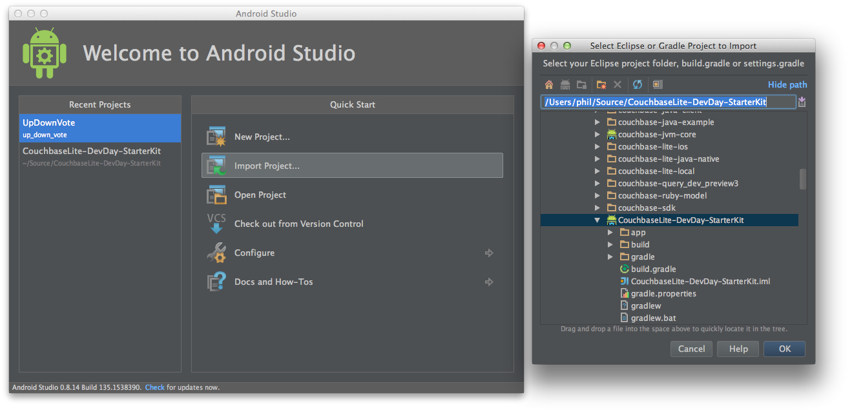
Setup Android Studio

Slide 6
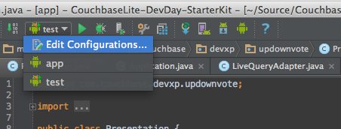
Run Configurations

Slide 7
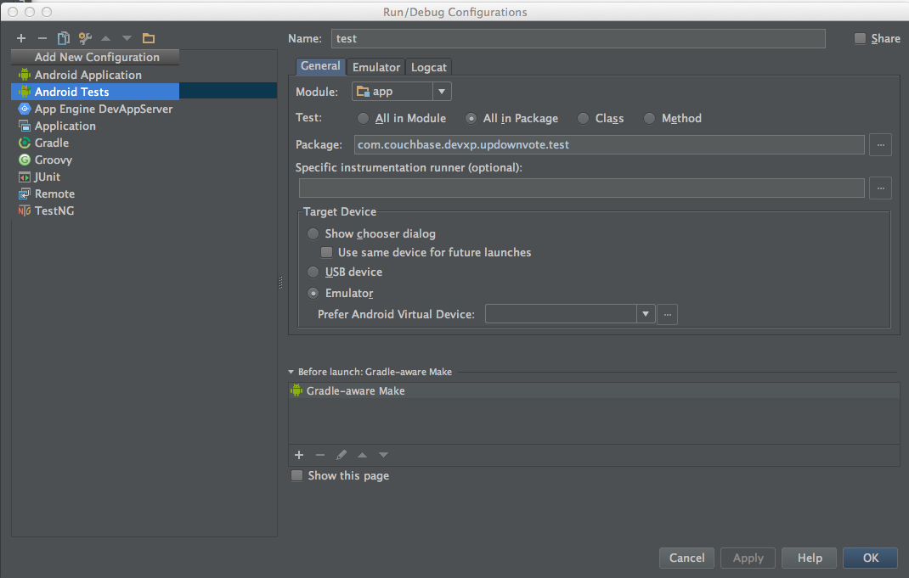
Run Configurations

Slide 8
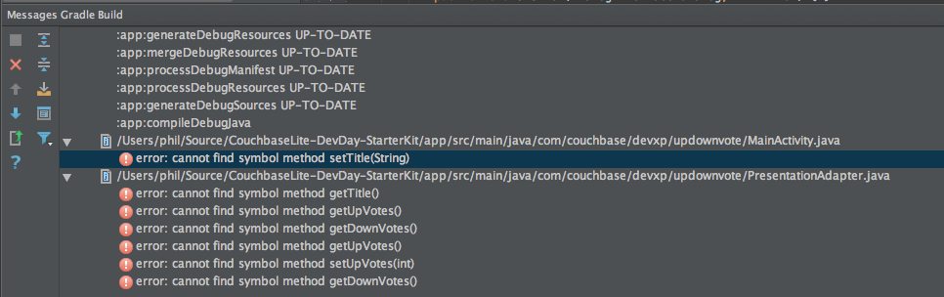
Run! and see it Fail…

Slide 9
Ready for Development
Imported the Project
Added a configuration to run the tests as well as the app
Ready to fix what is needed

Slide 10
Implementing the App

Slide 11
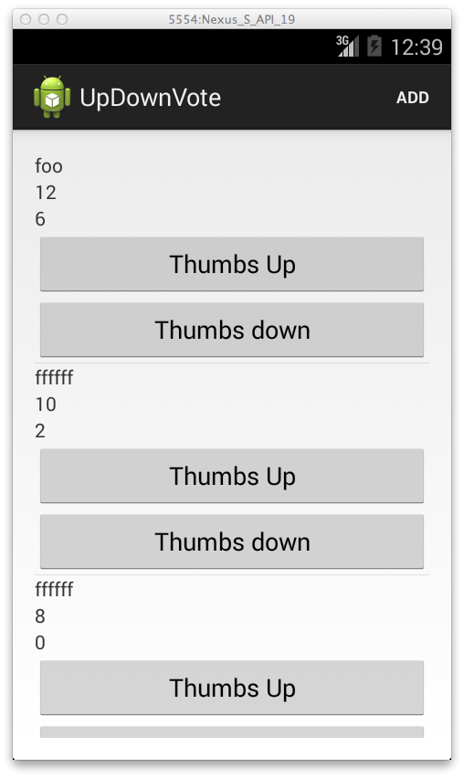
The end result … not pretty but it’s mine!

Slide 12
What should it do?
Display a list of Presentations
Create new Presentations
Vote Presentations up and down
Share the list with others (Sync)

Slide 13
Connect to the Database

Slide 14
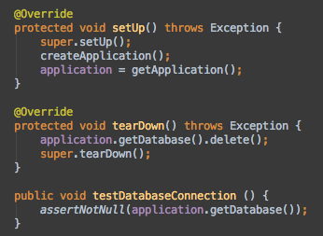
Testing the Database
Notes:
ApplicationTest class
Creates and Application instance
Tries to get the Database
Resets the Database when done

Slide 15
Getting a Database
Create a Database Manager
Open a Database by name
Store a handle to be used everywhere

Slide 16
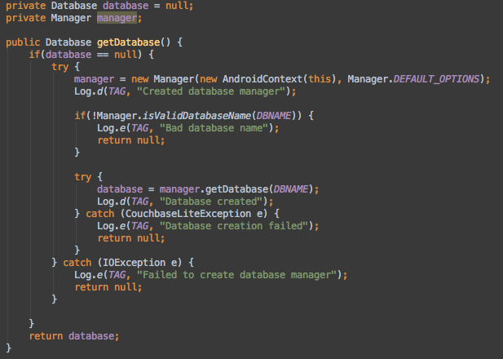

Slide 17
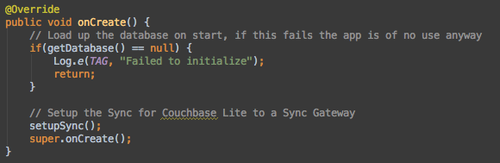
Establish a Connection when the App loads
Notes:
- Call in the Application onCreate Method

Slide 18
The Presentation

Slide 19
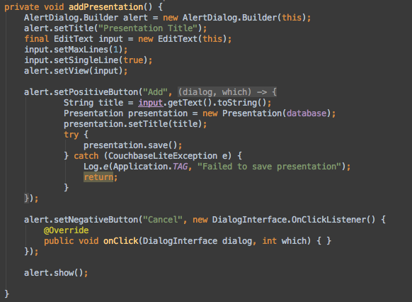
The Interface
Notes:
Handles the Add button in the interface to create a new Presentation with a given title
Your code needs to be able to create the Presentation an save it

Slide 20
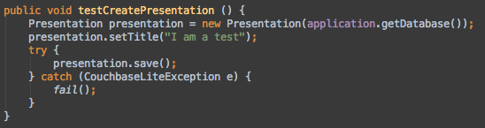
The Test

Slide 21
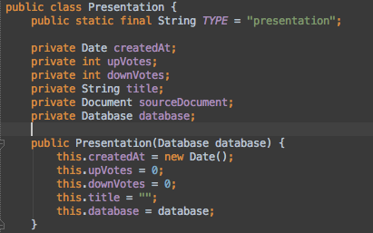
Simple POJO

Slide 22
Couchbase Lite Documents
Hold JSON like Data
Composed of Key Value Pairs where Key is a String and Value can be whatever
Can be indexed
Are created with “random” keys
Hold additional meta Data
Revision
Key
…

Slide 23
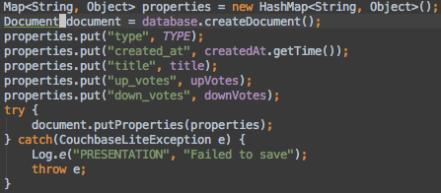
Storing a HashMap

Slide 24
Querys

Slide 25
Indexes
Couchbase Lite Documents can be contained in a View
A View is defined by Map and Reduce functions
View functions are just pieces of Java

Slide 26
The Test

Slide 27
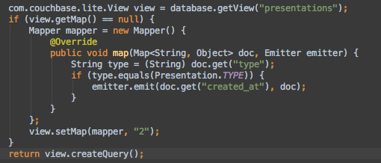
A list of all

Slide 28
Detour Live Queries
Are auto-updating whenever the Data changes
Can feed lists via an Adapter class
Link the Model to the View Layer

Slide 29
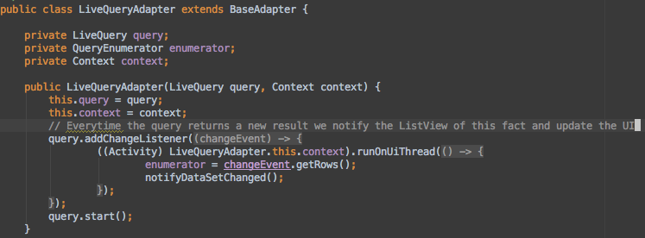
Live Query Adapter
Notes:
The idea is to mimic the behavior of an ArrayAdapter so we can directly feed a ListView
Use Notifications to trigger view updates
For more details see the full code

Slide 30
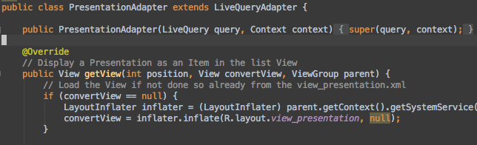
Render a Live Updating View
Notes:
Use the Live Query Adapter to feed a ListView with views for the presentations
This allows for complete auto updating lists managed by Android and CBL without more interactions
See complete code for details

Slide 31
Updating a Presentation

Slide 32
What we need
Access to the original Document
We need to know which revision we base on
We need to know all the properties
Copy all the properties to a new Document
Create a new Revision

Slide 33
Why Revisons
Couchbase Lite has to deal with Conflicts all the time
Users update documents before sync
Users go offline …
Conflict Resolution is build on Revision Trees
Not to dissimilar from Git and alike
Allows Couchbase Lite to determine what to display, what is the “latest”

Slide 34
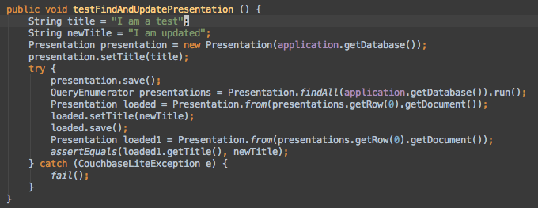
The Test
Notes:
Store a Presentation
Load it
Update it
Save it
See if it worked…

Slide 35
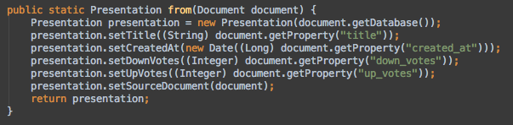
Deserializing

Slide 36
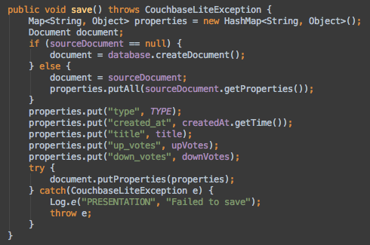
Updating
Notes:
Important to copy over everything to make sure we have the base revision

Slide 37
Setting up Sync

Slide 38
Couchbase Lite Sync
Backed by Sync Gateway
Sync over HTTP
Just need to create Push and Pull Replications
Monitoring is handled via an Observer

Slide 39
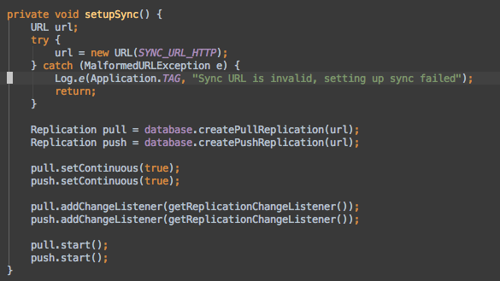
Setting up a Replication

Slide 40
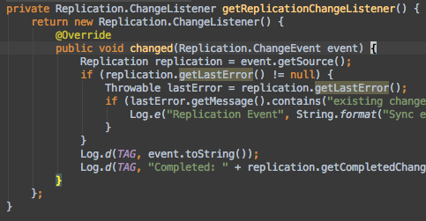
Monitoring

Slide 41
Wrapping Up

Slide 42
What have we seen
Wrapping Couchbase Documents in POJOs
Syncing the Database with a Remote
Using Couchbase Lite Locally

Slide 43
Next
More about Sync Gateway
More about Day to Day Development
More about Conflicts

