Slide 1
Workshop 1 – Setting up Couchbase

Slide 2
Agenda
Installation locally
Installation on cloud (Amazon / Azure)
Installation with Docker

Slide 3
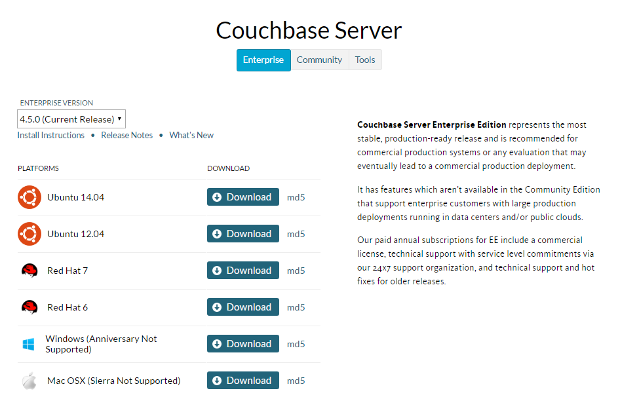
Install Locally: Windows/Mac/Ubuntu
http://couchbase.com/nosql-databases/downloads
USB thumb drives are available
Notes:
Doesn’t work on Ubuntu 16
Doesn’t work on Windows 10 AU
Doesn’t work on Mac OS X “Sierra”
If you don’t have those, you can use a cloud instance, or docker, or a VM

Slide 4
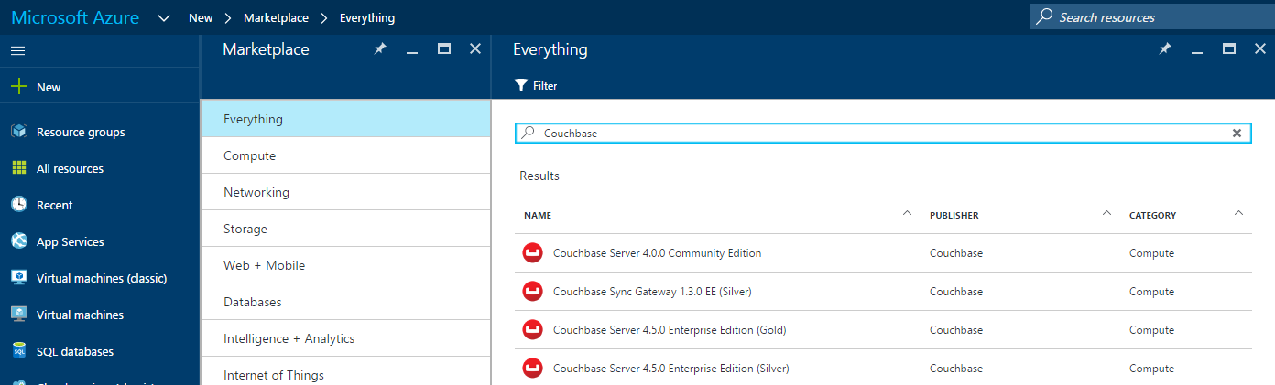
Install on Cloud: Azure
https://azure.microsoft.com/en-us/marketplace/partners/couchbase/
https://portal.azure.com

Slide 5
Install on Cloud: Amazon
https://aws.amazon.com/marketplace

Slide 6
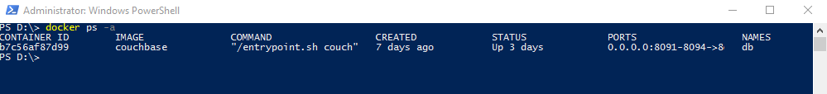
Install with Docker
https://hub.docker.com/_/couchbase/
enterprise-4.5.0
docker run -d −−name db -p 8091-8094:8091-8094 -p 11207:11207 -p 11210-11211:11210-11211 -p 18091-18093: 18091-18093 couchbase

Slide 7
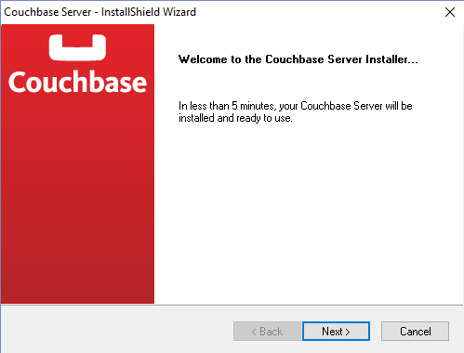
Install

Slide 8
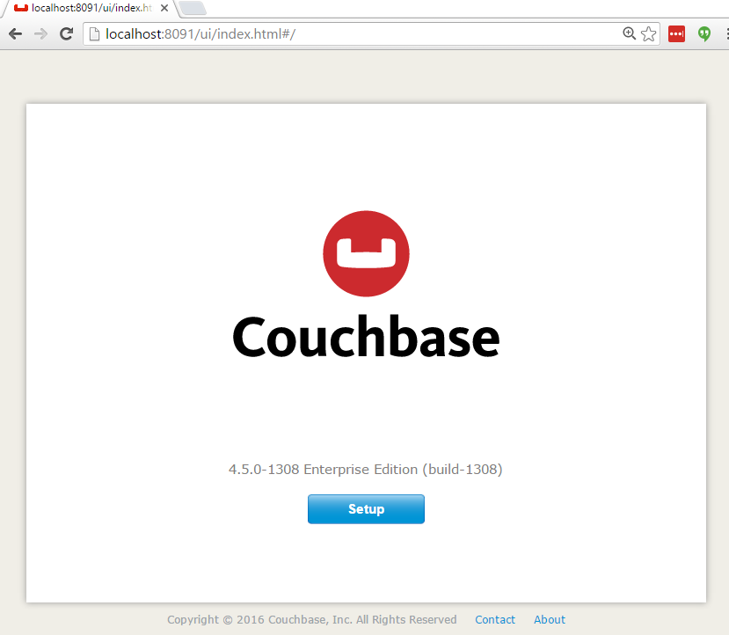
Configuration
http://localhost:8091

Slide 9
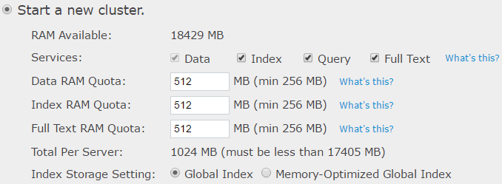
Configuration

Slide 10
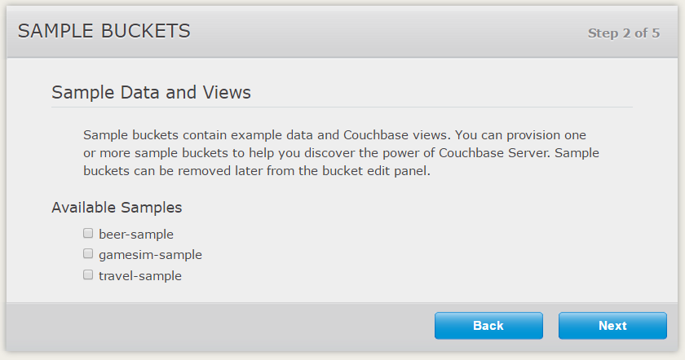
Configuration

Slide 11
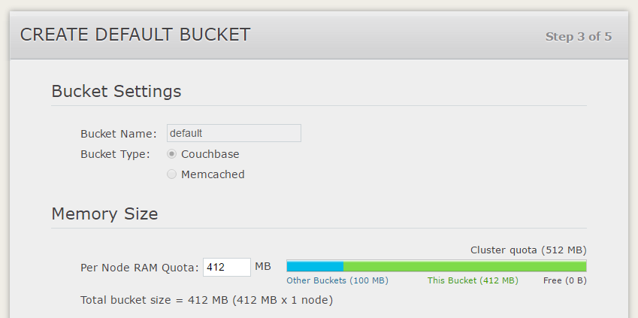
Configuration

Slide 12
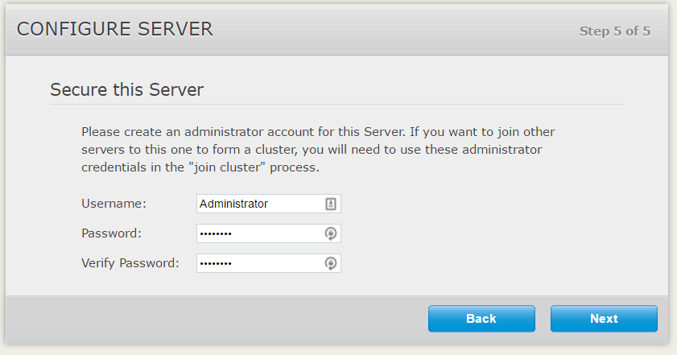
Configuration

Slide 13
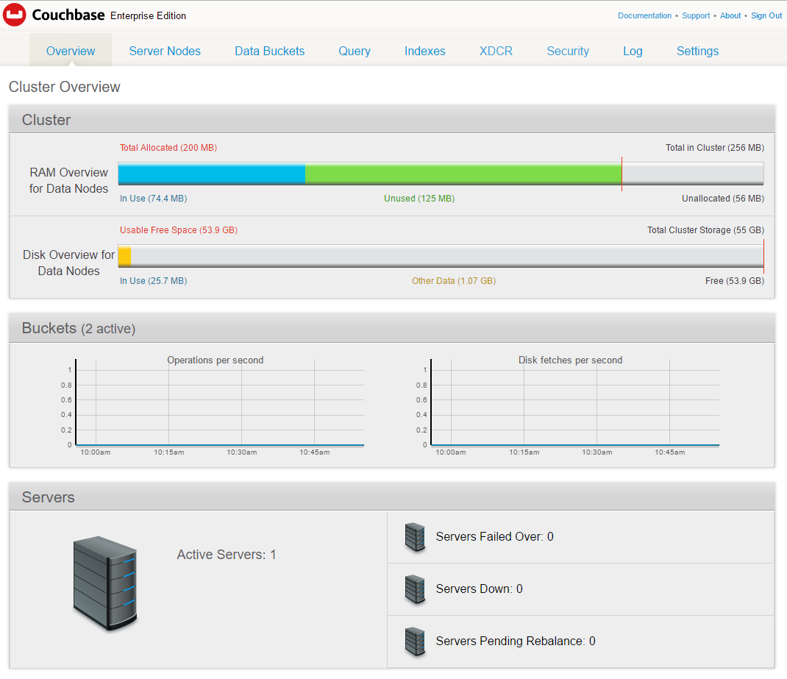
Configuration

Slide 14
Questions

