Slide 1

Couchbase Mobile Introduction

Slide 2
Why Mobile?

Slide 3
Why?
Mobile devices are everywhere
©2014 Couchbase, Inc.

Slide 4
Why?
Unique position as the most complete NoSQL offering on the market
©2014 Couchbase, Inc.

Slide 5
Developing for Mobile

Slide 6
The state Of Mobile Development
Many different devices, platforms, tools, frameworks to choose from
Nothing stands out, yet
Same for IoT/Wearable
©2014 Couchbase, Inc.

Slide 7
The state Of Mobile Development
A lot of choices to make
A lot of choices to test
Things tend to get complicated
Things tend to take a lot of time
©2014 Couchbase, Inc.

Slide 8
The state Of Mobile Development
All this time spent on something else than your business
©2014 Couchbase, Inc.

Slide 9
Building a Syncing Mobile App
What about storage?
What about users and security?
What about syncing with the server?
©2014 Couchbase, Inc.

Slide 10
Building a Syncing Mobile App
All this time spent on something else than your business
©2014 Couchbase, Inc.

Slide 11
Help Developers
The need for identified, tested, proven solutions
©2014 Couchbase, Inc.

Slide 12
Where do we help?

Slide 13
The Question
So why don’t today’s mobile apps always work?
©2014 Couchbase, Inc.

Slide 14


Today’s Mobile Apps
No Internet
Try again later.
please wait…
©2014 Couchbase, Inc.

Slide 15
How does this affect what people think about your app?
Doesn’t work a lot of the time and when it does it’s slow.
©2014 Couchbase, Inc.

Slide 16
The Problem
Data location is the problem.
©2014 Couchbase, Inc.

Slide 17
Data Location Options & Effects
1
2
3
4
5
Data Location | Network Requirement | Application Availability | Application Responsiveness | Enabling Technology
Remote Only | Always Connected | Sometimes Available | Variable | REST Services (JSON)
Local Only | Never Connected | Always Available | Always Fast | SQLite
Local & Remote | Occasionally Connected | Always Available | Always Fast | Sync
©2014 Couchbase, Inc.

Slide 18
Data Location Options & Effects
1
2
3
4
5
Data Location | Network Requirement | Application Availability | Application Responsiveness | Enabling Technology
Remote Only | Always Connected | Sometimes Available | Variable | REST Services (JSON)
Local Only | Never Connected | Always Available | Always Fast | SQLite
Local & Remote | Occasionally Connected | Always Available | Always Fast | Sync
©2014 Couchbase, Inc.

Slide 19
The Solution: Local Data + Sync
©2014 Couchbase, Inc.

Slide 20
Couchbase Mobile

Slide 21

Couchbase Mobile
Couchbase Lite
On-device, lightweight, native embedded JSON database
Sync Gateway
Synchronize on-device Couchbase Lite with Couchbase Server in the cloud
Couchbase Server
High performance, scalable, always-on JSON database in the cloud

Slide 22





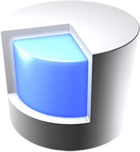



Couchbase Lite
Full Featured
JSON
Native
Lightweight
Secure
Offline
Native
Cross-Platform
Couchbase Lite

Slide 23
Sync Gateway
Replication
Access Control
Filtering
Validation
Sync Gateway

Slide 24
Channels
Nature
Admin
Sports
San Francisco

Slide 25
Replication
Pure
Peer-to-Peer
Peer-to-Peer
Scale Out

Slide 26
Access Control, Filtering, and Validation
Pluggable Authentication
Javascript sync function runs on all mutations.
Access/Filtering
channel(…): Routes the document to the named channel
access(…): Grants access to a channel to a specified user, list of users, or a role
role(…): Grants a user a role
Validation
throw(…): Prevents a document mutation from persisting
requireUser/Role/Access(…): Validates the user, their role assignments, or their access privileges.

Slide 27
Sync Function
function (doc, oldDoc) {
if (doc.published) {
channel ("public");
}
access (”joe", ”public");
role (”joe", "role:admin");
throw ({forbidden : "read only!"})
requireUser(doc.owner);
requireRole("admin");
requireAccess(”public");
}
Notes:
Capabilities:
Enforce document validity (schema)
Enforce specific user ID or role membership
Tag document with channels
Grant users access to channels

Slide 28
Couchbase Server
JSON
Highly Scalable
High Performance
Always On
Couchbase Server

Slide 29
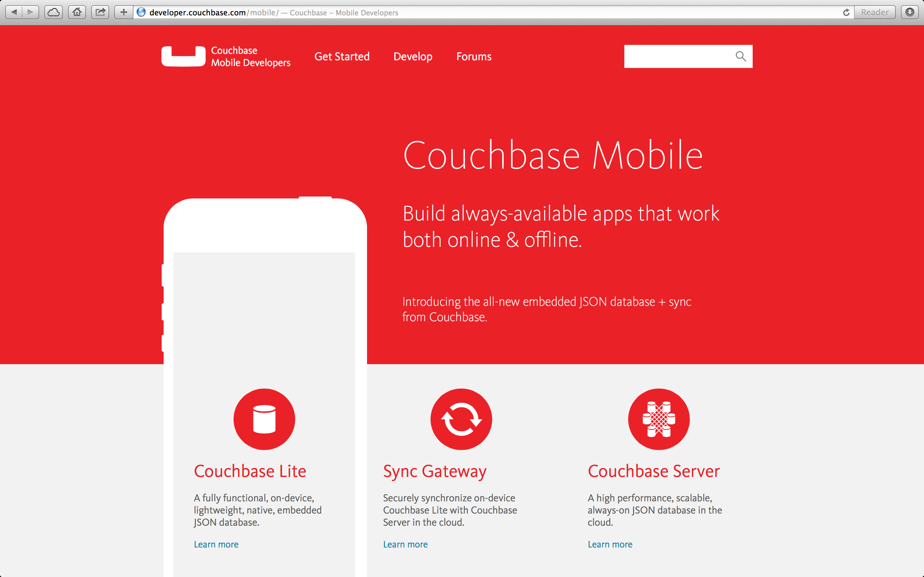

Slide 30
Thanks!

