Slide 1
Lab: N1QL Basics
Subtitle

Slide 2
Agenda
Simple Queries
Array Comprehensions
Joins/Unnest

Slide 3
Simple Queries

Slide 4
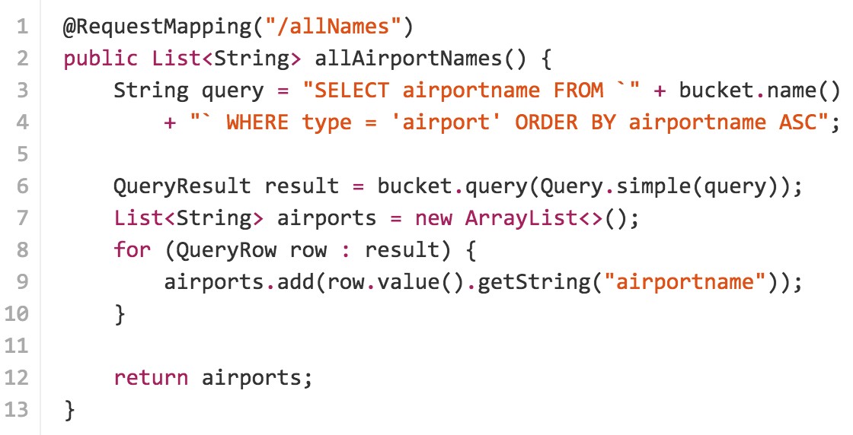
Raw Query String
Raw Query and Blocking Iteration

Slide 5
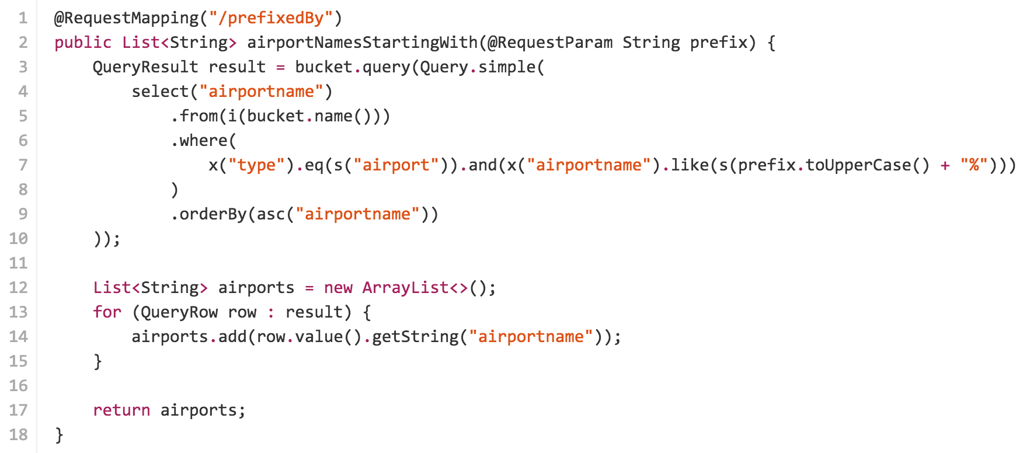
Java Builder API
Safer API through method chaining

Slide 6
Array Comprehensions

Slide 7
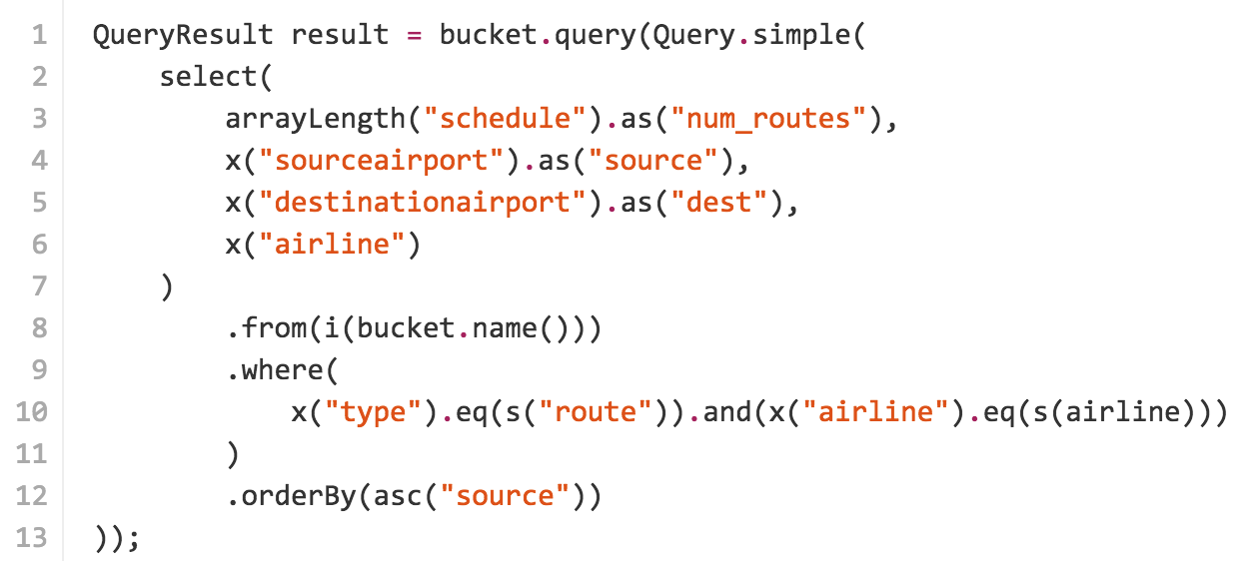
Array Comprehension

Slide 8
Join & Unnest

Slide 9
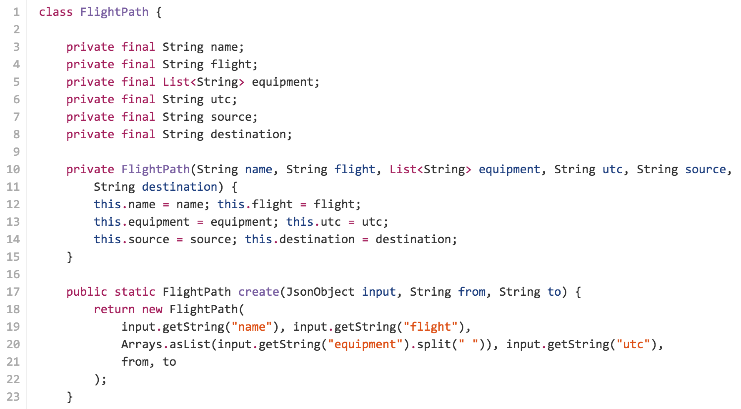
Join & Unnest

Slide 10
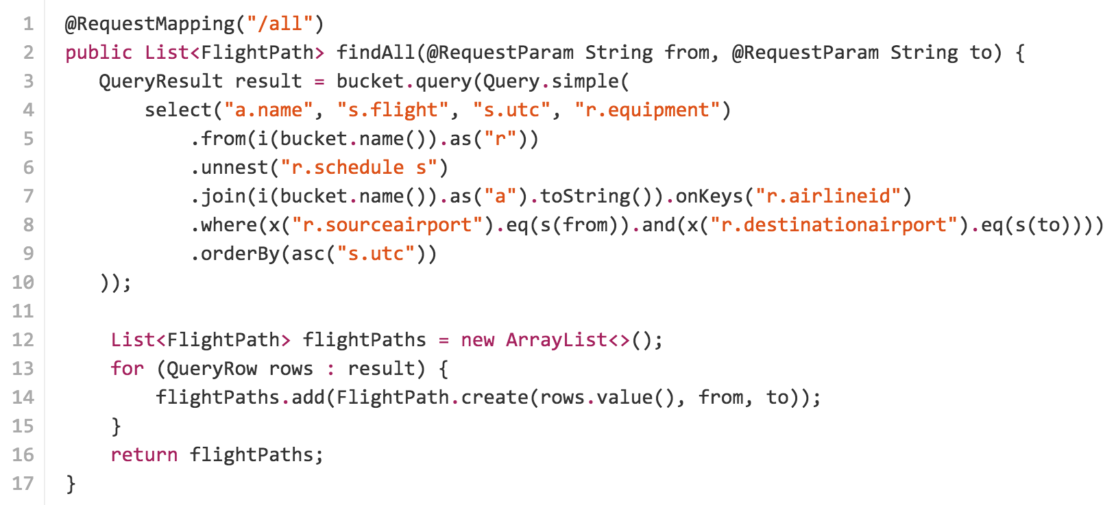
Join & Unnest

Slide 11
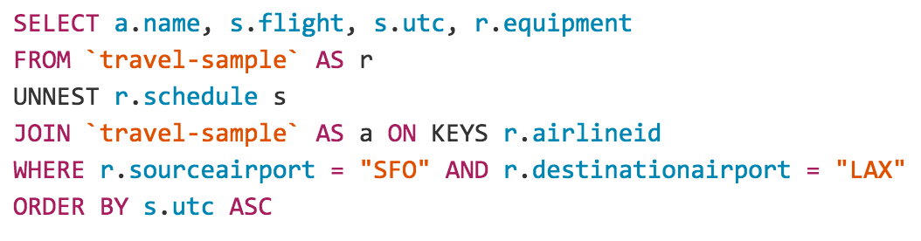
Join & Unnest

Slide 12
Questions?

Slide 13
Thank you.

