Slide 2
Data Modeling with Couchbase

Slide 3









Our Real Developer Brain

Slide 4


Mmm, data.
big
data
The Post-Postmodern Mind
21st century - Now.

Slide 5
RDBMS VS COUCHBASE

Slide 6
RDBMS Organization
RDBMS organizes data as tables
Tables represent data in rows; n columns of m rows
Table rows have a specific schema, each column as a static type
Simple Datatypes: strings, numbers, datetimes, booleans, can be represented by columns in a single table
Complex Datatypes: dictionaries/hashes, arrays/lists cannot be represented in a single table [Impedence Mismatch]
All rows have identical schema, schema changes require taking database offline, migrations, royal pains
Reading/Writing/Transactions require mutex and locking

Slide 7
Couchbase Organization
Couchbase operates like a Key-Value Document Store
Simple Datatypes: strings, numbers, datetime, boolean, and binary data can be stored; they are stored as Base64 encoded strings
Complex Datatypes: dictionaries/hashes, arrays/lists, can be stored in JSON format (simple lists can be string based with delimiter)
JSON is a special class of string with a specific format for encoding simple and complex data structures
Schema is unenforced and implicit, schema changes are programmatic, done online, and can vary from Document to Document

Slide 8
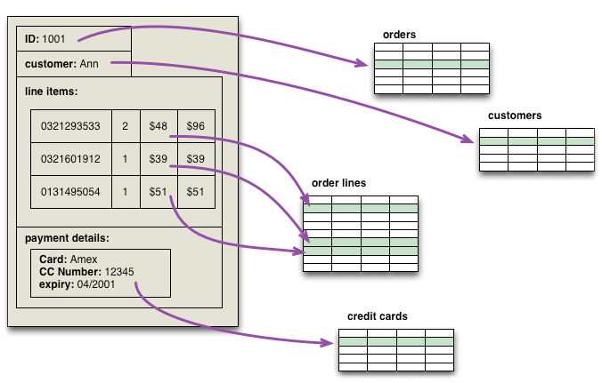
Aggregate View of Data
http://martinfowler.com/bliki/AggregateOrientedDatabase.html

Slide 9
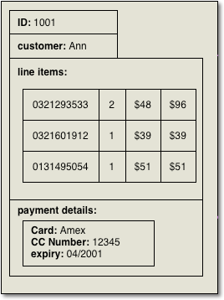
Store and Retrieve Aggregates
order::1001
{
uid: ji22jd,
customer: Ann,
line_items: [
{ sku: 0321293533, quan: 3, unit_price: 48.0 },
{ sku: 0321601912, quan: 1, unit_price: 39.0 },
{ sku: 0131495054, quan: 1, unit_price: 51.0 }
],
payment: { type: Amex, expiry: 04/2001,
last5: 12345 }
}
Easier to Distribute Data
More Flexibility
Reduced Latency

Slide 10
Complex Datatypes
public class User {
private String name;
private String email;
private Integer age;
private Boolean gender_male;
private DateTime created_at;
private ArrayList items_viewed;
private Hashtable preferences;
private ArrayList<Books> authored;
public User(...) {
...
}
...
}
RDBMS
Simple Types are easy, make them columns
Complex Types are more challenging, require separate tables and joins, slower to store and retrieve
ORM's reduce complexity but trade off additional speed/scale, hard to optimize

Slide 11
Complex Datatypes
{
"doctype": "User",
"name": "Jasdeep Jaitla",
"email": "jasdeep@couchbase.com",
"age": 38,
"gender_male": true,
"created_at": "2013-09-20 23:59:59",
"items_viewed": [
"12345", "23456", 34567"
],
"preferences": {
"email_notifications": true,
"sms_notifications": false
},
"authored": [
{ "title": "Couchbase Models",
"price": 49.95 }
]
}
Couchbase
Can represent both simple and complex data types in JSON data structures
Can modify schema on the fly, and Documents of a specific "type" can vary in schema
"Type" is arbitrary, it's a programming strategy, there are no actual "types", but it's typical to embed the class name as a "doctype" json key

Slide 12
Benefits of JSON
Can Represent Complex Objects and Data Structures
Very simple notation, lightweight, compact, readable
The most common API return type for Integrations
Facebook, Twitter, you name it, return JSON
Native to Javascript (can be useful)
Can be inserted straight into Couchbase (faster development)
Serialization and Deserialization are very fast

Slide 13
JSON Document Structure
meta
{
“id”: “u::jasdeep@couchbase.com”,
“rev”: “1-0002bce0000000000”,
“flags”: 0,
“expiration”: 0,
“type”: “json”
}
document
{
“uid”: 123456,
“firstname”: “jasdeep”,
“lastname”: “Jaitla”,
“age”: 22,
“favorite_colors”: [“blue”, “black”],
“email”: “jasdeep@couchbase.com”
}
Meta Information Including Key
All Keys Unique and Kept in RAM
Document Value
Most Recent In Ram And Persisted To Disk

Slide 14


Objects Serialized to JSON and Back
User Object
u::jasdeep@couchbase.com
{
“uid”: 123456,
“firstname”: “jasdeep”,
“lastname”: “Jaitla”,
“age”: 22,
“favorite_colors”: [“blue”, “black”],
“email”: “jasdeep@couchbase.com”
}
string | uid
string | firstname
string | lastname
int | age
array | favorite_colors
string | email
add()
User Object
u::jasdeep@couchbase.com
{
“uid”: 123456,
“firstname”: “jasdeep”,
“lastname”: “Jaitla”,
“age”: 22,
“favorite_colors”: [“blue”, “black”],
“email”: “jasdeep@couchbase.com”
}
get()
string | uid
string | firstname
string | lastname
int | age
array | favorite_colors
string | email

Slide 15
BASIC KEY PATTERNS

Slide 16
Basic Keying
Use a Unique value for key (email, username, sku, isbn, etc.)
Users
u::jasdeep@couchbase.com
u::scalabl3
Products
p::978-0321573513 [isbn]
Predictable Keys can follow Key-Value patterns (Users typically can be done this way and are the most numerous items)
Unpredictable Keys (GUID, UUID, etc.) require Views (Map-Reduce Indexes) to find their documents

Slide 17
Counter-ID
Data Creation
id = incr("counter-key")
add("key" + id, data)
Application
Iterate Through Collection
count = get("counter-key")
multi-get(keys[])
Application

Slide 18
Counter-ID
Similar to IDENTITY column in RDBMS
Creating New Document is a pair of operations, INCR and ADD
Initialize one Key as an Atomic Counter (I do at App Start)
Increment Counter and save new value
id = client.incr("blog::couchbase::comment_count")
Use the id as component of key for new document
client.add(""blog::couchbase::c"::" + id, self.to_json)

Slide 19
Lookup Pattern
Data Creation
add("u::550e8400-e29b-41d4-a716", data)
add("jasdeep@couchbase.com",
"u::550e8400-e29b-41d4-a716")
Application
add("scalabl3",
"u::550e8400-e29b-41d4-a716")
Data Retrieval
key = get("jasdeep@couchbase.com")
get(key)
Application

Slide 20
Lookup Pattern
Create simple document that has referential data (Key) to primary document
Primary Document u::a2bf2-23317-2302
Lookup Document: u::jasdeep@couchbase.com { u::a2bf2-23317-2302 }
Lookup Documents aren't JSON, they should just be the Key as a string so you skip JSON parsing
Requires Two GET operations, first GET Lookup, then GET primary Document
key = client.get("u::jasdeep@couchbase.com")
doc = client.get(key)

Slide 21
User Data Multiple Social Networks & Emails
u::count
1001
u::1001
{ "name": "Jasdeep Jaitla",
"facebook_id": 16172910,
"email": "jj@scalabl3.com",
“password”: ab02d#Jf02K
"created_at": "5/1/2012 2:30am",
“facebook_access_token”: xox0v2dje20,
“twitter_access_token”: 20jffieieaaixixj }
fb::16172910
1001
nflx::2939202
1001
twtr::2920283830
1001
em::jj@jasdeep.com
1001
em::jj@scalabl3.com
1001
uname::scalabl3
1001

Slide 22
Combine Counter-ID and Lookup
Data Creation
id = incr("user::count")
add("u::" + id, data)
add("jasdeep@couchbase.com", id)
Application
add("scalabl3", id)
Data Retrieval
key = get("jasdeep@couchbase.com")
get(key)
Application

Slide 23
Combine Counter-ID and Lookup
Pro's
Binary Operations, overall faster than large volume of View Queries
Essentially creates several ways to find a single document
Is always consistent, just like all other Binary operations
Con's
Increases Number of Documents, therefore Metadata usage in RAM
But this is generally a non-issue for most people

Slide 24
User Data (Sample)
CREATE TABLE Users
id, int, identity(1000) PRIMARY KEY
name, nvarchar(100)
facebook_id, bigint
email, nvarchar(255)
created_at, datetime
u::count
1
u::1001
{ "name": "Jasdeep Jaitla",
"facebook_id": 16172910,
"email": "jj@scalabl3.com",
"created_at": "5/1/2012 2:30am" }
fb::16172910
1001
em::jj@scalabl3.com
1001

Slide 25
RDBMS
Couchbase
INSERT INTO Users
(name, facebook_id, email, created_at)
VALUES ("Jasdeep Jaitla", 16172910, "jj@scalabl3.com", "5/1/2012 2:30am")
Get User By FB
SELECT * FROM Users
WHERE facebook_id = 16172910
Get User by Email
SELECT * FROM Users
WHERE email = “jj@scalabl3.com”
user_data = { "name": "Jasdeep Jaitla", "facebook_id": 16172910,
"email": "jj@scalabl3.com",
"created_at": "5/1/2012 2:30am" }
uid = couch.incr("u::count") + 1000
couch.add ("u::" + uid, user_data)
couch.set ("em::" + user_email, uid)
couch.set ("fb::" + user_fb, uid)
Get User By FB
uid = couch.get("fb::16172910")
user_data = couch.get ("u::" + uid)
Get User By Email
uid = couch.get("em::jj@scalabl3.com")
user_data = couch.get ("u::" + uid)
Each Table Grows and it gets Slower for Each Request

Slide 26
MULTIPLE DOCUMENTS

Slide 27
Aligning Documents to Behaviors
user::1
{
name: “Jasdeep”,
points: 1000,
shopping_carts: [ 1000, 1001, 1002 ],
products_bought: [ 2000, 2001, 2002],
games_won: [ 3000, 3001, 3002, 3004],
notifications: [ “Lorem”, “Ipsum”, “docet”, ...]
}
user::1
{ name: “Jasdeep” }
user::1::points
{ points: 1000 }
user::1::shopping_carts
{ carts: [ 1000, 1001, 1002 ],
products_bought: [ 2000, 2001, 2002] }
user::1::games_won
{ game_ids: [ 3000, 3001, 3002, 3004] }
user::1::notification_count
57
user::1::notifications::57
{ message: “Hi Bob” }
user::1::notifications::56
{ message: “Happy Hour?” }

Slide 28
Behavior Driven Design
Reduce the number of User Actions that affect a single document
Instead, separate that user document in a predictable key structure and make it accessible via getters and setters in your class
Like TDD/BDD encourages smaller, simpler methods, that are easier to write and maintain

Slide 29
MODELING A USER

Slide 30
How Data Looks
Data is Data, regardless of the form it takes in the database!
Data is much more often denormalized, not always, but most of the time
The NoSQL Paradigm Shift is structural, not the data content itself
Objects don’t care how their data is stored, and the application model has it’s own relationships in it’s object model

Slide 31
The User Object
Couchbase
public class User {
private String name;
private String email;
private Integer age;
private Boolean gender_male;
private DateTime created_at;
public User(...) {
...
}
public Save() {
}
public static FindByEmail() {
}
}
RDBMS
u::jasdeep@couchbase.com
{
“doctype”: “User”,
“name”: “Jasdeep Jaitla”,
“email”: “jasdeep@couchbase.com”
“age”: 22,
“gender_male”: true,
“created_at”: 1382937362
}
CREATE TABLE Users
id, int, identity(1000) PRIMARY KEY
name, nvarchar(100) or TEXT
email, nvarchar(255) or TINYTEXT
age, tinyint
gender_male, boolean
created_at, datetime

Slide 32
The User Object
Take Database Offline, Execute Change and Migration, Bring Back Online
Can be Changed Dynamically while Online!
Couchbase
public class User {
private String name;
private String firstname;
private String lastname;
private String email;
private Integer age;
private Boolean gender_male;
private DateTime created_at;
private DateTime updated_at;
public User(...) {
...
}
public Save() {
}
public static FindByEmail() {
}
}
RDBMS
u::jasdeep@couchbase.com
{
“doctype”: “User”,
“name”: “Jasdeep Jaitla”,,
“firstname”: “Jasdeep”,
“lastname”: “Jaitla”,
“email”: “jasdeep@couchbase.com”
“age”: 22,
“gender_male”: true,
“created_at”: 1382937362,
“updated_at”: 1382937783
}
ALTER TABLE Users
ADD firstname TEXT
ADD lastname TEXT
ADD updated_at DATETIME

Slide 33
The User Object
Take Database Offline, Execute Change and Migration, Bring Back Online
Can be Changed Dynamically while Online!
Couchbase
public class User {
private String name;
private String firstname;
private String lastname;
private String email;
private Integer age;
private Boolean gender_male;
private DateTime created_at;
private DateTime updated_at;
private ArrayList favorite_colors;
public User(...) {
...
}
public Save() {
}
public static FindByEmail() {
}
}
RDBMS
u::jasdeep@couchbase.com
{
“doctype”: “User”,
“name”: “Jasdeep Jaitla”,,
“firstname”: “Jasdeep”,
“lastname”: “Jaitla”,
“email”: “jasdeep@couchbase.com”
“age”: 22,
“gender_male”: true,
“favorite_colors”: [ “black”, “blue” ],
“created_at”: 1382937362,
“updated_at”: 1382937783
}
ALTER TABLE Users
ADD favorite_colors TEXT
Requires Special Processing
in Model to Encode/Decode
To/From ArrayList

Slide 34
The User Object
Take Database Offline, Execute Change and Migration, Bring Back Online
Can be Changed Dynamically while Online!
RDBMS
public class User {
private String name;
private String firstname;
private String lastname;
private String email;
private Integer age;
private Boolean gender_male;
private DateTime created_at;
private DateTime updated_at;
private ArrayList favorite_colors;
private ArrayList products_viewed;
public User(...) {
...
}
public Save() {
}
public static FindByEmail() {
}
}
Couchbase
u::jasdeep@couchbase.com
{
“doctype”: “User”,
“name”: “Jasdeep Jaitla”,,
“firstname”: “Jasdeep”,
“lastname”: “Jaitla”,
“email”: “jasdeep@couchbase.com”
“age”: 22,
“gender_male”: true,
“favorite_colors”: [ “black”, “blue” ],
“products_viewed”: [ 1234, 2345, 3456 ],
“created_at”: 1382937362,
“updated_at”: 1382937783
}
CREATE TABLE ProductsViewed
uid, int FOREIGN KEY
product_id, int FOREIGN KEY
Denormalized Form, can also be a separate document, or Counter-ID Pattern
RETRIEVE
SELECT * FROM ProductsViewed pv
LEFT OUTER JOIN Products p
ON pv.product_id = p.id
LEFT OUTER JOIN Users u
ON pv.uid = u.id

Slide 35
What about the UserID?
Use email address or username as the Key
key = u::jasdeep@couchbase.com
key = scalabl3
get key => User Doc
Use a Counter-ID pattern with Lookup
create: incr u::count, add u::[count] => User Doc
lookup: get jasdeep@couchbase.com => [id], get u::[id] => User Doc
Use UUID/GUID/Snowflake/Custom with Lookup
get jasdeep@couchbase.com => [id]
get u::[id] => User Document

Slide 36
What about the UserID?
Use social login id, if you use only Facebook for instance
key = u::[fb_id]
get key => User Doc (from Facebook)
Use a Lookup to have two ways to get Doc
lookup: get jasdeep@couchbase.com => [fb_id], get u::[fb_id] => User Doc
Use UUID/GUID/Snowflake/Custom with Multiple Lookups
get e::jasdeep@couchbase.com => [user_id]
get fb::[fb_id] => [user_id]
get u::[user_id] => User Doc

Slide 37
What about the UserID?
You can also use Views (Indexes) to get User Document keys
Not recommended in isolation (as the only means) because Indexes are Eventually Consistent (watch webinar Couchbase 104: Views)
Key Value Patterns will be consistent and faster, high volume of data doesn’t change latency
Views/Indexes are good on top of Key Value Pattern as alternate way to get to User Documents (i.e. customer support can use different ways to lookup users for forgotten passwords, etc.)

Slide 38
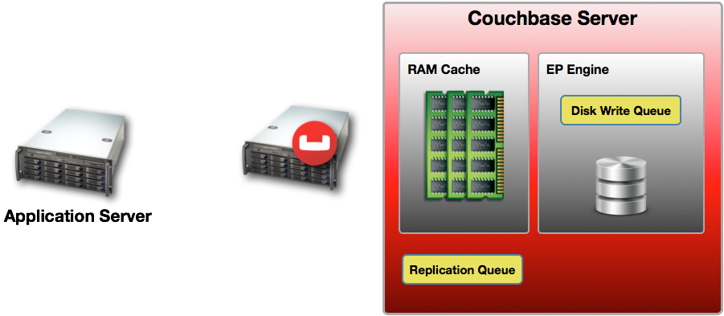
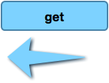

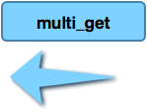
Retrieve User and Products Viewed
user document key is: email address
Get User Document
Get Product Documents
key: u::jasdeep@couchbase.com
keys:
[ p::1234, p::2345, p::3456 ]

Slide 39
Retrieve User and Products Viewed
user document key is: counter-id, lookup with email
Get User Document ID
Get Product Documents
Get User Document
(id = 505)
value: 505
key: e::jasdeep@couchbase.com
keys:
[ p::1234, p::2345, p::3456 ]
key:
u::505

Slide 40
Mental Adjustments #1
In SQL we tend to want to avoid hitting the database as much as possible
We know, intuitively, that it’s costly when tying up connection pools, and overloading the db servers
Even with caching and indexing tricks, and massive improvements over the years, SQL still gets bogged down by complex joins and huge indexes
In Couchbase, get’s and set’s are so fast they are trivial, and not bottlenecks, this is hard for many people to accept and absorb at first

Slide 41
Mental Adjustments #2
The key to finding data is the Key!
Key design can give you many different ways to access data, being able to predict key values, and use them creatively
Many newcomers see Views as a replacement for key design, because it seems more “SQL”-like
Use Views for what you cannot do with Key Design, and there are lots of things you can't do with Key Design

Slide 42
RDBMS TO COUCHBASE

Slide 43
Complex Joins vs Multiple Gets
select * from Products p
left join CartItems ci on p.product_id = ci.product_id
left join ShoppingCarts sc on ci.shopping_cart_id = sc.shopping_cart_id
left join Users u on sc.user_id = u.id
where u.id = 1001 and sc.shopping_cart_id = 5
shopping_cart_id =
cb.get(“u::1001::transaction::count”)
cart_items =
cb.get(“u::sc::” + shopping_cart_id”)
foreach item_id in cart_items.items
cart_details.push(
cb.get(“product::” + item_id) )
end
Going to get MORE and MORE EXPENSIVE as data grows!
Performance remains the same even if data grows!

Slide 44
Let us try it!

Slide 45
Model a Session Store
Users have unique IDs
Users can login via email or twitter

Slide 46
One solution
Using referential keys
u:101 => { name: “phil” … }
em:phil@couchbase.com => u:101
tw:1234 => u:101

Slide 47
Booking Contracts for a Hotel
We need to keep a history of the Contracts for each change
We need to easily find the latest one

Slide 48
One solution
Key contracts by 2 counter IDs
b:101:2 => { booking: “lerchenhof”, date: 1.10.2014, … }
b:101 => 2 // the current version
b:101:1 => { booking: “lerchenhof”, date: 2.10.2014, … }

Slide 49
Product catalog
We want to search products by their name
We need to keep a consistent stock
We have many images for each product

Slide 50
One solution
One main document for the static data
prod:101 => { name: “my-product”... }
prod:101:images => [ img1, img2, … ] // string which can be appended to
prod:101:stock => 5 // counter for the stock

