Slide 2
Diving into the Couchbase Java SDK
Philipp Fehre
@ischi github: sideshwcoder
Developer Advocate

Slide 3
SDK Principles

Slide 4
Couchbase SDK 2.0
Rewritten from the ground up … after 8 years or so
Everything is asynchronous first
Have a core that can be used elsewhere
Clojure, Scala, Java, JRuby all build on it
Optimize for performance
Disruptor buffering requests (ring buffer)
Make it easy to use (simple =/= easy)
RxJava

Slide 5
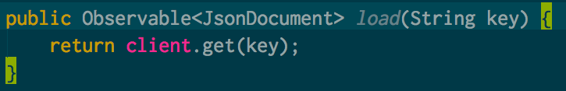
What does it look like?

Slide 6
Workflow
SDK generates Requests
Requests get translated to Events
Events get queued in Ring buffer
Events get executed
Responses get queued in Ring buffer
Responsed are translated to Response Objects
Response Objects are returned to the SDK

Slide 7
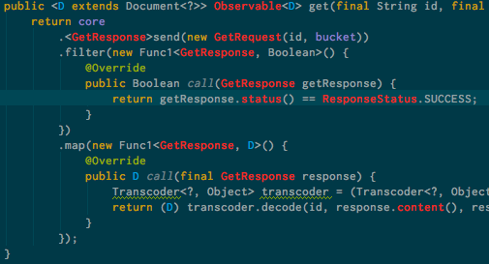
So what happens

Slide 8
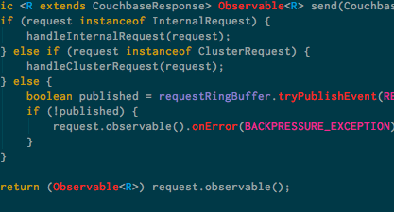
The core

Slide 9
2 Things can happen
Request gets added to the request buffer
Everything nice and shiny!
Return the observable response
Ring buffer is full
Call the onError on the Observable to signal back to SDK

Slide 10
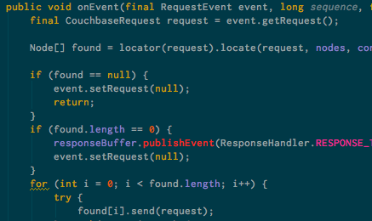
Request Handling

Slide 11
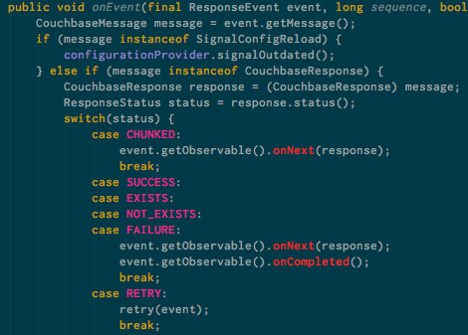
Response Handling

Slide 12
Whats with all the Observables?
Abstract away asynchronous operations
High level API to manage flows of Data
Data in montion
Provided by RxJava

Slide 13
RxJava

Slide 14
Some history
Netflix Project (RxJava)
Originally a Microsoft Project (Rx for .NET)
Model Data in Motion

Slide 15
Observables are to Futures what Values are to Iterables

Slide 16
Say what now?
A push based collection
subscribe
onNext
onError
onCompleted
Manage streams of Data

Slide 17
What can happen
--- A --- | >
--- A --- B --- C --- |>
--- A --- B --- X >
--- X >
--- >

Slide 18
What can I do with this
Operations on collections
Map
Filter
FlatMap
…
Lay out your data flow and let the data stream through

Slide 19
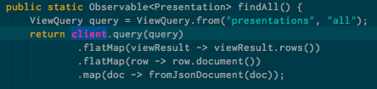
Lay out what you want todo

Slide 20
Map
Executes an a function on every item in the stream
--- A --- B --- C --- |>
Stream.map(func)
--- func(A) --- func(B) --- func(C) ---|>

Slide 21
Filter
Filter items from a Stream
--- A --- B --- C --- |>
Stream.filter(func Event == A)
--- A --- --- ---|>

Slide 22
FlatMap
Flattens Observables
--- A ( --- U ---|>) --- B ( --- V ---|>) --- C ( --- W ---|>) --- |>
Stream.flatMap
--- U --- V --- W ---|>

Slide 23
Merge
Merges a stream
--- A --- B --- C --- |>
--- U --- V --- W --- |>
Stream.merge(Stream2)
--- A --- U --- B --- V --- C --- W ---|>

Slide 24
So why Rx
Abstract the async implementation from your users
Provide a nice abstraction that works for multiple async values

Slide 25
What we learned from SDK
Rx is easy not simple
Some operations are synchronous
Open connection…
It’s easier to add synchronous operations later
Users like a synchronous interface to get started
Give it to them and they will use it
We have it in there now for development and testing
No toBlocking().single() everywhere

Slide 26
Q&A

