Slide 1
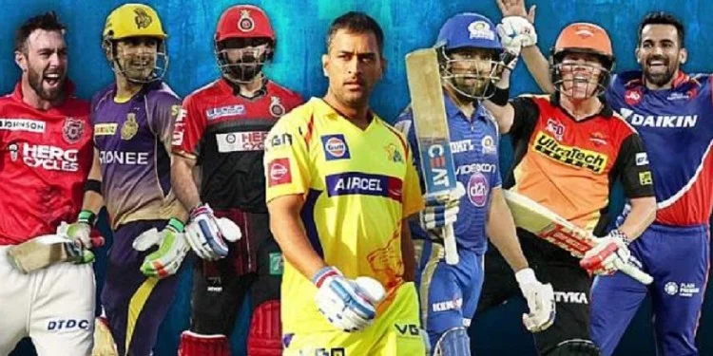
Data Analysis on IPL seasons
by Avinash Patel

Slide 2
IPL Match
IPL is a T-20(20 over a side ) cricket game conducted by BCCI( Board of Control for Cricket in India) every year. The league was played in the year 2008 and has been conducted every year since then. 8 team participate every year in double round robin league fashion and then top 4 team qualify for final berth.
Python language has been used to explore and present visualization graph to understand the IPL's journey so far.

Slide 3
Expectation from the Data Analysis
Predicting the out come of the match, based on the history of the tournament.
Key factors affecting outcomes of matches will be analysed.
Factors that affect match outcomes could be venue (stadium), city, toss winner, and toss decision (field/bat), batsman, bowler, runs scored, wicket taken etc..

Slide 4
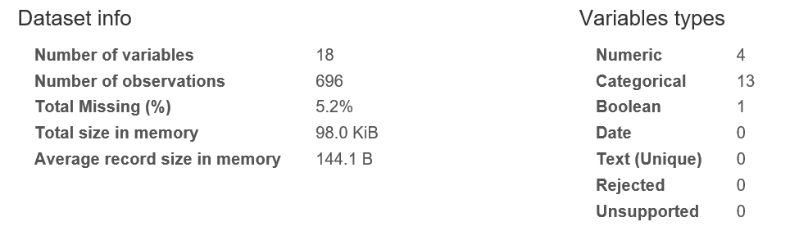
Description on Data

Slide 5
Questions to be answered:
How many matches we’ve got in the dataset?
How many seasons we’ve got in the dataset?
Which Team had won by maximum runs?
Which Team had won by maximum wicket?
Which Team had won by closest Margin (minimum runs)?
Which Team had won by minimum wicket?
Which Season had most number of matches?
Which IPL Team is more successful?
Has Toss-winning helped in winning matches?
Toss-winning team opted for Bat/Field - Season wise
Toss-winning team opted for Bat/Field - Team wise
Study on match Result - Normal/Tie/No-result
Result of the match - Team wise

Slide 6

Packages Required / Profiling
import numpy as np # numerical computing
import pandas as pd # data processing, CSV file I/O (e.g. pd.read_csv)
import matplotlib.pyplot as plt #visualization
import seaborn as sns #modern visualization
import pandas_profiling
Dataset / Profiling:
df_matches = pd.read_csv(r'https://raw.githubusercontent.com/insaid2018/Term-1/master/Data/Projects/matches.csv’)
profile = pandas_profiling.ProfileReport(df_matches)
profile.to_file(outputfile="IPL_Match.html")

Slide 7
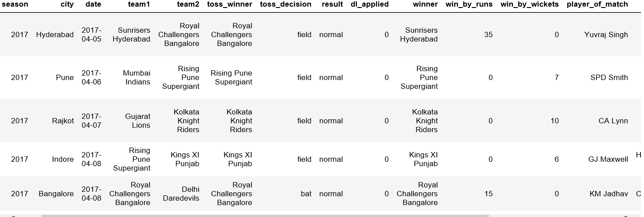

Sample data

Slide 8


Analysis on complete dataset of matches
How many matches we’ve got in the dataset?
df_matches['id'].count()
696
How many seasons we’ve got in the dataset?
df_matches['season'].unique()
array([2017, 2008, 2009, 2010, 2011, 2012, 2013, 2014, 2015, 2016, 2018], dtype=int64)
Which Team had won by maximum runs?
df_matches.iloc[matches['win_by_runs'].idxmax()]['winner']
'Mumbai Indians'

Slide 9
Which Team had won by minimum runs?
df_matches.iloc[matches[matches['win_by_runs'].ge(1)].win_by_runs.idxmin()]['winner’]
'Mumbai Indians’
Which Team had won by minimum runs?
df_matches.iloc[matches['win_by_wickets'].idxmax()]['winner']
'Kolkata Knight Riders'

Slide 10
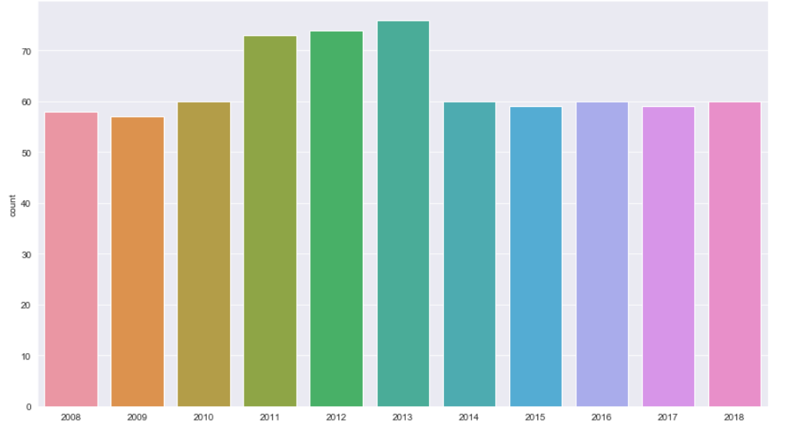

Number of matches based on seasons

Slide 11
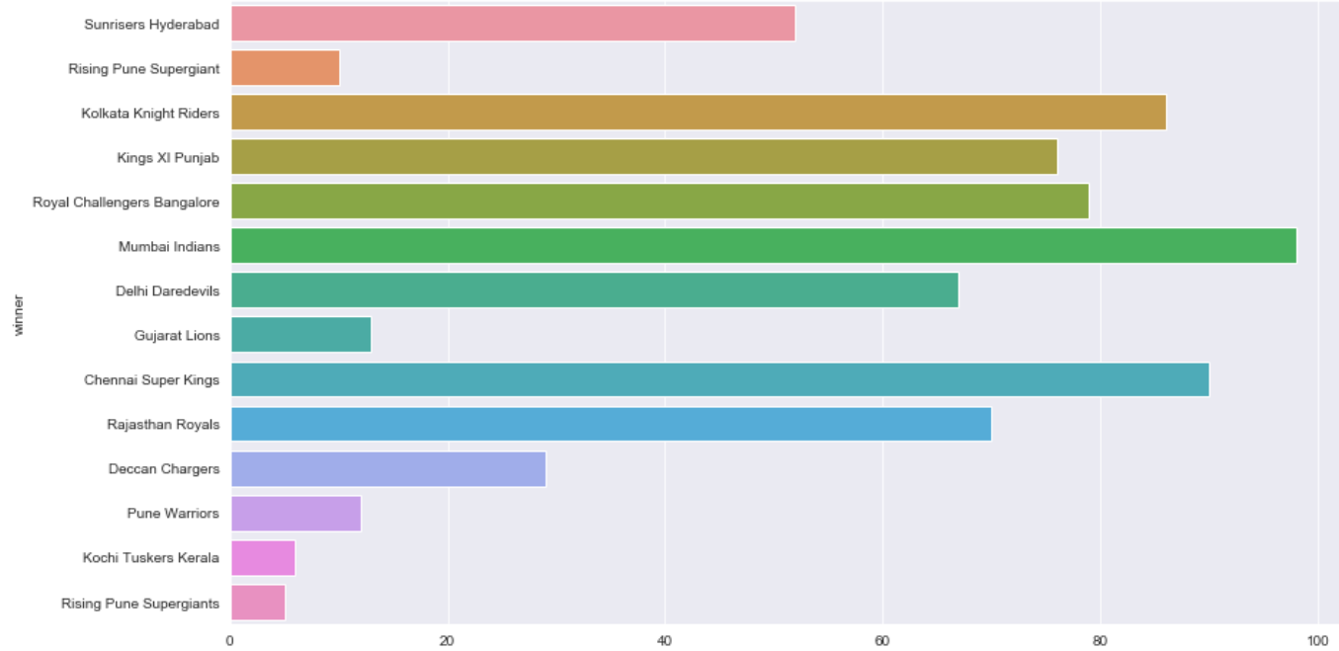

Most successful team in all the seasons of IPL

Slide 12
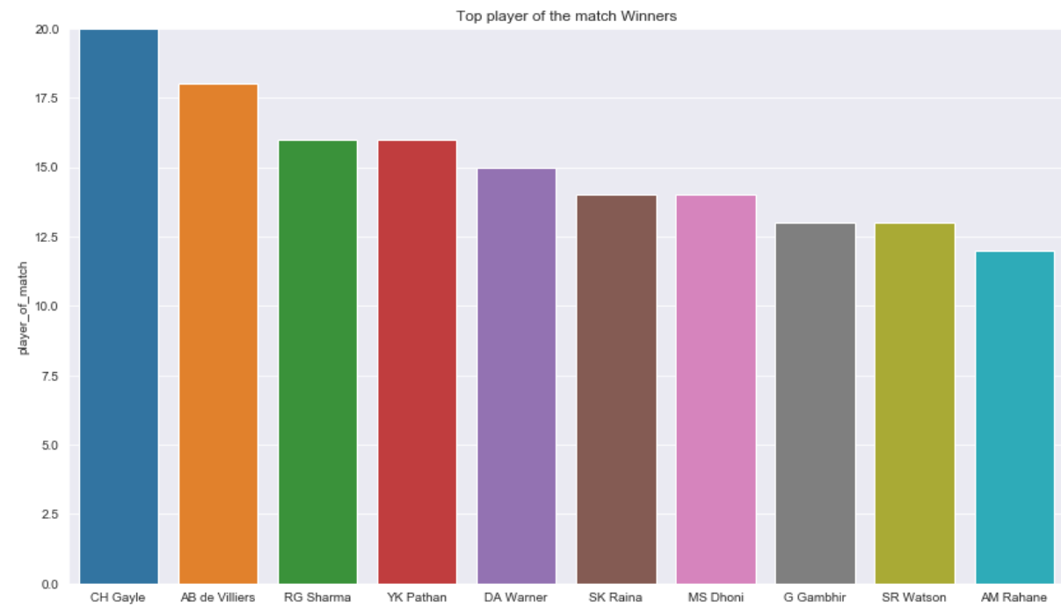
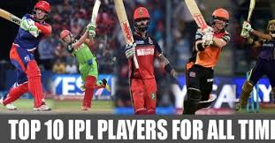
Top 10 player of the match

Slide 13
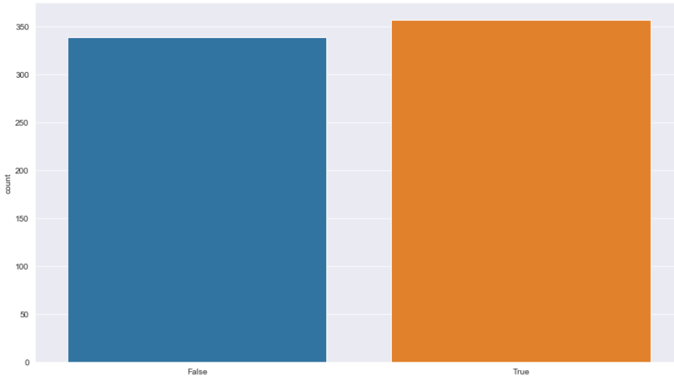

Toss-winning vs Match-winning

Slide 14
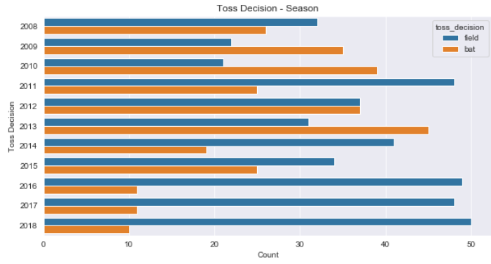


Toss-winning team opted for Bat/Field - Season wise

Slide 15
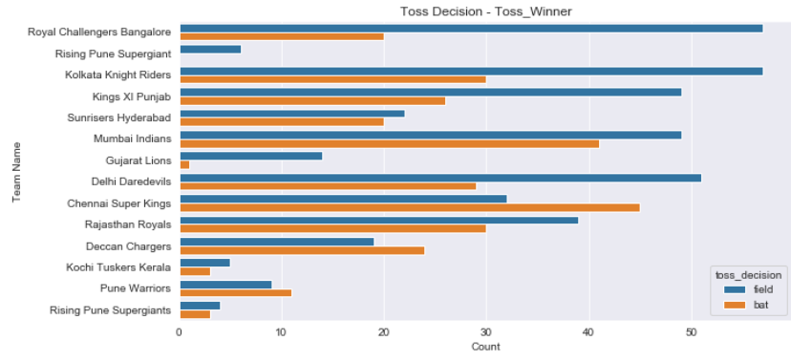
Toss-winning team opted for Bat/Field - Team wise

Slide 16
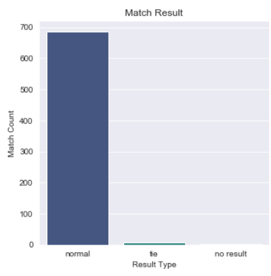


Match Result (Normal/Tie/No result)

Slide 17
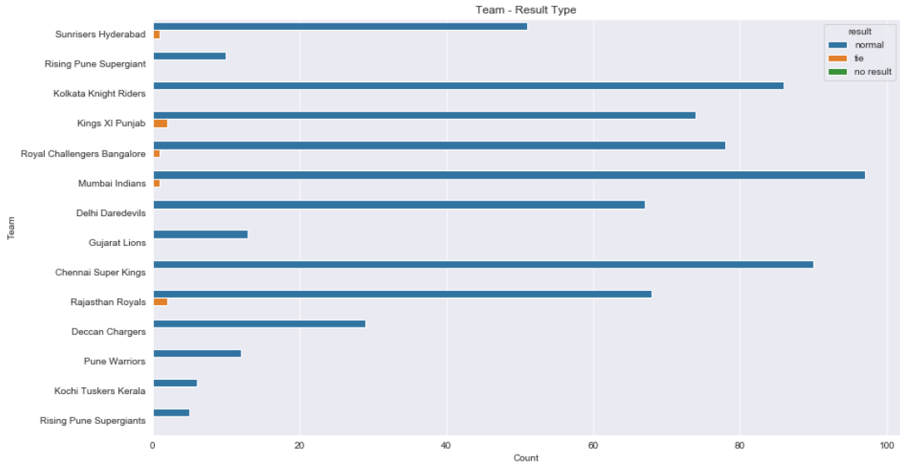
Match Result (Normal/Tie/No result)

Slide 18
Conclusion
Team winning match with high run is considered to be best team and has high chance to win the season.
Team having great players who has been player of the match has good chance to win.
Most of team winning the toss opted to field first and chase.
Team winning the toss will not always win the match, the probability of wining the match is 52%.
Match result is normal for most of the value, which will not affect the team much on winning the season.

