Slide 1
Medianizer
Team-14
GOPALA KRISHNA AVINASH TUMMALAPALLI
SIRISHA MANTHRAMURTHY
SAI KARTHIKEYA ADDAGADA
SAI TEJASWEE REDDY PASHAM

Slide 2
Motivation
People end up using many applications, each for a specific kind of media. This is quite burdensome and frustrating sometimes. So here comes Medianizer, where a plethora of media is brought onto a single platform, so that the customers are likely to fetch desired media in the blink of an eye. Medianizer is a universal application, where you can avail a wide range of access over media. This is a collection of media such as Music, Videos, Photos and Books where users can rent or purchase media.

Slide 3
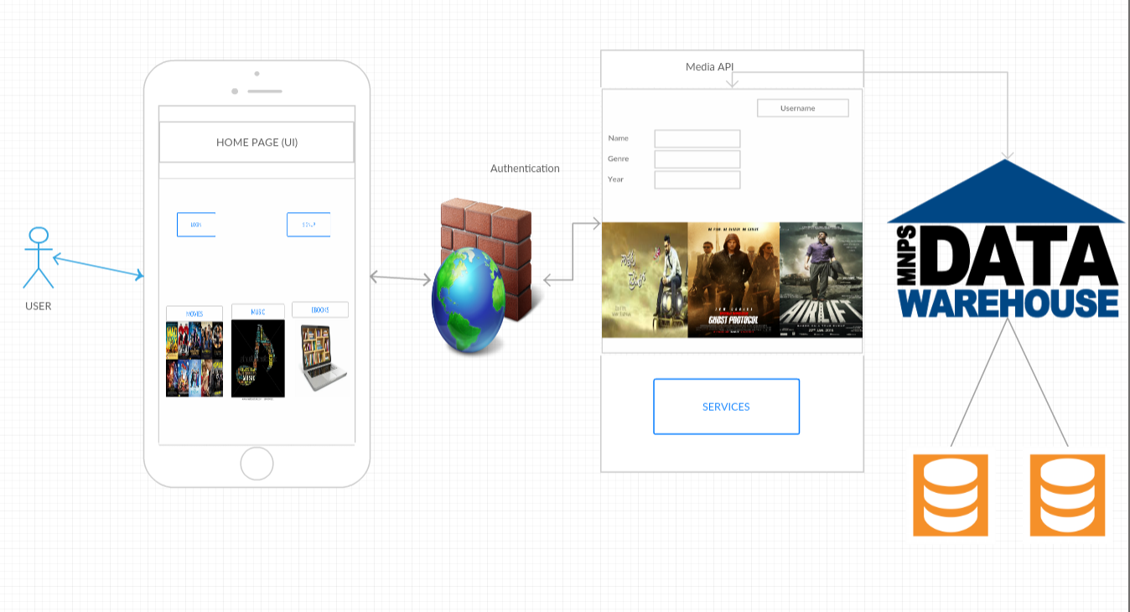
Architecture diagram

Slide 4
Technologies used
Android SDK
J2EE
XML
Firebase

Slide 5
features
One stop platform to access thousands of books.
One stop platform to access a wide variety of music.
One stop platform to access all genres of movies.
Enables voice search.

Slide 6


