Slide 1

Phone Call in Midnight , Weekends and fear of getting call when out

Slide 2

SMS have following problem (1) Some time there continuous sms which have no solution Example Queue Sms (2) incomplete message which no clear explantion

Slide 3

Lack of documentation on error which occurs repeatedly

Slide 4

Reason’s for error or only send on mail. Many times we have search mail to find if such error have occurred

Slide 5
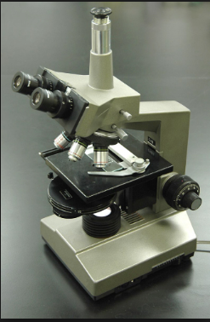
There is no postmortem for the error or issue Why error have occurred and what should be proposed solution for the error

Slide 6

No information on how many application are effected, Which are those application ? What is there impact on failure ? How Often those application fails ? What are the reason it failing? How many time the reason is same?

Slide 7
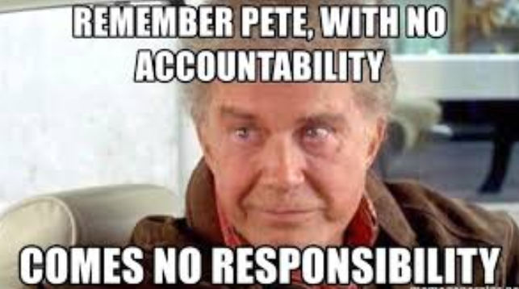
No, Accountability on error which have reported in prod. No Jira are created , No follow-up for error

Slide 8

What is Solution for above problems?

