Slide 1

Phone Call in Midnight , Weekends and fear of getting call when out

Slide 2

SMS have following problem (1) Some time there continuous sms which have no solution Example Queue Sms (2) incomplete message which no clear explantion

Slide 3

Lack of documentation on error which occurs repeatedly

Slide 4

Reason’s for error or only send on mail. Many times we have search mail to find if such error have occurred

Slide 5
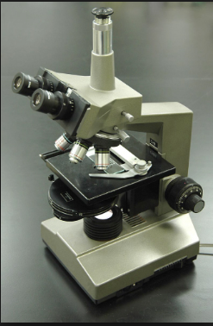
There is no postmortem for the error or issue Why error have occurred and what should be proposed solution for the error

Slide 6

No information on how many application are effected, Which are those application ? What is there impact on failure ? How Often those application fails ? What are the reason it failing? How many time the reason is same?

Slide 7
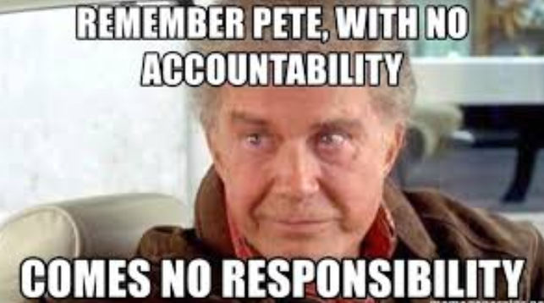
No, Accountability on error which have reported in prod. No Jira are created , No follow-up for error

Slide 8

What is Solution for above problems?

Slide 9
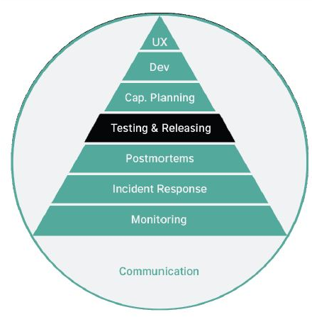

Slide 10



What We have ?
We have Splunk reports and Monitoring System We have Splunk in prod and non-prod both
We have Grafana in non-prod region

Slide 11

What We have don’t have ?
We donot have application specific Splunk Query We donot have any place to store the Splunk Query
We have donot have Grafana in prod region
Need Apm tool in prod region such new relic , App dynamics etc

Slide 12



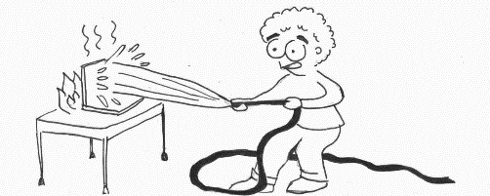
What We have ?
System Which Breaks.
An Alerting System Which alerts on Email Phone Voice mail Sms
Person on call have basic to intermediate problem solving know and for application

Slide 13
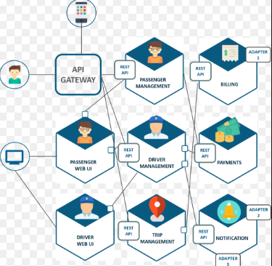
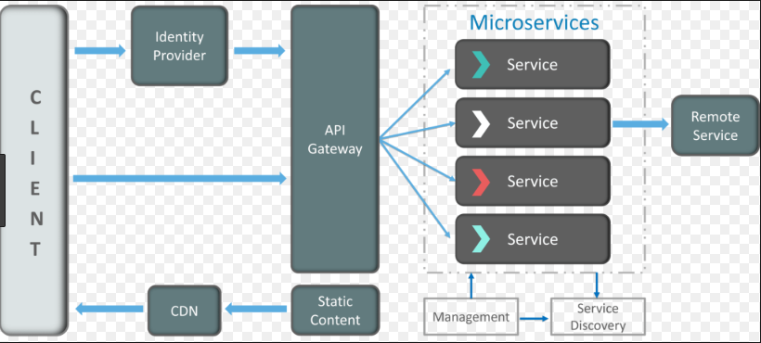
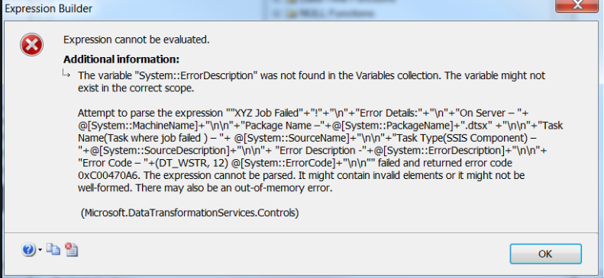
What We Don’t have?
How and Why Failing System is Interacting ?
Explanation of Competent by Competent should be attached to confluence page or some common place
Error Collection at one place and there solution at one place.

Slide 14


What We have ?

Slide 15
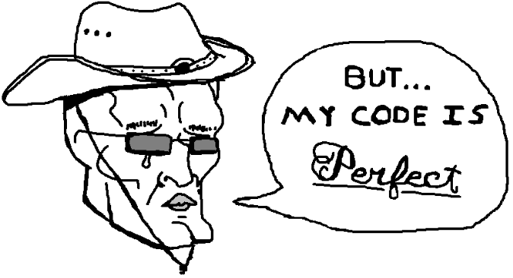
What We Don’t have?
(1) We do not have any Postmortem of Issue . (2) Postmortems Collections https://github.com/danluu/post-mortems (3) Stack flow https://meta.stackoverflow.com/questions/340960/a-post-mortem-on-the-recent-developer-story-information-leak (4) Postmortems Teamplate https://github.com/dastergon/postmortem-templates

Slide 16

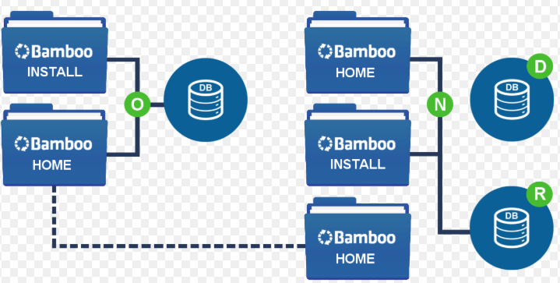
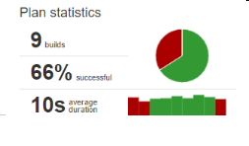
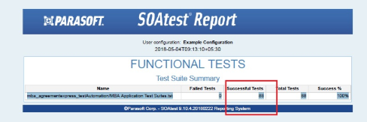
What We have?
We have CI / CD pipe line
Unit test cases are getting executed
Para soft test is getting executed

Slide 17

What We have?
We are good with testing and Releasing

Slide 18
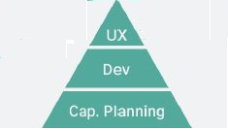
Following point may not be needed in our use case Cap planning Dev UX

