Slide 1

Offer Creation Using Machine learning POC

Slide 2
Offer Creation Using Machine learning POC
Technology Stack
Implementation in Python
Implementation in Android
How Self learning is done
How It can be used to achieve goal for offer prediction and creation
Any Question on Poc

Slide 3
Offer Creation Using Machine learning POC
What Technology Stack had been used for development?
Python
Jupyter Notebook
TensorFlow, Pandas, Sklearn, numpy, Android
Database used Titanic Database

Slide 4
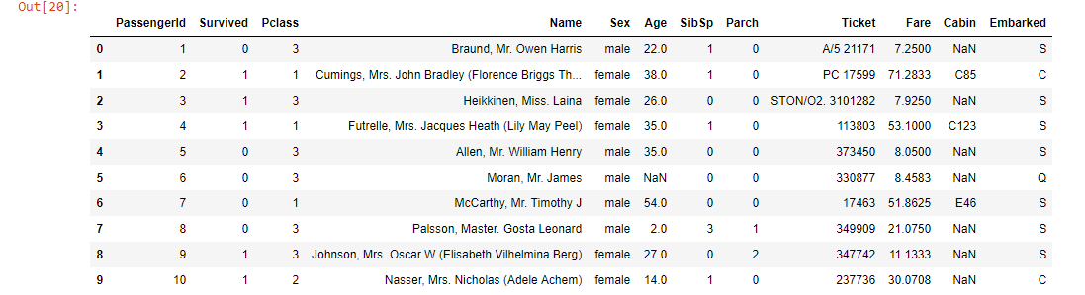
Offer Creation Using Machine learning POC
Target is to predict if Passenger will Survive or Not based on provided parameter
Following is dataset Screen Shoot

Slide 5
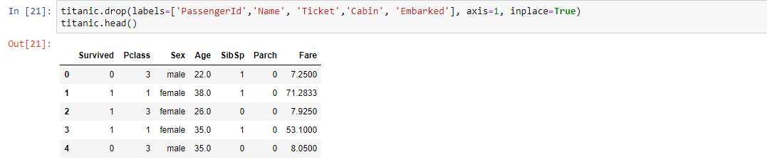
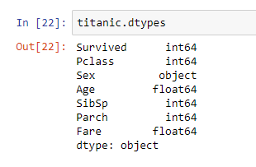
Offer Creation Using Machine learning POC
Step1 of ML is cleaning Creating Structure of Data what need to analyzed?

Slide 6
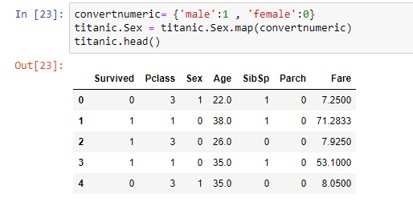
Offer Creation Using Machine learning POC
Step2 Cleaning of data from non-Numeric values

Slide 7
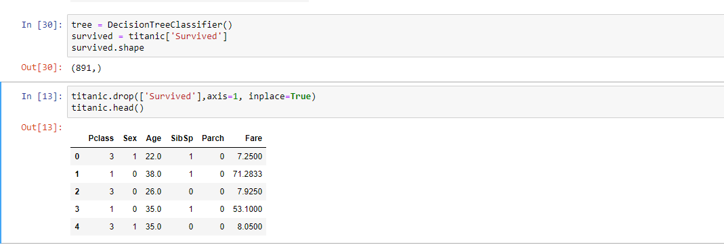
Offer Creation Using Machine learning POC
Step3 Initialize the ML Learning

Slide 8

Offer Creation Using Machine learning POC
Step4 Breaking Dataset into Learning and testing dataset

Slide 9
Offer Creation Using Machine learning POC
Step5 Testing ML for It Accuracy

Slide 10
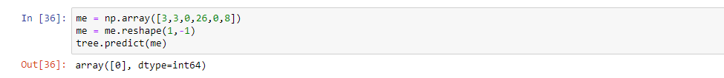
Offer Creation Using Machine learning POC
Step6 Testing With Independent Data

Slide 11
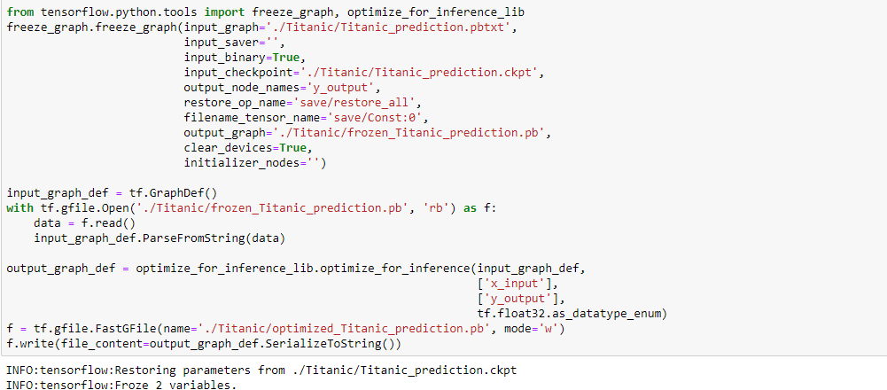
Offer Creation Using Machine learning POC
Step7 Exporting Protobuf file which used by Other Application

Slide 12
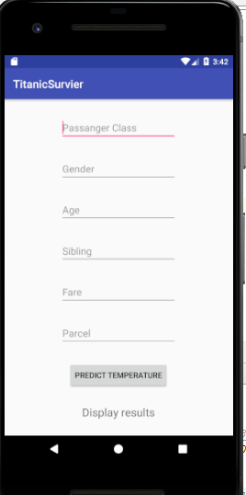
Offer Creation Using Machine learning POC
Step8 Android Screen

Slide 13
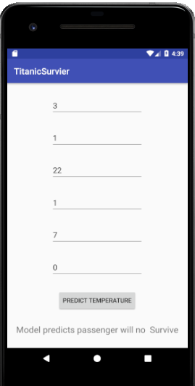
Offer Creation Using Machine learning POC
Step8 Android Screen

Slide 14
Offer Creation Using Machine learning POC
Why we have Used Titanic Data to Present Offer Creation?
Because we have binary Classification for Offer
Based on Customer Data we can try to predict if Offer can be given to customer or not?
In future by looking offer parameter we can predict which parameter is good for creating new offer

Slide 15
Offer Creation Using Machine learning POC
No , This easisiest way of consuming Protobuf file which we can call from android app
Most Ideal way would be having Micro or web service to consume the applciation
I android is only way to work on ?

Slide 16
Offer Creation Using Machine learning POC
IS model is STATIC Can It self learn ?
Model is Not static
Yes, model can self learn , if needed model can generate learning for specific user and sepefic offer and improve itself.
Implementation is in Slide 11

Slide 17
Offer Creation Using Machine learning POC
Where is related code ?
Location Python Code https://github.com/AvinashTiwari/Artifical-intelligence/tree/master/Poc_Titanic
Location for Android code https://github.com/AvinashTiwari/Artifical-intelligence/tree/master/Poc_Titanic/TitanicSurvieraap

