Slide 1
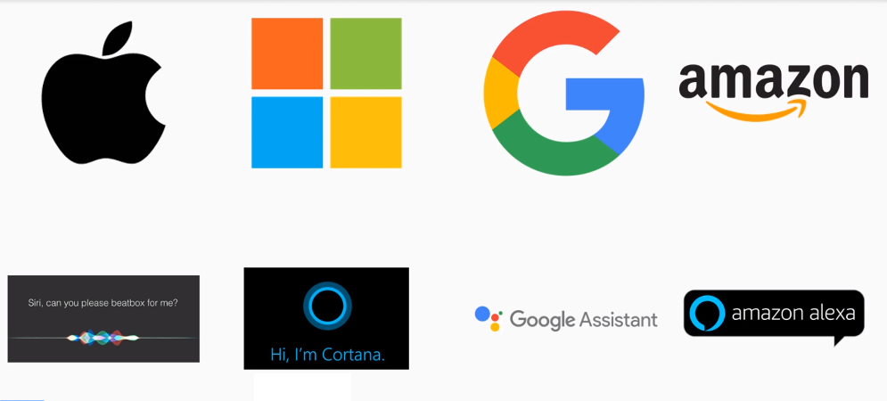
Real World NLP and DNLP

Slide 2

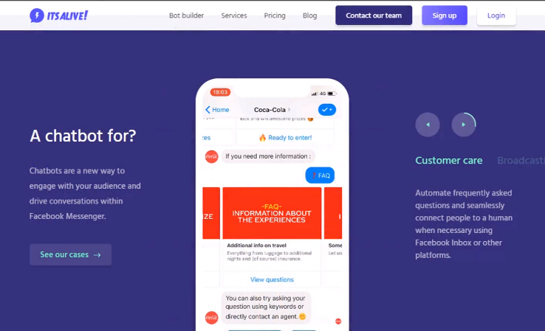
Real World NLP and DNLP

Slide 3
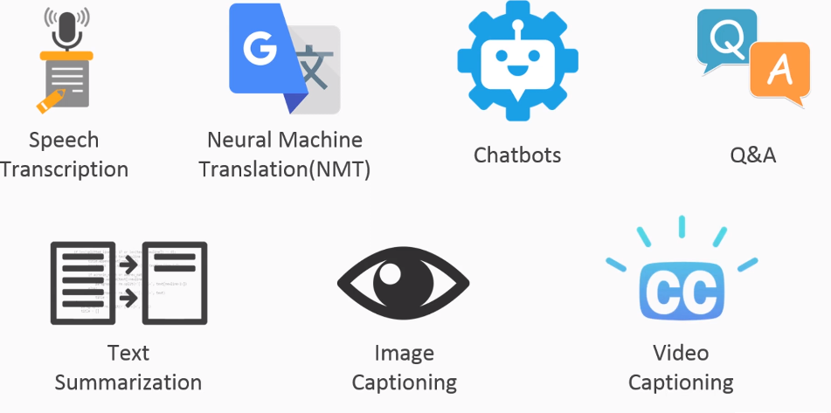
Different Uses OF NLP

Slide 4
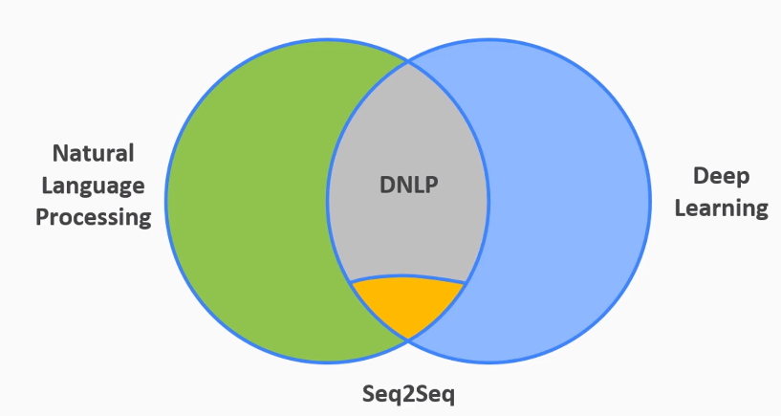
Venn Diagram to Understand NLP,DNLP and Seq2Seq

Slide 5
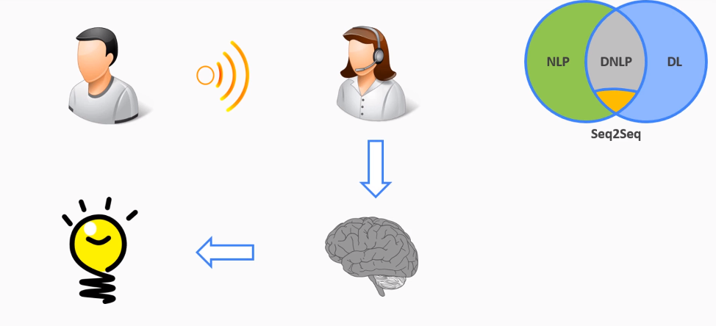
End-to-End Deep Learning Model (Human)

Slide 6
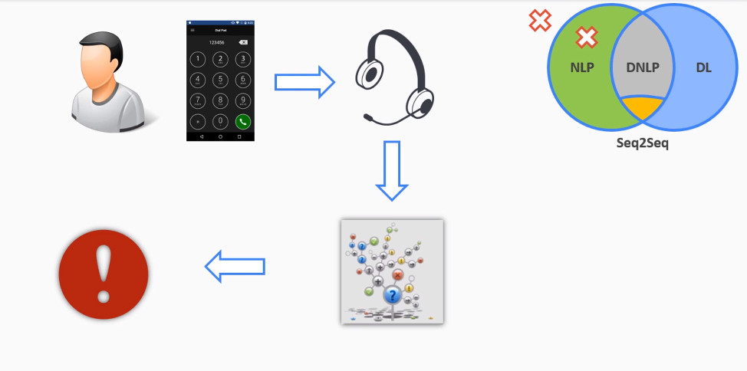
End-to-End Deep Learning Model (If else Machine)

Slide 7
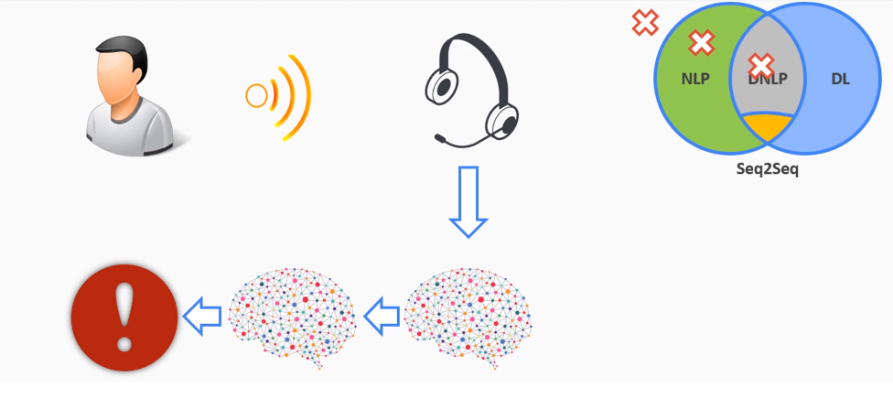
End-to-End Deep Learning Model (If else Machine)

Slide 8
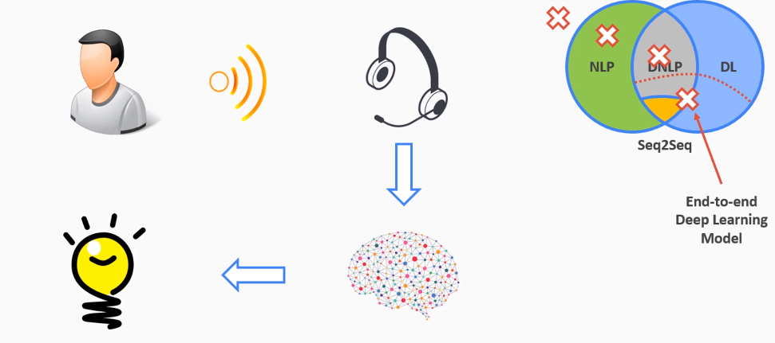
End-to-End Deep Learning Model (If else Machine)

Slide 9
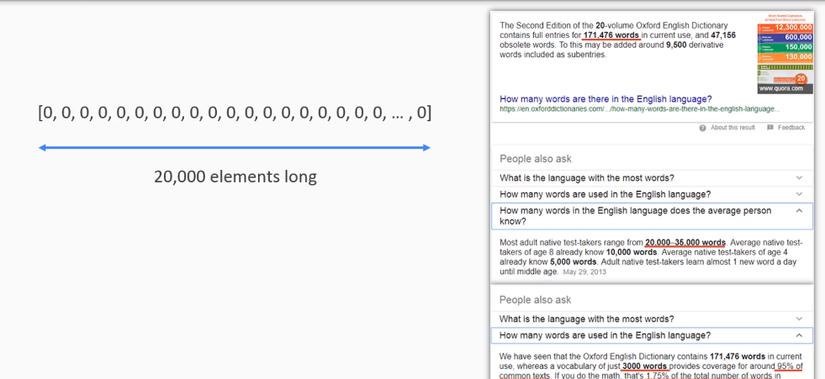
Bag-to-Bag Model

Slide 10
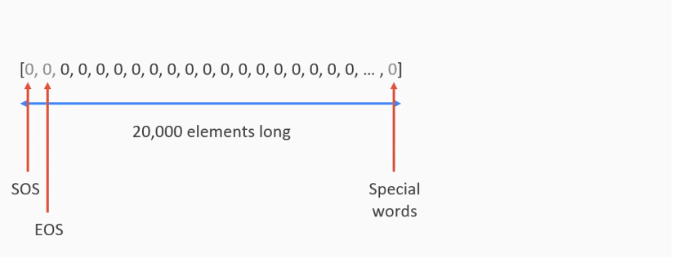
Bag-Of-Words Model

Slide 11
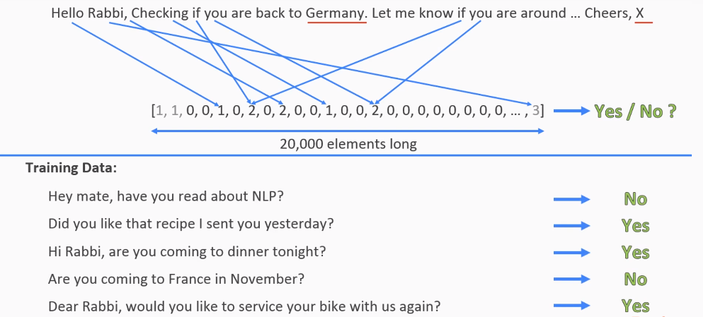
Bag-Of-Words Model

Slide 12
Bag-Of-Words Model

Slide 13
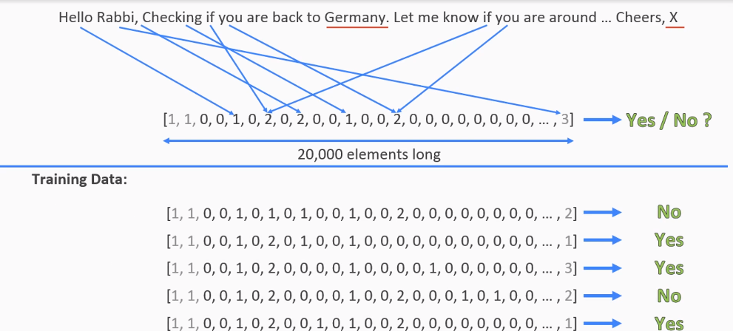
Bag-Of-Words Model

Slide 14
Bag-Of-Words Model

Slide 15
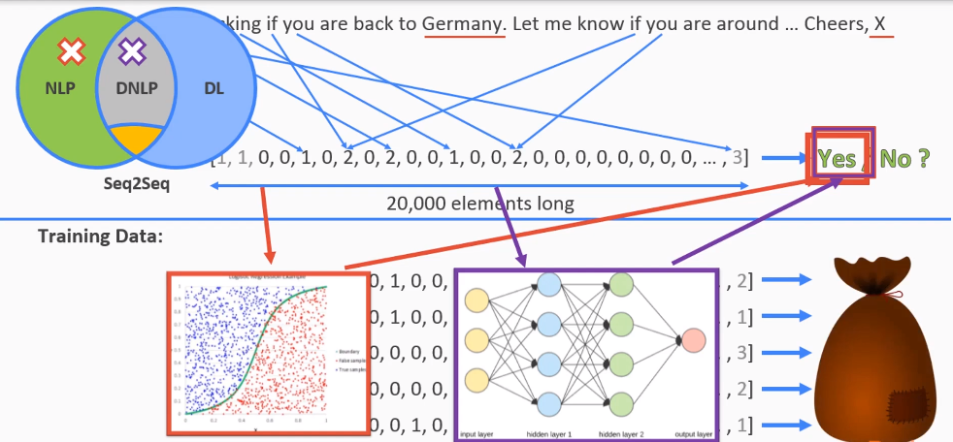
Bag-of-Word Model

Slide 16
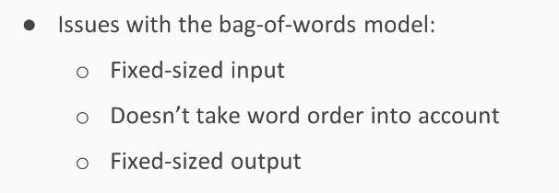
Limitation Of Bag-Of-Words

