Slide 1
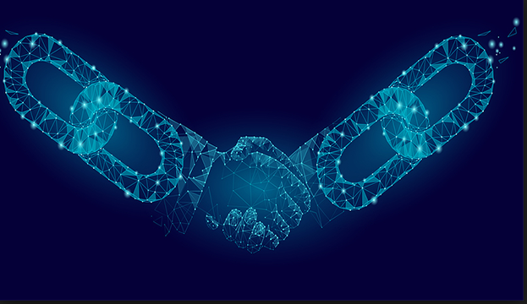
Block Chain

Slide 2
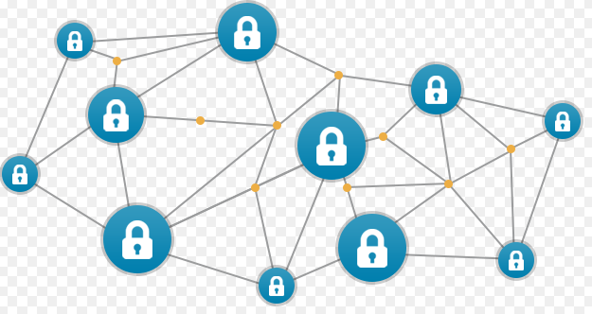
What is Block Chain
The blockchain is a distributed and decentralized ledger that stores data such as transactions, and that is publicly shared across all the node of its network

Slide 3
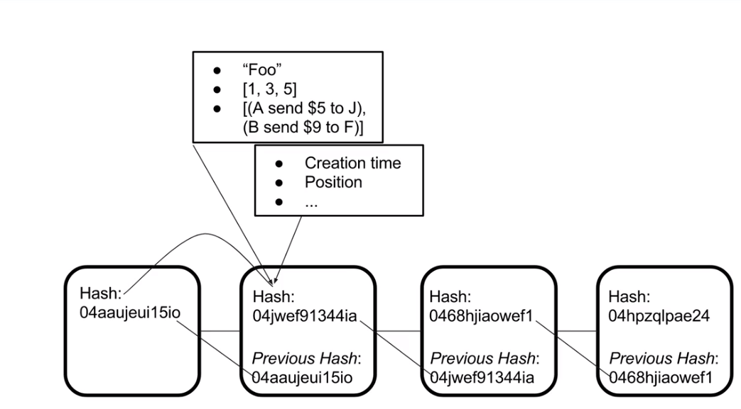
How is Block Created ?
(1) There is unique has Created for each Block
(2) Hash can be of anything
(3) Current has is linked to pervious hash
(4) Point 3 means Last block is integral part for Creating new value

Slide 4
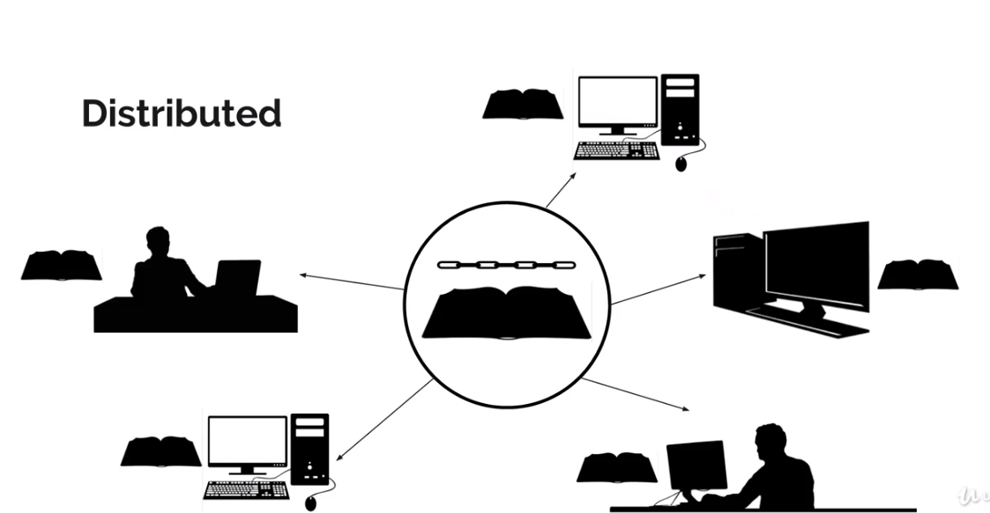
So what is Block Chain?
Block chain is nothing but the Distributed /Decentralized Ledger?
Why Distributed because it shared across the network and people can connect it and complete the transaction and it history is stored
By connecting each get the entire history of Ledger (block chain)

Slide 5
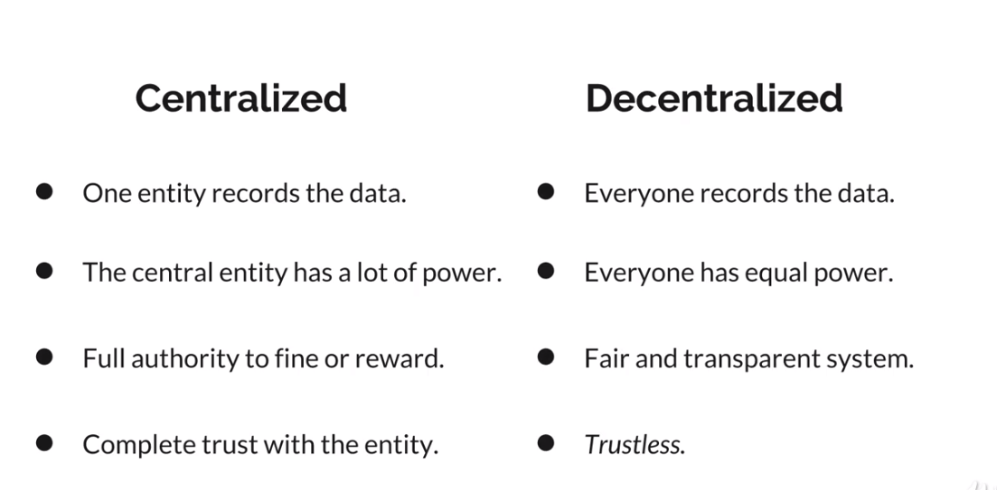
What do you mean By Decentralized?

Slide 6
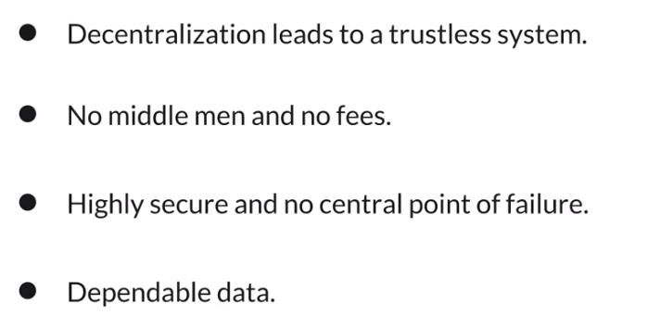
Why to use Block Chain?

Slide 7
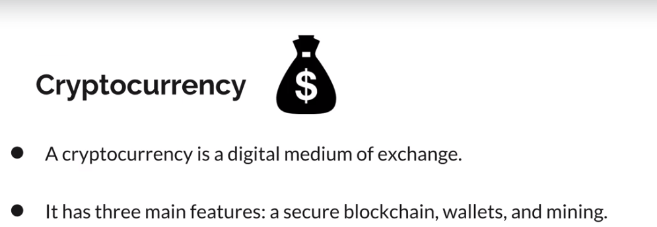
Use Case for Block Chain?

Slide 8
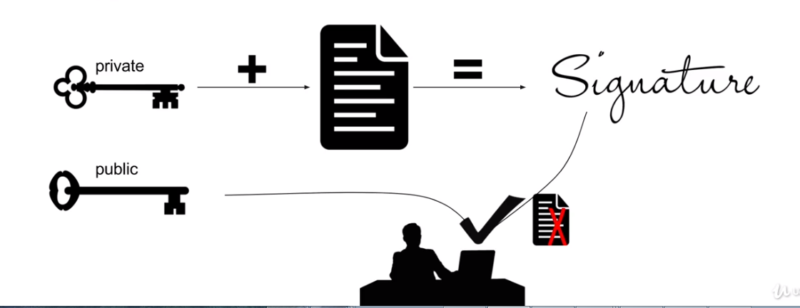
Oooo money How Secure It is?
Uses Cryptography to generate digital signature
It is unique signature to individual account So who ever want to record data inside the block chain has to use unique signature
What is Digital Signature? It is Private key (secret) public key (open to identify)

Slide 9

Ok , Where Should I Store my money?
Wallet
It is an Object where Both Public and private key is used. Public key is used as address to wallet

Slide 10
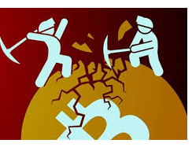
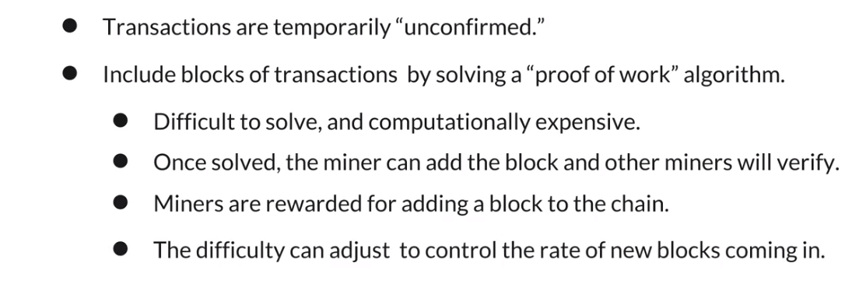
How transaction is completed/Recorded?
Mining

Slide 11



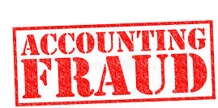
Other Use cases?
Voting System
Block chain based document and Identification System
System Audit
Preventing /detecting Accounting Fraud

Slide 12
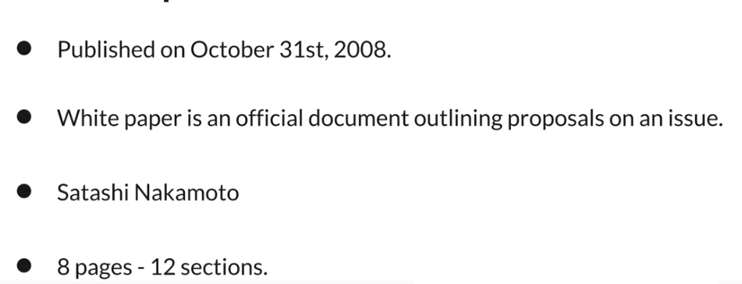
White Paper For Bit Coin
https://bitcoin.org/bitcoin.pdf

Slide 13

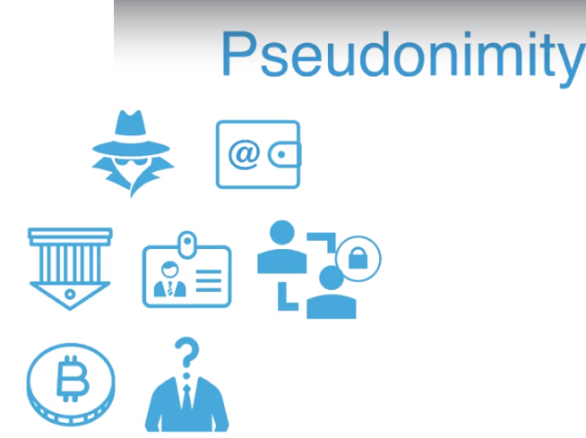
So What is not Block chain ? It is not solution to All problem
As we know data is present in all nodes and read by all node.
Privacy is bit questionable. If use case where we have to prevent reading of data Open block chain is not an option.
If you want Kyc (know your customer)
Then Open block chain is Not and answer

Slide 14
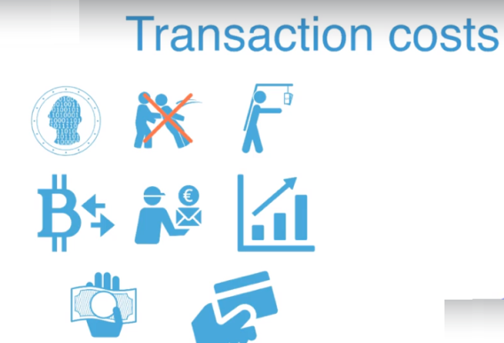
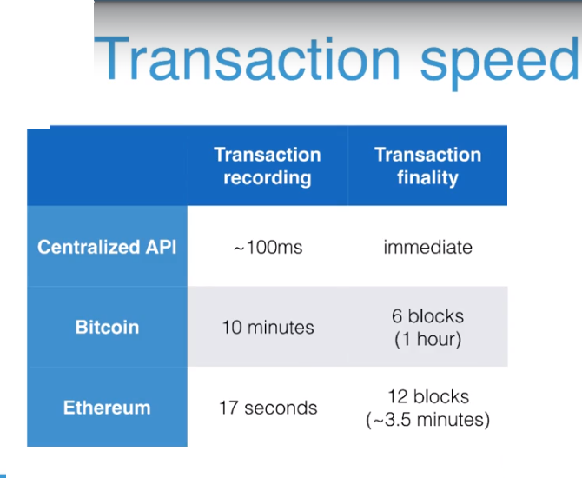
So What is not Block chain ? It is not solution to All problem
Transaction cost is going to go up.

Slide 15
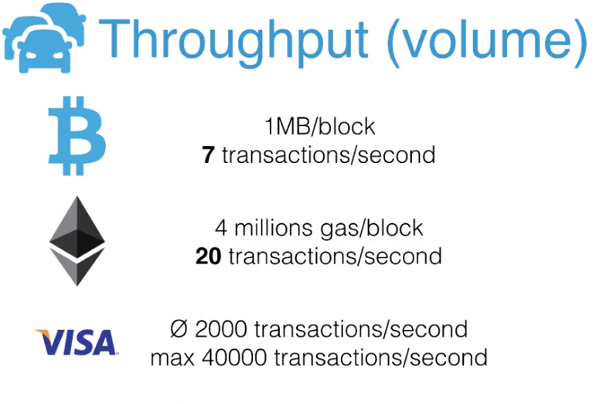
So What is not Block chain ? It is not solution to All problem

Slide 16
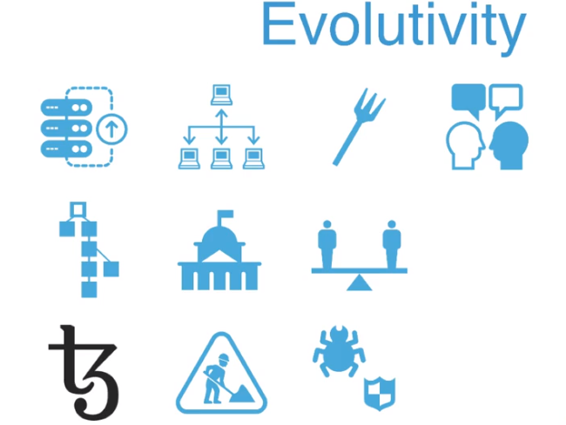
So What is not Block chain ? It is not solution to All problem

Slide 17
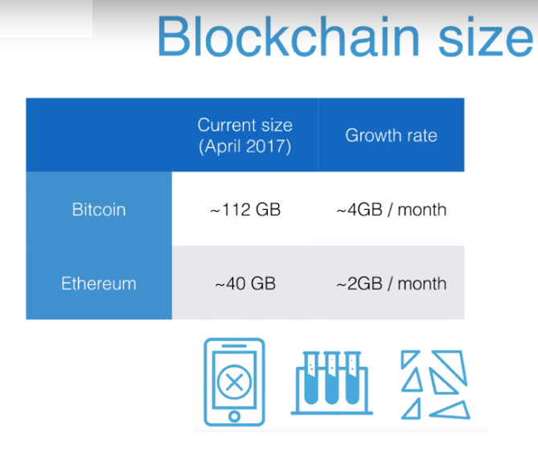
So What is not Block chain ? It is not solution to All problem

