Slide 1
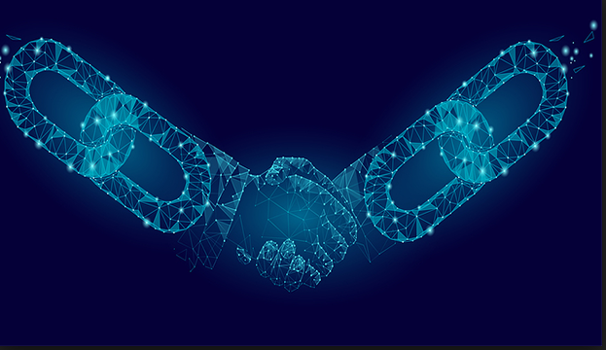
Block Chain

Slide 2
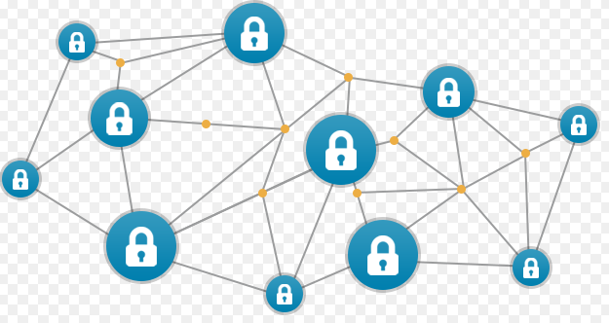
What is Block Chain
The blockchain is a distributed and decentralized ledger that stores data such as transactions, and that is publicly shared across all the node of its network

Slide 3
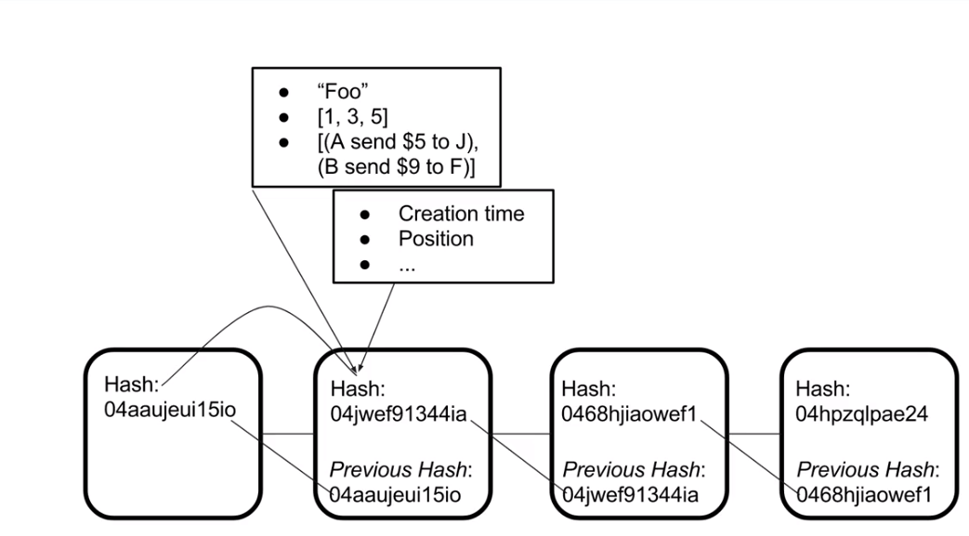
How is Block Created ?
(1) There is unique has Created for each Block
(2) Hash can be of anything
(3) Current has is linked to pervious hash
(4) Point 3 means Last block is integral part for Creating new value https://www.youtube.com/watch?v=_160oMzblY8

Slide 4
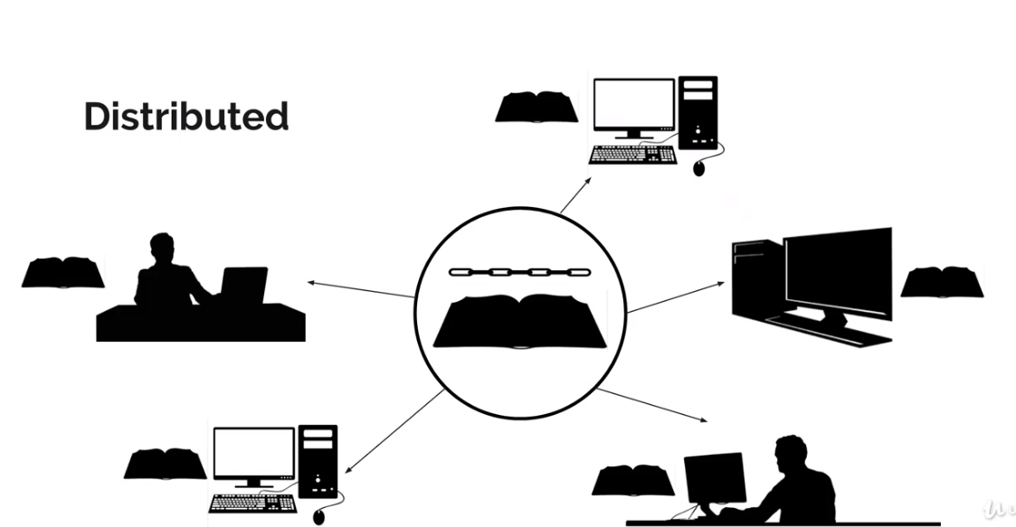
So what is Block Chain?
Block chain is nothing but the Distributed /Decentralized Ledger?
Why Distributed because it shared across the network and people can connect it and complete the transaction and it history is stored
By connecting each get the entire history of Ledger (block chain)

Slide 5
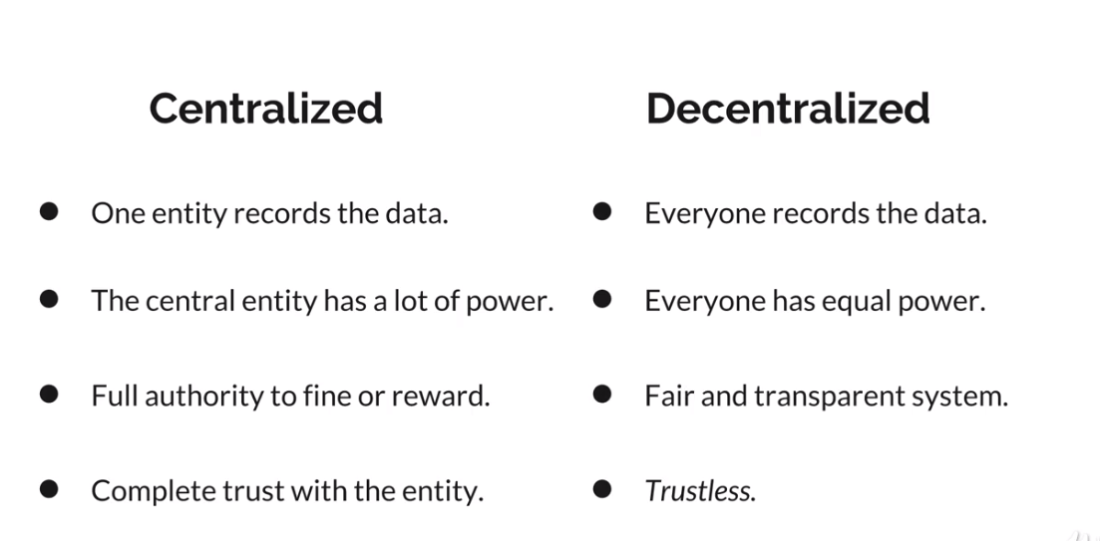
What do you mean By Decentralized?

Slide 6
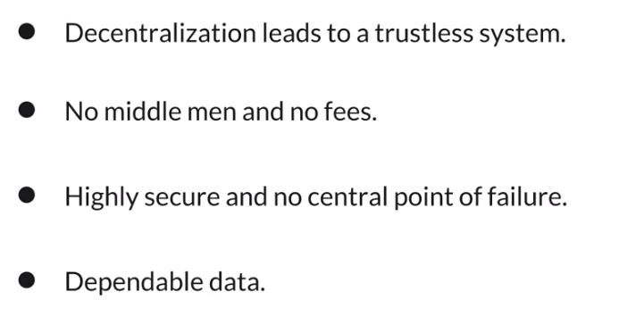
Why to use Block Chain?

Slide 7
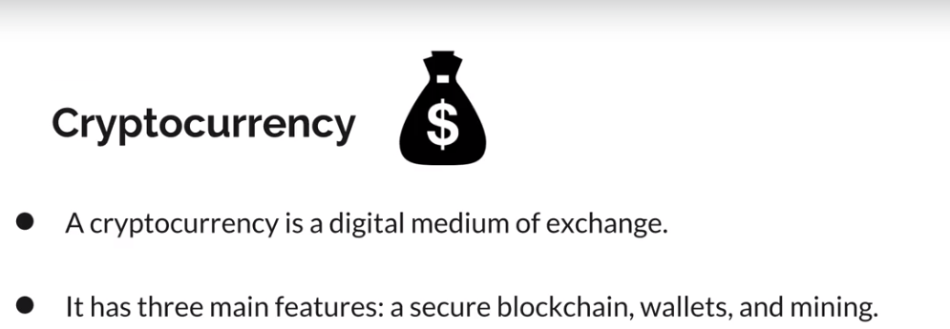
Use Case for Block Chain?

Slide 8
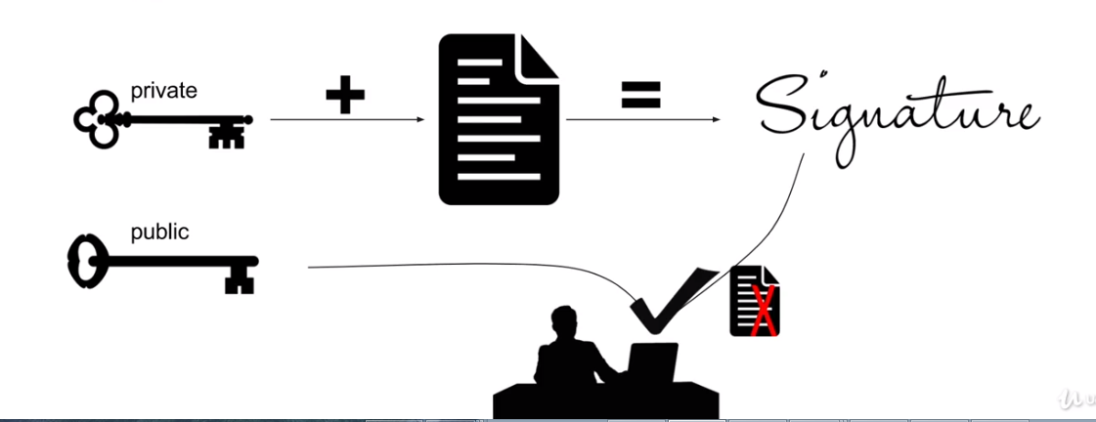
Oooo money How Secure It is?
Uses Cryptography to generate digital signature
It is unique signature to individual account So who ever want to record data inside the block chain has to use unique signature
What is Digital Signature? It is Private key (secret) public key (open to identify)

Slide 9
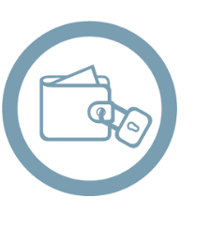
Ok , Where Should I Store my money?
Wallet
It is an Object where Both Public and private key is used. Public key is used as address to wallet

Slide 10
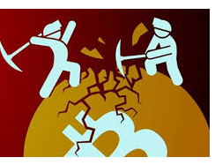
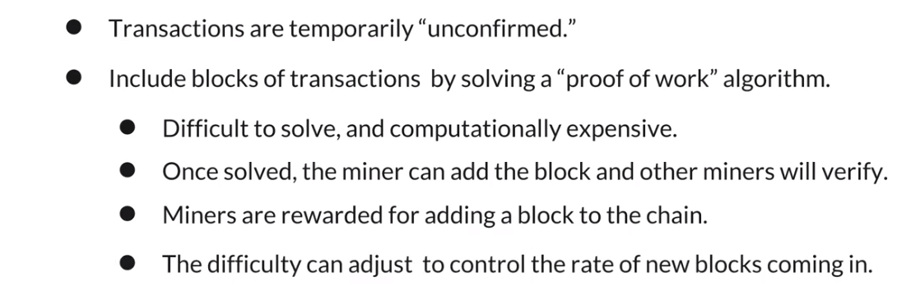
How transaction is completed/Recorded?
Mining

Slide 11



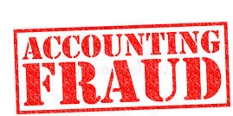
Other Use cases?
Voting System
Block chain based document and Identification System
System Audit
Preventing /detecting Accounting Fraud

Slide 12
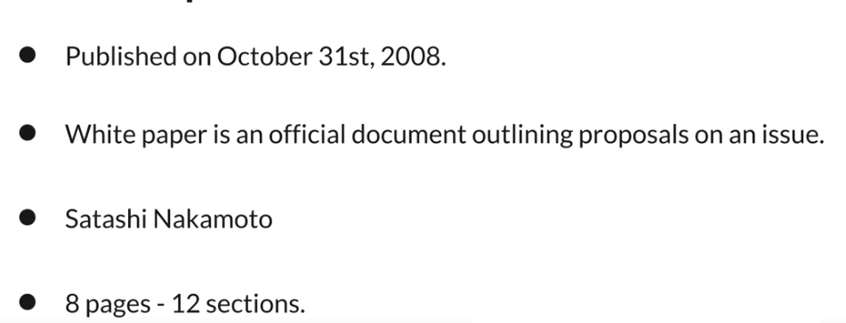
White Paper For Bit Coin
https://bitcoin.org/bitcoin.pdf

Slide 13
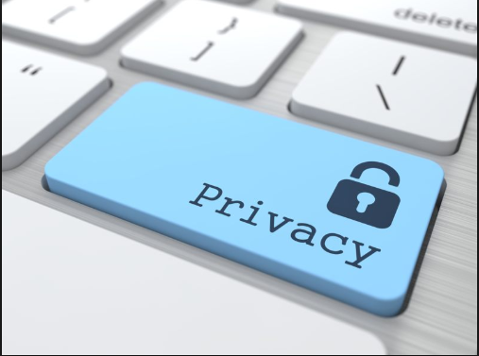
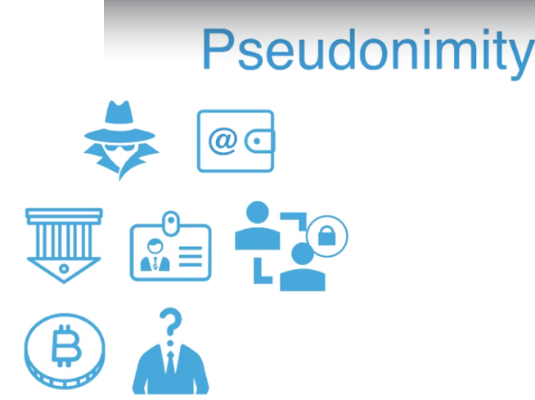
So What is not Block chain ? It is not solution to All problem
As we know data is present in all nodes and read by all node.
Privacy is bit questionable. If use case where we have to prevent reading of data Open block chain is not an option.
If you want Kyc (know your customer)
Then Open block chain is Not and answer

Slide 14
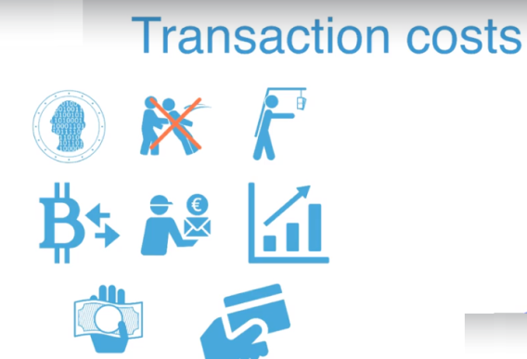
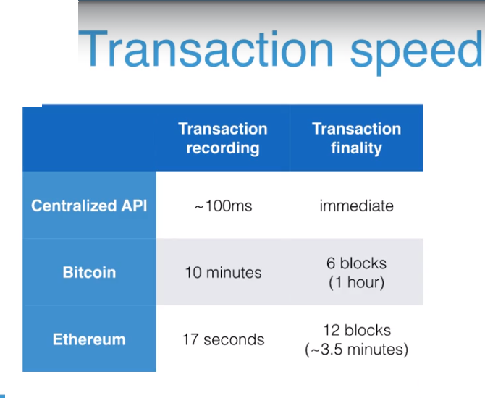
So What is not Block chain ? It is not solution to All problem
Transaction cost is going to go up.

Slide 15
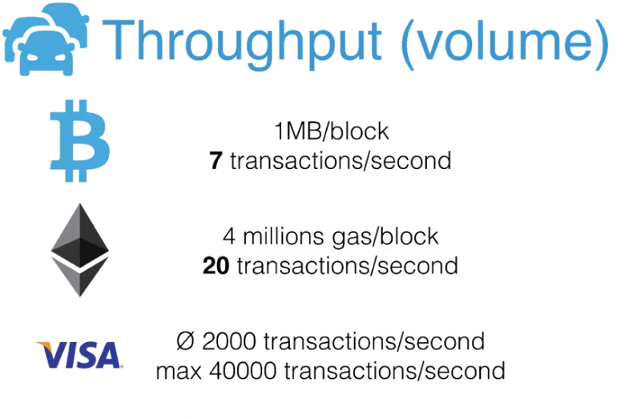
So What is not Block chain ? It is not solution to All problem

Slide 16
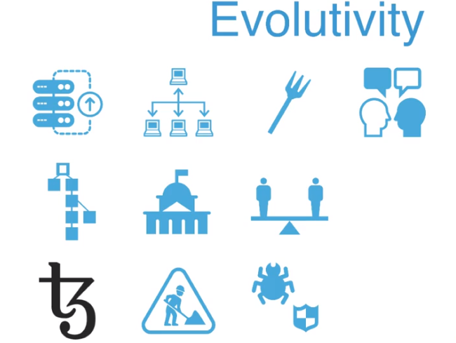
So What is not Block chain ? It is not solution to All problem

Slide 17
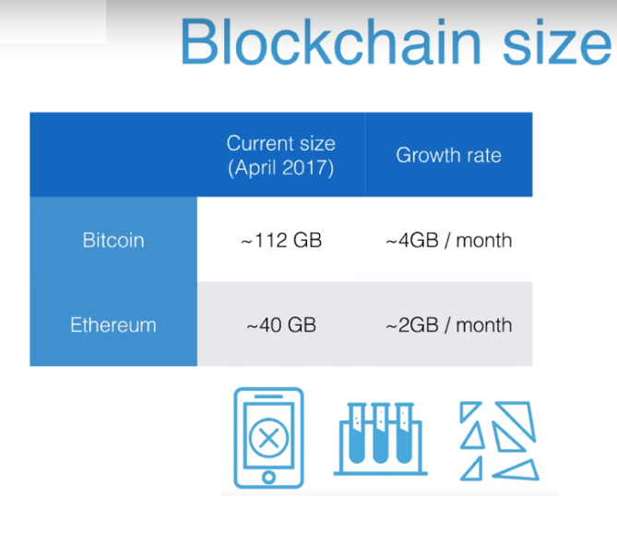
So What is not Block chain ? It is not solution to All problem

Slide 18
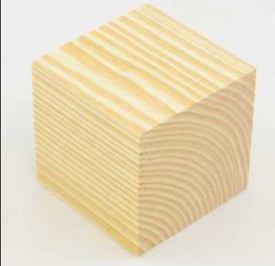
So What is A Block?
Most fundamental unit, we need block to build block chain?
It is kind of collection for following things.
(a) Timestamp in milliseconds
(b) lastHash- the hash of the block before it
(c) the data store
Code :- blockchain/block.js

Slide 19
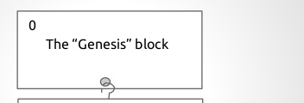
So From where First Block Came?
(a) concept of genesis Origin of First block
(b) It has dummy value
(c) It has predefine value
Code :- blockchain/block.js

Slide 20
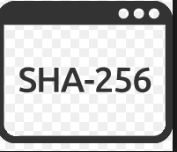
Why are using SHA256?
(1) The has is generated from the timestamp, lastHash and Stored data
(2) We have used algorithm called SHA-256
(3) Because it generate hash value with bit size of 256 , 32 byte
(4) Which represent 32 char.
(5) Produces unique 32-byte (256 bit) has value for Unique data input
(6) One-way street
(7) It is useful for block validation
Code :- blockchain/block.js /chain-util.js

Slide 21
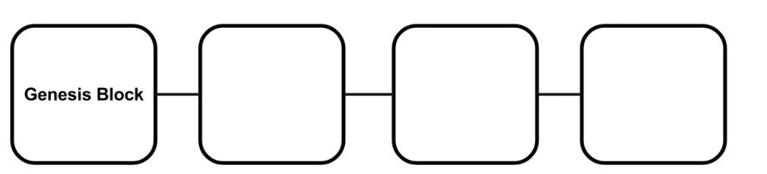
Hope What Block Chain Understood?
Code :- blockchain/index.js

Slide 22
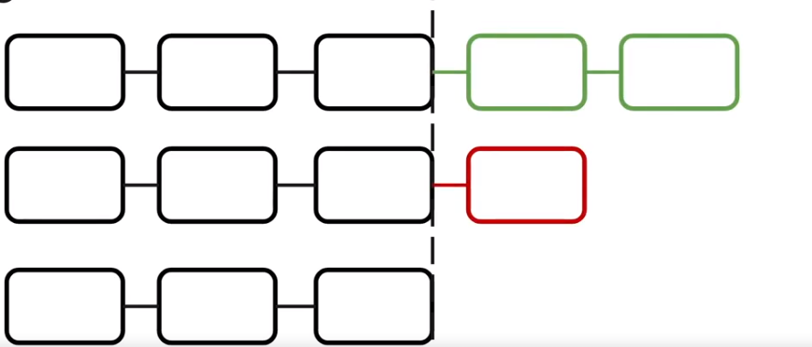
What is rule to validate the chain?
(1) Accept the longer chain of block
(2) Agreed upon is which has most data in it
(3)It reduce problem for fork
which means If Miner A and B submit Block of size 1, not Half of Miner may have value of A and Half Of Value B
Code blockchain/index.js / isValidChain

Slide 23
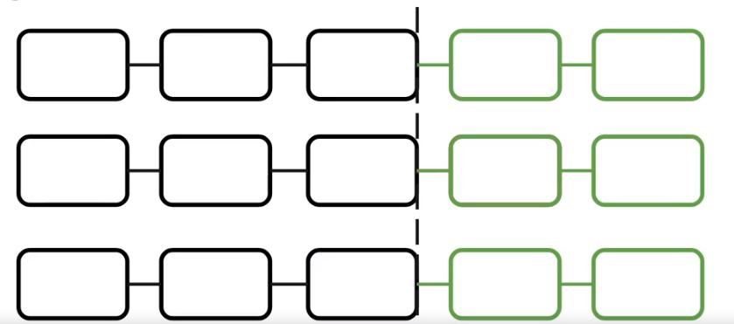
What is rule to validate the chain?
Code blockchain/index.js / isValidChain

Slide 24
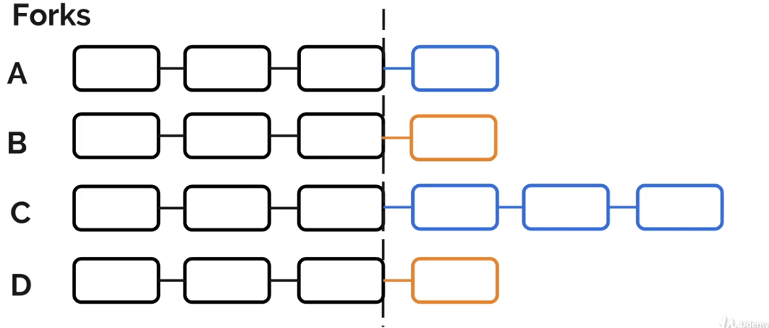
What is rule to validate the chain?
Code blockchain/index.js / isValidChain

Slide 25
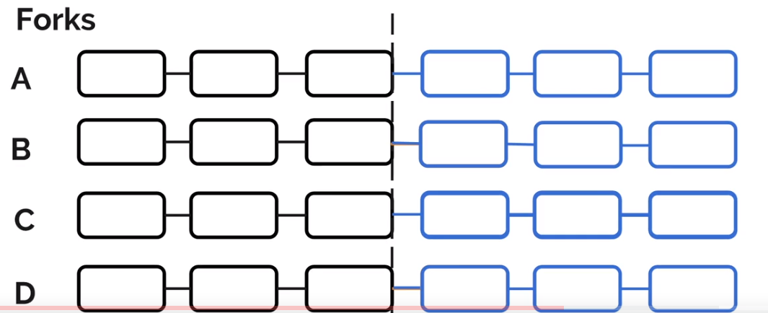
What is rule to validate the chain?
Code blockchain/index.js / isValidChain

Slide 26
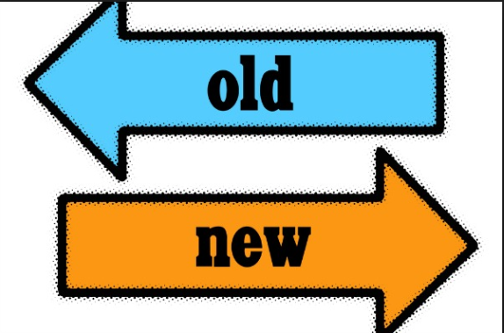
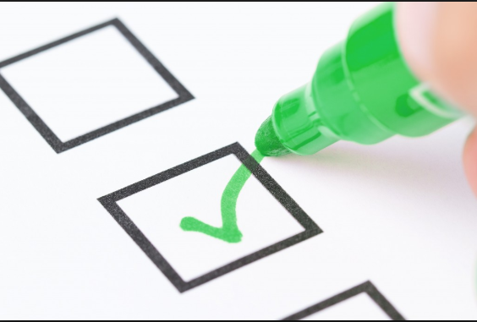

Ok, I Got it How chain is validated, Now How chain is updated ?
For that there method replaceChain in file
what is does check
(1) Used the longest chain as shown slide before
(2) validation of chain with method isValidChain
(3) Then we replace our current chain with new Chain
Code blockchain/index.js / isValidChain / replaceChain

Slide 27
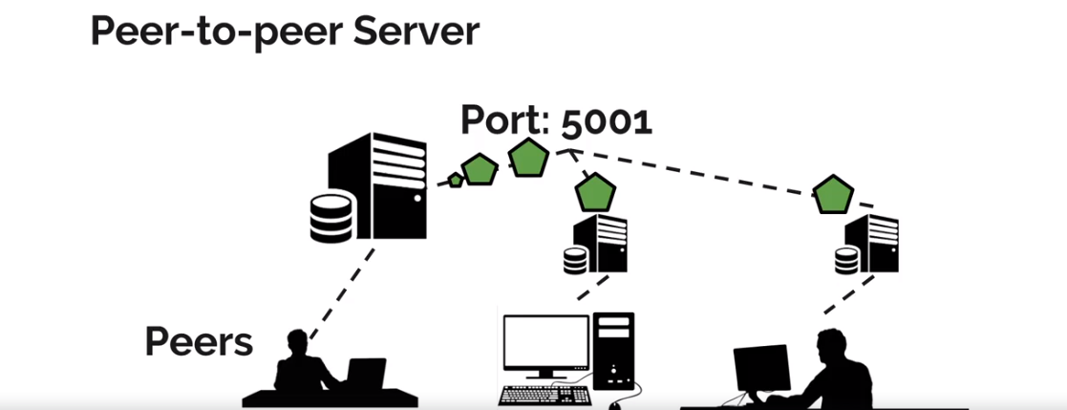
What are you using for communicate with different node?
(1)The First app to Start peer-to peer server
(2) A later server connecting to the original (3) We are using WebSocket for communication
Code app/p2p-server.js

Slide 28
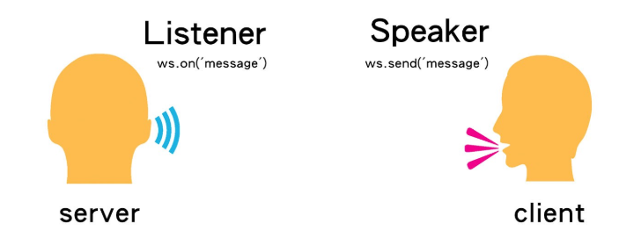
How every thing is synchronized?
(1)Every thing is Synchronized using
Code app/p2p-server.js

Slide 29
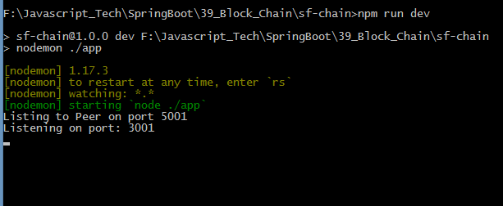
How every thing is synchronized?
Ran the application
Code app/p2p-server.js

Slide 30
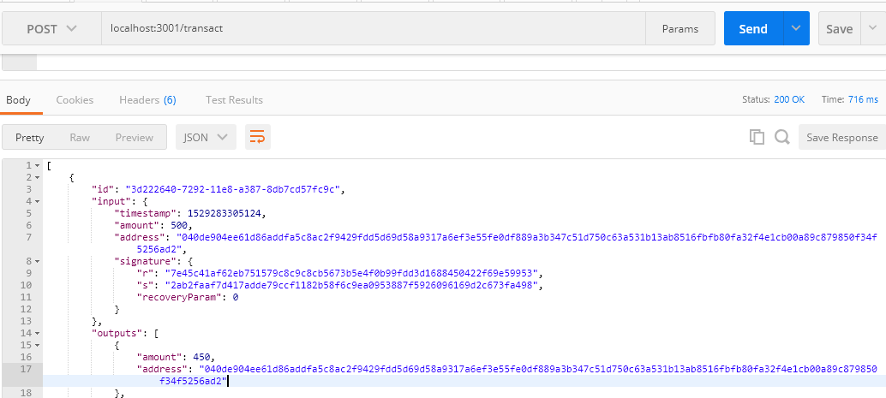
How every thing is synchronized?
Started Transaction Using Post man
Code app/p2p-server.js

Slide 31
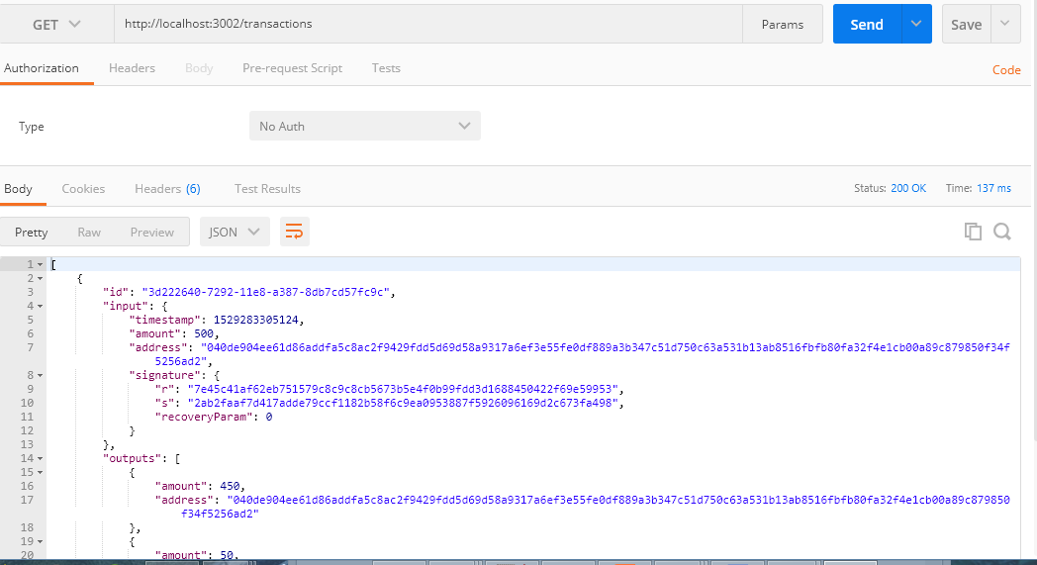
How every thing is synchronized?
Seeing Transaction on another port
Code app/p2p-server.js

Slide 32
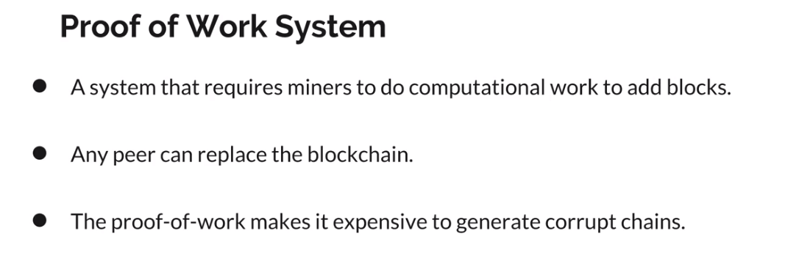
What is Proof Of Work?
Code (nonce defined and used) config.js blockchain/block.js

Slide 33
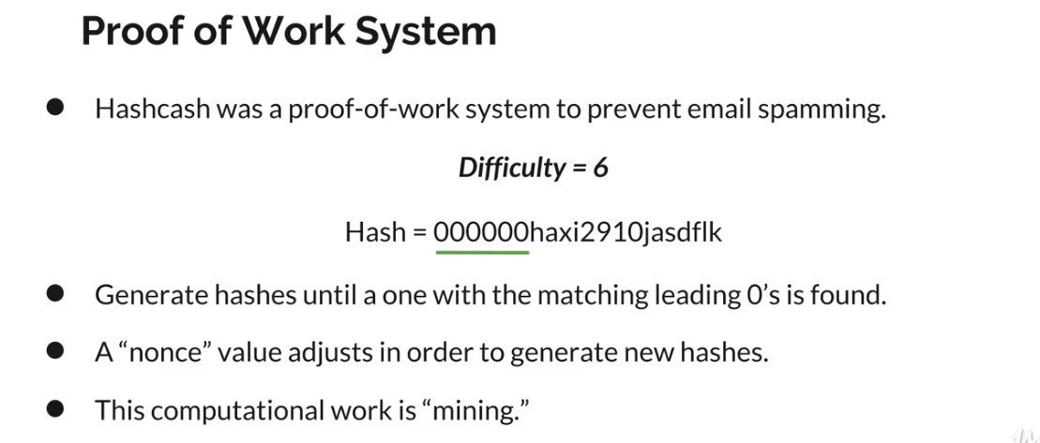
What is Proof Of Work?
Code (nonce defined and used) config.js blockchain/block.js

Slide 34
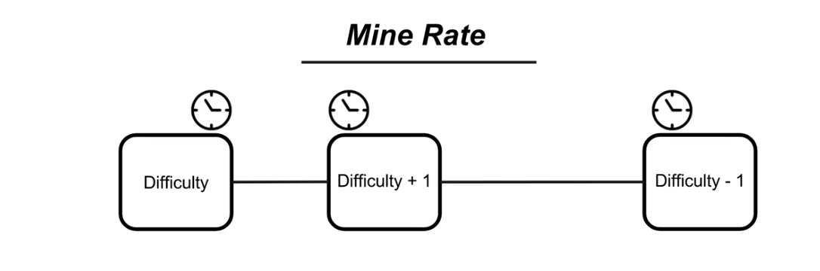
Is Difficulty is Constant?
No
Code (nonce defined and used) config.js blockchain/block.js / adjustDifficulty

Slide 35
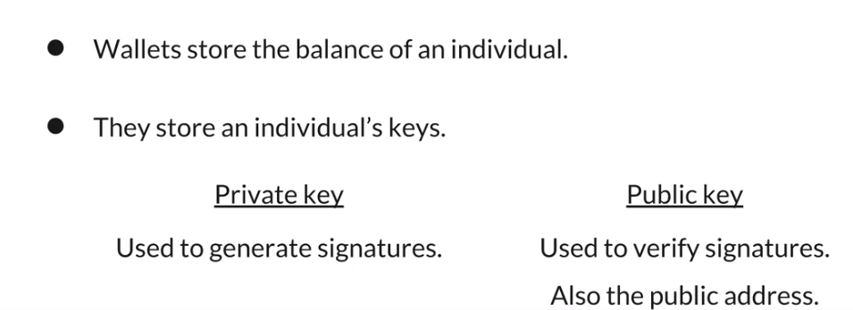
Again What is Wallet?
Code wallet/index.js / createTransaction

Slide 36
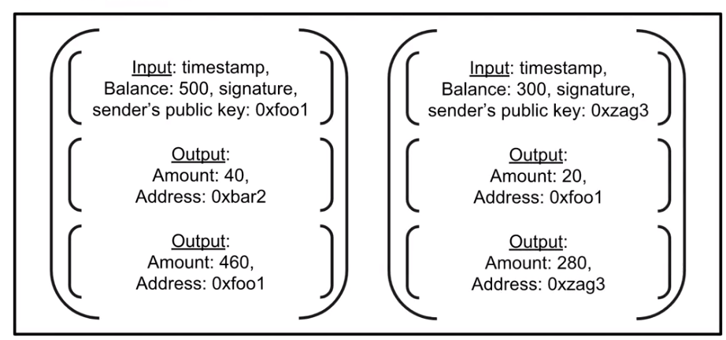
What is Transaction?
Code wallet/ transaction.js

Slide 37
Private and Public Key Again?
Uses Cryptography to generate digital signature
It is unique signature to individual account So who ever want to record data inside the block chain has to use unique signature
What is Digital Signature? It is Private key (secret) public key (open to identify)
Code wallet/ transaction.js / signTransaction / VerifyTransaction chain-util.js / verifySignature

Slide 38
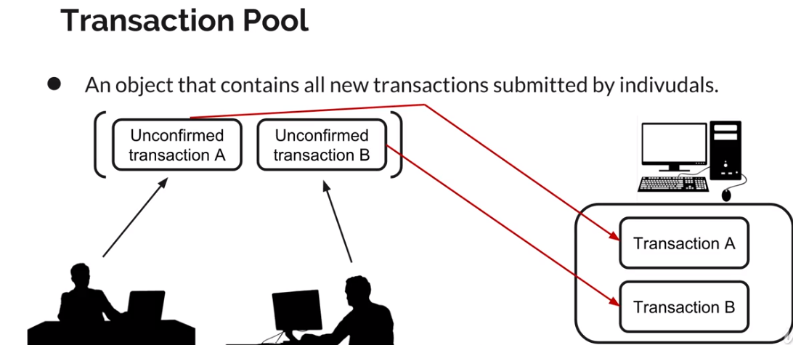
How do you handle Unconfirmed Transaction?
Code wallet/ transaction-pool.js

Slide 39
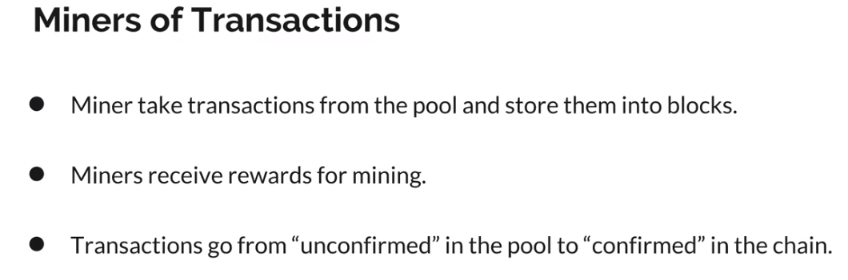
How Transaction is confirmed?
Code wallet/ app/miner.js

Slide 40
How to Access all endpoint?
(1) /Blocks
This response is when block get mined
(2) /mine-transactions
This mines any un confirmed transaction
(3) /transact
This init the transaction with specified amount
{"recipient": "foo-4dr3ss1","amount": 50}
Json format
(4) /transactions
Shows what transaction is pending .
Code app/index.js

