Slide 1
TDD
Test Driven Development

Slide 2
What is TDD?
Test Driven Development is a methodology
Keeping Test one step head of code

Slide 3
Common Misconception
TDD is not about testing
TDD is about design and development
By testing first you design code

Slide 4
How TDD is Followed?
Short development iteration
Based on requirement and pre-written -test
Produce code necessary for iteration
Refractor both code and test

Slide 5
How TDD Help Developers?
TDD Help to produce clean working code
Write Test Code that fulfills the requirement
Refractor code make it more readable
Remove the Fear to change

Slide 6

How TDD Help Developers?
TDD Help to produce clean working code
Write Test Code that fulfills the requirement
Refractor code make it more readable
Remove the Fear to change

Slide 7
How TDD Help Management?
Less Bugs in Production
Less Time for fixing bug
Having documentation ready in code itself
Most important winning project from competitors and understand without there help.

Slide 8
SOLID Principle?
In object-oriented computer programming, the term SOLID is a mnemonic acronym for five design principles intended to make software designs more understandable, flexible and maintainable (Defination from Web)

Slide 9

Full form SOLID ?
(S) Stands for Single responsibility principle
A class should have only a single responsibility

Slide 10
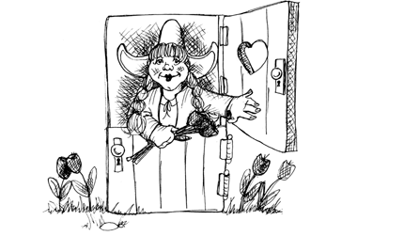
Full form SOLID ?
(O) Stands for Open/closed principle
Software entities … should be open for extension, but closed for modification.

Slide 11
Full form SOLID ?
(L) Stands for Liskov substitution principle
objects in a program should be replaceable with instances of their subtypes without altering the correctness of that program.

Slide 12
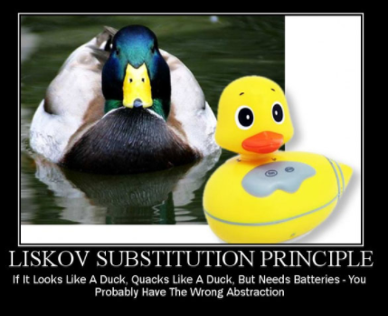
Full form SOLID ?
(L) Stands for Liskov substitution principle
.

Slide 13

Full form SOLID ?
(I) Stands for Interface segregation principle
many client-specific interfaces are better than one general-purpose interface

Slide 14
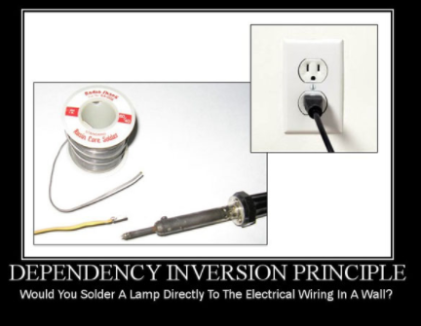
Full form SOLID ?
(D) Stands for Dependency inversion principle
many client-specific interfaces are better than one general-purpose interface (avoid using new)

Slide 15
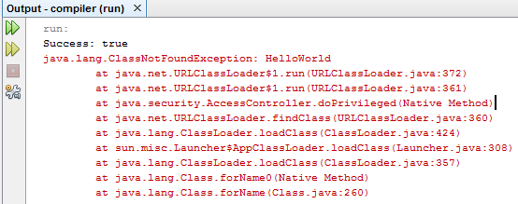

RED, GREEN AND REFACTOR
This Means
RED (Make It fail) There should be error in compilation or Test

Slide 16
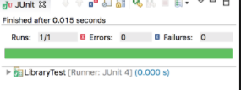
RED, GREEN AND REFACTOR
This Means
Green (Make It Sucess) There should be No error in compilation or Test

Slide 17
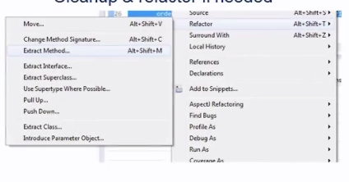
RED, GREEN AND REFACTOR
This Means
Refactor (Make It clean) Code Should be clean

Slide 18




Required Setup
JAVA
Eclpise (STS)
Maven
H2

Slide 19
Junit Concept
Good Unit test following Steps
Setup Involves Setup of data and Fixture which need for execution
Execution Invocation of method under test
Verification Assertion of result which is returned by method under test
Teardown Clearing all what was created during setup and execution of test

Slide 20
Junit Concept
Some important Junit @annotation
@Test Which Method going to be tested
@Before This is where anything before Start of test ca be setup
Verfication Library such as org.junit.Asserr.* HamcrestMactherAssert

Slide 21
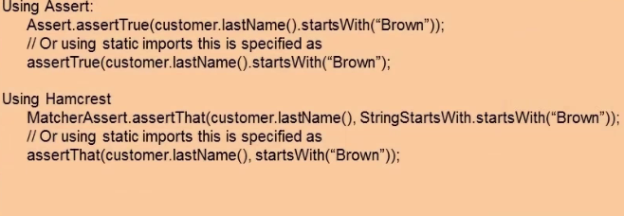
Junit Concept
Some important Junit @annotation
@After This method used everything is completed .

Slide 22
Red/Green/Refactor and Junit
Video From Clean Code Bob Martin
Download Link https://goo.gl/7UWnmw
https://goo.gl/obYMqJ

Slide 23
Test Doubles
Stubs
Fake
Mock

Slide 24
Test Doubles
Stubs
Means Which Provide back predefined answers
No Behavior
It has Information recording
Help in providing state based verification

Slide 25
Test Doubles
Fake
More advance then stub
One of best example is Database testing
Providing SqlExpress / Local mongo instance of testing

Slide 26
Test Doubles
Fake
Mock is behavior based verification
Example Method were called with right parameters
Difference between mock and stub , Most of the time mock defined before execution of test
Assertion is made by Mock

Slide 27
Mocking Concept
Method under Test often leverage dependency
Testing with dependencies create challenges Live Database is needed Multiple developers testing simultaneously Incomplete dependency
Mocking Framework give control
Mocking framework Mockito ,Easymock ,Jmock

Slide 28
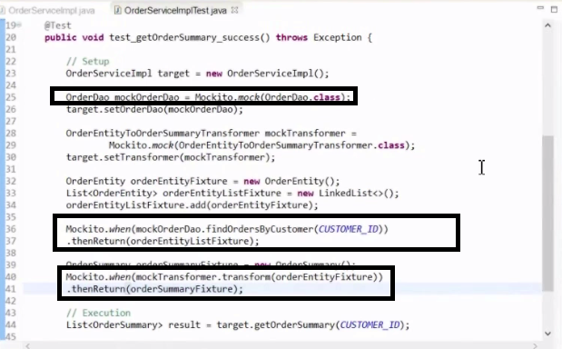
Mockito Overview
Setup – Creating The mock Example :- Xdao xyz= Mockito.mock(Xdao .class)
Setup - Method stubbing
Mocito.when(xyz.find(a)). thenReturn(<data>)

Slide 29

Mockito Overview
Verifcation

Slide 30
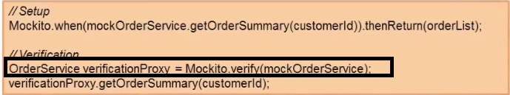
Mockito Verification
Mockito.verify is used to verify an intentend mock operation was
Verifcation mode Allows extra verification of Operation times ,atLeastOnce

Slide 31
Mockito Verification
Mockito.verify is used to verify an intentend mock operation was
Verifcation mode Allows extra verification of Operation times ,atLeastOnce

Slide 32


Mockito Advance Features
Argument matching Argument matchers provide extra control of stubs and verification calls.
Example
If different parameter is passed mock will return null
Example

Slide 33
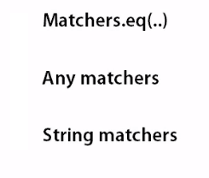
Mockito Advance Features
List Argument matching

Slide 34
Mockito Advance Features
Verifying in Sequence
When we want verify if Operation A needs B and C in Sequence in One by One.
InOrder method is called

Slide 35
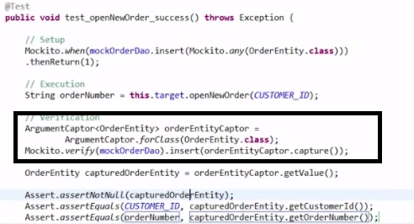
Mockito Advance Features
Capturing object passed inside the mock
Argument Captors is used

Slide 36
Good Test
(F)IRST
Test Should be Fast To execute
F(I)RST
Test Should be Independent from one Another
FI(R)ST
Test Should be Repeatable
FIR(S)T
Test Should be Self-validating
FIRS(T)
Test Should be written before code

Slide 37
Anti-pattern in Testing
The Singleton
Create The World
Completely mocked
Usually Passes
Big test
Slow Test

Slide 38
Anti-pattern in Testing
The Singleton
It means retain state over time
It is not good for Testing
Because Test are Self contain
Use Interface in place of Singleton

Slide 39
Anti-pattern in Testing
Create The World
When test Need lot of depency
It make Hard to fiqure out what is needed when test
It makes slow to run
It makes setup bittle

Slide 40
Anti-pattern in Testing
Completely mocked
This kind of Test Mocks
It just checks the flow of mock

Slide 41
Anti-pattern in Testing
Usually Passes
This Type of Test passes most of time and fails some time
There is no change in code when last time it passed
This type error occurs when there external depency and they are not mocked example database / webservices

Slide 42
Anti-pattern in Testing
One Big test
Do lot of assertion
Calling different method and Asserting between them
It become bigger and bigger

Slide 43
Anti-pattern in Testing
Second class test
Test code that poorly structured
Not keeping code in good shape

