Slide 1

Identifying New York’s most profitable zips
Data Product to identify the most profitable Zip within New York City
A case study for ABC real estate company

Slide 2
Agenda
Problem Statement
Data Quality Checks
Methodology
Exploratory Data Analysis
Data Analysis
Cost Factor Calculation
Calculating Occupancy Rate
Outlier Removal on Pricing
Metric Creation
Analyzing Results
Recommendations
Next Steps
Demo (R Code, RMD file)

Slide 3
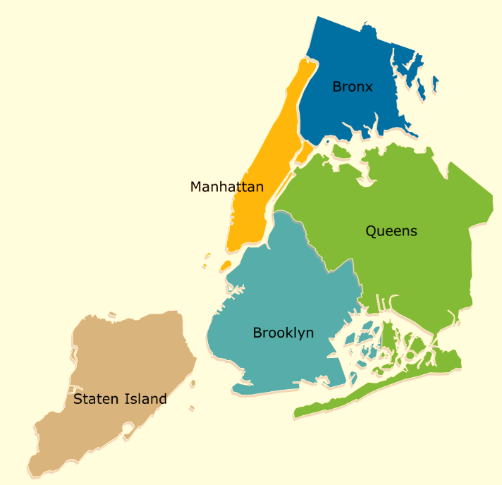
ABC real estate company is looking to identify most profitable zips within New York city
Data Available
Cost data: Zillow provides us an estimate of value for two-bedroom properties
Revenue data: AirBnB is the medium through which the investor plans to lease out their investment property
Background
New York consists of following five boroughs/ neighborhoods
Assumptions
The investor will pay for the property in cash
The time value of money discount rate is 0%
All properties and all square feet within each locale can be assumed to be homogeneous

Slide 4
Following steps were performed to bring data in the required format
Data Loading- Revenue and Cost files were loaded
Missing value check- Data is checked for missing values
Relevant Column Names- Column names of both Datasets were checked and relevant columns are filtered from the dataset
Missing values in columns- Check count of missing values in relevant columns. Zipcode has 1.5% and bedrooms has 0.16% missing values.
Data Cleaning- Making zip to 5 digits. Dropping the dollar sign and changing the format to numeric format
Merging the file -Merging with the revenue file to get property cost of 2 bedroom apartments on the zip
Filtering for NY Zips -Filtering for NY zip codes that will be considered for the analysis

Slide 5
Ten steps approach was followed to finalize results
Data Loading
Data Quality Checks
Creating Master Dataset
Exploratory Data Analysis
Analyzing Cost Factor
Filtering property listings based on review count
Calculating Occupancy rate
Outlier removal based on prices
Metrics creation
Analyzing Results

Slide 6
Manhattan has the highest number of property listings with ~85% of properties in that area
Manhattan has the highest number of properties (listings) which suggests that it is most preferred place for visitors
Manhattan is followed by Brooklyn followed by staten Island
Similar trend is observed at zip level with top 3 zips belonging to Manhattan followed by Brooklyn

Slide 7
Cost factor was calculated based on the bed room count of the property
Since, we had property cost of only 2 bedroom apartment, we decided to calculate property cost
based on the bedroom count for each property
Steps to calculate the factor -
Average size (in sq. feet) was calculated across bedroom counts
Cost factor was calculated after dividing size with that of 2 bedroom house
1
2
To calculate cost factor following formula is applied-
Avg. size/size of 2 bedroom apartment
E.g. for 4 bedroom
3350/924=3.63

Slide 8
Only properties with 5 or more reviews were considered in the analysis
To keep the results reliable and have enough properties in the analysis, we decided to go ahead with 5 or more properties
Only properties with 5 or more review were considered in the analysis (4,527)

Slide 9
Occupancy Rate was calculated based on the Location review score of the property listings
Since, we are interested in location, location review score was used in the analysis which would serve as a proxy for occupancy rate based on location
Occupancy rate was calculated using the availability in next 30 days (column availability_30) present in the dataset
Majority of the property listing received 9 or 10 location review rating
Occupancy rate increases as we go from low to high location review score

Slide 10
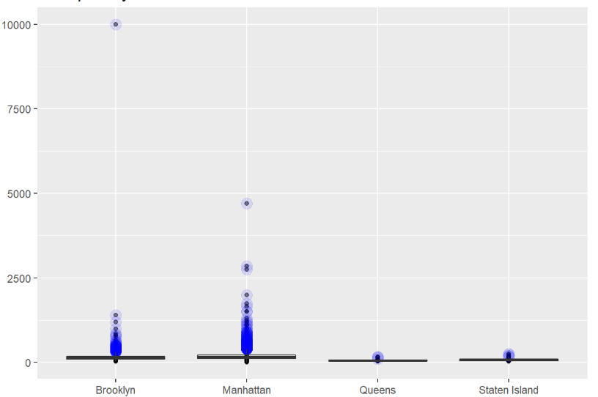
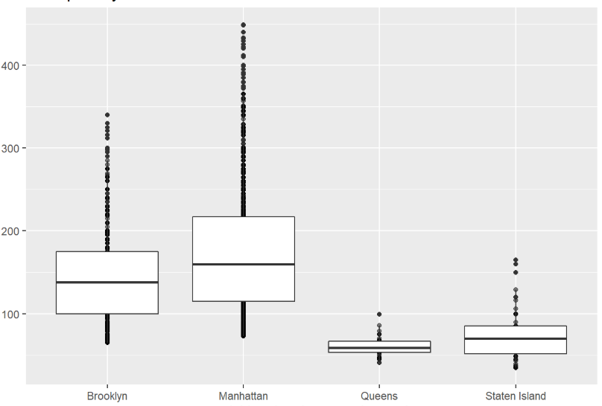
Outliers were removed based on the price charged for the property
Price per day (in $)
Remove outliers based on price per day as keeping them would skew our results and make our analysis unreliable
Only properties in the range 5% to 95% were kept in the analysis

Slide 11
Breakeven period metric was used to analyze property listings across zip codes
1
2
Annual Revenue= price per day X 365 X Occupancy rate
Property Cost = Latest cost of 2 bedroom apartment X Cost Factor calculated
3
Breakeven Period =
Property cost / Annual Revenue
Breakeven period is a really good metric to understanding of how much time it would take to get the investment back or when the property would become profitable

Slide 12
Metrics were calculated across boroughs to understand most profitable boroughs
Manhattan was found to be the costliest place to stay followed by Brooklyn, Staten Island and Queens
Property cost closely follows the same trend as annual revenue
Breakeven time is least for Staten Island with 13.9 years followed by Queens, Brooklyn and Manhattan
Similar trend is expected for zip codes

Slide 13
Staten Islands Zip codes have lowest breakeven period when compared to other zip codes
If we need to select Top 10 zip codes, a cut off of ~20 years can be taken

Slide 14
Zips were arranged in order of their profitability to identify most profitable Zips
Although, most of the properties are in Manhattan as it receives the highest number of guests . Our Analysis suggests that the breakeven is also longest for Manhattan due to high property cost
Manhattan presents tough competition as there are many competitors and it has high property cost. Overall, it has long breakeven point and doesn’t present a good opportunity in terms of ROI
Staten Island has considerable lower property cost but it also gets fewer guests. Also, travelers and tourist who are visiting NY for business and leisure, it is much better for them to stay in Manhattan which is closer to offices and other tourist attractions
But going just by numbers it seems it is much safer to invest in a property at Staten Island as it offers shorter Breakeven point and is less risky compared to other locations
This is the list of top 10 performing zips that came in the analysis-
10305(SI)
10306(SI)
10314(SI)
10312(SI)
10303(SI)
10308(SI)
11234(B)
11434(Q)
10304(SI)
11215(B)

Slide 15
ABC real estate should diversify investments in all the boroughs based on calculated metrics
Our recommendation would be to diversify and buy properties in top performing zips of
different neighborhoods with prime focus on Staten Island
Since, Staten Island doesn’t receive than many visitors, not all properties should be bought in that area
Top performers in respective neighborhoods should be chosen to minimize risks and maximize return
Potential candidates also depend on the investment as the property cost varies significantly based on location
Profitability should be evaluated in a year to understand whether these properties are providing expected returns
For instance, If we need to recommend 8 zips then these are the zips we would recommend-
10305(SI)
10306(SI)
10314(SI)
10312(SI)
11234(B)
11434(Q)
11215(B)
10036(M)

Slide 16
Modifying the analysis for following factors would result in more accurate results
Property cost - Property cost used for this analysis was from Jun’17. Latest property cost should be used if it is available. We can also use forecasting techniques like ARIMA to predict latest property cost from past trend. We can also take the actual cost of properties which would give more accurate results
Factors impacting Occupancy - In the present analysis, although we have used occupancy rate based on review score location, there are other factors which impact occupancy rate. We should also normalize our results for other factors like cleanliness, staff behavior etc which definitely impacts Occupancy rate. We can also use Availability_30 at property level to get more accurate results
Discount/Interest Rate - In this case, we have taken 0% discount rate as our assumption but that assumption is not practical. Some reasonable percentage rate can be taken to calculate NPV value and make a more accurate prediction

Slide 17
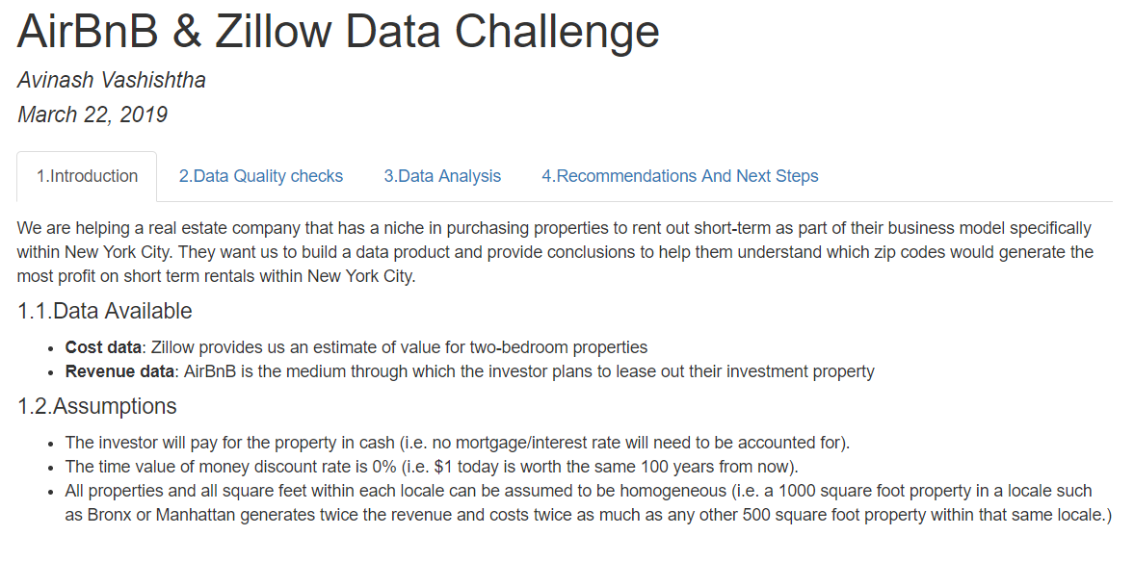
Demo
RMD File output
R output

