Slide 1

Development of Perceptual Metrics for the Verification of
Radar Simulation Data
Avinash Mahesh Nirmala M.S in ICT, Friedrich-Alexander-Universität Erlangen-Nürnberg,
Supervisor: Peter Mergenthaler, Oliver Sura

Slide 2
Comparision of Analytical solutions with MOM, Ray-launching, UTD

Slide 3
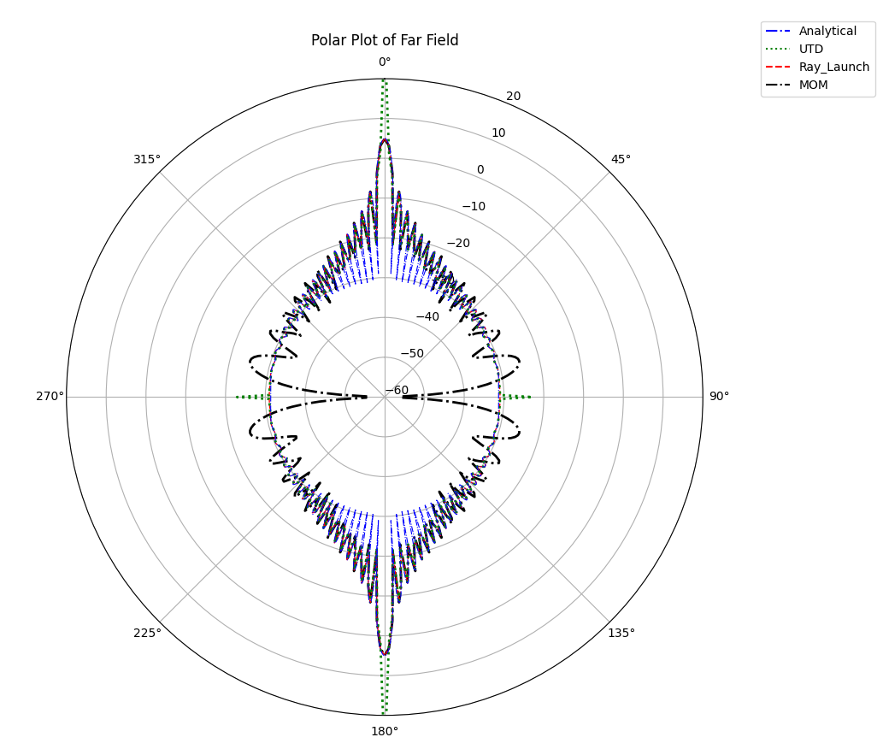
Comparision
Analytical solutions are computed using formulas provided in matlab book, and implemented RCS function for plate in Matlab.
Analytical and MOM have all most same amplitude until 45⁰
Ray launching is all most matches the analytical solution

Slide 5
Metal plate graphical rendering in LHFT

Slide 6

Graphical rendering
From Vector (from_vec) - This is the position of the camera itself. You need to place it at a suitable distance to view the plate clearly. Assuming the plate is at the origin and the camera needs to be positioned directly in front of it, you could set the camera at a position along the z-axis.
At Vector (at_vec) - This vector points to where the camera is looking at. Since the plate is at the origin and we want the camera to focus there
Up Vector (up_vec) - This defines the upward direction relative to the camera's point of view. Since the plate is rotated 90 degrees, and assuming the rotation is about the z-axis making the top of the plate align with the y-axis, you would typically want the up vector to align with the z-axis to keep the camera's view upright
Resulting image of graphical render, in LHFT simulator

Slide 7
Graphical rendering
Range in m | RCS in dBsm | Antenna intervel | RCS in dBsm
0.3 | -36.22309854567456 | 0 | -36.50662
0.4 | -36.272925370604156 | 5 | -36.60505
0.5 | -36.309885090762684 | 6 | -38.3249
0.6 | -36.339824417152016 | 7 | -41.880478
0.7 | -36.36481793261085 | 8 | -48.06490
0.8 | -36.399147731979326 | 9 | -84.05269
0.9 | -36.42760727598572 | 10 - 170 | No rays
1 | -36.43237920692748 | 171 | -84.51881
5 | -36.636900473562605 | 175 | -36.60647
7 | -36.64421164790298 | 177 | -36.54292
8 | -36.48156064091168 | 180 | -36.50662
10 | -36.08923222924891 | 176 | -36.57123
20 | -36.28516285950191 | 178 | -36.523009
100 | -37.64062746706982 | 179 | -36.511652
200 | -35.14185273490382 | 181 | -36.510189
700 | -22.675143707093305

Slide 8
End

