Slide 1

Development of Perceptual Metrics for the Verification of
Radar Simulation Data
Avinash Mahesh Nirmala M.S in ICT, Friedrich-Alexander-Universität Erlangen-Nürnberg,
Supervisor: Peter Mergenthaler, Oliver Sura

Slide 2
RCS vs Angle using FEKO simulator

Slide 3
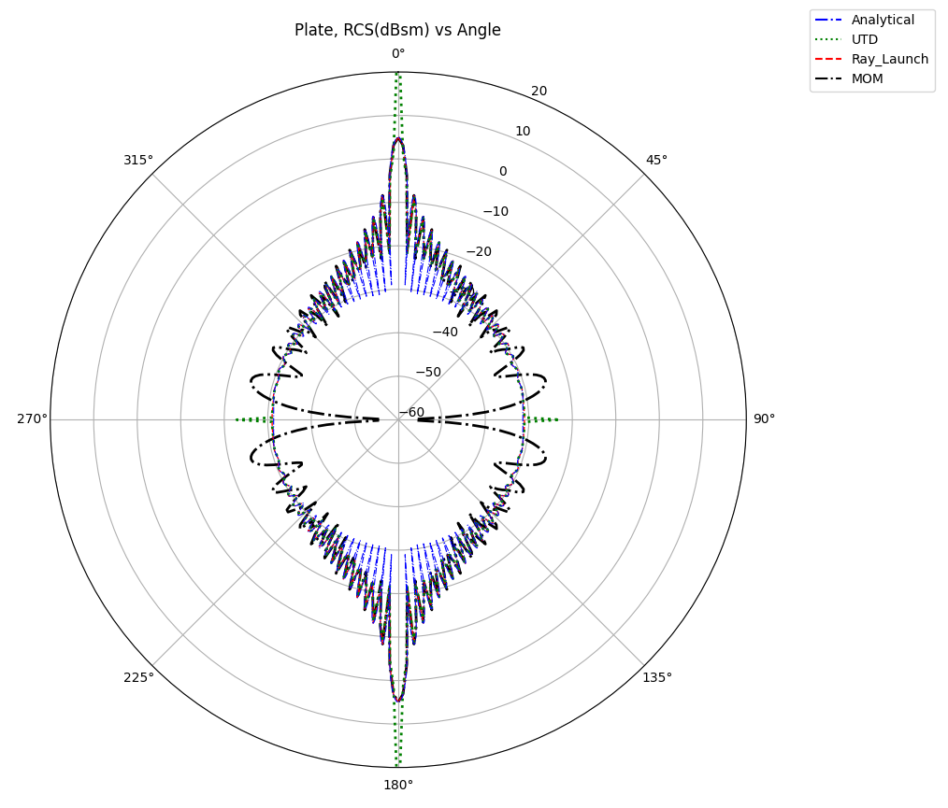
Comparision
Analytical solutions are computed using formulas provided in matlab book, and implemented RCS function for plate in Matlab.
Analytical and MOM have all most same amplitude until 45⁰
Ray launching is all most matches the analytical solution

Slide 4
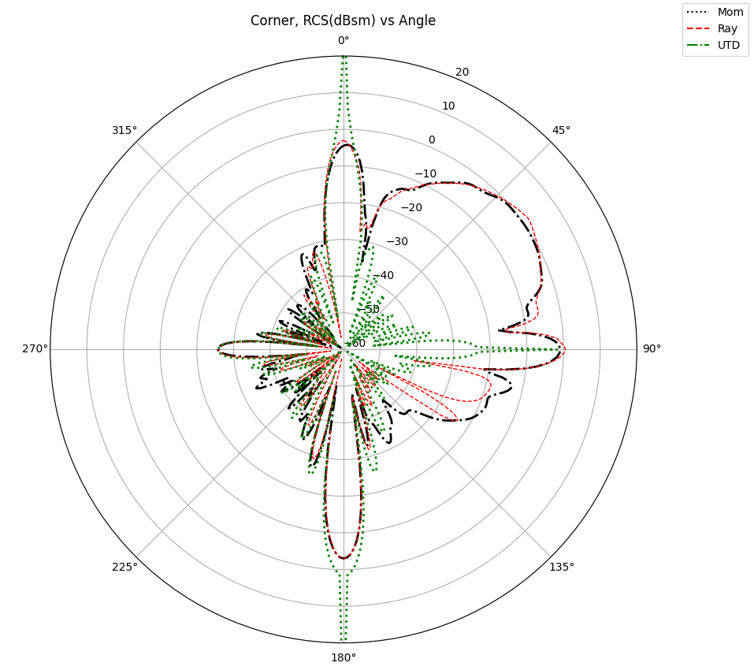
Comparision
Analytical solutions are computed using formulas provided in matlab book, and implemented RCS function for plate in Matlab.
Analytical and MOM have all most same amplitude until 45⁰
Ray launching is all most matches the analytical solution

Slide 5
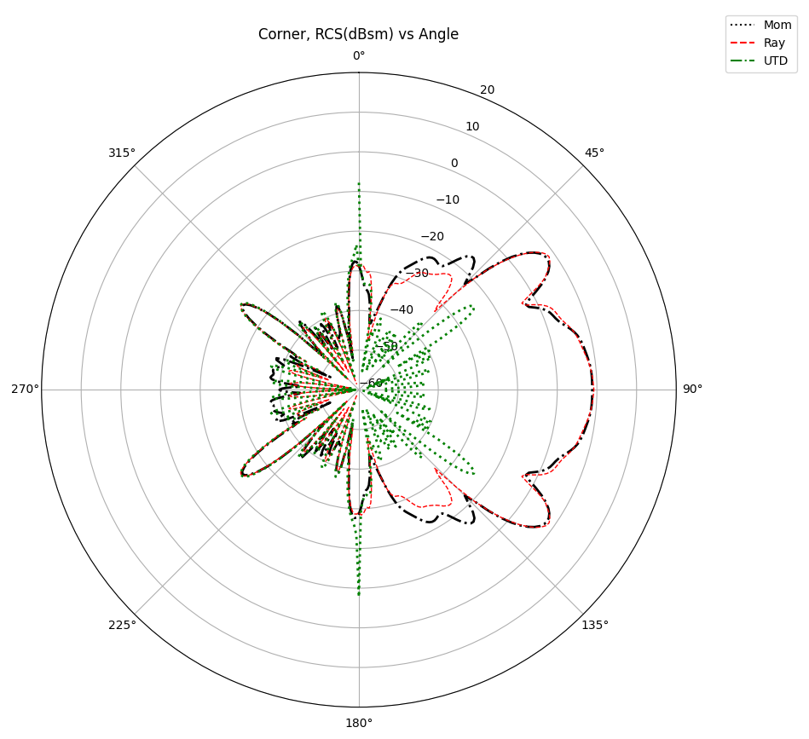
Comparision
Rotating corner right and left

Slide 6
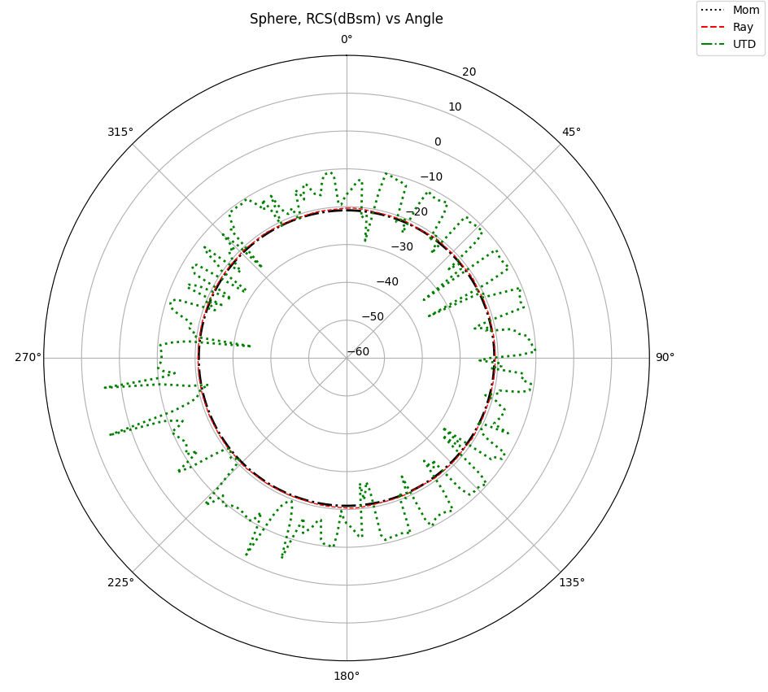
Comparision
Analytical solutions are computed using formulas provided in matlab book, and implemented RCS function for plate in Matlab.
Analytical and MOM have all most same amplitude until 45⁰
Ray launching is all most matches the analytical solution

Slide 7
Metal plate graphical rendering in LHFT

Slide 8

Graphical rendering
From Vector (from_vec) - This is the position of the camera itself. You need to place it at a suitable distance to view the plate clearly. Assuming the plate is at the origin and the camera needs to be positioned directly in front of it, you could set the camera at a position along the z-axis.
At Vector (at_vec) - This vector points to where the camera is looking at. Since the plate is at the origin and we want the camera to focus there
Up Vector (up_vec) - This defines the upward direction relative to the camera's point of view. Since the plate is rotated 90 degrees, and assuming the rotation is about the z-axis making the top of the plate align with the y-axis, you would typically want the up vector to align with the z-axis to keep the camera's view upright
Resulting image of graphical render, in LHFT simulator

Slide 9
RCS vs Angle using LHFT-Simulator

Slide 10
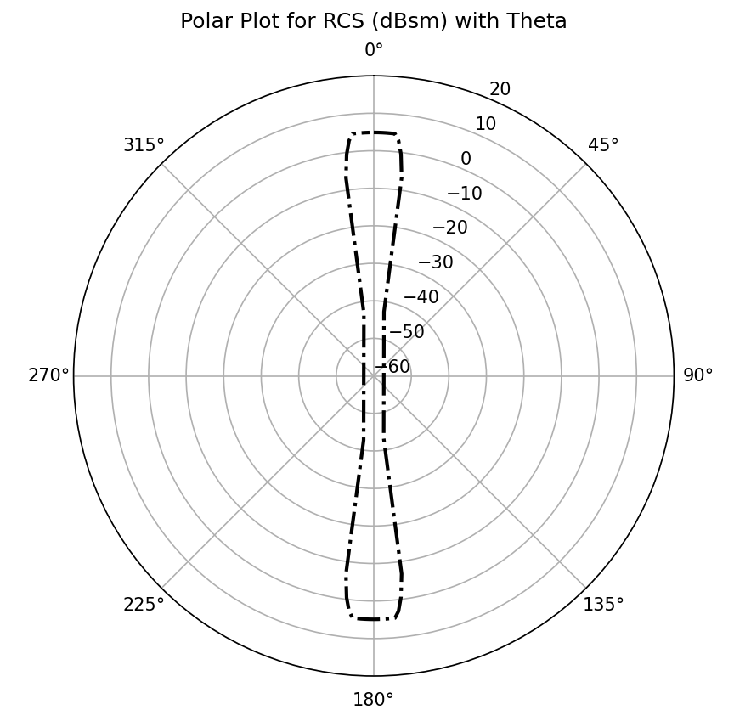
PEC plate RCS vs Angle
Specifications: PEC plate with 5cm each side Object range : 1 Over sampling factor : 30 Rx antenna radius : 0.3 Azimuth angle : 5.72

Slide 11
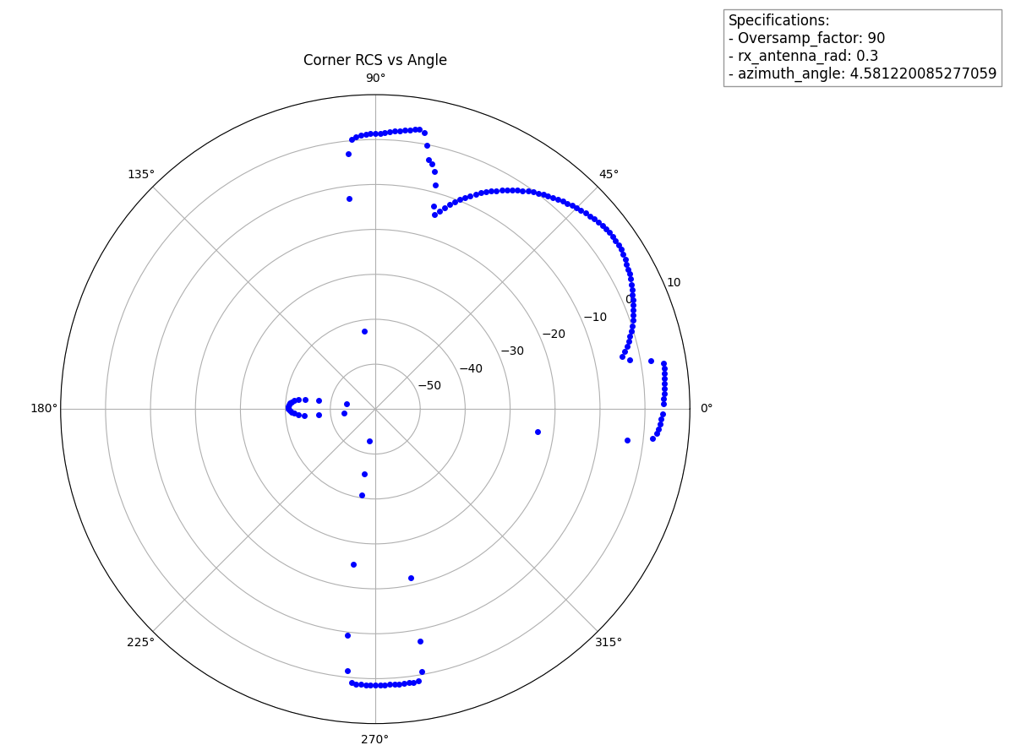
PEC Corner RCS vs Angle
Specifications: PEC corner with 5cm each plate Object range : 1 Over sampling factor : 90 Rx antenna radius : 0.3 Azimuth angle : 4.58

Slide 12
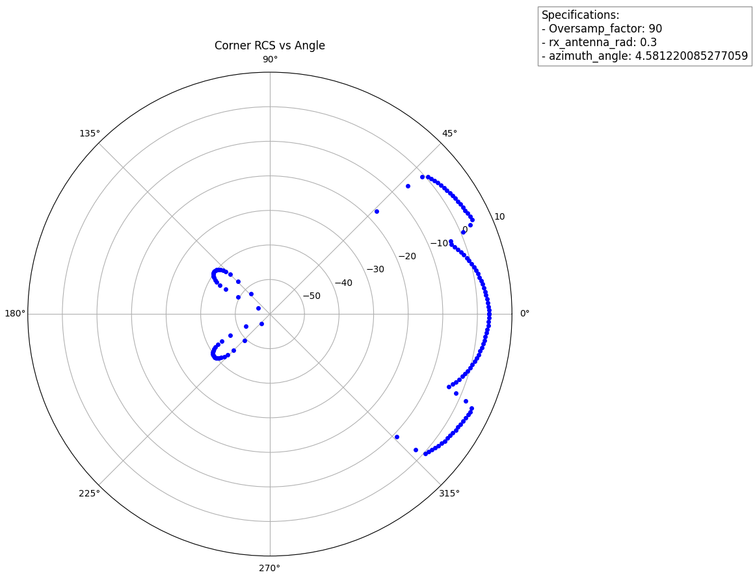
PEC Corner RCS vs Angle
Specifications: PEC corner with 5cm each plate Object range : 1 Over sampling factor : 90 Rx antenna radius : 0.3 Azimuth angle : 4.58 Rotate up: 45

Slide 13
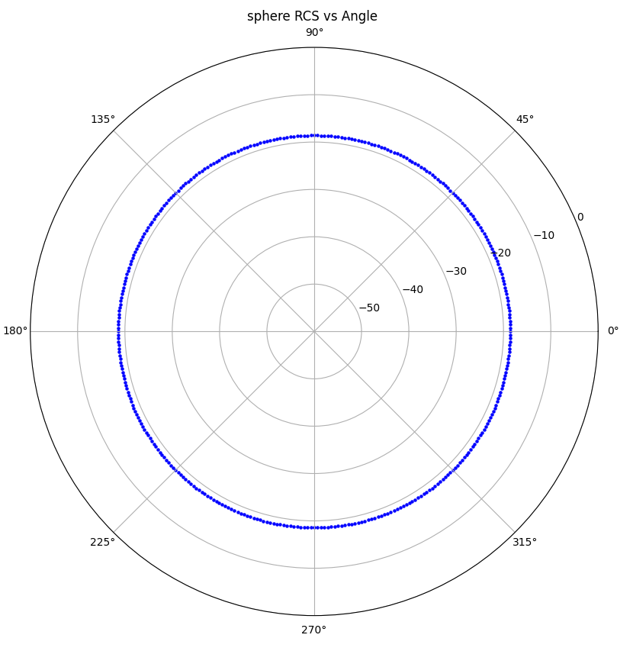
PEC Corner RCS vs Angle
Specifications: PEC sphere with 5cm radius Object range : 1 Over sampling factor : 30 Rx antenna radius : 0.3 Azimuth angle : 5.72

Slide 14
RCS vs Range using LHFT simulator

Slide 15
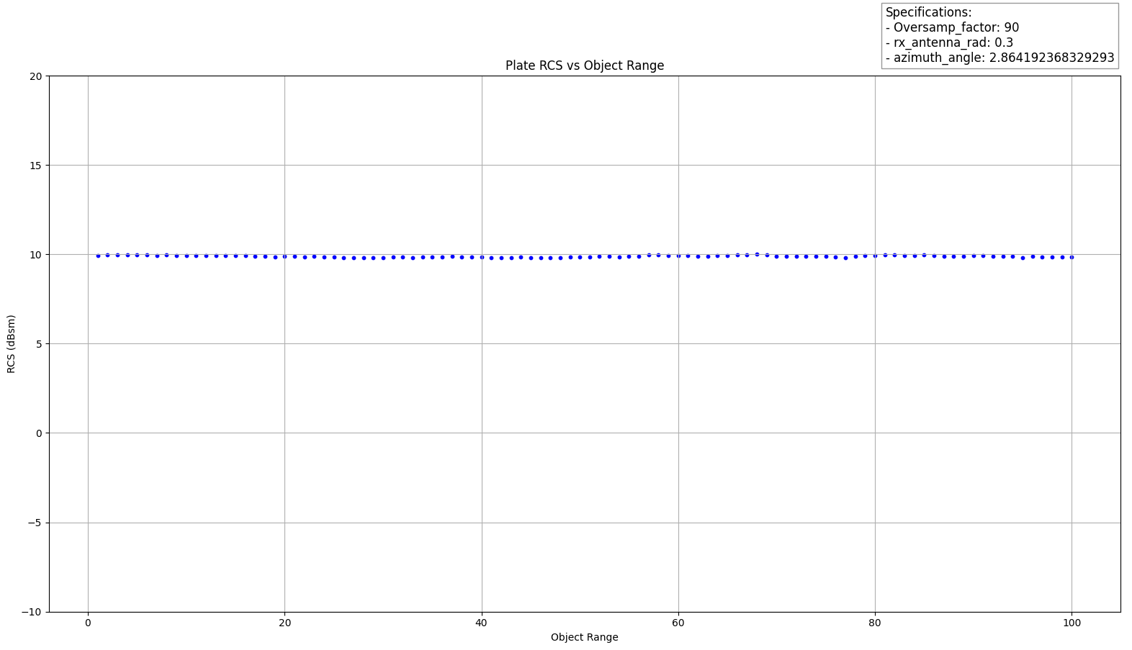
PEC Plate RCS vs range with higher sampling factor

Slide 16
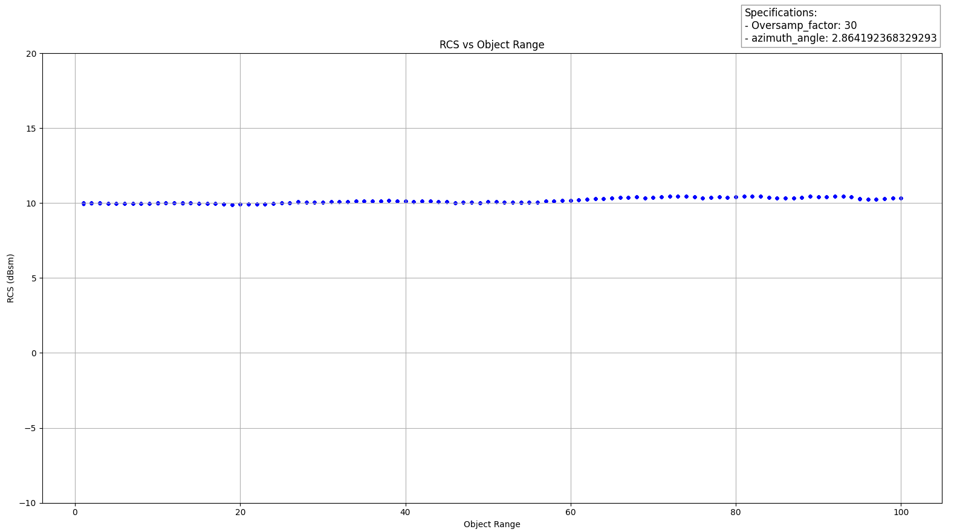
PEC Plate RCS vs range

Slide 17
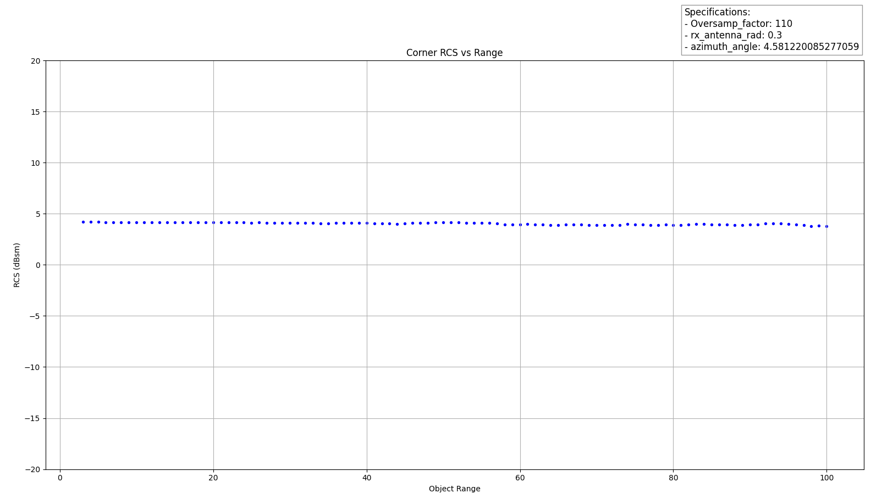
Corner RCS vs range

Slide 18
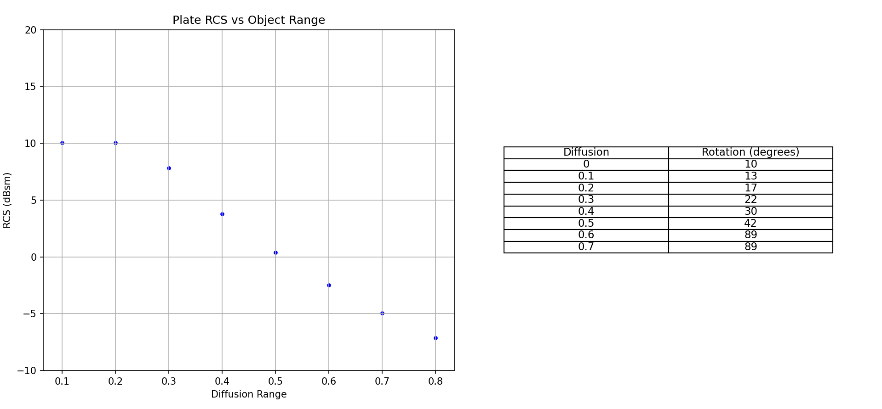
Plate RCS vs Diffusion constant
Specifications: Object range : 1 Over sampling factor : 60 Rx antenna radius : 0.3

Slide 19
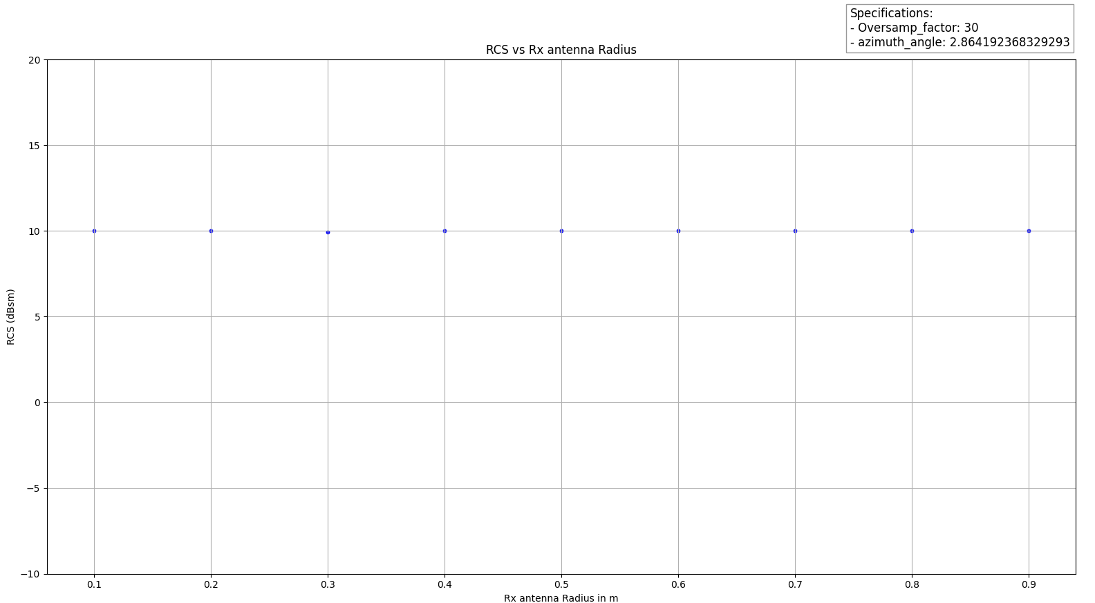
PEC Plate RCS vs Rx antenna radius
RCS values are constant over the RX antenna radius

Slide 20
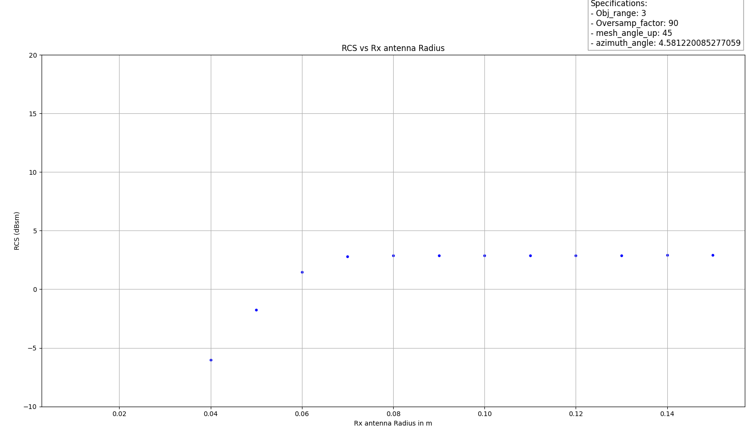
PEC corner RCS vs Rx antenna radius
Corner RCS vs Rx antenna rad
RCS values are constant after 0.08 RX antenna radius

Slide 21
Reason for Higher lobes near edge of plate using MOM

Slide 22
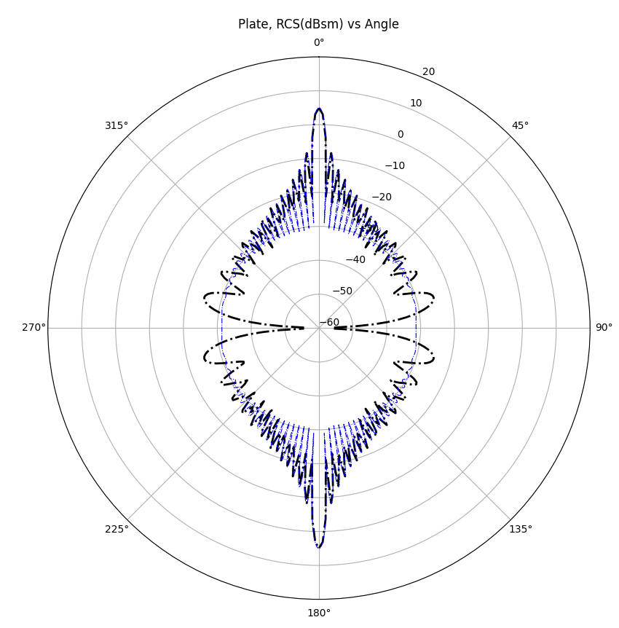
Higher side lobes near edge of PEC plate using MOM
Why do we have higher side lobes near edge of plate using MOM?
Primarily this is due to calculation of higher frequency RCS with MOM, leads to diffraction and edge scattering effects, while ray launching considers specular reflections.
Additionally, MOM accurately models surface currents, including their radiation near edges, which is not fully captured by ray launching and analytical methods.
Analytical methods often use simplifying assumptions to solve the problem near the edges of the plate. RL-GO approximations model the behavior of electromagnetic waves as rays, and ignoring complex interactions like diffraction and edge effects
Reference “Electromagnetic Scattering by Surfaces of Arbitrary Shape by R. F. Harrington”
MOM and analytical solution, with 60Ghz frequency

Slide 23
End

