Slide 1

HACKVYUHA 2025 PROJECT
TEAM INTRODUCTION
Team name :- code-warriors (HACKV38)
Names and roles of team members :- Neha Ganakumar - Project presentation
Nikhita Biradar - Project report
Anand Kumbar - Frontend
Madhura Chilakandi - UI/UX design
Avinash Biradar - backend
Collage Name:- BLDEAS V P Dr P G Halakatti collage of engineering and technology vijayapur
and
Angadi Institute of technology and management Belagavi
Contact details :- nehaganakumar@gmail.com
nikhitarambiradar@gmail.com
kumbaranand007@gmail.com
madhurachilakandi2004@gamil.com
avinashbiradar722@gmail.com

Slide 2
Problem Statement: 3
Real-Time Productivity Detection in Workspaces
Build a real-time monitoring system to detect Individuals in office desks, meeting rooms, or school environments and accurately calculate the time spent in productive spaces. The system should also account for breaks, idle times, and movement between zones.

Slide 3
Solution Overview
One-Liner Pitch:
A real-time AI-powered workspace monitoring system that detects individual presence across
zones, calculates productive hours, and visualizes usage insights through live dashboards
and anomaly alerts.
What the solution does:
The solution continuously monitors video feeds from office or school environments to detect
individuals in real time, track their movement across predefined zones (desks, meeting rooms,
break areas), calculate their productive time, generate heatmaps of occupancy, and unauthorized access.
Key benefits :
Real-Time Monitoring with YOLOv8 and DeepSORT.
Zone Mapping using OpenCV & Redis.
Time Logging & Idle Detection.
Heatmaps, Analytics Dashboards, and Alerts.

Slide 4

Innovation & Uniqueness
Unique Approach:
Real-Time Monitoring
Zone Detection
Time Calculation Logic
Heatmap & Analytics Dashboard
Anomaly Detection
Novel Integrations:
Interactive Productivity Timeline
Voice-Assisted Check-ins
AR-Powered Live Heatmaps
Anomaly Feedback Loop

Slide 5
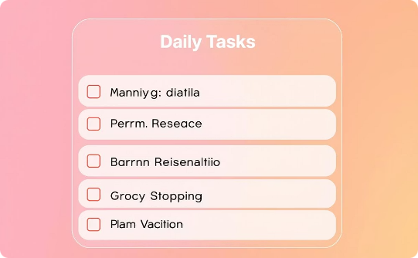
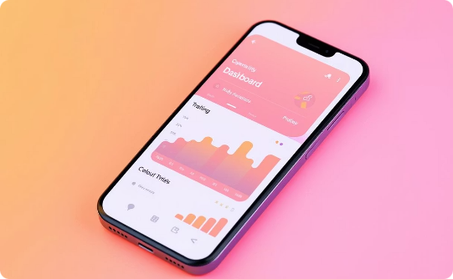
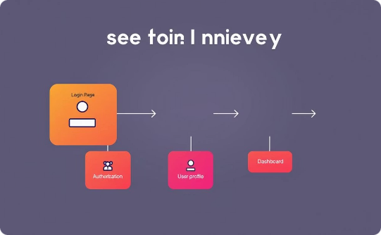
UI/UX Screens
Wireframe Design
High Fidelity Prototype
User Journey
Initial layout focusing on minimalistic task management.
Final polished design offering an engaging user experience.
A smooth flow optimized for quick user adoption and retention.

Slide 6
Technical Architecture & Tech Stack
System Architecture
Technologies Used
Tools & Frameworks
Microservices deployed on cloud with scalable load balancing.
HTML &CSS for frontend
Figma for design
Python backend
PostgreSQL database

Slide 7
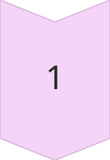
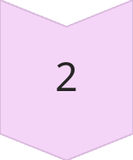
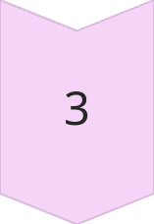
Prototype Demo Highlights
Live Interaction :
Real-time task updates boost productivity and reduce delays.
Real-Time Occupancy DetectionInstantly detects individuals in desks, meeting rooms, and break areas.
Feature Showcase :
Easy navigation between messaging, task lists, and reports.
Live Time Tracking DashboardShows current time spent in each zone with
live updates.
Demo Access : Dynamic User StatesAutomatically labels users as Working,
On Break, Idle, etc.

Slide 8
GitHub Repository
GitHub Project link :- https://github.com/Avinashb722/hackv38.git
.

Slide 9
Feasibility and Scalability
The solution is feasible with current technologies. The use of existing CV models (like YOLOv8, DeepSORT), real-time frameworks (Kafka, GStreamer), and dashboards (Streamlit) makes it technically implementable.
Key Feasible Points:
Body detection and tracking using pretrained models is well-established.
Zone-based presence detection can be mapped with basic camera calibration.
Time tracking logic and heatmaps are straightforward with time-series databases and visualization tools.

Slide 10
Impact & Value Proposition
Impact
Improved Operational EfficiencyEnables real-time tracking of personnel movement and zone usage, allowing companies to streamline workflows and reduce downtime.
.Enhanced Security and ComplianceDetects unauthorized access and idle behaviors, supporting safer and more compliant work environments.
Value Proposition1.
Data-Driven Productivity OptimizationProvides actionable insights into how space and time are used, helping organizations make informed decisions to boost performance.
Scalable and Cost-Effective SolutionDesigned with modern tech stacks for scalability, it reduces the need for manual monitoring and improves cost efficiency in large or dynamic workspaces.

Slide 11
Challenges Faced:
Real-Time Zone Transition and MappingChallenge: Defining fixed spatial zones (desks, meeting rooms, break areas) on video feeds and accurately detecting transitions between them.Technical Difficulty: Requires fine-tuned spatial calibration using tools like OpenCV and possibly homography to map camera coordinates to real-world zones.
Low Latency Processing with High ScalabilityChallenge: The system must process multiple video streams and provide live updates with minimal delay.Technical Difficulty: Real-time video ingestion (using Kafka/WebRTC), efficient processing (using Flink), and horizontal scalability must be orchestrated smoothly.
Accurate Human Detection and Tracking Across ZonesChallenge: Continuously and precisely detecting individuals in real-time video feeds is complex due to variations in camera angles, lighting, occlusions (e.g., people overlapping), and body postures.Technical Difficulty:
To successfully address the three major challenges in the Real-Time Productivity Detection in Workspaces project, the team should adopt a combination of technical tools, best practices, and architectural strategies

Slide 12
FUTURE SCOPE
Scalability Across Industries
Integration with Biometric and Access Systems
AI-Driven Productivity Insights
Smart Environmental Adaptation
Privacy-Preserving Monitoring
Predictive Anomaly DetectionFuture anomaly detection could

Slide 13
Learning and experience
New Tools or Skills GainedComputer Vision: Gained hands-on experience with object detection models like YOLOv8 and tracking algorithms such as DeepSORT/ByteTrack for identifying individuals across video frames.Real-Time Streaming: Learned to integrate tools like WebRTC and GStreamer for low-latency video feed processing.Zone Detection and Spatial Mapping: Used OpenCV to map zones such as desks, meeting rooms, and break areas, and track transitions accuraely Data Handling & Visualization: Leveraged PostgreSQL/TimescaleDB for event logging and Streamlit/Flask to build a real-time dashboard with heatmaps and analytics
Team Collaboration ExperienceDeveloped strong collaborative workflows, including role-based task distribution (e.g., CV model tuning, backend integration, dashboard design).[8:16 AM, 5/18/2025] Madhura Chilakandi: Importance of modular design to allow parallel development and easier integration of components.Gained insight into balancing performance with accuracy, especially in object detection and anomaly alerts.Learned to manage system latency, crucial for real-time responsiveness.Understood the value of usability and visualization in presenting technical outcomes to non-technical stakeholder

Slide 14
THANK YOU
Contact details
LinkedIn:- https://www.linkedin.com/in/anandkumbar07?utm_source=share&utm_campaign=share_via&utm_content=profile&utm_medium=android_app
GitHub:-
https://github.com/Anandck07

