Slide 1
Build Tools

Slide 2
Maven

Slide 3
Topics
Introduction to Maven
Running Maven
Archetype & Creating Archetype
Maven Plugging
POM Files
Repositories
Eclipse Integration

Slide 4
Maven
Maven, - accumulator of knowledge,
A standard way to build the projects, a clear definition of what the project consisted of, an easy way to publish project information and a way to share JARs across several projects.
Maven is build tool
to build deployable artifacts from source code.
preprocessing, compilation, packaging, testing, and distribution
Project Management Tool
To Help In Project Management
run reports, generate a web site, and facilitate communication among members of a working team.

Slide 5
Maven- Convention over Configuration
Maven is based on conventions.
The Location of source code is known is because of the convention used by It.
Without customization, source code is assumed to be in ${basedir}/src/main/java
Having a source in the correct directory, is based requirement if that is done Maven will take care of the rest.

Slide 6
Maven vs ANT
Apache Ant
No formal conventions like a common project directory structure or default behavior.
It is procedural. Need to tell Ant exactly what to do and when to do it.
Apache Maven
Conventions based ,know where source code is present
Maven's Compiler plugin put the bytecode in target/classes, and it produces a JAR file in target.
Maven is declarative with the use of a pom.xml

Slide 7
Running Maven
Maven is a Java tool, Java should be Installed
Download Maven :http://maven.apache.org/download.html
Unzip the installation archive
Set the M2_HOME and Path environment variables in the following way:
M2_HOME=C:\apache-maven-2.2.1
Path=%M2_HOME%\bin
mvn –version
Will print out installed version of Maven, indicating successful installation .

Slide 8
Archetype
Archetype is a Maven project templating toolkit.
Its a standard plug-in which comes with Maven .
The Archetype plug-in runs outside of a Maven project build life cycle and is used for creating Maven projects.
Archetype will help authors create Maven project templates
Once these archetypes are created and deployed in repository they are available for use by all developers within organization.

Slide 9
Using an Archetype
To create a new project based on an Archetype,
mvn archetype:create goal
maven-archetype-simple
An archetype which contains a simple Maven project.
maven-archetype-webapp
An archetype which contains a sample Maven Webapp project.
mvn archetype:create -DgroupId=com.mycompany.app -DartifactId=my-webapp -DarchetypeArtifactId=maven-archetype-webapp

Slide 10
Maven Plugin
Most of the action in Maven happens in plugin goals
compiling source,
packaging bytecode,
publishing sites
Maven Lifecycle and other Goals are done through these Plugins
Plugins are retrieved from the Maven Repository maintained centrally and shared universally.
mvn install
With New Maven installation will retrieve most of the core Maven plugins from the Central Maven Repository.

Slide 11
Maven Repositories
Maven repositories store a set of artifacts which are used by Maven during dependency resolution for a project.
Local repositories can be accessed on the local hard disk.
Remote repositories can be accessed through the network.
An artifact is bundled as a JAR file which contains the binary library or executable.
An artifact can also be a war or an ear.
After downloading repository, Maven will always look for the artifact in the local repository before looking elsewhere.
Notes:
Faculty Notes:
Resolving Project Dependencies
During the build process, the project dependencies are resolved with the help of Maven 2 dependency management engine. Dependencies are specified in <dependencies> elements within a pom.xml file. Project dependencies are stored on repository servers. The dependencies resolver attempts to resolve the dependencies in the following order:
Your local repository is checked for the dependency.
A list of remote repositories is checked for the dependency.
In case, 1 and 2 fail, an error is reported.
By default, the first remote repository contacted in step 2 is a worldwide-accessible centralized Maven 2 repository containing artifacts for most popular open source projects.
Local Repository
Your Maven 2 local repository is a directory on your disk, located at HomeDirectory/.m2/repository. This repository acts as a high-performance local cache, storing any artifacts downloaded as a result of dependency resolution.
Remote Repository
Remote repositories are accessed over the network. You can maintain a list of remote repositories to use in your settings.xml configuration file. The settings.xml file is present in the conf folder of apache-maven-2.2.1.

Slide 12
Local Repository
On Windows XP,
C:\Documents and Settings\USERNAME\.m2\repository
mvn install command,
Maven will install project's artifact in local repository. .

Slide 13
Resolving Dependency
During the build process, the project dependencies are resolved with the help of Maven 2 dependency management engine.
Dependencies are specified in <dependencies> elements within a pom.xml file.
Project dependencies are stored on repository servers. The dependencies resolver attempts to resolve the dependencies in the following order:
Your local repository is checked for the dependency.
A list of remote repositories is checked for the dependency.
In case, 1 and 2 fail, an error is reported.
By default, the first remote repository contacted in step 2 is a worldwide-accessible centralized Maven 2 repository containing artifacts for most popular open source projects.

Slide 14
Physical Overview of Maven 2
pom.xml
Local & Remote
Repositories
Project Object
Model
Dependency
Management
Model
Project Life cycle and phases
Plug-in
Plug-in
Plug-in
Source files
Generated
Files
Resources
Binaries
Packaged Binaries
Notes:
Faculty Notes:
POM is Maven’s understanding of your particular project.
Dependencies are specified as a part of pom.xml file. Maven resolves project dependencies according to it’s dependency management model. Maven 2 looks for dependent components in local and global repositories. In Maven terminology, the dependent components are known as artifacts. Artifacts resolved in remote repositories are download to the local repository.
Maven 2 can deal with transitive dependencies also. That is, Maven 2 works perfectly when resolving dependencies that your dependencies depend on.
All file handling tasks are performed by the Maven engine through plug-ins. Plug-ins are configured and described in the pom.xml file. The plug-ins are handled as artifacts by the dependency management model and are downloaded on demand. Each plug-in can be associated with various phases of a life cycle.

Slide 15
POM File
The src/test/java directory contains he pom.xml is the project's Project Object Model, or POM.
POM is Maven’s understanding of a project.
Dependencies are specified as a part of pom.xml file.
Dependent components are known as artifacts, they are resolved in remote repositories are download to the local repository.
The plug-ins are handled as artifacts by the dependency management model and are downloaded on demand.

Slide 16
POM.XML
- - - - schema definations ---
<groupId>com.mycompany.app</groupId>
<artifactId>my-app</artifactId>
<packaging>jar</packaging>
<version>1.0-SNAPSHOT</version>
<name>Maven Quick Start Archetype</name>
<url>http://maven.apache.org</url>
<dependencies>
<dependency>
<groupId>junit</groupId>
<artifactId>junit</artifactId>
<version>3.8.1</version>
<scope>test</scope>
</dependency>
</dependencies>
</project>

Slide 17
POM.XML
project
This is the top-level element in all Maven pom.xml files.
groupId
This element indicates the unique identifier of the organization or group that created the project. The groupId is one of the key identifiers of a project and is typically based on the fully qualified domain name of your organization.
artifactId
This element indicates the unique base name of the primary artifact being generated by this project. The primary artifact for a project is typically a JAR file.

Slide 18
POM.XML
packaging
This element indicates the package type to be used by this artifact (e.g. JAR, WAR, EAR, etc.).
Executing Phases of Application
mvn compile
To Compile the application
Mvn test
To Test the application

Slide 19
Phases in Maven
A phase is a step in the build lifecycle, which is an ordered sequence of phases. When a phase is given, Maven will execute every phase in the sequence up to and including the one defined.
compile:
compile the source code of the project
package:
take the compiled code and package it in its distributable format, such as a JAR.
deploy:
done in an integration or release environment, copies the final package to the remote

Slide 20
Creating a Simple Project
Maven Archetype plugin is used to Start a new Maven project,
archetype:generate
select archetype #15, and then enter "Y" to confirm and generate the new project:
To build and package the application, the following command is used from the directory containing pom.xml
Mvn compile - from the command line.

Slide 21
Execute a Simple Project
mvn exec:java -Dexec.mainClass=com.training.App
java -cp target/simple-1.0-SNAPSHOT.jar org.sonatype.mavenbook.App

Slide 22
Creating a Goal
<plugin>
<groupId>org.codehaus.mojo</groupId>
<artifactId>exec-maven-plugin</artifactId>
<version>1.1</version>
<executions>
<execution>
<phase>test</phase>
<goals>
<goal>java</goal>
</goals>
<configuration>
<mainClass>com.training.App</mainClass>
</configuration>
</execution>
</executions>
</plugin>

Slide 23
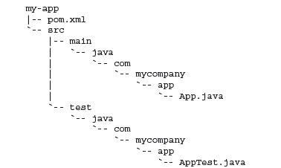
Creating a Project
mvn archetype:create -DgroupId=com.mycompany.app -DartifactId=my-app
Ceate goal will create a directory with the same name given as the artifactId.
Under this directory standard project structure will be created

Slide 24
Execute the Application
mvn package will execute a series of phases like
Validate
generate-sources
process-sources
generate-resources
process-resources
compile
java -cp target/my-app-1.0-SNAPSHOT.jar com.mycompany.app.App
Which Will execute the Application App.java

Slide 25
Adding a Unit test
It is a development best practice to provide unit tests for all code modules.
Maven 2 created a placeholder AppTest.java unit test
Can Remove the file and place customized unit testing code
Use mvn test command.

Slide 26
Site Generation and Reporting
Maven is its ability to generate documentation and reports.
mvn site
This will execute the site lifecycle phase.
This lifecycle is concerned solely with processing site content under the src/site directories and generating reports.
After this command executes, you should see a project web site in the target/site directory.

Slide 27
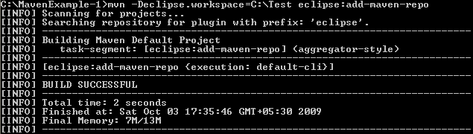
Configuring Maven with eclipse
Eclipse needs to know the path to the local maven repository.
Classpath variable M2_REPO has to be set.
The execution of the above command should result in the following:

Slide 28
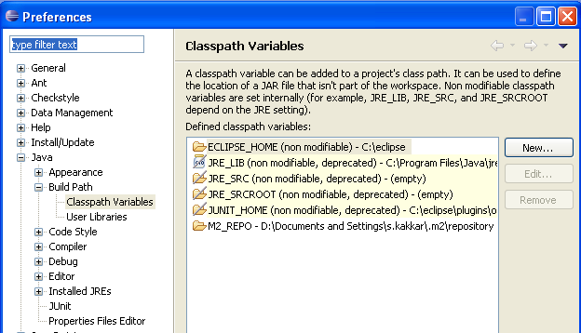
Configuring Maven with eclipse (Continued..)
Now open up your eclipse and check if this variable M2_REPO has been added.

Slide 29
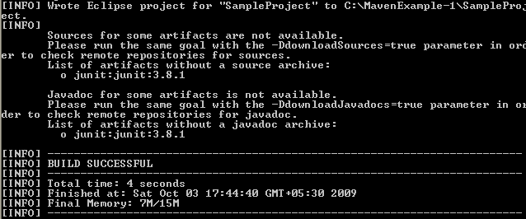
Creating eclipse specific files
To generate the eclipse metadata files from your pom.xml you execute the following command:
The above command generates eclipse related files like .project and .classpath .

Slide 30
Importing the project in Eclipse
After generating the Eclipse Classpath and Project files for your project, import the project into Eclipse with the following steps:
From the Eclipse workspace menu select File > Import
2. Expand General and select Existing Projects into Workspace
3. Mark Select root directory and hit Browse. Browse for the directory in which your POM file is in. Press OK.
4. You should now see your project checked under the Projects: box. Press Finish.
5. You should now see your project in Eclipse.

Slide 31
Running Maven outside eclipse
Delete all the files under C:\MavenExample-1\SampleProject\target
Let’s now use Maven to build it as a jar and try to run it outside eclipse. Execute the following command from the command line:
You can see SampleProject-1.0-SNAPSHOT.jar under C:\MavenExample-1\SampleProject\target. Based on the pom.xml file, the jar was built.
You can run the Java application in the command line as follows:

Slide 32
Running Maven from Eclipse
Eclipse provides a feature which allows you to run external programs.
This feature can be utilized to insert Maven commands to a list of external tools which are available to your workspace.
Go through the following steps for the setup:
From the Eclipse workspace menu select Run > External Tools > External Tools Configurations...
Select Program from the left.
Right click on Program and select New.
Provide a name for this configuration. This name is used for identifying your maven command in the list of external tools. E.g. mvn install.
Press Variables… (on the right hand side).
Press Edit Variables…

Slide 33
Running Maven from Eclipse (Continued)
Press New…
Enter the following:
Variable = maven_exec
Value = C:\apache-maven-2.2.1\bin\mvn.bat
Description = Maven Executable
Press Ok
Select maven_exec from the Select Variable and press ok.
Press Browse Workspace... under Working Directory and select the folder in which your project's POM file is located if you want to launch a Maven goal within a single project

Slide 34
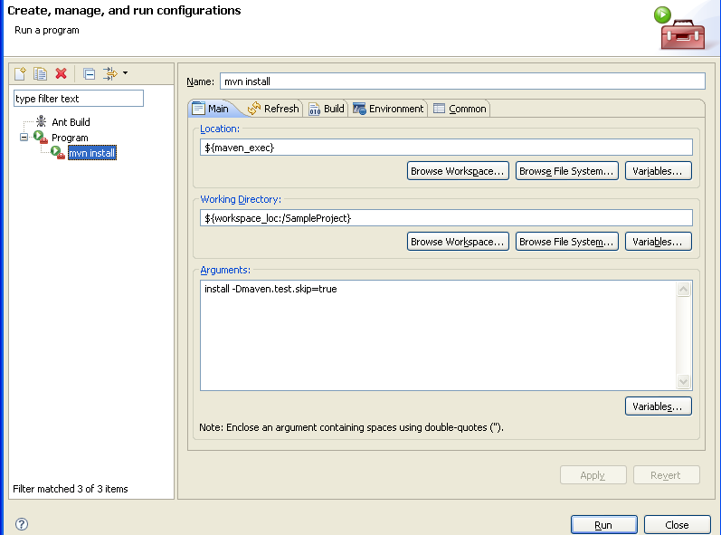
Running Maven from Eclipse (Continued)
Notes:
Faculty Notes:
Provide the arguments to pass to Maven. E.g. If you want to run the install goal you need to add install to the Arguments field. Any additional arguments can be defined here as well, e.g. -Dmaven.test.skip=true.

