Slide 1
DevOps

Slide 2
DevOps
What is DevOps?
Why is DevOps is Needed?
DevOps Lifecycle
DevOps Stages
DevOps Tools
DevOps PipeLine

Slide 3
What is Dev Ops
DevOps is a culture which promotes collaboration between Development and Operations Team to deploy code to production faster in an automated & repeatable way. The word 'DevOps' is a combination of two words 'development' and 'operations.'
DevOps helps to increases an organization's speed to deliver applications and services. It allows organizations to serve their customers better and compete more strongly in the market.
In simple words, DevOps can be defined as an alignment of development and IT operations with better communication and collaboration.

Slide 4
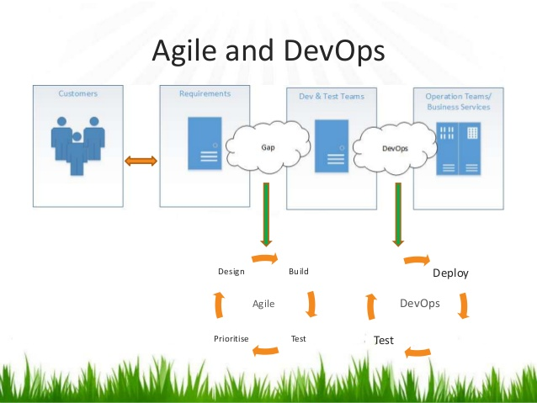
Why is DevOps is Needed?

Slide 5
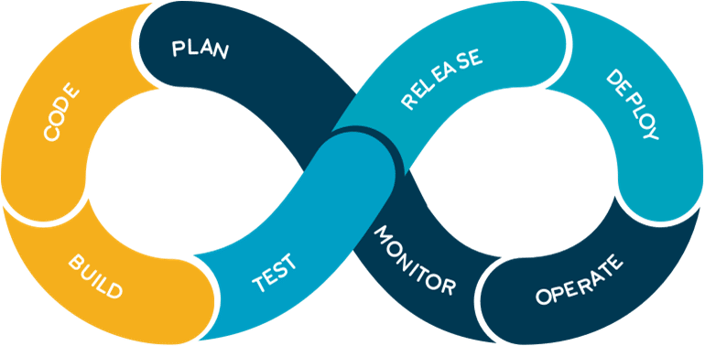
DevOps Lifecycle
The process of adding new features and fixing bugs continuously
to improve the application, in the shortest time possible.
Code: First step to this life-cycle is Code,
where developer build the code on any platform.
Build: You build the version of your program
in any extension depending upon the language you’re using.
Test: For DevOps to be successful,
you must Automate all the testing process using any
automation tools like Selenium etc.
Release: Process for managing, planning, scheduling and controlling the build in different environments after testing and before deploying.
Deploy: Then Deploy is to get all your application’s artifacts/all your code files and deploy or execute them on the server.
Operate: Then we run that application after the deployment, where users are using it as a real use case.
Monitor: Monitor helps in providing a crucial information which basically help you to ensure the service uptime and the optimal performance.
Plan: Gather all the information through monitoring and whatever the feedback you received through the monitoring, you implement those changes for the better performance.

Slide 6
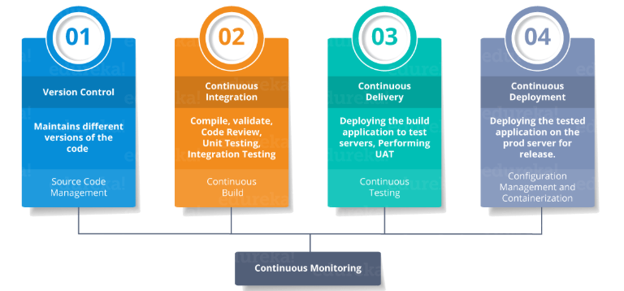
DevOps Stages

Slide 7
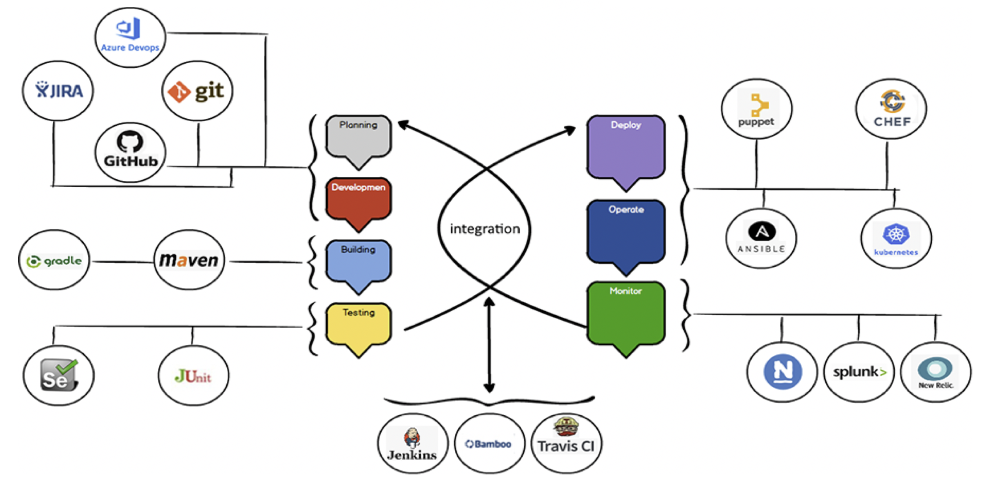
DevOps Tools

Slide 8
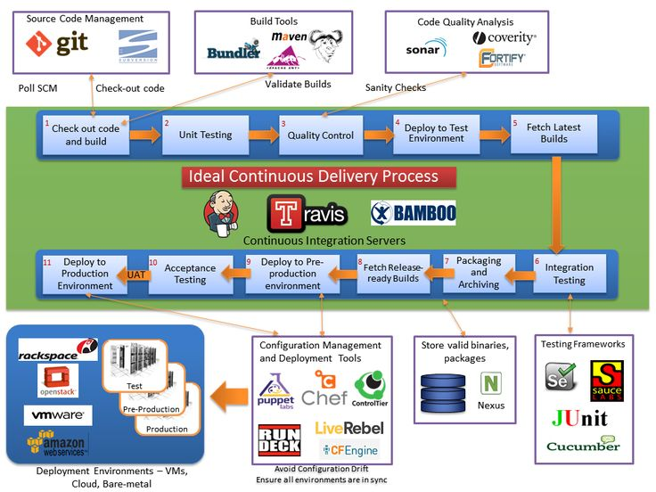
DevOps Pipeline

