Slide 1
House Price Prediction Using Machine Learning
A study on predicting housing prices based on key attributes like rooms ,area, place, and more.

Slide 2
Introduction
Predicting house prices is a significant challenge in the real estate sector.
- It helps buyers make informed decisions.
- Aids sellers in setting competitive prices.
- Machine learning provides powerful tools for accurate predictions.

Slide 3
Problem Statement
House prices depend on various factors such as location, area, and crime rates.
- Lack of accurate pricing models leads to inefficiencies.
- Need for a data-driven approach to predict housing prices effectively.

Slide 4
Dataset Description
Key attributes considered in the dataset:
- Price: Price of houses on different classification.
- Bedrooms: \No. of Bedrooms.
- Area: Area of the plot in sq.ft.
- Additional features: stories, main road, guestroom etc.

Slide 5
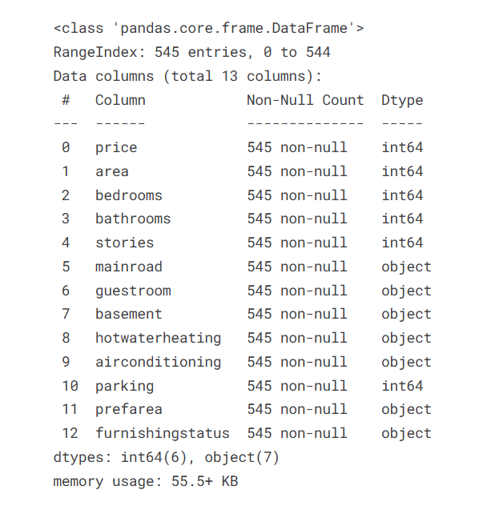

Slide 6
Data Preprocessing
Steps involved in cleaning and preparing data:
- Handling missing values.
- Removing outliers.
- Encoding categorical data.
- Normalizing and scaling numeric data.

Slide 7
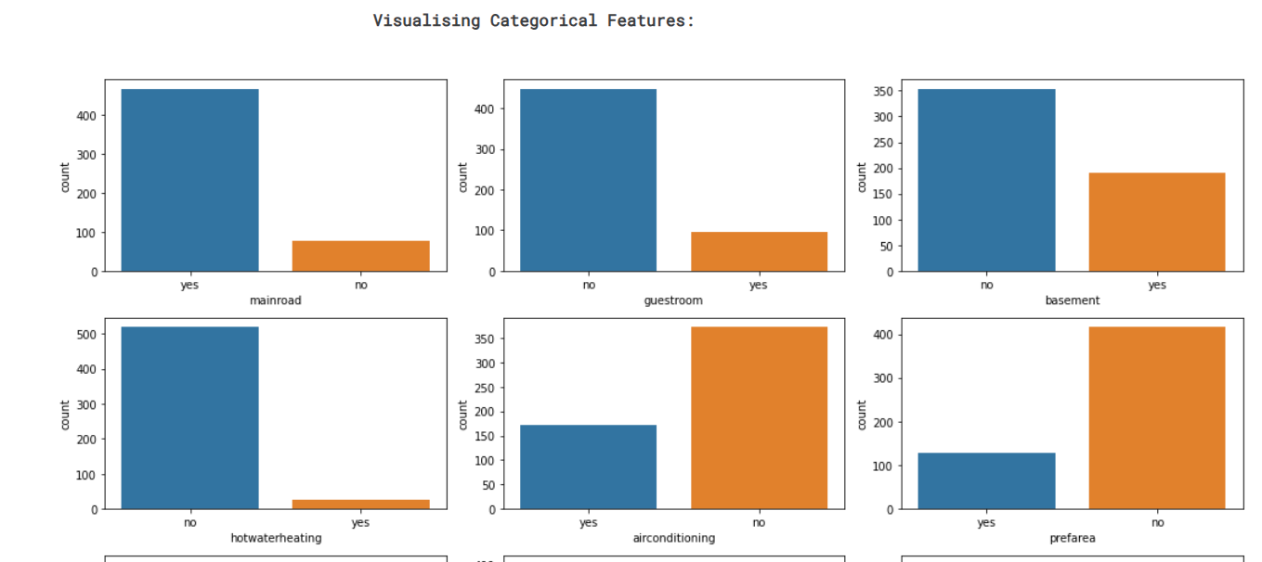
Representation view

Slide 8
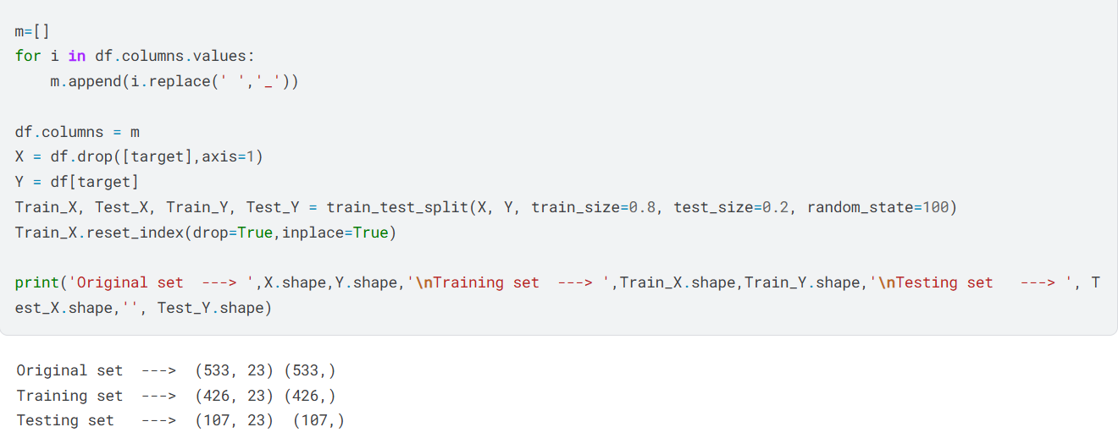
Dividing data into test and train

Slide 9
Model Building
Machine learning models used for prediction:
- Linear Regression
- Decision Tree
- Random Forest
Evaluation Metrics: Mean Squared Error (MSE), R-squared.

Slide 10
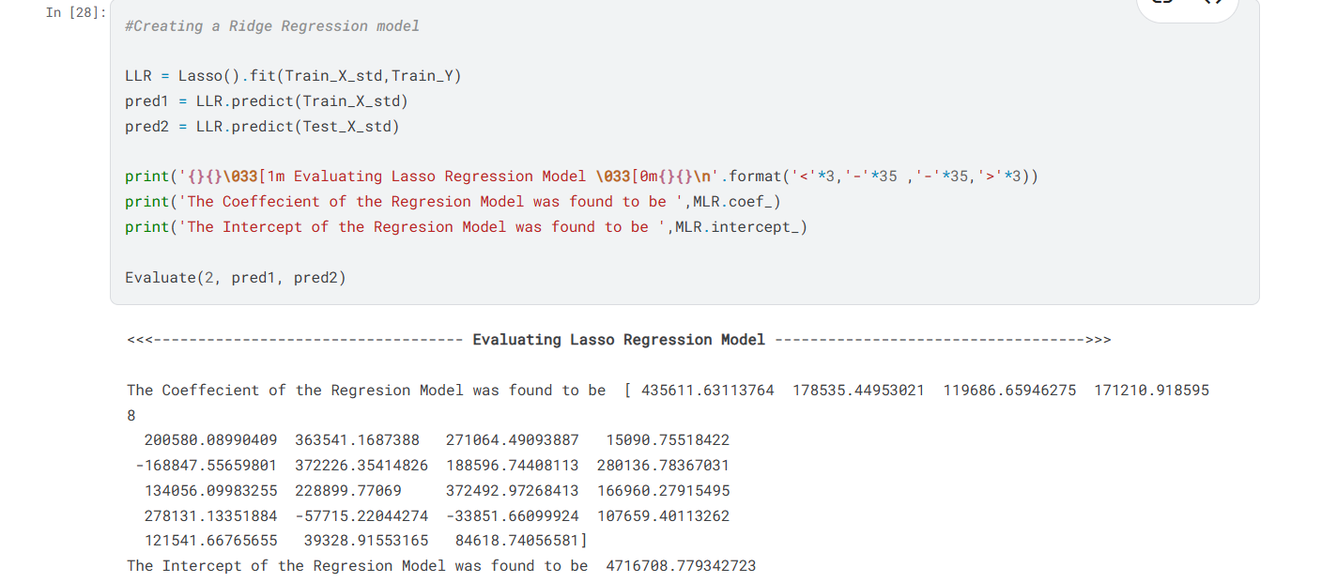
Creating the regression model

Slide 11
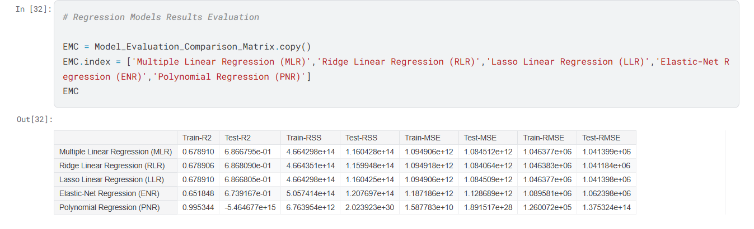
Analyzing the result

Slide 12
Results and Analysis
Findings from the implemented models:
- Random Forest achieved the highest accuracy.
- Linear Regression performed well with fewer features.
- Decision Tree showed overfitting in some cases.

Slide 13
Conclusion
House price prediction models can effectively estimate prices using machine learning.
- Helps in better decision-making for buyers and sellers.
- Future improvements include adding more features and refining models.

