Slide 1
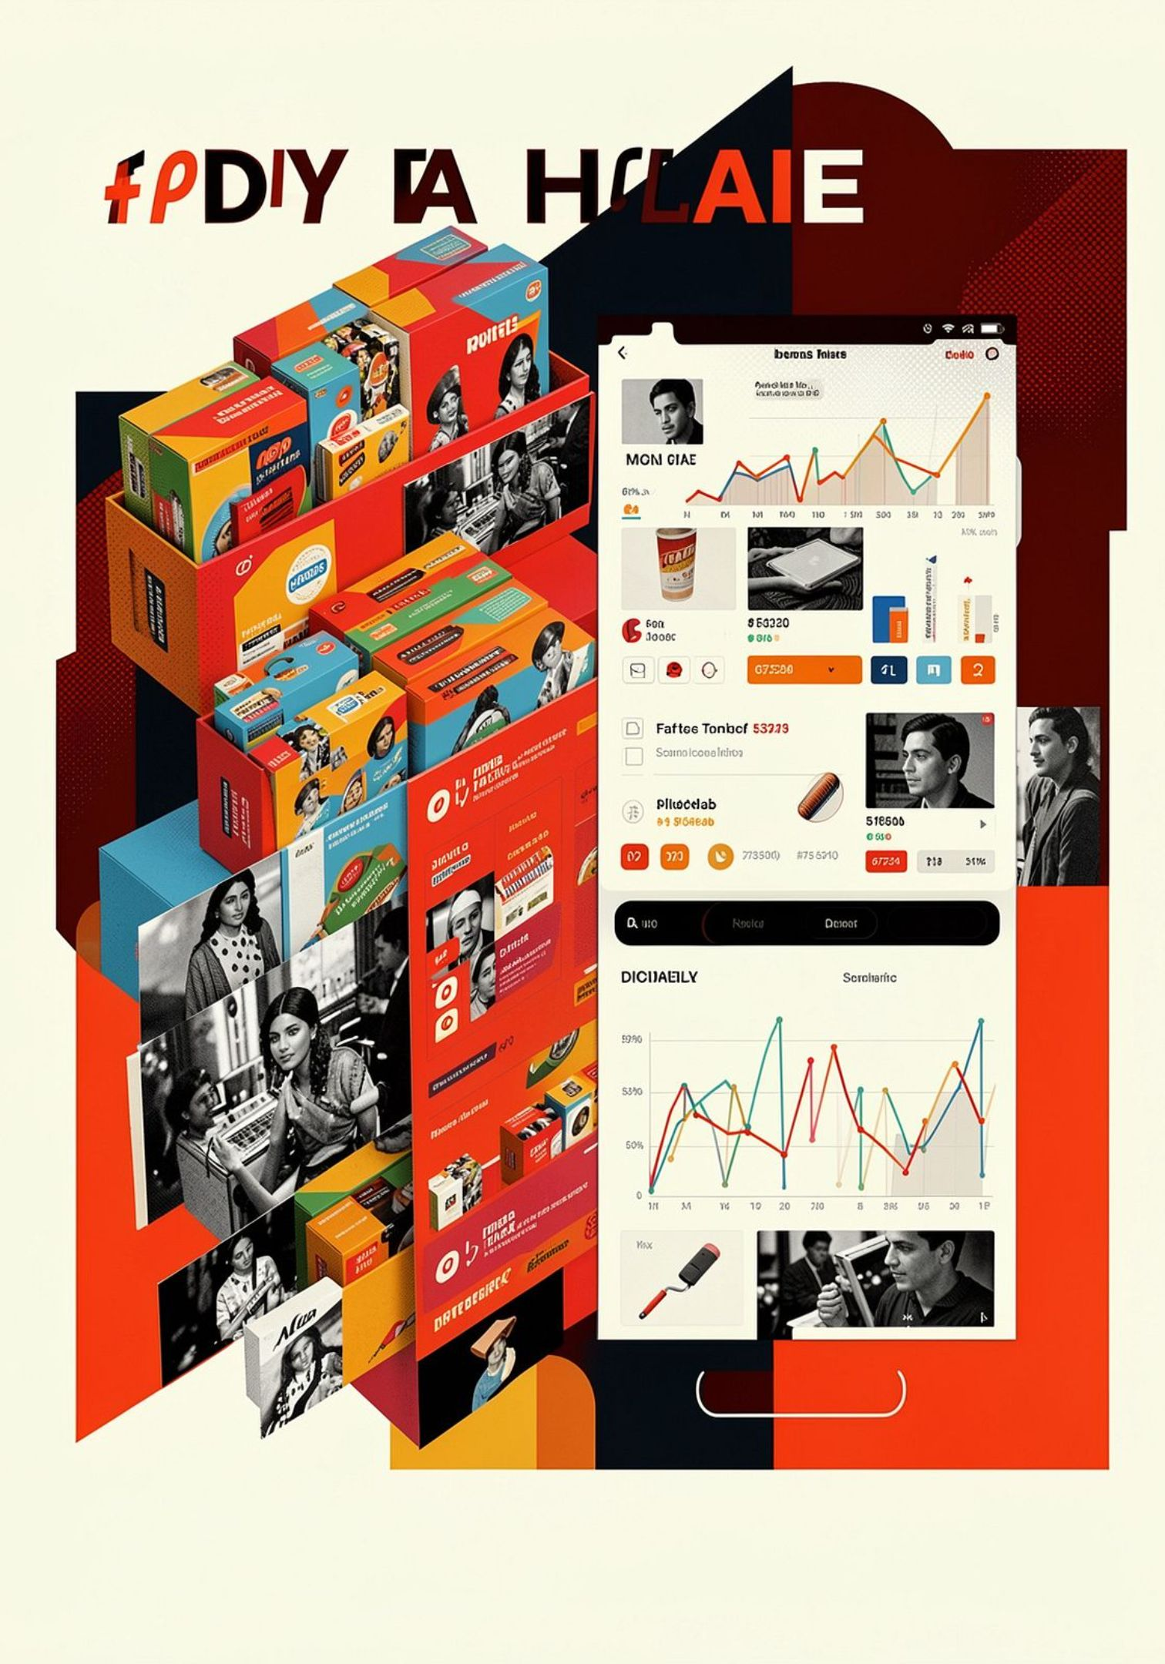
Indian E-Commerce Sales & Profitability Analysis
End-to-end analytics project: Python · Pandas · MySQL · SQL · Power BI · DAX
April 2018 – March 2019 · 332 customers · 5,615 units · ₹431,502 revenue

Slide 2
EXECUTIVE SUMMARY
Project at a Glance
₹431K
₹24K
5.55%
Total Revenue
Total Profit
Profit Margin
5,615
332
Units Sold
Customers
Revenue alone is not sufficient for decision-making. Electronics leads revenue, but Clothing leads profit. Furniture's 1.81% margin needs attention. Tables lost ₹4,011 — the worst sub-category. Repeat customers deliver 5.79× more profit per customer than one-time buyers.

Slide 3

BUSINESS PROBLEM & APPROACH
From Raw Data to Business Insights
The business needed clarity on where sales and profit come from, which customers are valuable, and whether targets are being met.
SQL Analysis
Dashboard & Insights
Raw Data & Cleaning
Transform and probe data with MySQL views & procedures
Power BI Modeling
Visualize KPIs and derive business insights
Ingest and clean source datasets using Python/Pandas
Build DAX measures and a robust data model
Three datasets cleaned and validated: List of Orders (500 rows), Order Details (1,500 rows), Sales Target (36 records).

Slide 4
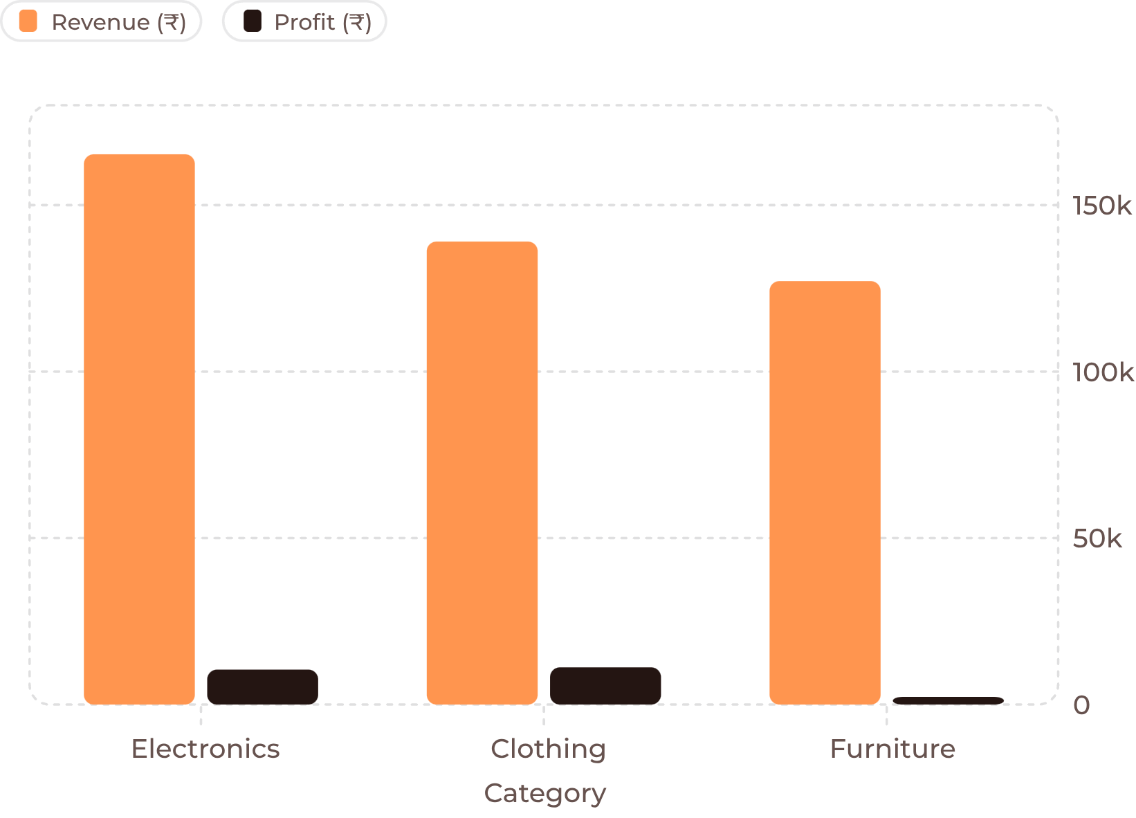

CATEGORY PROFITABILITY
Revenue Leader ≠ Profit Leader
Key Findings
Electronics: highest revenue (₹165K) but not highest profit
Clothing: profit leader (₹11.2K) and best margin (8.03%)
Furniture: ₹127K revenue but only 1.81% margin
Tables: worst sub-category — ₹22,614 revenue, −₹4,011 profit
Electronic Games: also loss-making at −₹1,236
High volume ≠ high profit. Saree sold 782 units but earned only ₹352 profit; Printers sold 291 units and earned ₹5,964.

Slide 5
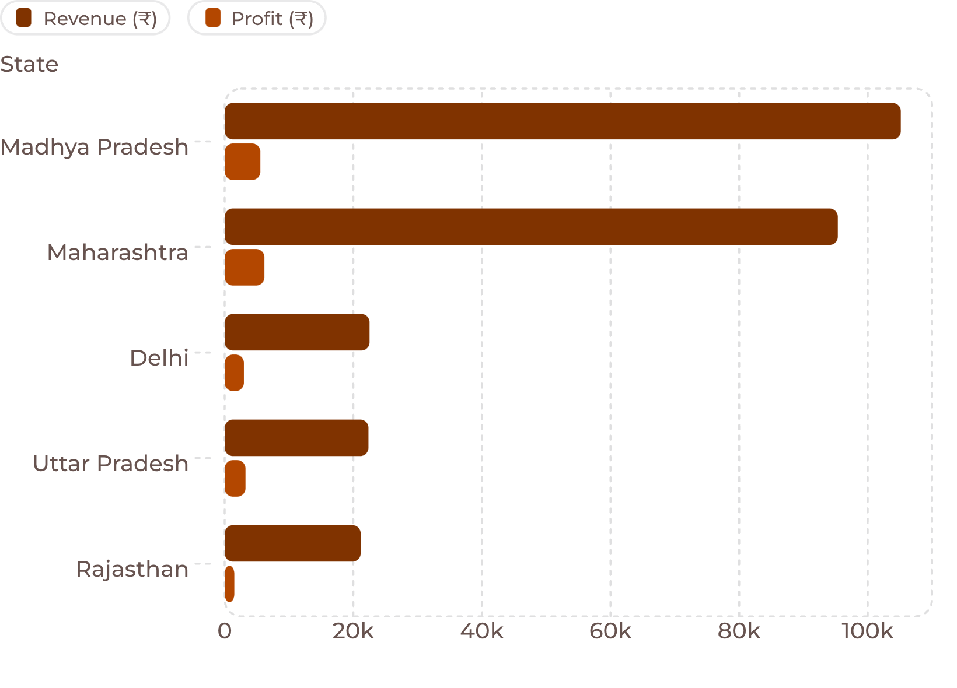
GEOGRAPHY & MONTHLY TRENDS
Where and When Performance Varied
Geography
Madhya Pradesh led revenue (₹105K); Maharashtra led profit (₹6,176). West Bengal had the highest state margin at 17.75%.
Monthly Performance
June 2018 was the worst profit month (−₹4,970). November 2018 peaked at ₹11,619 profit. Losses concentrated in Apr–Sep 2018; recovery began Oct 2018.

Slide 6
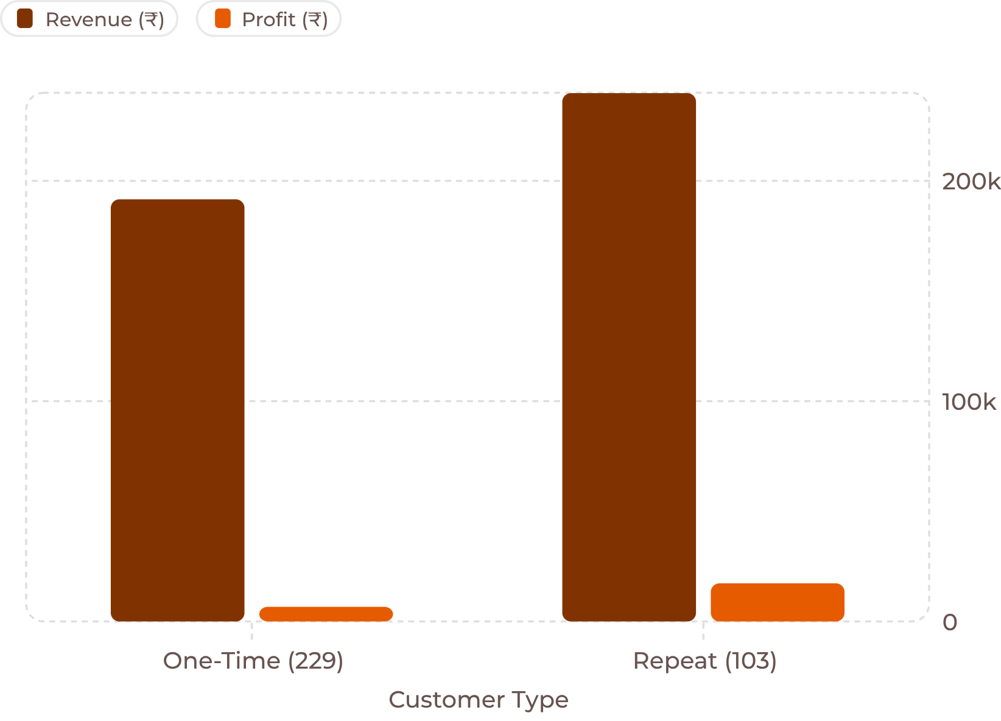

CUSTOMER ANALYSIS
Repeat Customers Drive Disproportionate Value
Customer Breakdown
229 one-time customers: ₹837 avg revenue, ₹29 avg profit per customer
103 repeat customers: ₹2,329 avg revenue, ₹168 avg profit per customer
Repeat customers generate 2.78× more revenue and 5.79× more profit per customer — an observed association, not a causal claim.
Top revenue customer: Yaanvi (₹9,177). Worst loss customer: Shishu (−₹1,836), largely from one Bookcases transaction.

Slide 7
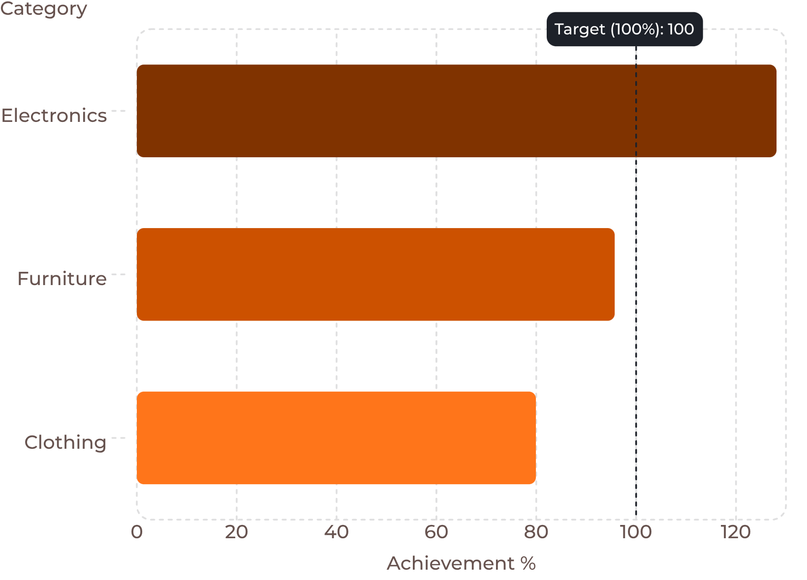

TARGET VS ACTUAL
Sales Target Achievement by Category
Target Results
Electronics: exceeded target by ₹36.27K (128.11%) — strongest in December at 206.22%
Furniture: missed by ₹5.72K (95.70%)
Clothing: largest shortfall at −₹34.95K (79.92%) — worst month was July at only 21.29%
Critical grain lesson: Target values must be aggregated to month + category before joining. Direct joins duplicate targets across transaction rows.

Slide 8

SQL & POWER BI
Technical Implementation
SQL Techniques
Power BI Data Model
Views: category_performance, state_performance, target_vs_actual
Stored procedures: GetSalesByState, GetSalesByDate
CTEs for grain-aware target aggregation
Bridge dimensions: MonthTable and CategoryTable
Prevents target duplication; enables correct slicer behavior
Independent _measures table for all KPIs
DAX Measures
Total Revenue, Total Profit, Profit Margin %
Target Achievement %, Target Variance
DIVIDE() used throughout for safe division
Grain awareness is the strongest lesson: always understand what one row represents before joining tables.

Slide 9
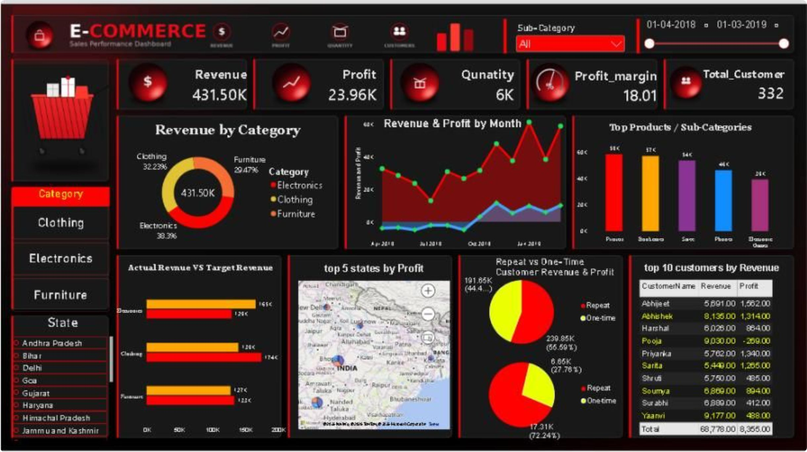
DASHBOARD
Power BI Dashboard Design
Three-page executive dashboard: Executive Sales Overview (KPIs, category revenue, monthly trends, top states), Profitability & Customer Analysis (sub-category profit, margins, repeat vs one-time), and Target & Performance (actual vs target, achievement %, variance). Slicers: Date, State, Category, Sub-Category, Customer Type.

Slide 10
FINDINGS & RECOMMENDATIONS
Key Insights & Next Steps
Key Findings
Recommendations
Electronics leads revenue & target; Clothing leads profit & margin
Furniture: ₹127K revenue, only 1.81% margin
Tables: largest loss (−₹4,011); Electronic Games: −₹1,236
June 2018 worst profit month (−₹4,970)
Repeat customers: 5.79× more profit per customer
Investigate Tables & Electronic Games at transaction level
Review Furniture pricing and cost structure
Strengthen repeat-customer retention programs
Improve Clothing target planning (July was 21.29%)
Always display revenue with profit and margin on dashboards

