Slide 1
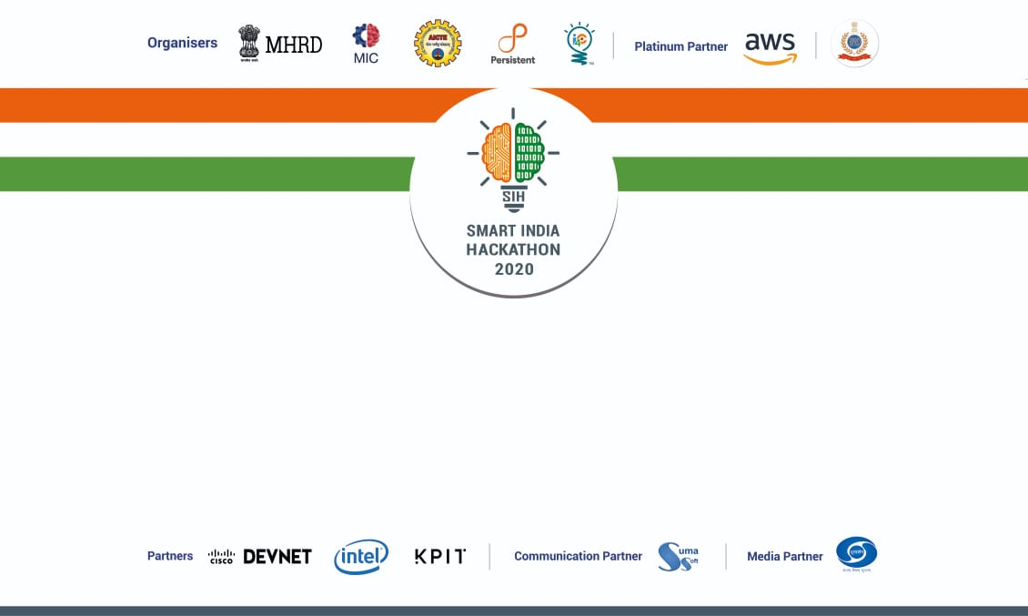


• Harish R (Mentor) • Karthika G (Mentor)
• Dinesh kumar (TL) • Karthick Moorthy
• Madhu smitha Nayak • Geetha M
• Avinash R • Arthi J
T E C H N E S

Slide 2
DEFINING THE PROBLEM STATEMENT
The problem statement here is to develop a virtual assistant for hassle free workflow of medical imaging devices with requirements like Front-end mobiles & web based interface for connecting to a variety of channels as Websites and constraints like Stand-alone applications with a web interface that adapts to different orientations, security & network bandwidth.

Slide 3
OUR APPROACH
Our application uses Augmented Reality to aid the novice users for operating devices like MRI,CT etc.
Our software detects the instrument or device and uses the data stored in cloud to assist the technician in operating the instrument.
An AR animation will be played over the instrument for visually guiding the user throughout the operation of the instrument.
A visual bot is also available, this visual bot is a chatbot/voicebot which provides instructions and guides the user through every step of the operation.

Slide 4
Why an AR Guide?
Using Augmented Reality, any information or data can be passed to learner in real-time with better sense of vision.
Indeed, medical fields will be among the first to embrace Augmented Reality in a big way.
Those who are unaware of the medical concepts and new to the field can even operate the instruments like an expert with Augmented Reality.
Recent hardware and software advances have reduced the cost of Augmented Reality while significantly improving the experience for users and developers.

Slide 5
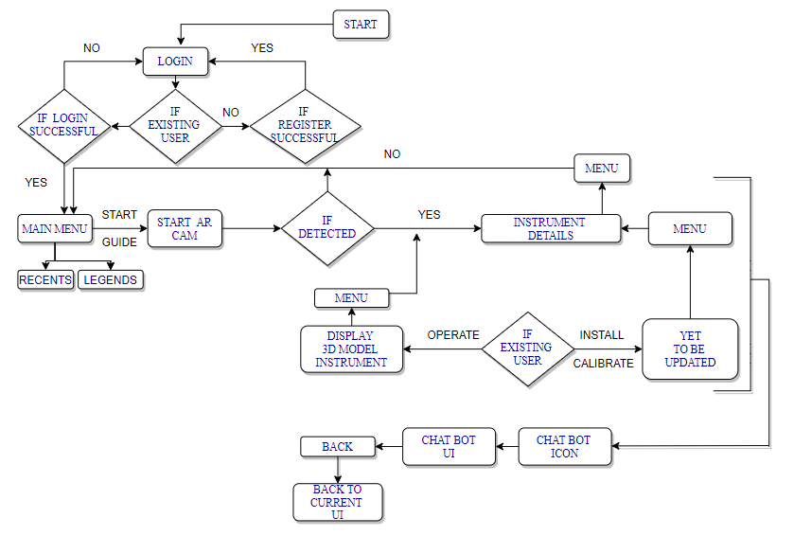
FLOW CHART

Slide 6
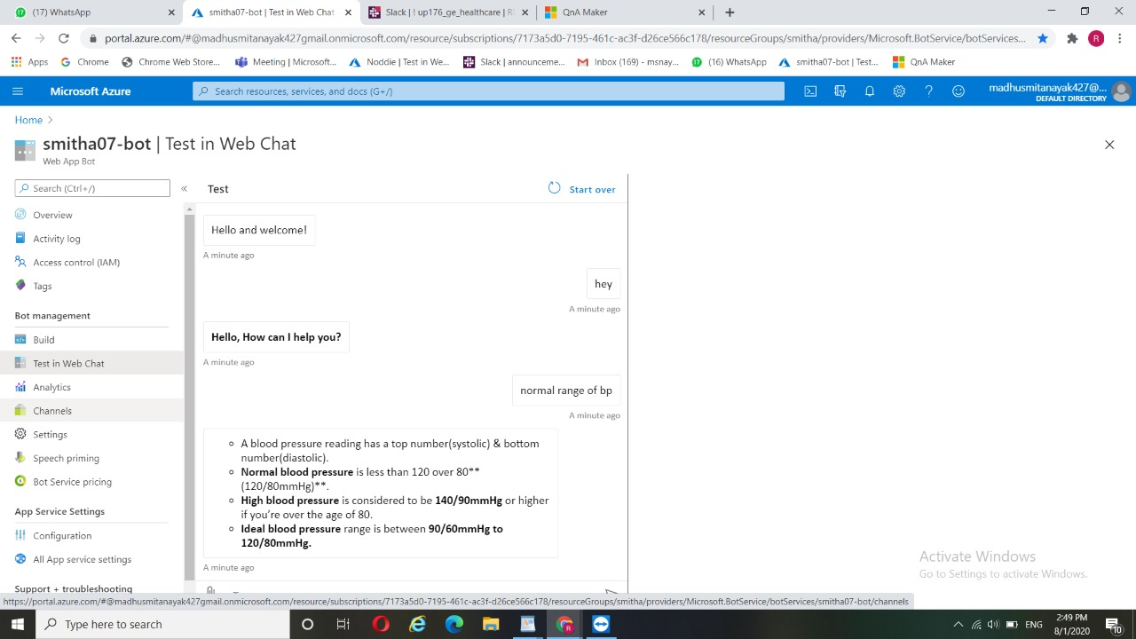
SOFTWARE USED
Chatbot(Text to Text) - Used Microsoft Azure platform for bot services.

Slide 7
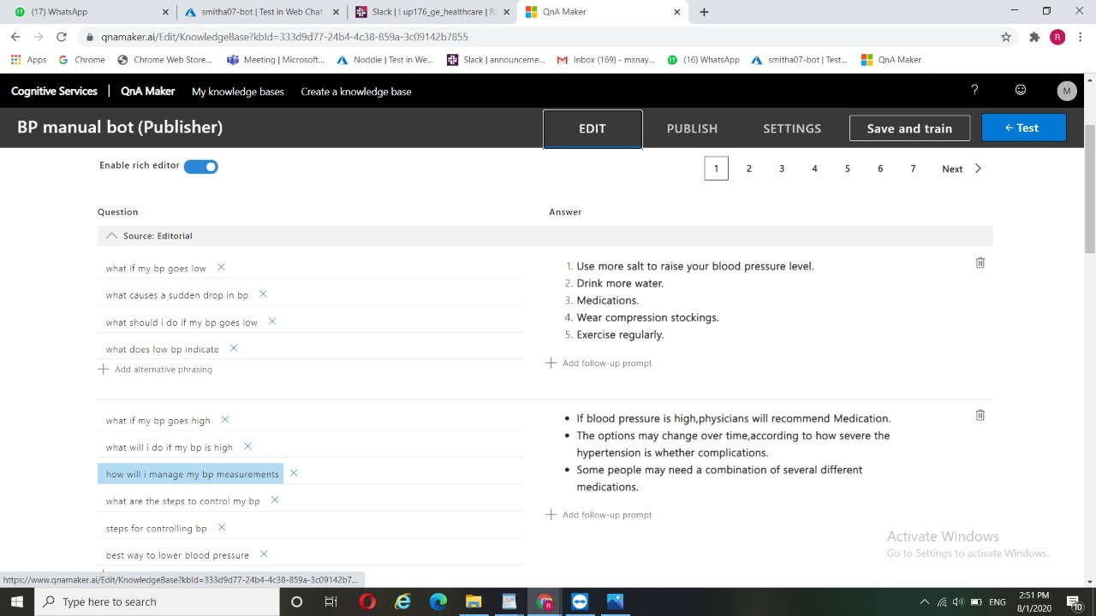
Database for Question - Uploaded questions to bot using KnowledgeBase of QnA maker

Slide 8
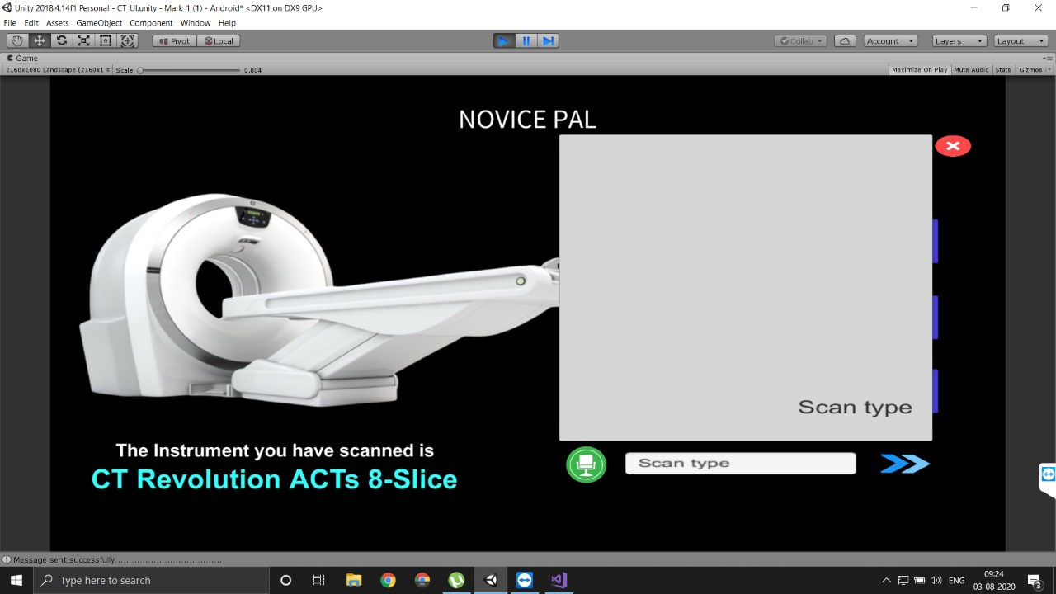
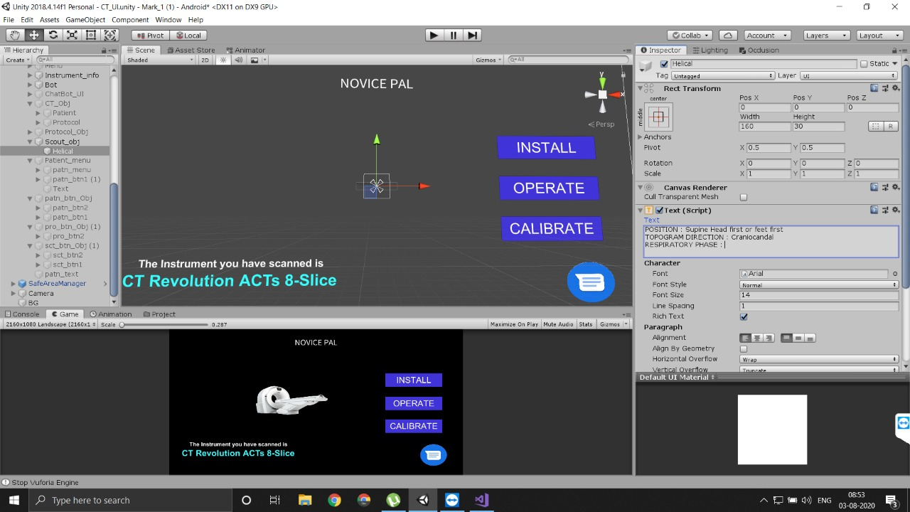
Hosting Chatbot - Used .NET to host the bot using API in mobile app.

Slide 9
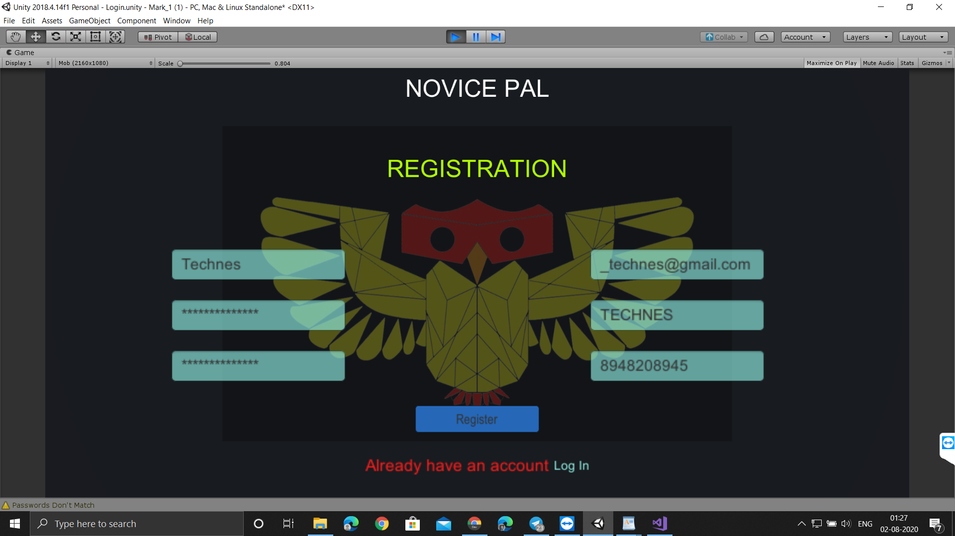
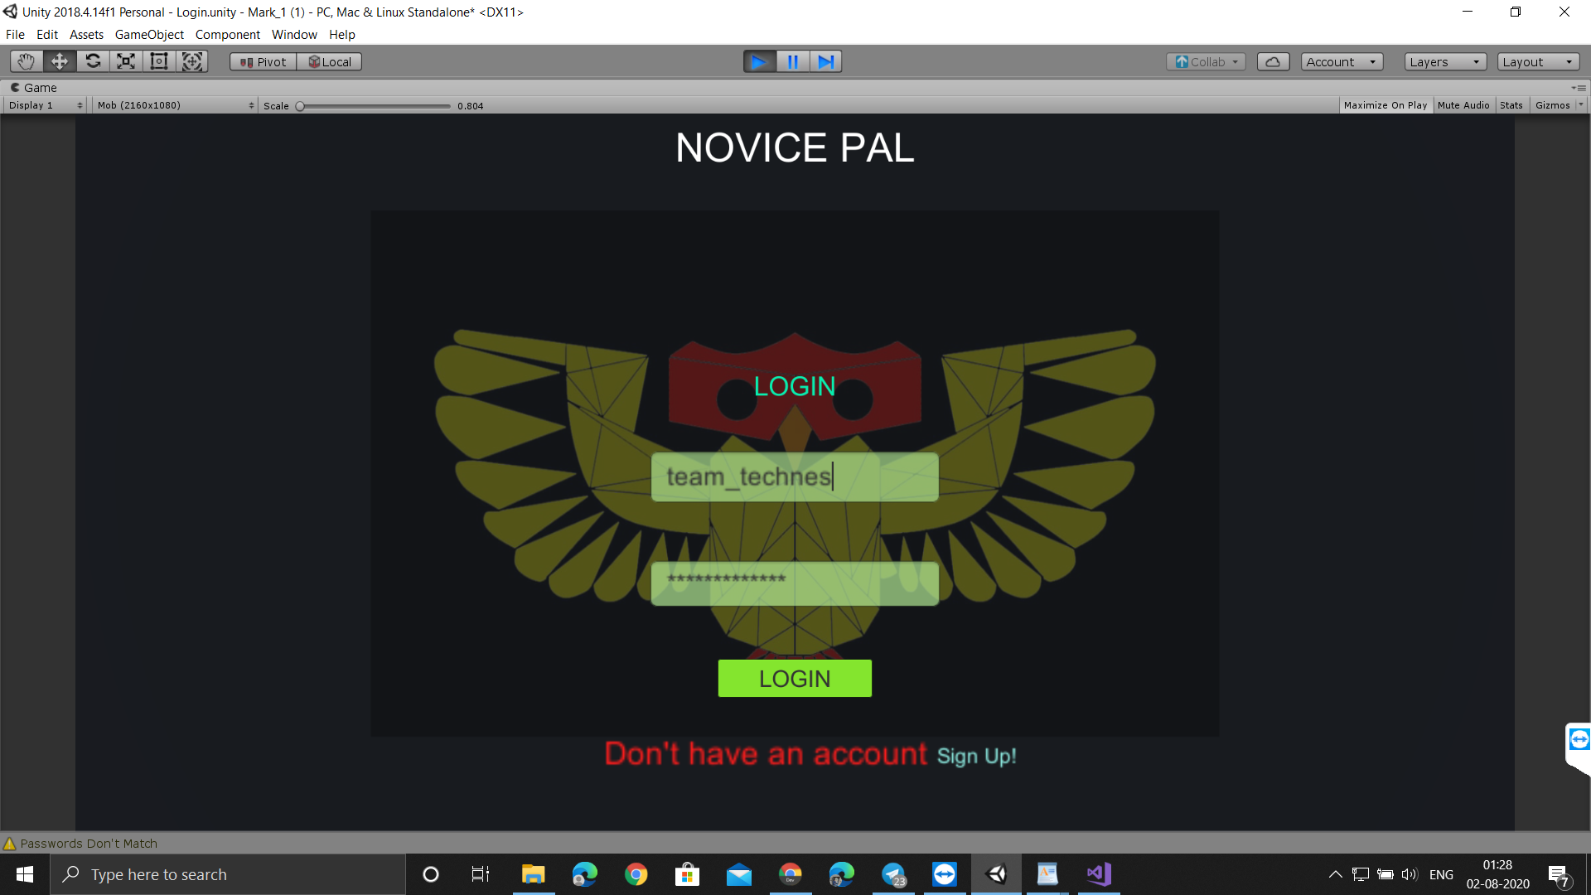
Designed UI app using UNITY
APPLICATION USER INTERFACE OF LOGIN PAGE /SIGN IN PAGE

Slide 10
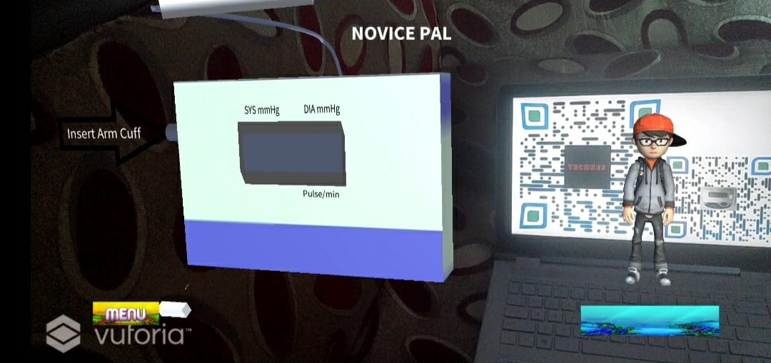
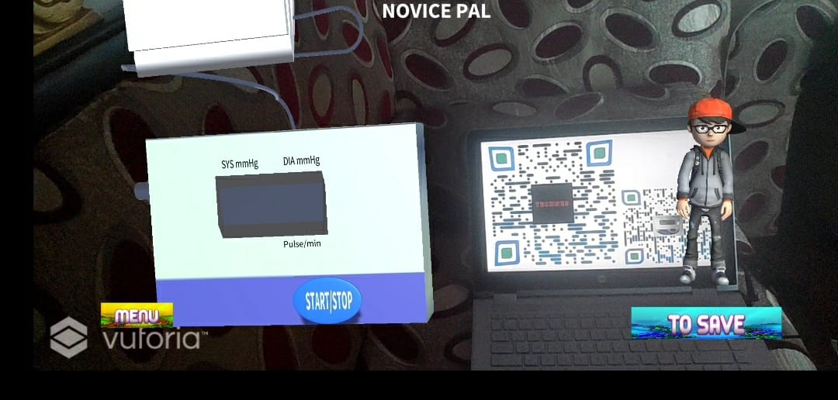
SAMPLE 3D MODEL

Slide 11
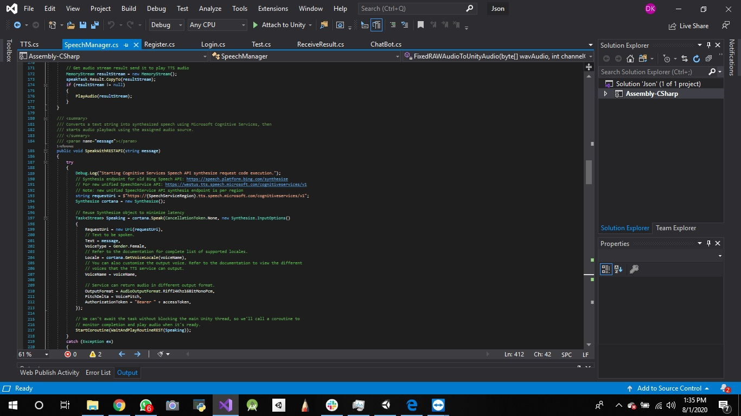
CHATBOT BACKEND PROGRAMMING USING UNITY

Slide 12
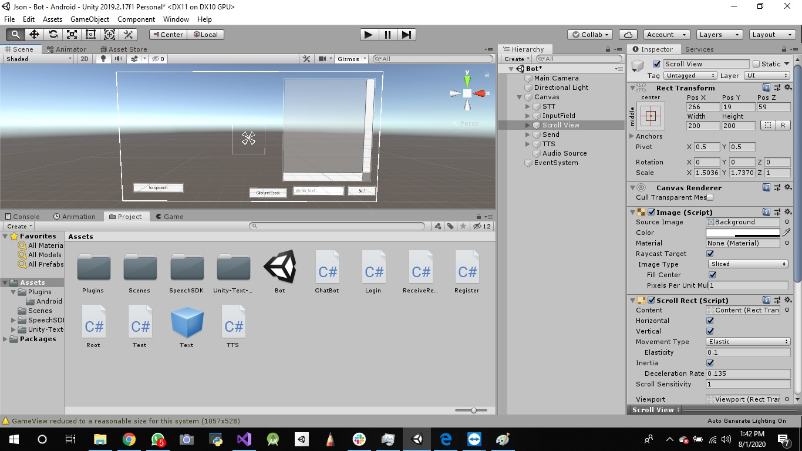
CHATBOT FRONTEND USING UNITY PROGRAMMING

Slide 13
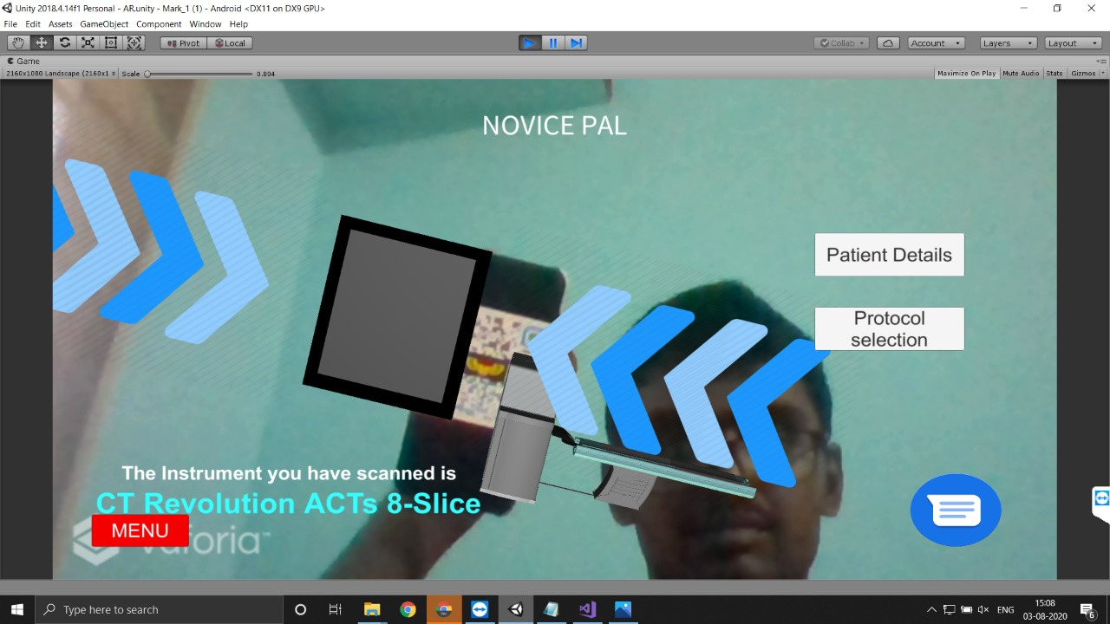
FINAL TESTING

Slide 14
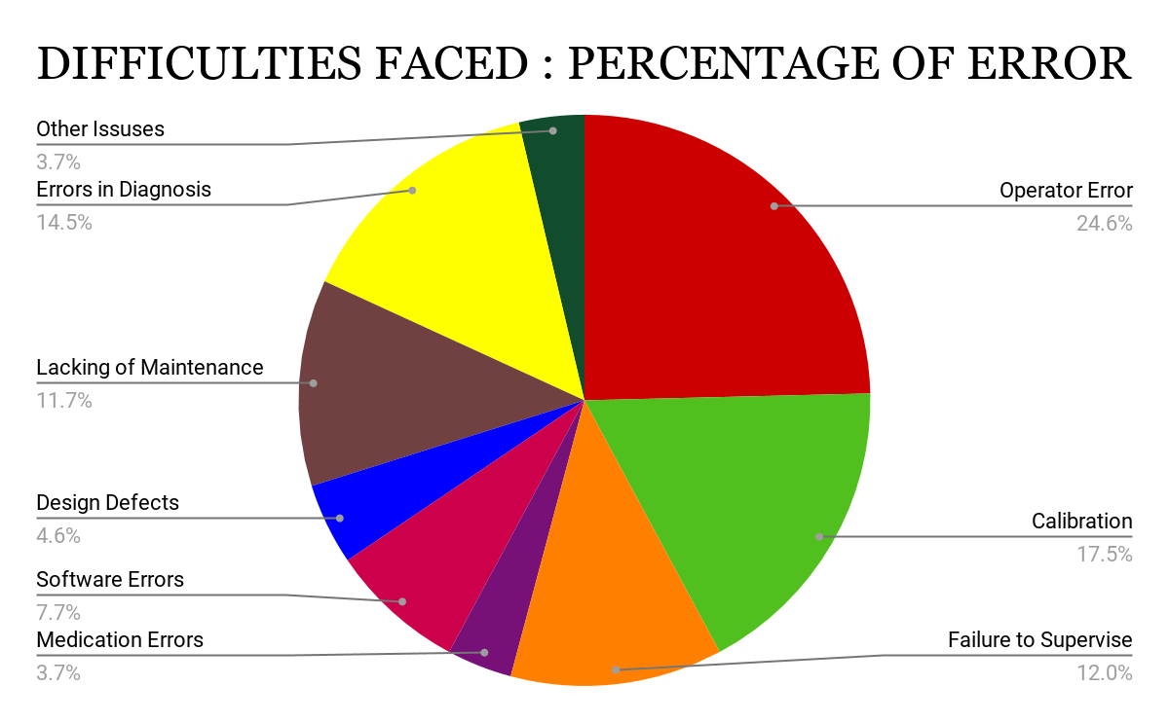

Slide 15
ADVANTAGES
Simplifies the work of installation and operation.
THE Animation and 3D model Reduces the need for highly professional technicians .
Decreases the time consumed by using manuals for operation and other purposes.
Errors can be detected and corrective measures are suggested.
This application can be used by beginners for hassle free operation of a complex instrument.

