Slide 1

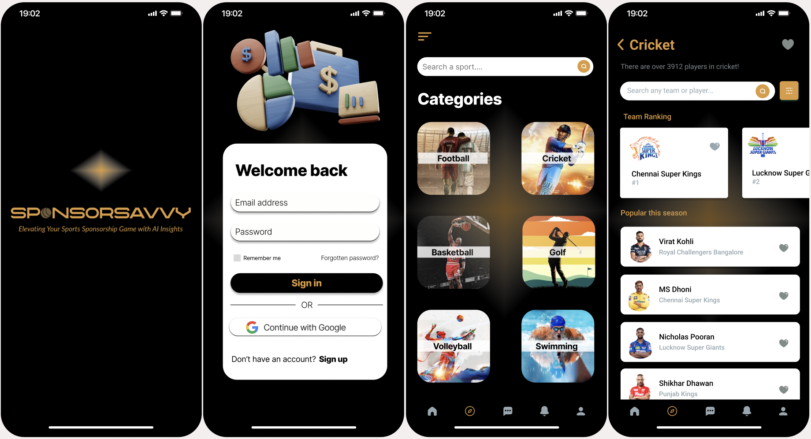
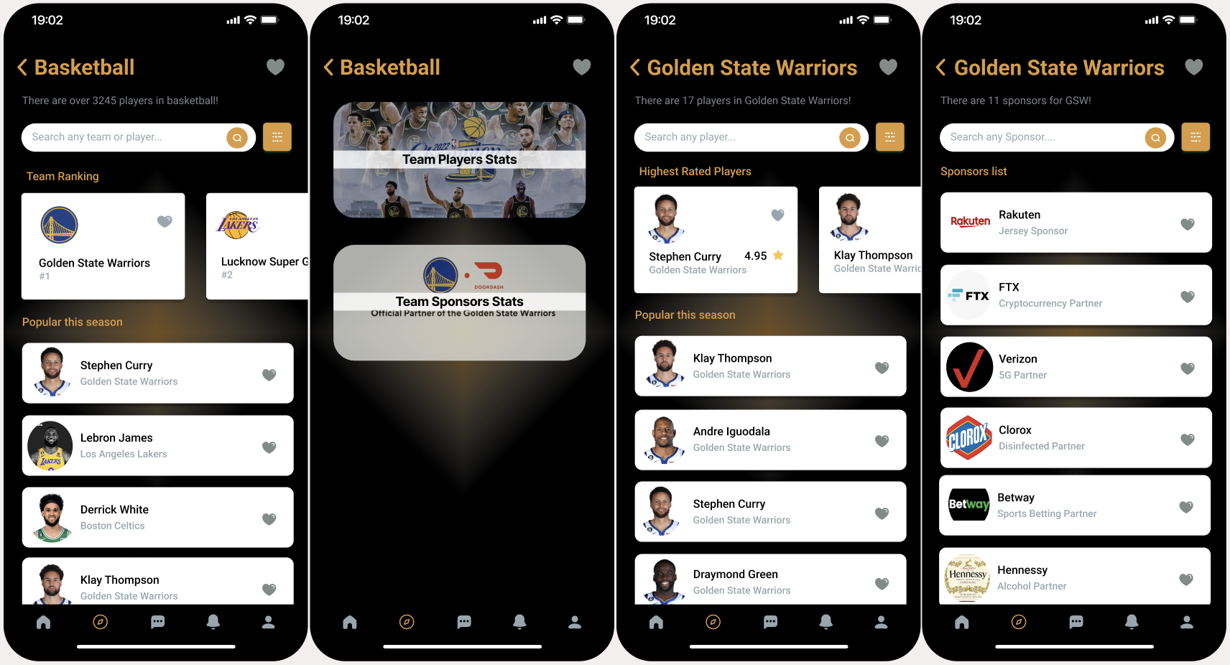
SponsorSavvy
Avinash Rajendran & Praveen Naik Jathoth
Mission:
SponsorSavvy uses ML to improve sports marketing strategies.
Provides precise insights for better decision-making.
Target market and user:
SponsorSavvy's target market in the sports industry includes event organizers and sponsors seeking to maximize their ROI.
The global sports sponsorship market is estimated at $45.3 billion, projected to grow at a 6.5% annual pace and reach over $60 billion by 2024.
We aims to capture a portion of this growing market with its AI-powered platform.
Financial Forecast:
SponsorSavvy expects steady revenue growth over the next 5 years.
The platform will use a subscription and commission-based model.
The projected revenue for the 1st year is $0.5M with a 20% growth rate in subsequent years.
Problem:
The current process of finding and securing event sponsors is time-consuming, inefficient, and often relies on personal connections.
There is a need for a centralized platform that connects event organizers with potential sponsors.
Milestones:
Launch beta version of the platform (Q1 2024)
Secure partnerships with 50 event organizers in the first year (Q3 2024)
Achieve 100 successful sponsorships in the first year (Q4 2024)
Expand to international markets (Q1 2025)
Solution and working:
SponsorSavvy offers a sponsorship management platform that matches event organizers and sponsors based on their requirements and interests.
The platform streamlines the sponsorship process and offers tools for sponsor outreach, communication, tracking, sponsor matching, data analytics, and reporting.
Competitive advantages:
Over conventional sponsorship management systems, our AI-powered platform offers a distinctive competitive advantage.
Our platform is made to assist sponsors accomplish their objectives by reducing time spent on tasks and boosting productivity.
The fact that our price structure is adaptable and reasonable makes it available to companies of all sizes.

