Slide 1
Assignment-1

Slide 2
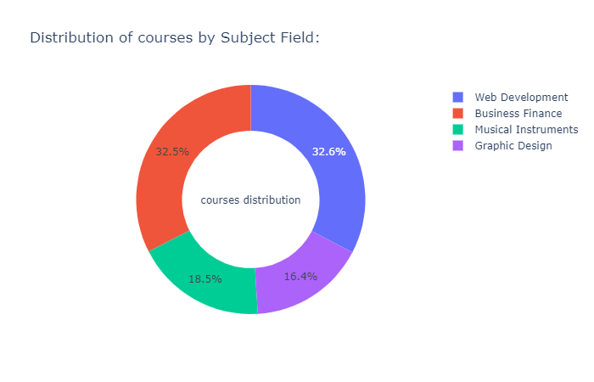
The picture depicts the percentage of each Subject in the dataset
Web Development
Business Finance
Musical Instruments
Graphic Design

Slide 3
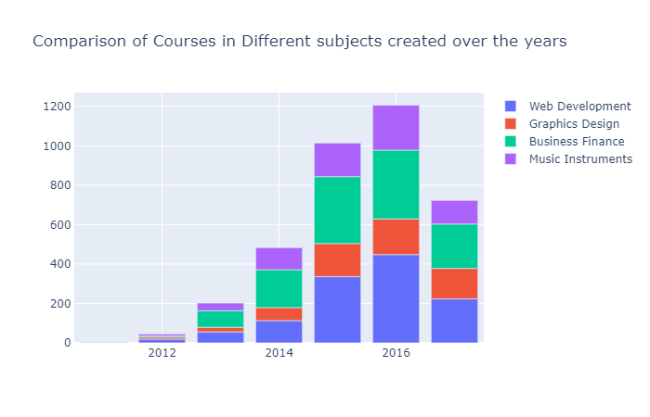
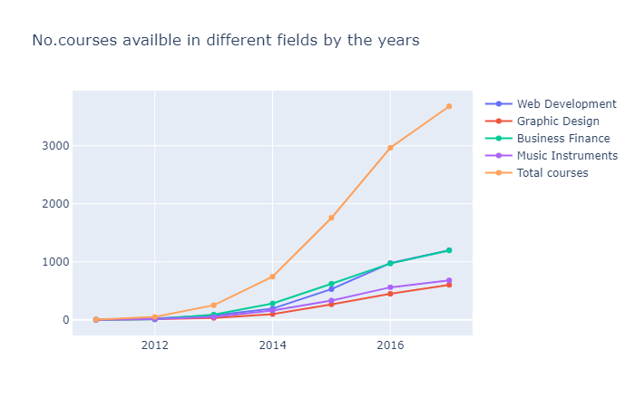
We can see the trends in courses created in different subjects over years
2011
2013
2015
2017
Courses available in different subjects over years:
2011
2013
2015
2017

Slide 4
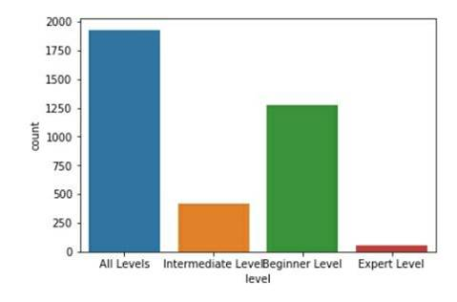
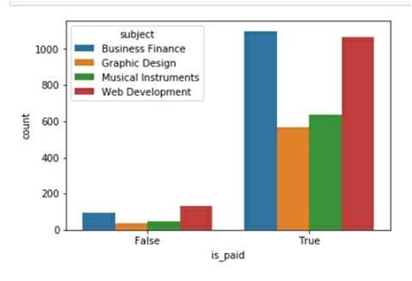
Some more analysis on the data
Distribution of all courses according to The level of expertise
Paid vs Unpaid Courses
Most students preferred All level Courses
Paid vs Unpaid : Paid Wins

Slide 5
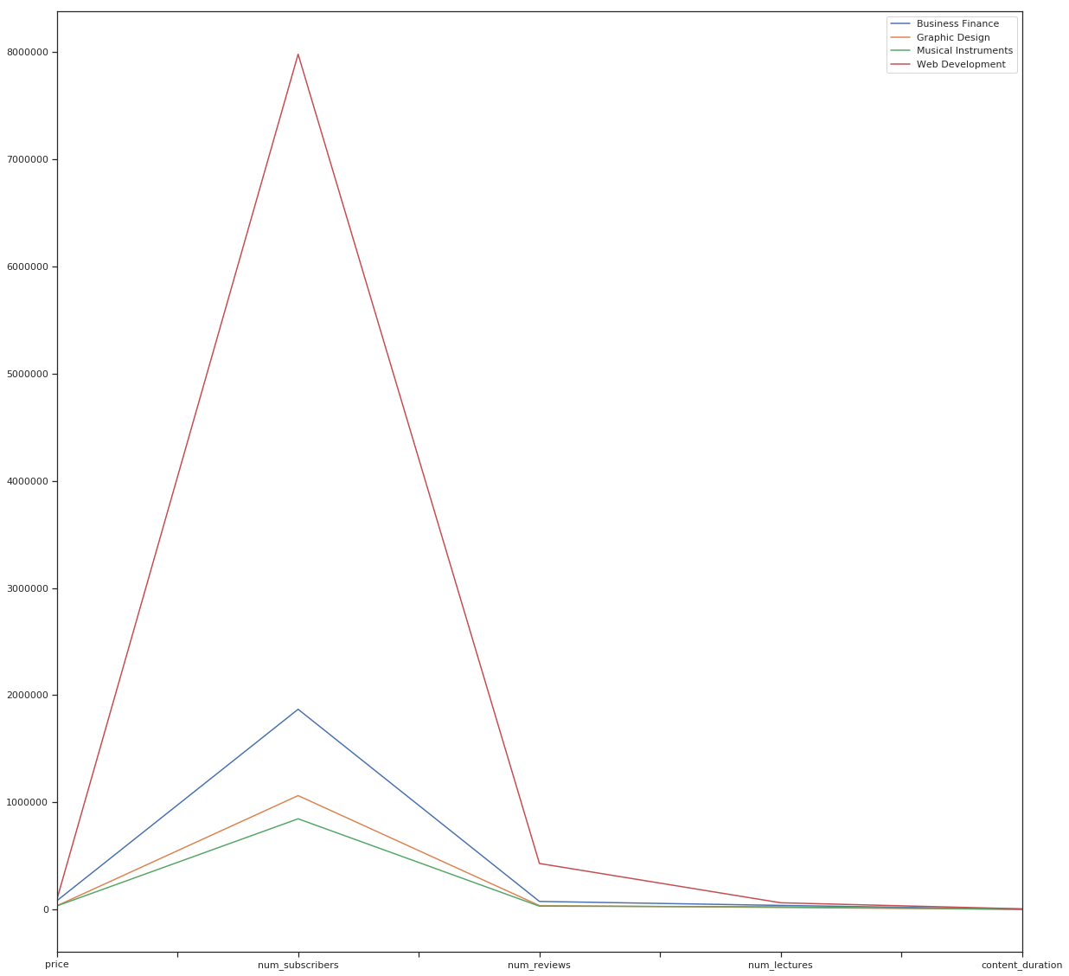
Cumulative comparison of different subjects

Slide 6
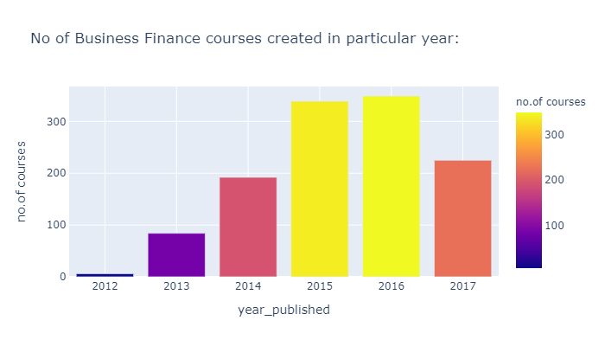
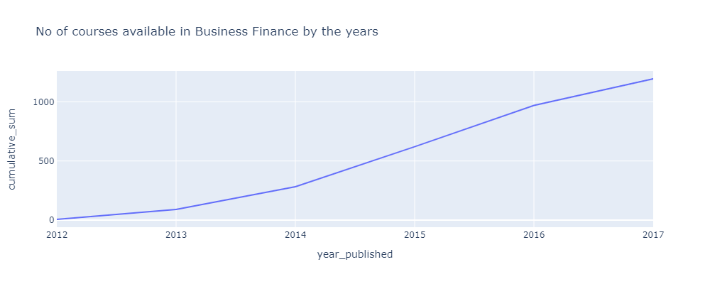
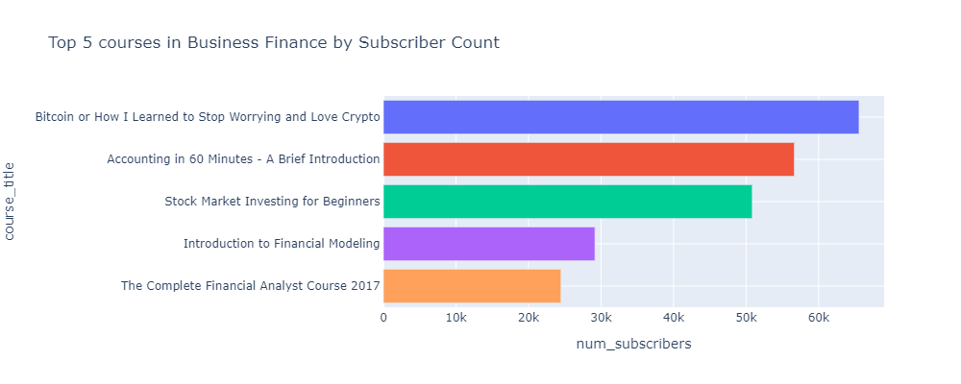
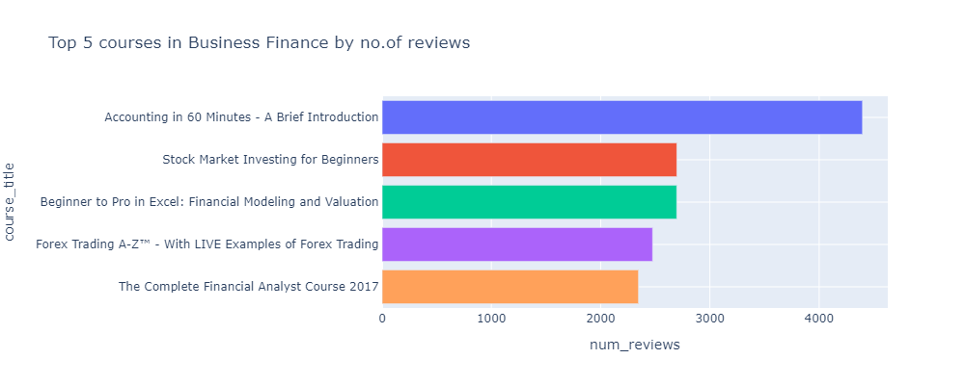
Let’s have an analysis Subject-wise
Business Finance:

Slide 7
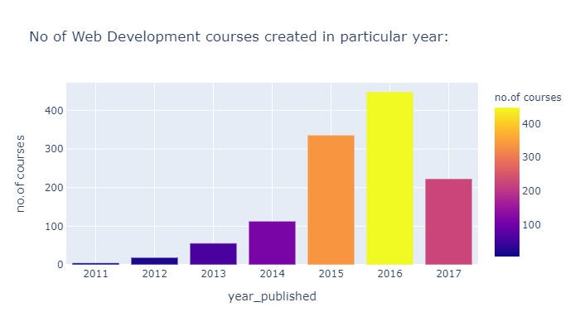
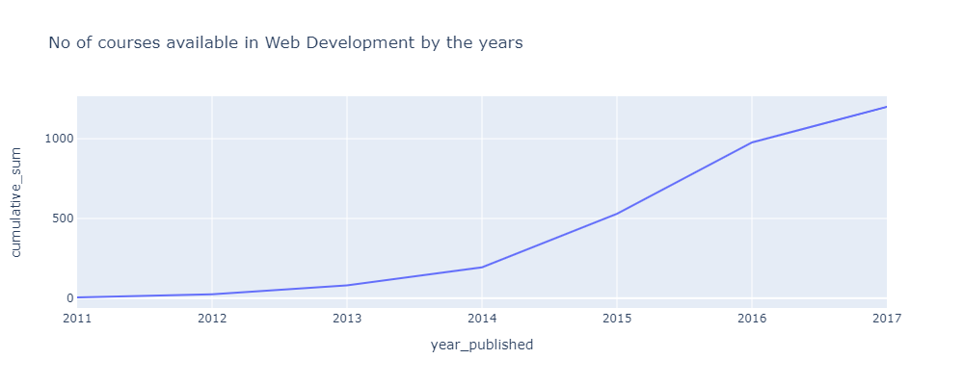
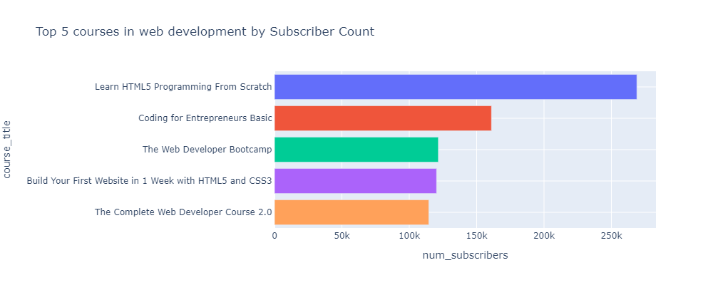
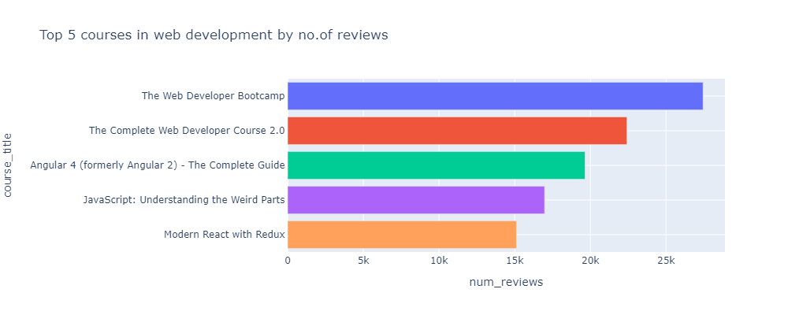
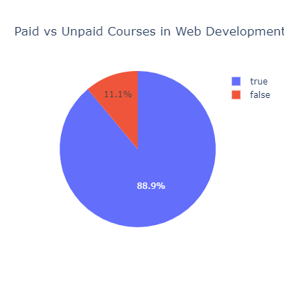
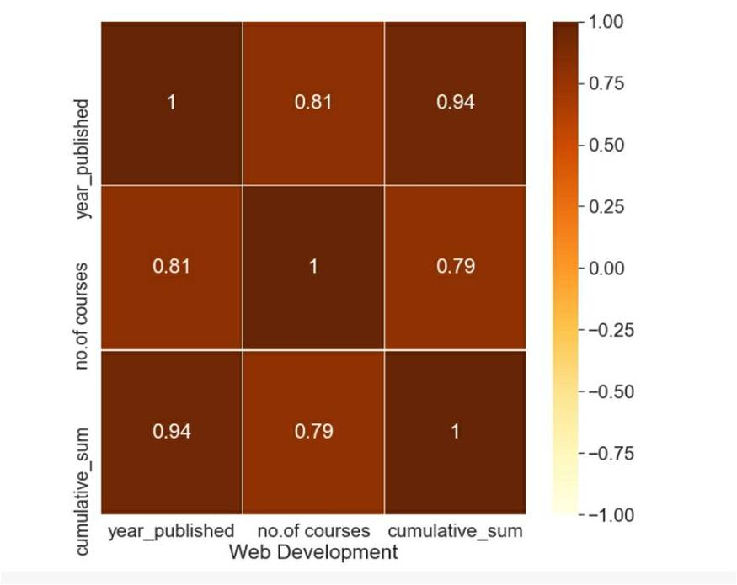
Web Development
Using heat map we made corr() function only for web development subject

Slide 8
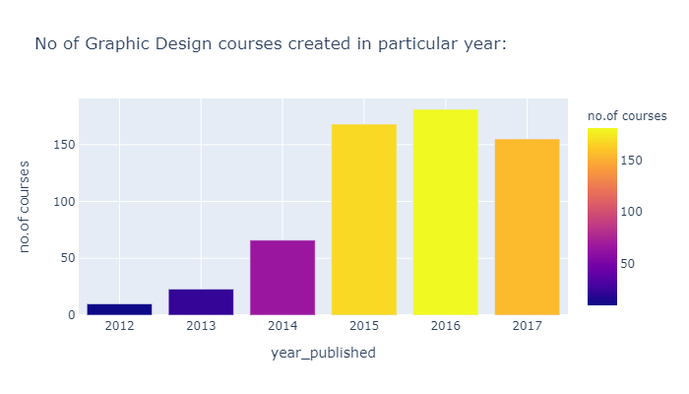
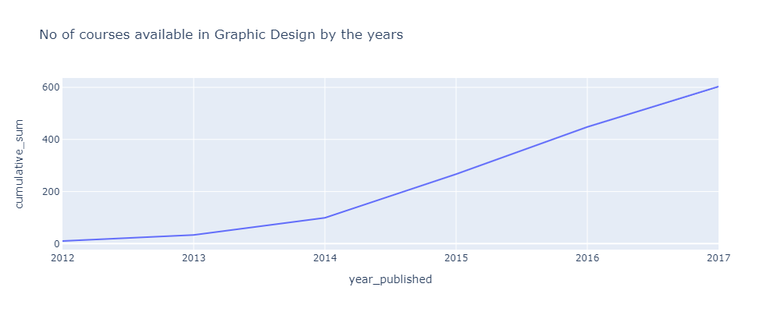
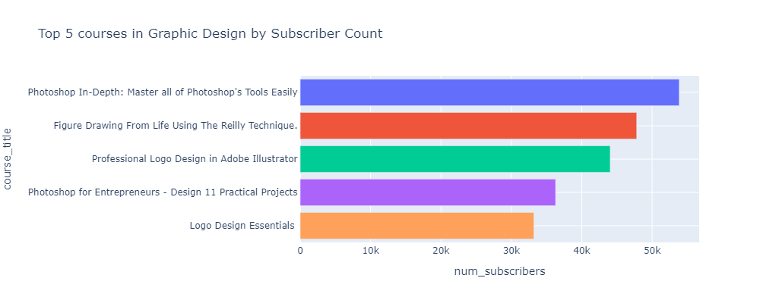
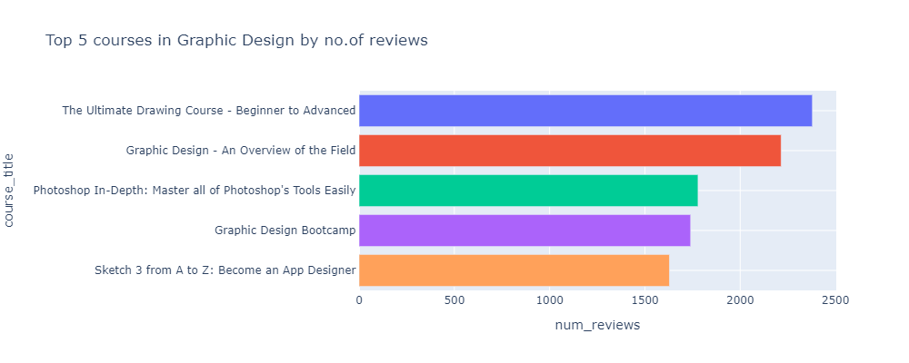
Graphic Design

Slide 9
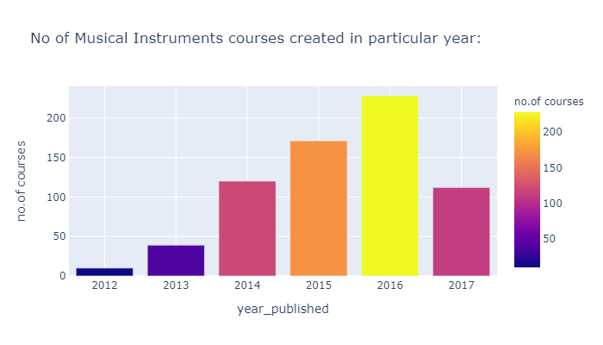
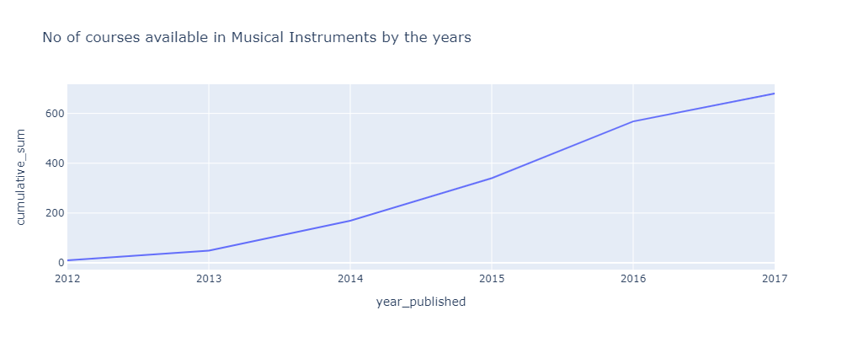
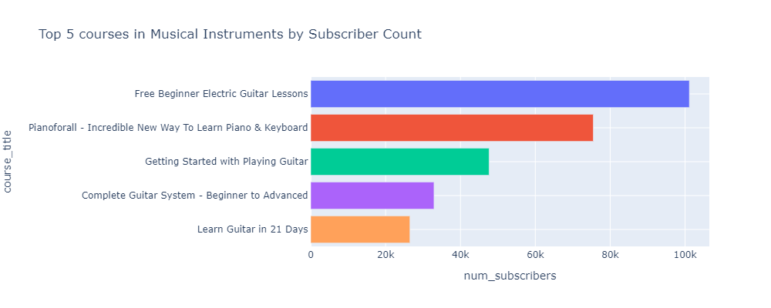

Musical Instruments

Slide 10
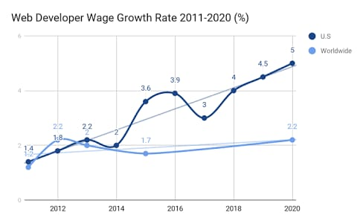
Web Development
Comparing our data with real world trends
Source: https://www.templatemonster.com/blog/web-developers-salary-predictions/
The wages of the Web Developers is being increased over the years so do the No.of web developers and no.of courses on web development

Slide 11
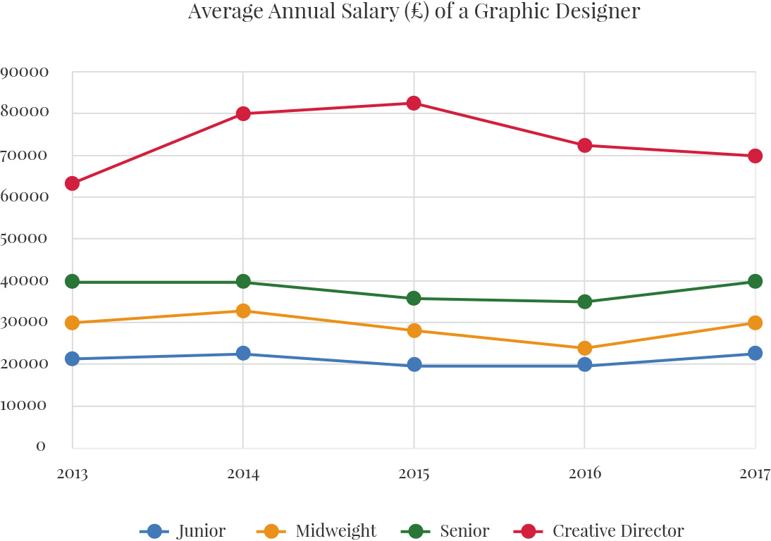
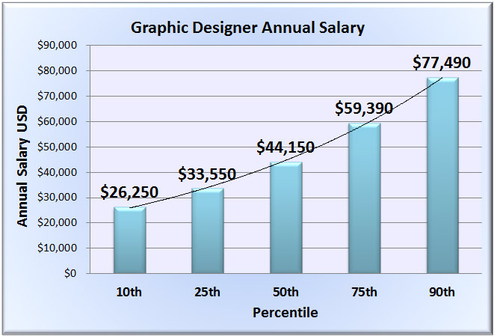
Comparing our data with Real World Trends
Graphic Design
Source: Google images
Though the Average annual salary of Graphic designers is approximately constant over years
The salary is increasing with experience
So the demand for graphic designers increasing over years so do the courses created.
Source: https://app.emaze.com/@ACQLTFQF#1

Slide 12
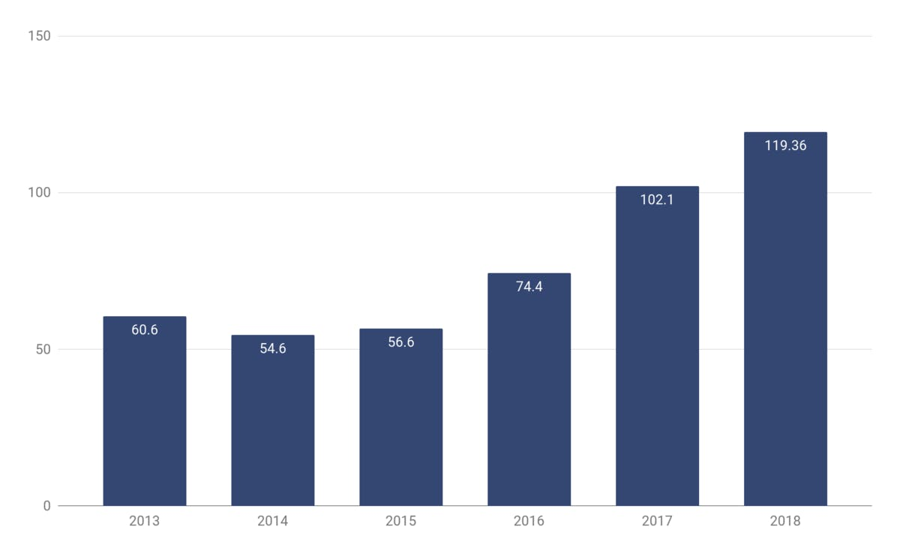
Comparing our data with real world trends
Musical Instruments
Digital music sales in India, 2013-2018, $US million Source: Deloitte, IFPI
The music sales in India is increasing over years and the interest in the music as well among the people. The no of courses also increased in music as the interest in music grows.

