Slide 1
Predicting a battery's core temperature, you can't measure
A physics + machine-learning hybrid for lithium-ion cells
Avinash Nayal · avinashnayal.com/thermal
Notes:
Title. The project estimates a lithium-ion cell's internal core temperature — the quantity that governs battery safety — from only the signals a real battery management system can measure: current, voltage, and surface temperature. It is a physics + ML hybrid. The through-line of the whole project is an honest accounting of where its uncertainty comes from.

Slide 2
The problem: the temperature that matters is the one you can't see
• Cells fail from the inside out
  – Core temperature drives degradation, thermal runaway, safety margin
• But sensors only ever see the surface
  – A BMS (and nearly every public dataset) reads casing temperature only
• The gap opens exactly when it matters
  – Under hard, high-current use the core runs several °C hotter than the surface
Fever analogy: like reading a fever off a skin thermometer when you care about core body temperature — the skin reading is real, but converting it to the core depends on how heat travels inside, which you can't read from outside.
Notes:
From Week 1. It's like measuring someone's skin temperature when what you really care about is their core body temperature during a fever. The skin reading is real and useful, but converting it to the core depends on how heat travels through the body — and you can't read that from the outside. The whole project exists to bridge that gap.

Slide 3
Why it's hard: there is no core temperature to train on
• No public dataset measures internal core temperature
  – There is no core thermocouple anywhere in the data
• So the labels must be synthesized
  – A calibrated physics model generates the core-temperature labels
  – An ML model then learns to reproduce them from measurable signals
• The honest consequence, stated up front
  – Every core temperature in this project is MODEL-DERIVED, not measured
Notes:
No public dataset measures the internal core temperature directly, so we can't just train a model on it. Instead a calibrated two-state physics model generates core-temperature labels, and the ML model learns to reproduce those. That single fact — the ground-truth core temperatures are model-derived, never measured — shapes everything: what can be validated, what cannot, and where the real uncertainty lives.

Slide 4
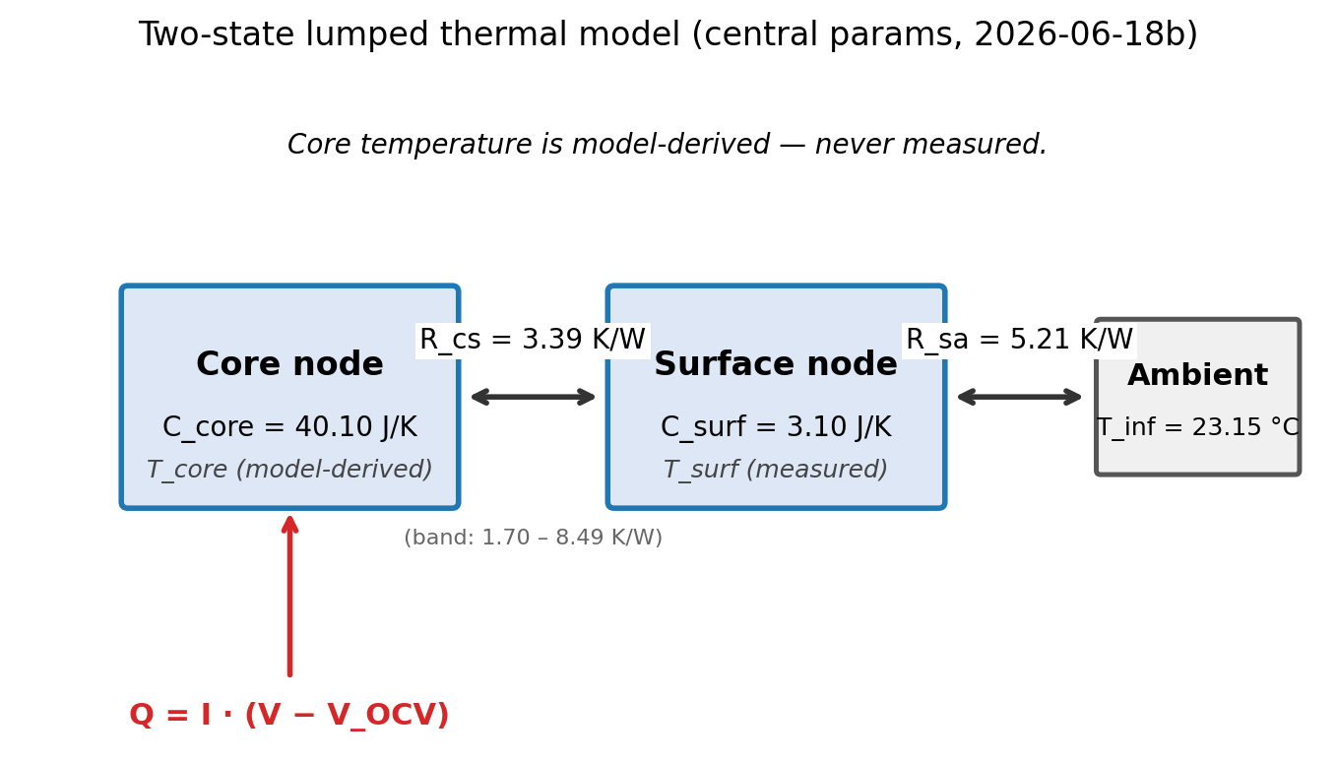
Approach: a two-stage physics-then-ML pipeline
• Raw drive cycles (I, V, T_surface @ 1 Hz)
  – ↓ calibrated two-state thermal model
• Model-derived core-temperature labels
  – ↓ learned surrogate
• ML map: I, V, T_surface → T_core
  – A deployed system could skip the physics and predict the core directly
Fig 1 — two-state lumped model (committed). LOCKED 2026-06-18b.
Notes:
Two stages. First, a calibrated physics model turns measurable signals into core-temperature labels. Second, a machine-learning model learns to reproduce those labels from the same measurable signals — so a deployed system could skip the physics entirely and predict the core directly.

Slide 5
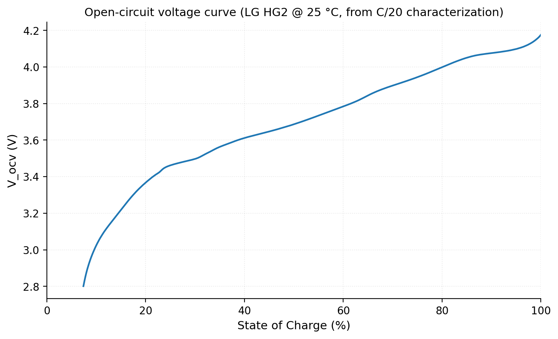
Data: real cells, standard drive cycles, surface-only sensing
• LG 18650HG2 dataset (Kollmeyer et al., McMaster; Mendeley Data)
  – Licensed CC BY 4.0 (DOI 10.17632/cp3473x7xv.3)
• Automotive cycles: US06, LA92, UDDS + eight mixed
  – This work uses the 25 °C set — eleven cycles, logged at 1 Hz
  – Colder ambients set aside on purpose (§4 shows why)
• Core-temp labels are MODEL-DERIVED, not measured
  – The dataset measures surface temperature only
Fig 5 — resting-voltage V_OCV(SOC) from the C/20 characterization (committed).
Notes:
From Week 1. The data are real lithium-ion cells run through simulated driving patterns. Everything here is the 25 °C set of the LG 18650HG2 dataset — eleven cycles at one reading per second. The crucial honesty point that shapes the whole project: these datasets only ever measure the battery's surface temperature — never the internal core temperature, which is exactly what we want to predict. So the core-temperature labels are model-derived, not measured.

Slide 6
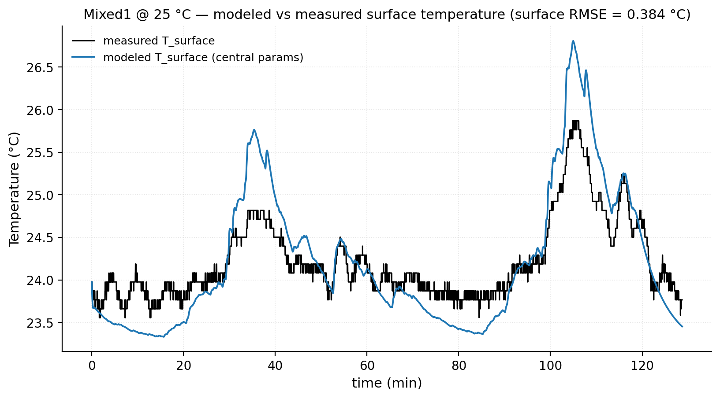
The physics: two coupled nodes, heat in, calibrate to surface
• Two-state lumped model
  – Hot core node + cooler surface node, coupled by internal resistance R_cs
• Heat generation: Q = I · (V − V_OCV)
  – current × overpotential = power lost as heat
• Constrained calibration — pin what you can, fit only what you must
  – Parameters tuned so modeled surface matches measured surface
  – In-regime held-out surface fit: 0.38 °C RMSE
Fig 6 — modeled vs measured surface, Mixed1 @ 25 °C (committed).
Notes:
From Week 2. The model splits the cell into two connected parts — a hot core and a cooler surface. Heat generated is current times overpotential, the gap between resting voltage and voltage under load. The model has four physical dials; a free four-parameter fit would be ill-posed, so we pin total heat capacity from mass and specific heat, fix the surface-to-air resistance from cooling tails, and fit only the rest against measured surface temperature. On an in-regime held-out cycle the modeled surface tracks the measurement to 0.38 °C RMSE — a good surface fit means we reproduce what we can measure; it says nothing directly about whether the hidden core values are right.

Slide 7
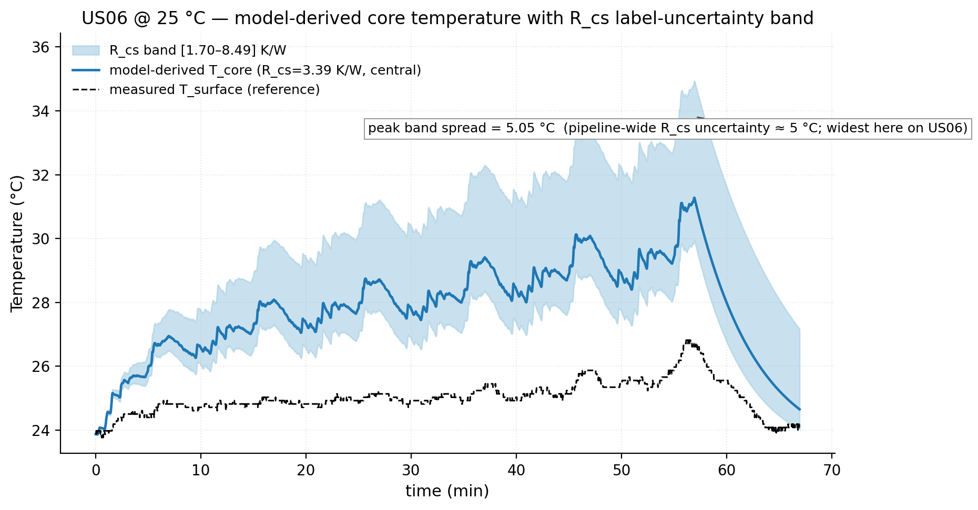
The honest finding: the dominant uncertainty is one we can't measure
• R_cs sets the core–surface gap: T_core − T_surf ≈ Q · R_cs
  – …yet surface temperature is almost insensitive to it
  – So the parameter that matters most is the one the data constrains least
• The move: refuse a false-precise value; propagate a plausible range
  – R_cs ∈ [1.70, 8.49] K/W (central 3.39) → core is a band, not a line
• ~5 °C core-temp label band (5.05 °C peak, US06)
  – An order of magnitude larger than the ML's own error — this dominates
  – Naming your method's weakest point = rigor, not failure
Fig 2 — R_cs label-uncertainty band on US06 @ 25 °C (committed).
Notes:
From Week 2 (continued) — the centerpiece. The whole point is to estimate the core–surface gap, which depends on how easily heat flows from core to surface, R_cs. Because we can only measure the surface, that exact parameter is the hardest to determine — two independent papers confirm it's a fundamental limitation, not a gap in effort. Analogy: like estimating an engine's core temperature from a thermometer taped to its casing — converting the casing reading to the core depends on how well heat travels through the metal, which you can't measure from outside. The honest move isn't to pretend you know it; it's to say it's somewhere in this range, so the core is somewhere in this band. That band is about 5 °C — the dominant uncertainty in the whole pipeline.

Slide 8
The ML stage: a faithful, honestly-evaluated surrogate
• Features from what a real system can measure
  – Instantaneous I, V, T_surface, T_ambient
  – Lags + rolling means of I² and I·V; surface rate-of-change dT_surface/dt
• Two models, from simple to flexible
  – Ridge (regularized linear) → HistGradientBoosting (tree ensemble)
• Evaluation that can't fool you
  – Leave-one-cycle-out: hold out WHOLE cycles, never random-split a time series
  – A mid-cycle row ≈ its neighbors → a random split tests memorization
Notes:
From Week 3. We trained ML models to reproduce the physics model's core labels using only signals a real system can measure — current, voltage, surface temperature, and their recent history (lags, rolling averages of I² and I·V, and the surface's rate of change). We scored honestly: every model was tested only on drive cycles it had never seen — leave-one-cycle-out — never on scattered moments from cycles it had already learned, because a random split of a time series tests memorization, not generalization.

Slide 9
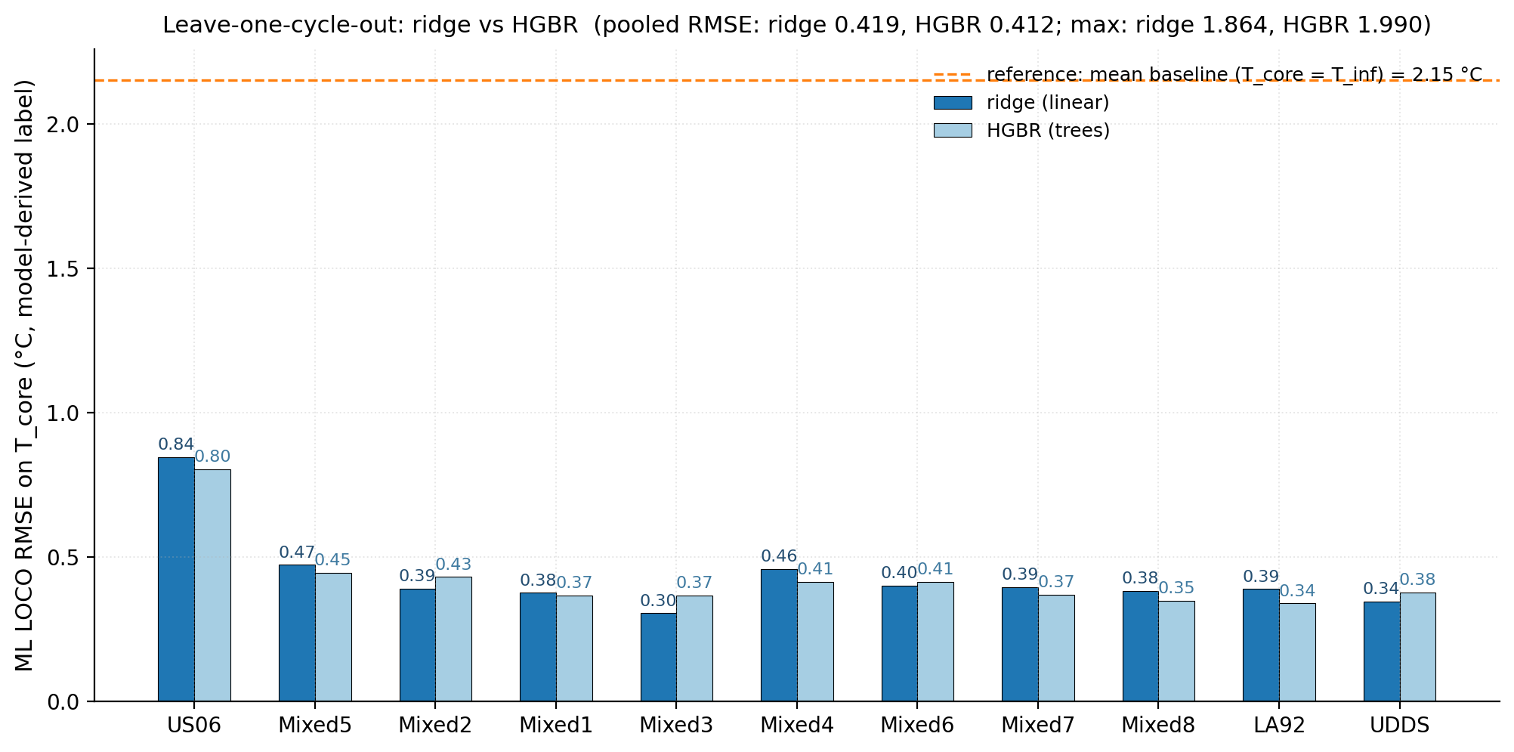
Results: a simple model already hits the physical ceiling
• Ridge and HGBR are a near-tie (agree within 0.01 °C)
  – Pooled LOCO RMSE: ridge 0.419 °C vs HGBR 0.412 °C
  – Worst-case max error: ridge 1.86 °C vs HGBR 1.99 °C
  – Ridge reported: ~tied RMSE, better worst-case tail, simpler
• Beats the naive baseline by ~5×
  – vs T_core = T_inf baseline (pooled LOCO RMSE 2.15 °C)
• The tie is the finding: the map is near-linear — ML is not the bottleneck
  – ~0.4 °C ML error sits inside a ~5 °C physical label band
Fig 4 — leave-one-cycle-out RMSE, ridge vs HGBR (committed).
Notes:
From Week 3. A simple linear model and a flexible tree ensemble came out essentially tied — pooled leave-one-cycle-out RMSE 0.419 vs 0.412 °C, agreeing within about a hundredth of a degree, both predicting unseen core temperature to within about half a degree. Ridge is reported: statistically indistinguishable RMSE, a slightly tighter worst-case tail, and simpler. Against the naive 'core sits at the resting temperature' baseline (T_core = T_inf, 2.15 °C RMSE) ridge is about 5× better. The tie is the real finding: the link between what we measure and the hidden core is simple enough that a basic model captures it, and that half-degree of ML error is small next to the several-degree physical uncertainty we already measured. The ML was never the bottleneck.

Slide 10
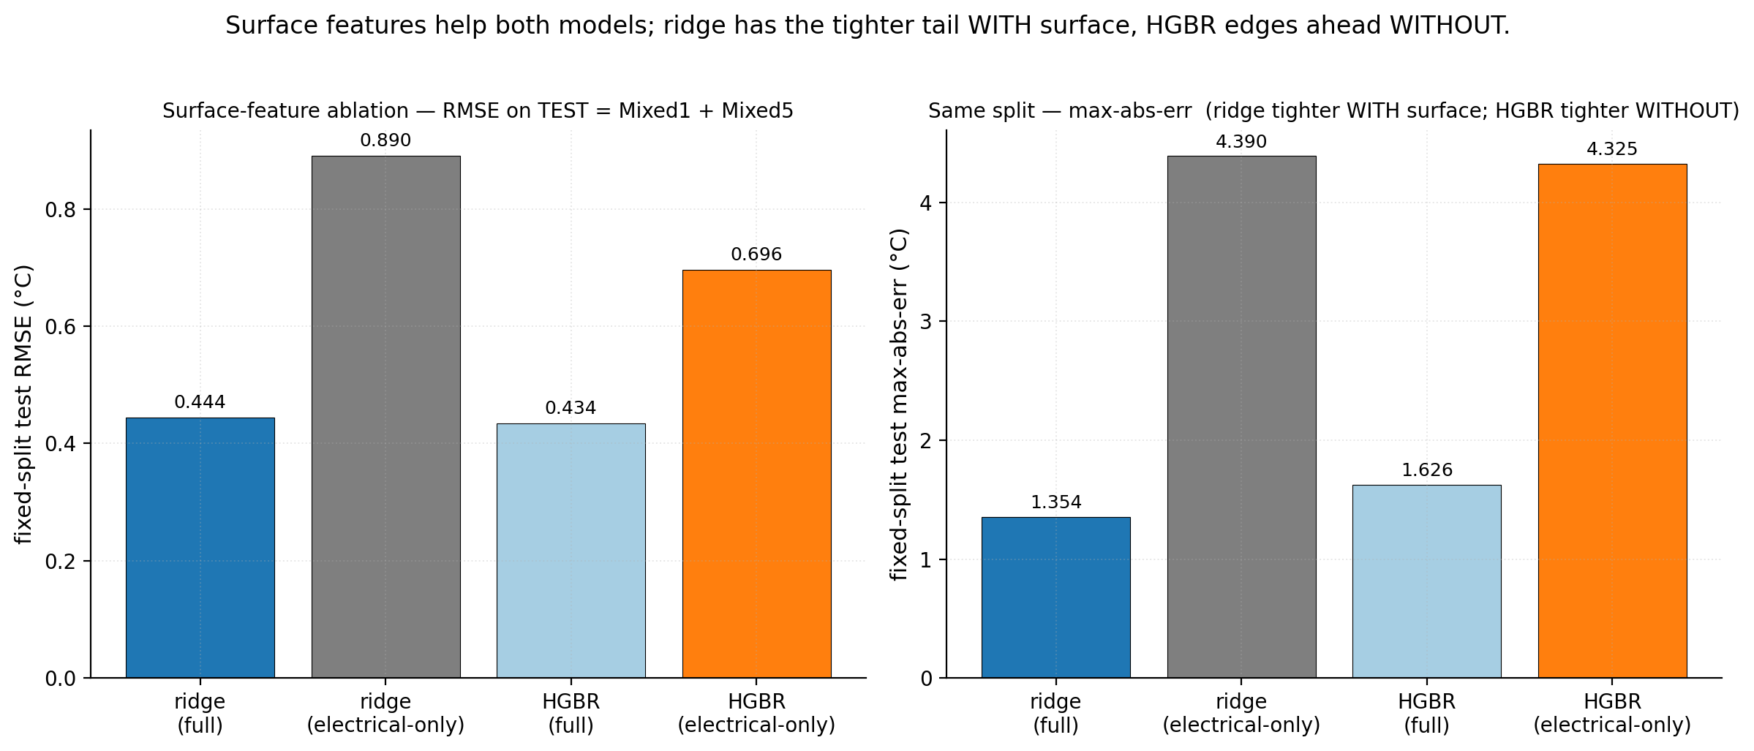
Ablation: how much is the surface signal really doing?
• Test: drop all surface-temperature features (electrical signals only)
  – Simulates a sensorless deployment — core from I and V alone
  – Fixed dev split (test = Mixed1 + Mixed5)
• Both models degrade sharply without surface
  – Full → electrical-only RMSE: ridge 0.444 → 0.890 °C
  – HGBR 0.434 → 0.696 °C
• And the ranking flips
  – With surface, ridge has the tighter tail (max 1.35 vs 1.63 °C)
  – Without surface, HGBR wins both (RMSE 0.696 vs 0.890; max 4.32 vs 4.39 °C)
Fig 7 — surface-feature ablation, fixed dev split (committed).
Notes:
The ablation asks whether the surface temperature is carrying real signal or just acting as a near-copy of the label. Deny the model its surface features and let it work from electrical signals alone: both degrade sharply — ridge RMSE goes 0.444 to 0.890, HGBR 0.434 to 0.696 °C — so surface temperature is doing real work. And the ranking flips: with the full feature set ridge has the tighter worst-case tail (1.35 vs 1.63), but strip the surface features and HGBR wins on both metrics. So the model choice is conditional — ridge for the sensored setup, HGBR would reopen the choice for a genuinely sensorless deployment. A clean follow-up direction, not a result to overclaim.

Slide 11
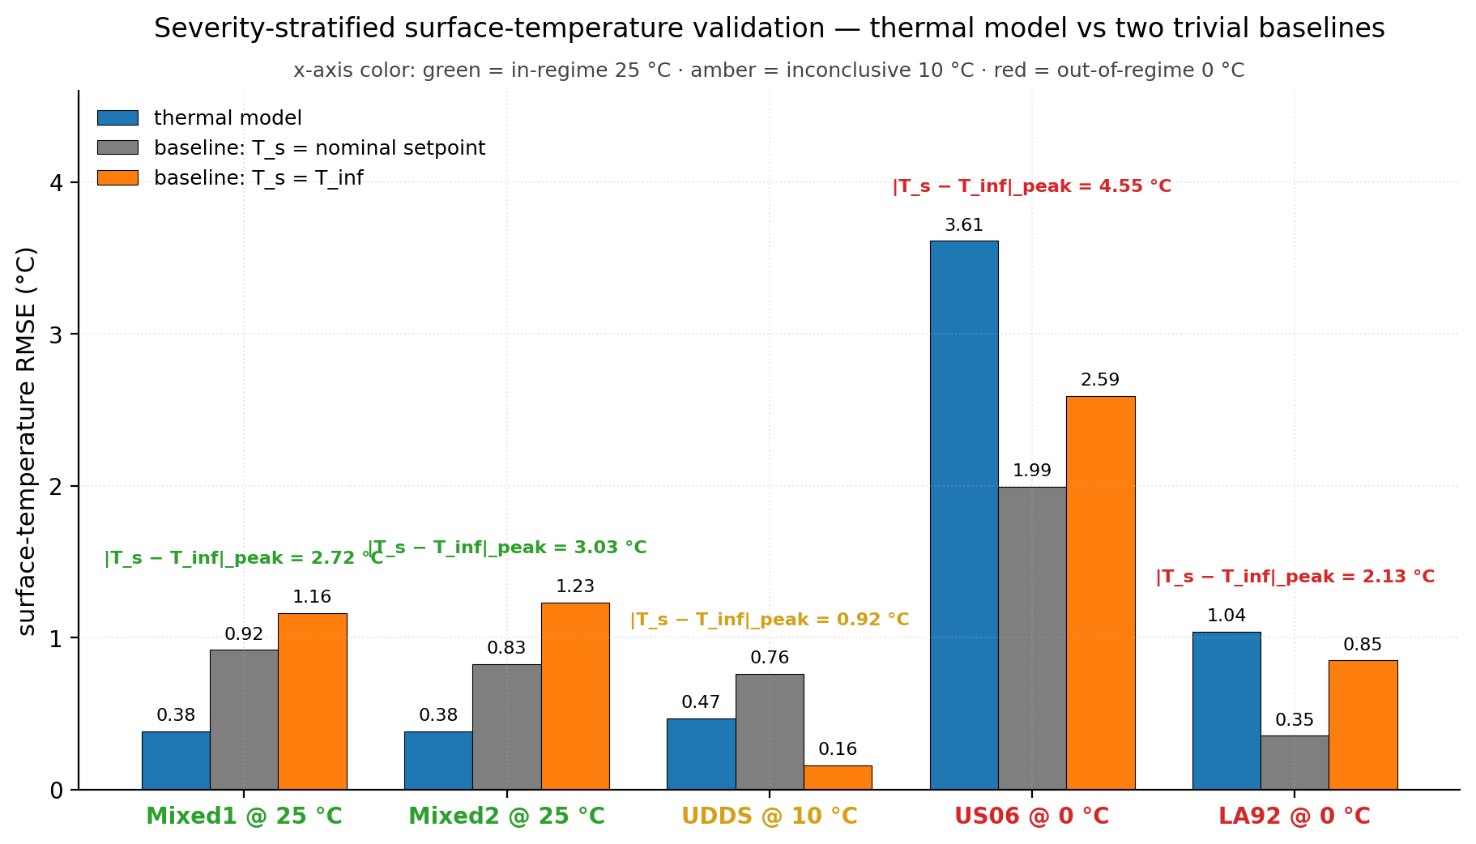
Limitations, stated on purpose
• Core-temperature labels are MODEL-DERIVED, not measured
  – No core thermocouple exists; low ML error certifies agreement with the
  – labels, NOT that their absolute core values are correct
• The R_cs label band (~5 °C) is the dominant uncertainty
  – Not one limitation among several — it IS the limitation
• Claims are cycle-scoped
  – Clean pipeline-value claims rest on two thermally-validated cycles (Mixed1, Mixed2)
  – Labels are 25 °C only; at 0 °C the model over-accumulates heat and breaks down
Fig 3 — surface-RMSE by regime; 0 °C is out-of-regime (committed).
Notes:
The limitations sit almost entirely on the physics-and-labels side. First and plainest: the core-temperature labels are model-derived, never measured — there is no core thermocouple in the data, so a low ML error means the surrogate faithfully reproduces the labels, not that the labels' absolute core values are correct. Second: the R_cs band, about 5 °C, is not one limitation among several — it is the limitation, and it sets the scale. Third: claims are cycle-scoped — the clean pipeline-value claims rest on two thermally-validated cycles, and the labels are 25 °C only; at 0 °C the model runs out of regime and over-accumulates heat. These are edges the project draws on purpose.

Slide 12
Reproducibility: two honest modes
• The repository is public
  – github.com/Avinashsingh17/li-ion-core-temperature-physics-ml
• Mode 1 — regenerate the published figures
  – From the committed, locked 2026-06-18b calibration
• Mode 2 — re-derive the calibration from scratch
  – For anyone who wants to check the physics rather than take it on trust
  – May not land bit-for-bit on the locked parameters
• A guard enforces it
  – The figure script refuses to run if the calibration drifts from the locked run
Notes:
The full pipeline, the locked calibration, the figures, and the working notes are public. Reproduction has two honest modes. The default regenerates the published figures from the committed locked 2026-06-18b calibration — and the figure script refuses to run if that calibration drifts, so the numbers can only ever come from the run that produced them. The second re-derives the calibration from scratch for anyone who wants to check the physics; it may not land bit-for-bit, and the same guard will say so. That split is the reproducibility version of the argument the whole write-up makes: be explicit about what's fixed, what's free, and how you'd know the difference.

Slide 13
I built a careful estimator of a quantity I can't measure — and the most valuable thing it produces is an honest account of how much it can't know.
You can get very good at reading the skin — but past a point, the limit isn't your skill with the thermometer you have. It's the thermometer you don't.
github.com/Avinashsingh17/li-ion-core-temperature-physics-ml
Notes:
The one-sentence version: I built a careful estimator of a quantity I can't measure, and the most valuable thing it produces is an honest account of how much it can't know. The fever analogy still holds — you can get very good at reading the skin, but past a point the limit isn't your skill with the thermometer you have; it's the thermometer you don't.

