Slide 1

Problem Statement and Team Details
Problem Statement: Research today is not just about finding answers — it’s about finding answers that can be trusted and shared. Students, teachers, and startup teams spend hours jumping between Google, PDFs, and blogs, only to end up with scattered, sometimes outdated knowledge.
Github link:https://github.com/Avinashy324/Smart_Research_Assistant
Team Name: Commit and conquer
Team Leader Name:Avinash Y
Institute Name: KLH University, Hyderabad
Team Leader Email ID: 2420030568@klh.edu.in

Slide 2
Problem and Solution
Problem
Doing research today feels messy. Students, teachers, and startup teams waste hours moving between Google, blogs, and PDFs just to get a few reliable points.
Search engines throw endless links without clear answers.
Most tools only handle one file at a time.
Many summaries don’t show sources, making it hard to trust them.
As a result, people lose time, energy, and often end up with half-baked or outdated information.
Solution
We are building a Smart Research Assistant that works more like a research notebook than just a chatbot.
Collects answers from both uploaded files and the web.
Shows agreements and differences across sources.
Keeps track of questions and answers in one place.
Refreshes automatically when new articles or updates come in.
Lets teams share the same space and work together.
Notes:
Problem
Doing research today feels messy. Students, teachers, and startup teams waste hours moving between Google, blogs, and PDFs just to get a few reliable points.
Search engines throw endless links without clear answers.
Most tools only handle one file at a time.
Many summaries don’t show sources, making it hard to trust them.
As a result, people lose time, energy, and often end up with half-baked or outdated information.
Solution
We are building a Smart Research Assistant that works more like a research notebook than just a chatbot.
Collects answers from both uploaded files and the web.
Shows agreements and differences across sources.
Keeps track of questions and answers in one place.
Refreshes automatically when new articles or updates come in.
Lets teams share the same space and work together.

Slide 3
Methodology & Implementation
Approach & Implementation
Step 1: User Interaction
A clean web interface where users ask questions.
Option to upload PDFs, research papers, or notes.
Step 2: Data Gathering
Backend fetches data from two sources:
Uploaded documents (PDFs, slides, notes).
Live web/blog feeds for fresh information.
Step 3: Information Processing
Extracts and cleans text.
Uses keyword + semantic search to find relevant sections.
Cross-checks multiple sources to detect agreements vs. conflicts.
Step 4: Summarization & Trust Layer
Generates short, structured answers.
Every point is backed by a citation.
Sources are ranked by recency and credibility (e.g., academic > random blog).
Step 5: Research Journal Creation
Instead of giving a one-time reply, all Q&A are stored in a living research notebook.
Notebook automatically updates when new data comes in (version control for knowledge).
Step 6: Dashboard & Collaboration
A team dashboard shows:
Key insights.
Sources used.
Usage counters/credits.
Multiple users can share the same project space and track contributions.

Slide 4
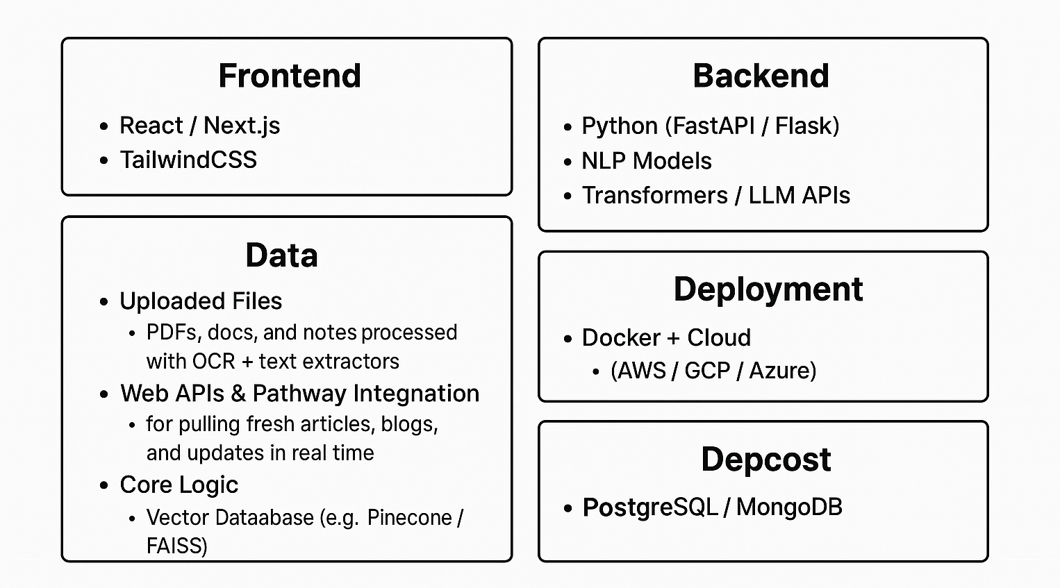
Technology Used

Slide 5
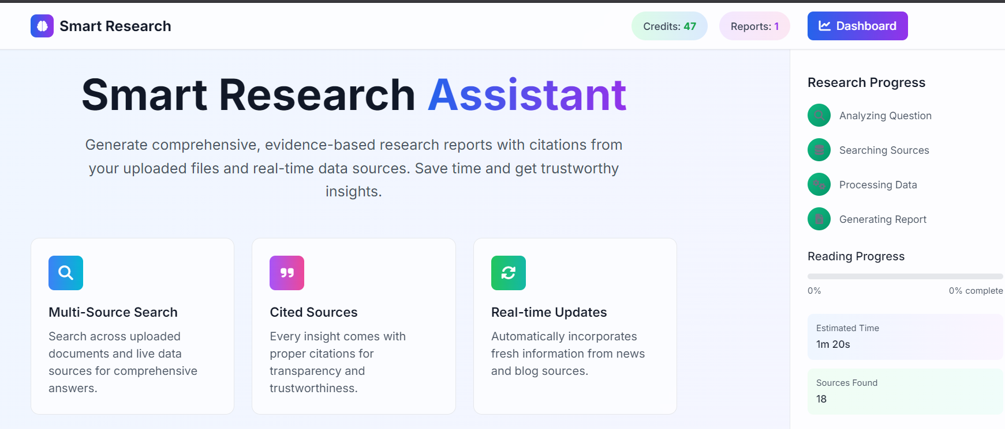
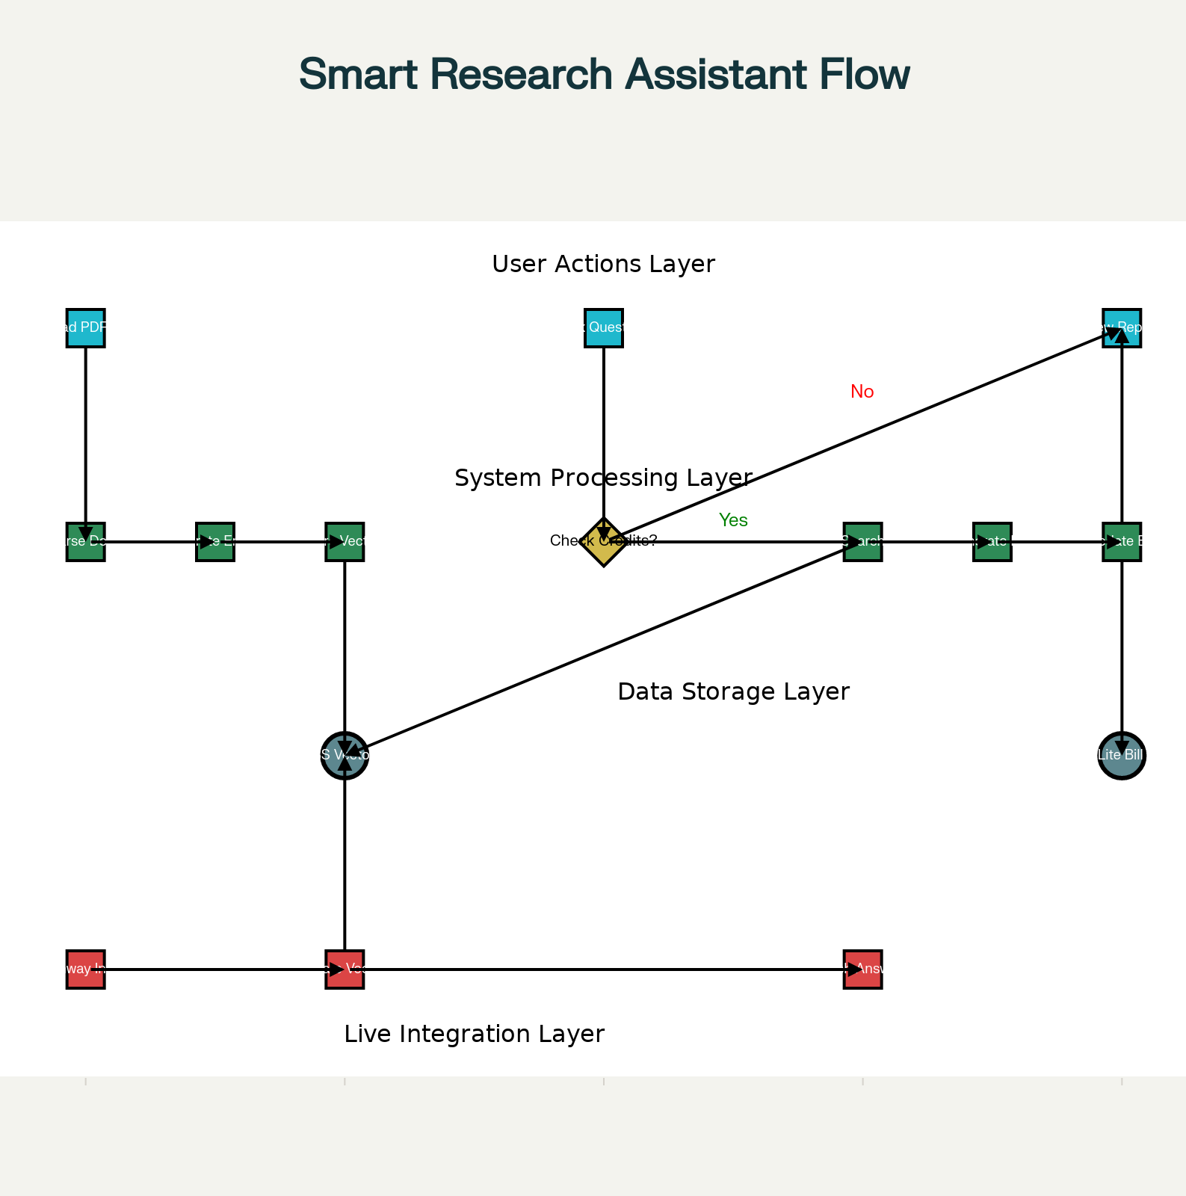
Flowchart & Supporting Images
Supporting Images
Flowchart

Slide 6
Feasibility and Market Use
Feasibility
Can be built using existing tools (React, Python, NLP, cloud services).
Scales easily with cloud deployment, starting small and expanding with users.
Usage tracking + billing model make it sustainable as a SaaS product.
Market Use
Students & Researchers – faster literature reviews and assignments.
Teachers – reliable, updated teaching resources.
Startups – quick validation of ideas and market trends.
Corporate Teams – summarize reports and track industry updates.
Why it Works
Saves time and reduces effort in research.
Adds credibility, collaboration, and continuous updates, unlike standard chatbots.
Fits into the growing demand for EdTech and productivity tools.

Slide 7
Conclusion
Research today is messy and time-consuming. Our project makes it simpler by giving users one place to ask questions, get clear answers with sources, and keep track of everything in a research notebook. Unlike normal tools, it highlights reliable information, stays updated, and even lets teams work together on the same space.
This way, students, teachers, and startups can save time, trust the results, and focus more on using knowledge instead of searching for it.
👉 A practical, collaborative, and future-ready approach to research.

