Slide 1
Solid
Avinava Basu

Slide 2
Becoming a better developer using SOLID design principles
Ignite
DRY and KISS
Accelerate
Code to extend, maintain and easy to understand
Succeed
Scalable extendable testable

Slide 3
Working on legacy code
Re-reading code multiple times to get to the part where change needs to be done
Hard to understand what a method does
Spending a lot of time to fix minor bugs

Slide 4
Working on startup code base
In charge of the dev process
Constantly adding new features
No formal layout
Dynamic playground , no time to worry about code structure!

Slide 5
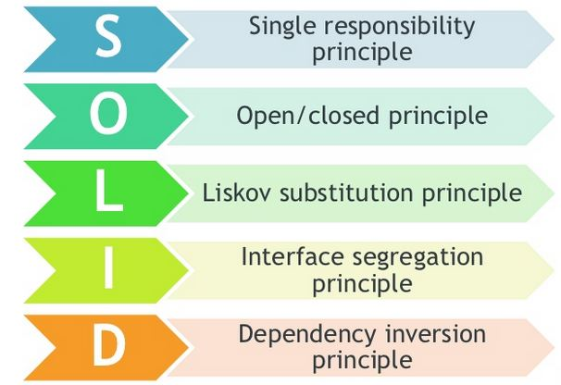
What is SOLID?

Slide 6
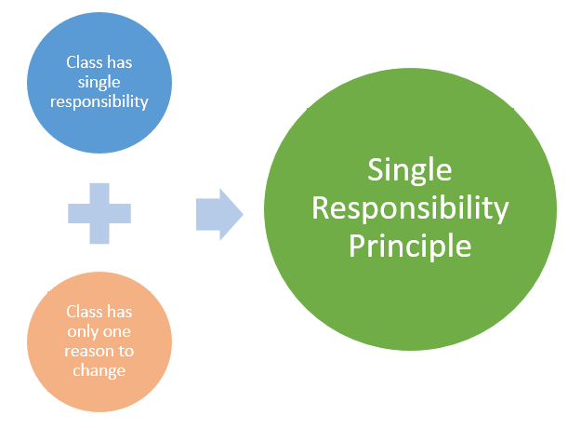
SRP- Single Responsibility Principle

Slide 7
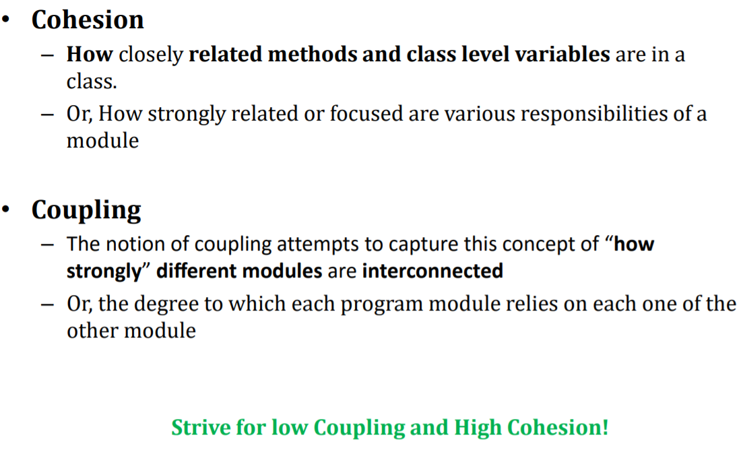
Cohesion and Coupling

Slide 8
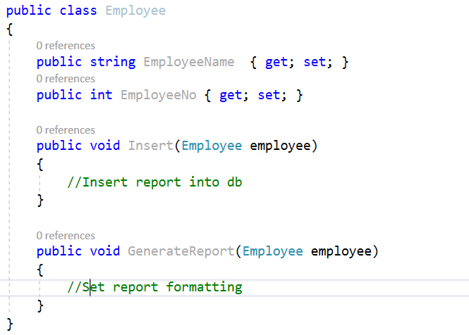
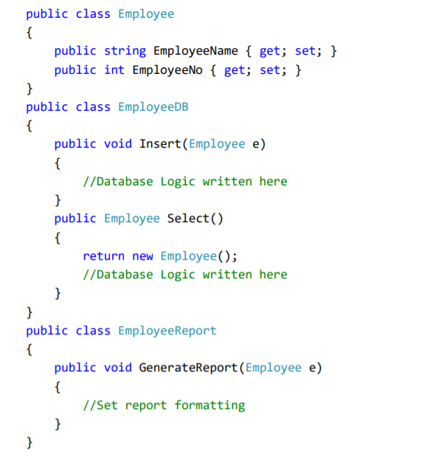
More responsibilities= More likelihood of change

Slide 9
Trivia question Can a class have multiple methods?
A reason to change Multiple small interfaces (follow ISP) can help to achieve SRP Following SRP leads to lower coupling and higher cohesion. Many small classes with distinct responsibilities result in a more flexible design.
Summary

Slide 10
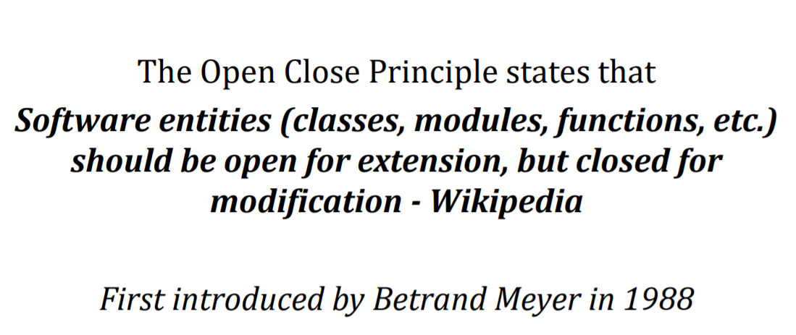
OCP- Open Closed Principle

Slide 11
Open for extension- Its behavior can be extended to accommodate new demand Close for modification – The existing source code of the module is not changed or minimum change when making enhancements
What is OCP?
Adding new rules require changes every time Each change can introduce bugs and require re-testing etc. We want to avoid introducing changes that cascade through many modules in our application

Slide 12
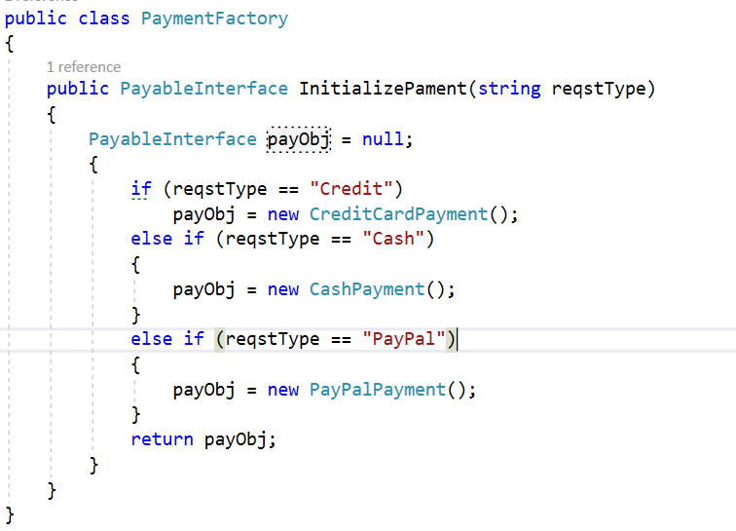
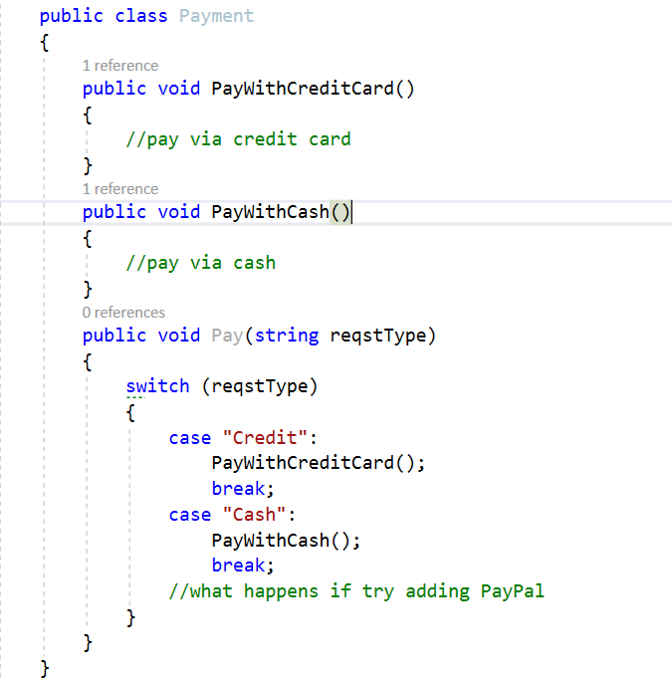
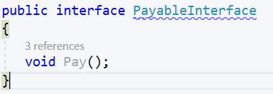
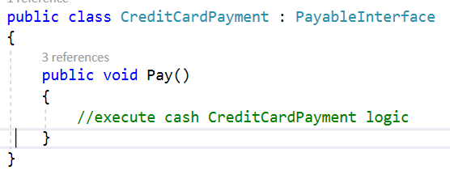
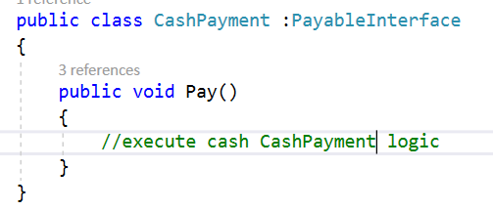
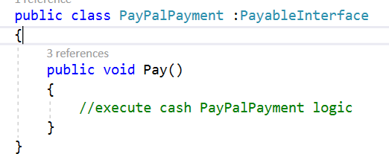
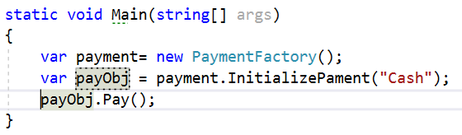
Implementation of OCP?

Slide 13
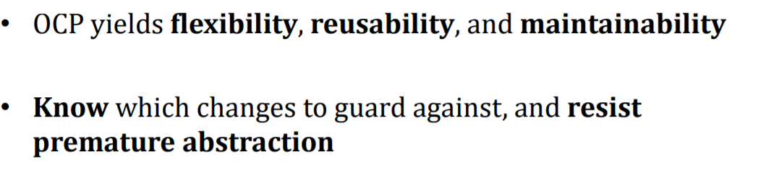
Summary

Slide 14
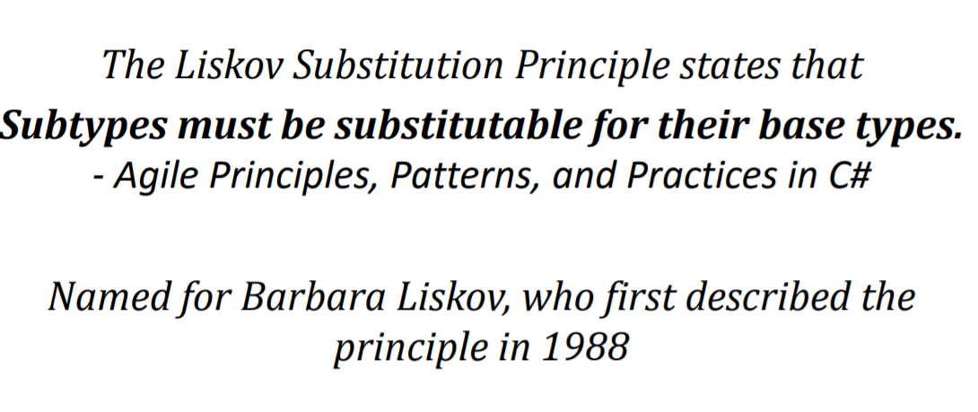
LSP- Liskov’s Substitution Principle

Slide 15
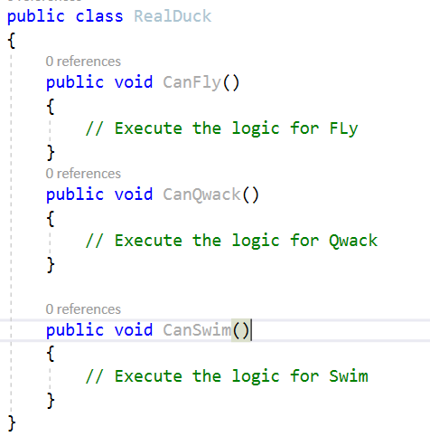
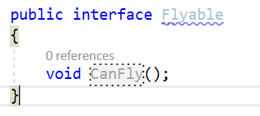
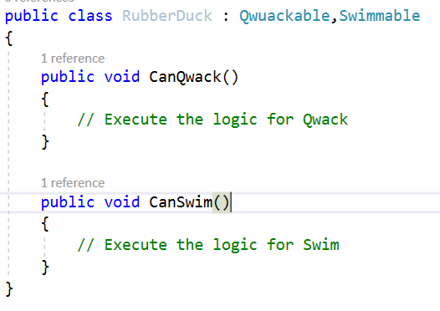
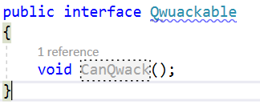
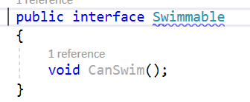
Implementation of LSP?

Slide 16
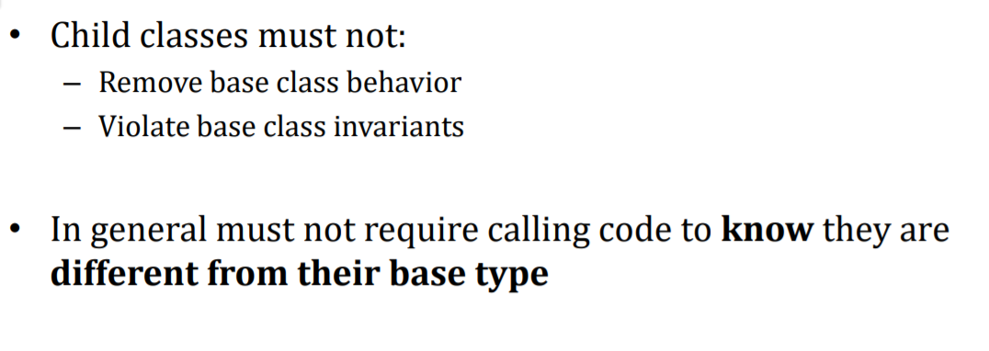
Summary

Slide 17
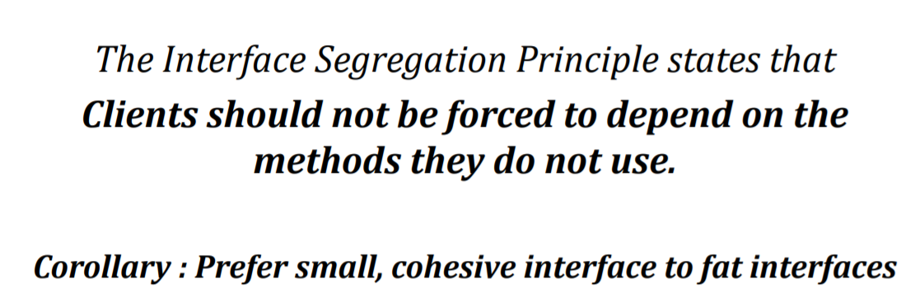
ISP -Interface Segregation Principle

Slide 18
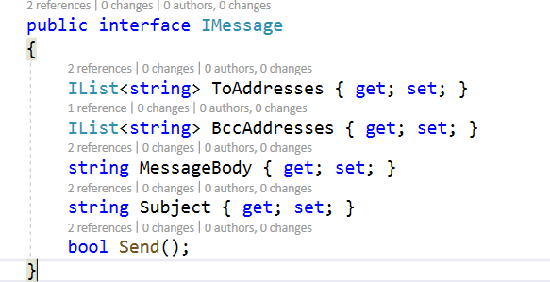
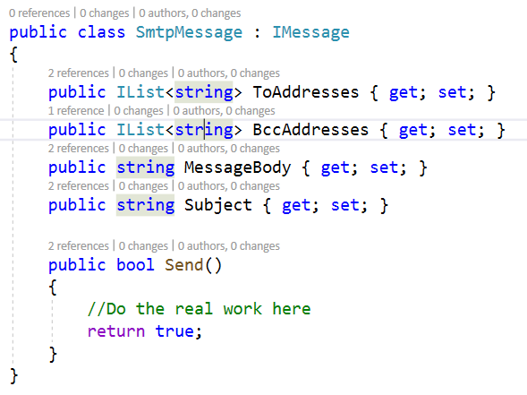
Implementation of ISP

Slide 19
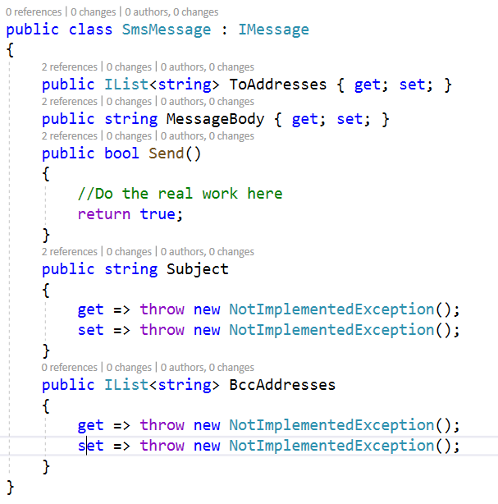
Implementation of ISP

Slide 20
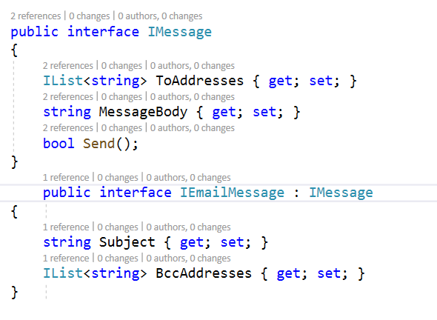
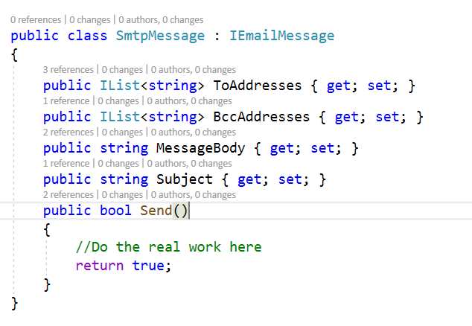
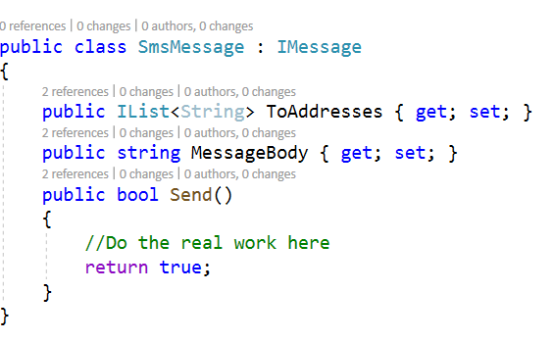
Resolving violation of ISP

Slide 21
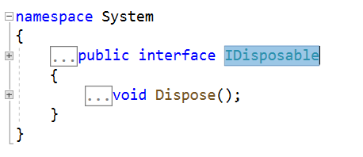
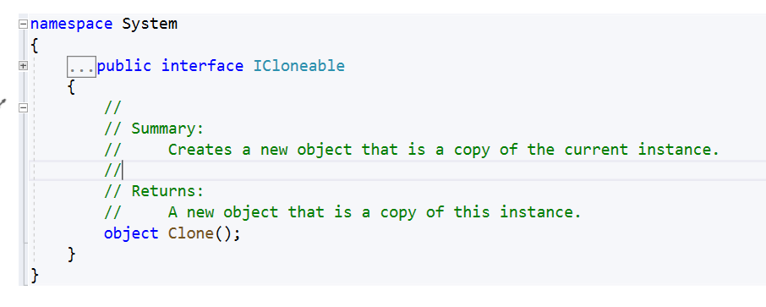
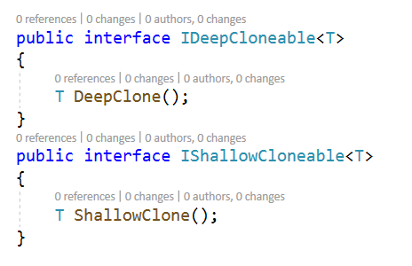
Summary
Is a small interface → good abstraction?

Slide 22
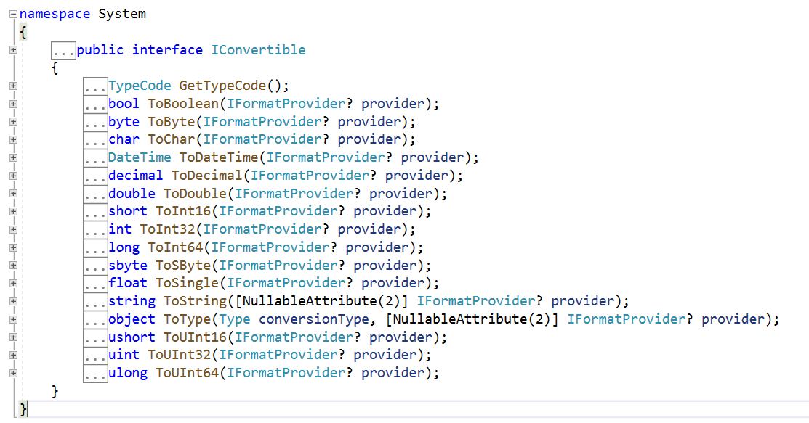
Summary
Is a fat interface necessarily a design flaw?

Slide 23
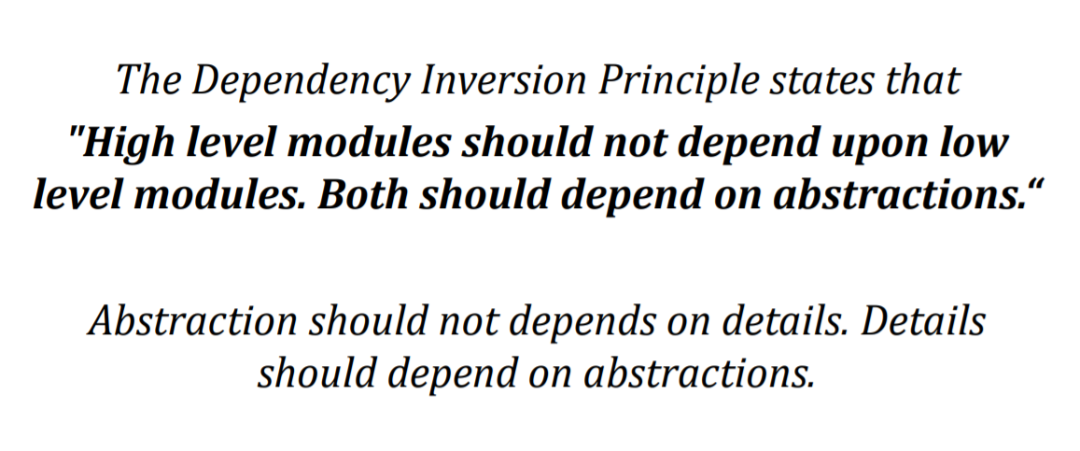
DIP-Dependency Inversion Principle

Slide 24
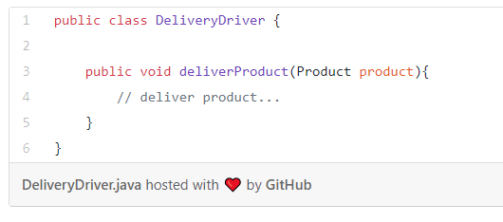
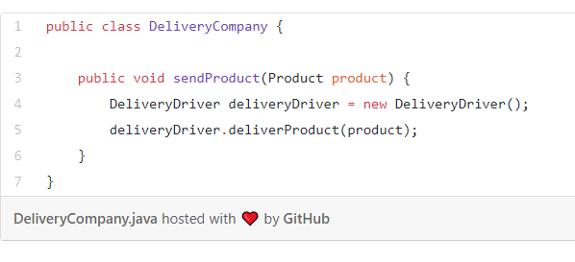
Implementation of DIP

Slide 25
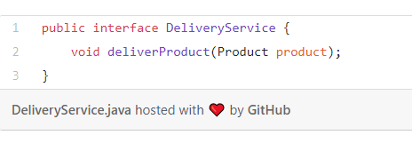
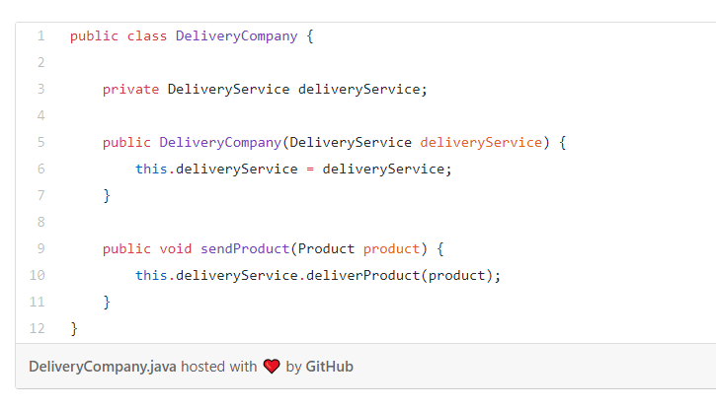
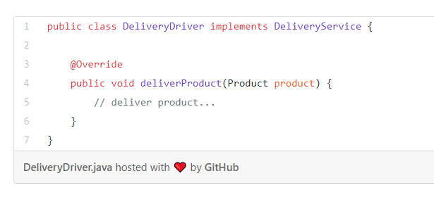
Resolving violation of DIP

Slide 26
Summary
The Dependency Inversion Principle means that a class should not depend directly on another class, but on an abstraction (interface) of this class
Benefits:
Reduce the coupling.
Code more reusable.

Slide 27
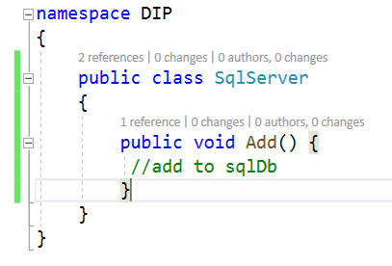
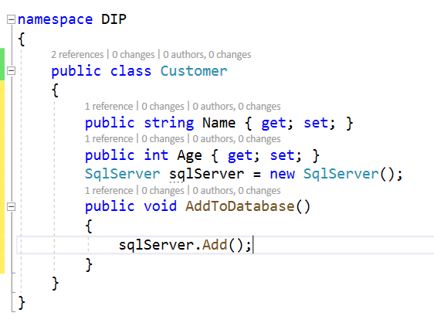
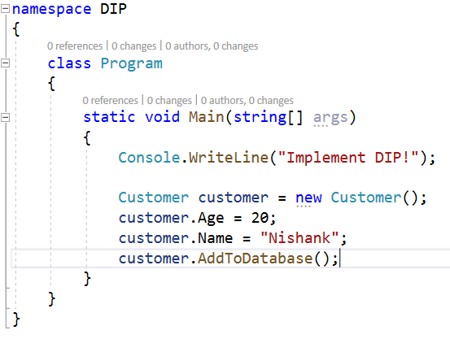
Consolidating SOLID

Slide 28
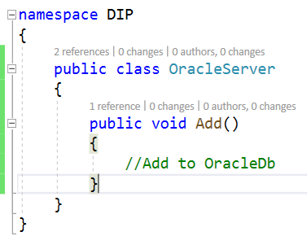
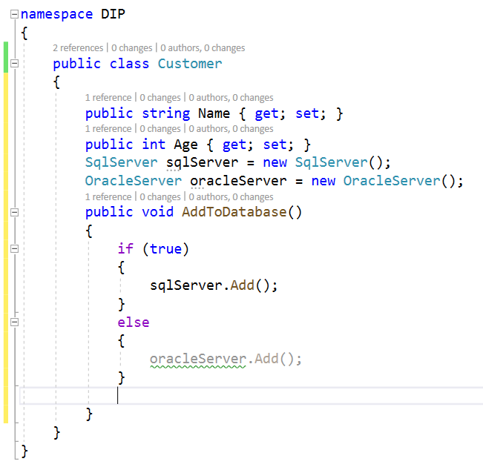
Consolidating SOLID

Slide 29
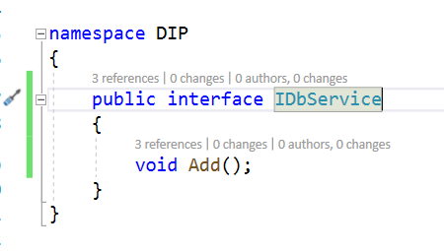
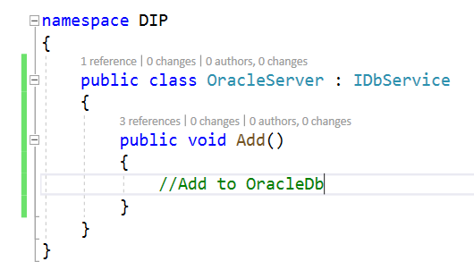
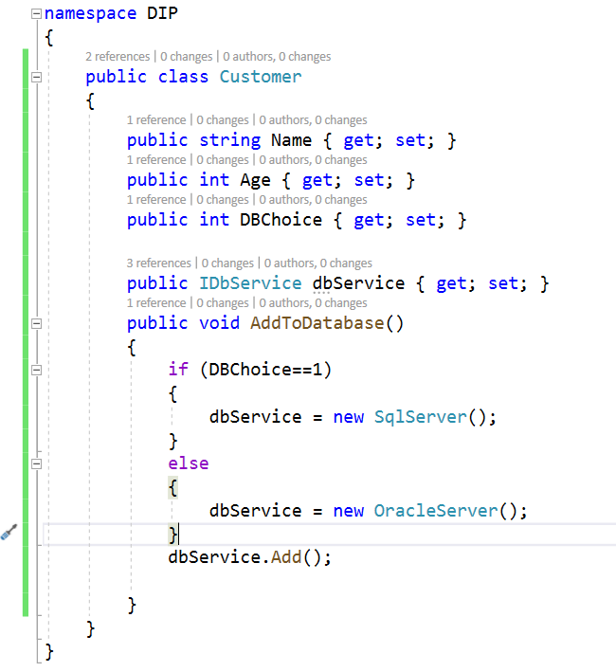
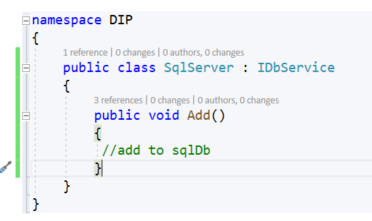
Consolidating SOLID

Slide 30
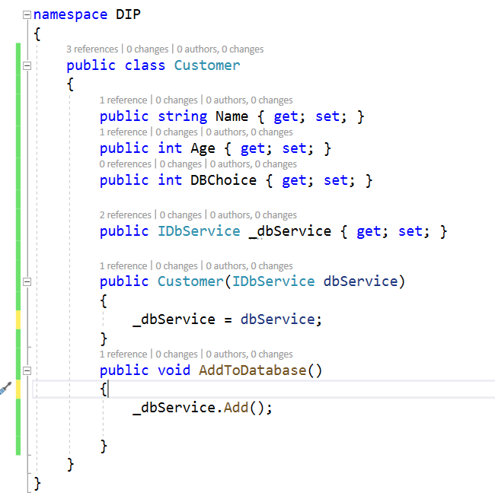
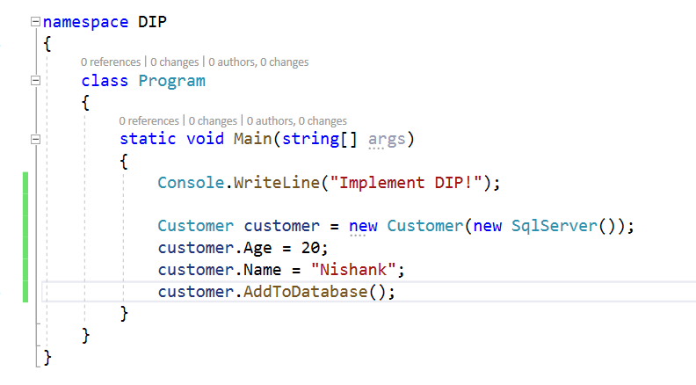
Consolidating SOLID

Slide 31
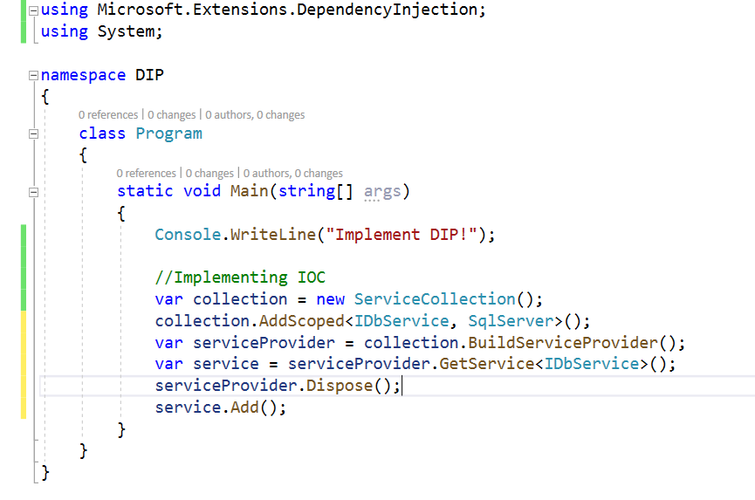
Consolidating SOLID

Slide 32
Common Criticisms of SOLID
SOLID Principles Are Vague
SOLID Leads to Complex Code
SOLID Is Too Idealistic
SOLID Is a Marketing Gimmick
SOLID Principles != Rules

