Slide 1
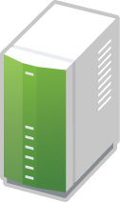
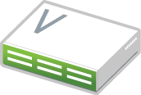
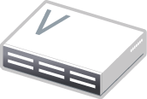
Cloud Management Platform
Virtual Instances
Virtual Instances
Traditional Computing
Private Cloud
Public Cloud
Enterprise Datacenter

Slide 2
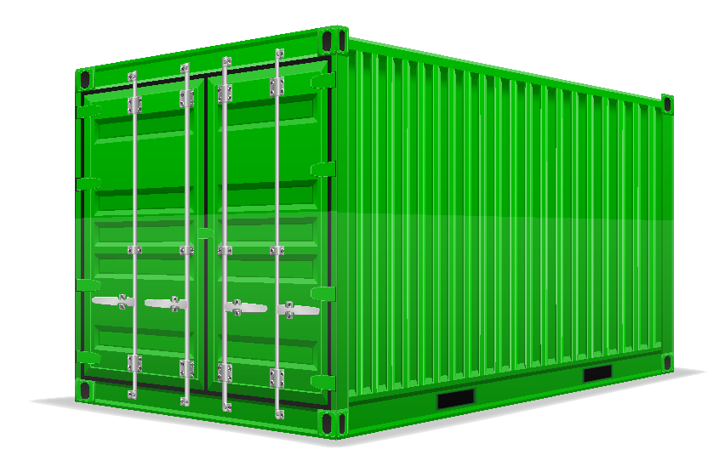
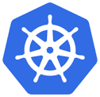
Virtual Instance
Virtual Instance
Virtual Instance
IaaS Stack
Private Cloud

Slide 3
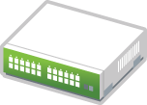
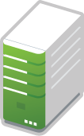

3 x Switch
(spine)
2 x TOR Switch
(leaf)
6 x OpenStack Control
(NET/OS/DB/MQ)
36 x Compute Node
(OpenStack-KVM)
1 x Storage Ceph-MON
1 x Storage Ceph S3-GW
12 x Storage Node
(Ceph-OSD)
Rack A1
Rack A2
Rack B1
Rack B2
Rack C1
Rack C2
Failure Domain A
Failure Domain B
Failure Domain C

Slide 4
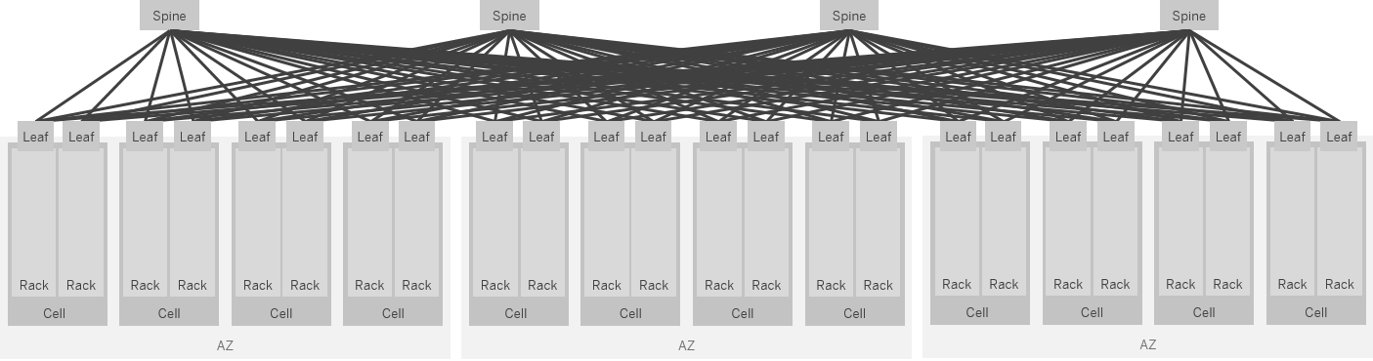

Slide 5
Management Network
Managmt
KVM-Node
Managmt
KVM-Node
SelfService Net A
VM 1
VM 2
VM 3
VM 4
SelfService Net B
OVS
OVS
control
data
control
data
OVS- Control- Network
Underlay – Transport Network

