Slide 1
Pinnacle Program Capstone Journey

Slide 2
Agenda
INTRODUCTION 3
GENERAL OVERVIEW 5
WHAT DID I LEARN SO FAR 8
CAPSTONE PROJECT 13
PINNACLE EXTRA MATERIAL 17

Slide 3

INTRODUCTION

Slide 4
Introduction
Why Data Science
Why Analytics Vidhya
Future Plans

Slide 5
GENERAL OVERVIEW

Slide 6
How did my journey have been so far…
Positive argument:
Descriptive Content
Directional Flow
Mentorship
Assignment Polished The Concept
Good Customer Service
Design Quality
Workshops
Research Orientation
Negative argument:
Some Module Lack Assignment
Some Module Rigorous (RL)
Some Module Need Split (Applied ML)
Recommendation Of Books

Slide 7
Module Covered
Introduction to GenAI | Advance Prompt Engineering | Mastering LLMOps: From Build to Deployment
Human Decision Making and its Biases | Building End-to-End Generative AI Applications | Computer Vision using PyTorch
Structured Approach to Problem Solving | Introduction to LangChain – Building Generative AI Apps & Agents | Getting started with Stable Diffusion
Applied Machine Learning | Introduction to AI Agents | Mastering Methods and Tools of Stable Diffusion
Introduction to Deep Learning using Pytorch | Mastering Reinforcement Learning | Advanced Stable Diffusion Techniques
Natural Language Processing using Pytorch | Finetuning LLMS | Responsible AI in the Generative AI Era
Getting Started with Large Language Model | Training LLMs using Pytorch | Successful AI strategies
Building LLM Application using Prompt Enggineering | Building Production Ready RAG system using LlamaIndex | Generative AI for Business – A leaders’ Handbook

Slide 8
What Did I learn So Far

Slide 9
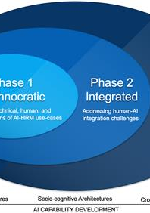
Business Terms
Technical Engineering and Business Go Hand In Hand
Why Decision-Making Is Hard
a) Baises
b) Problem Orientation
Thinking Pattern
a) Structured Thinking
b) Framing The Problem
c) PSW (Problem Statement Worksheet)
d) Adoption and Metrics Evaluation
This Photo by Unknown Author is licensed under CC BY

Slide 10
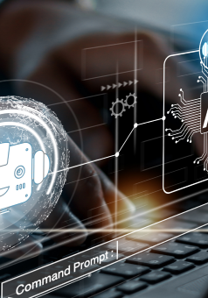
Technical Terms
Application of Machine Learning Into Business Statements
Various Deep Learning Libraries
a) PyTorch
b) Keras & Tensorflow
3) Machine Translation Using NLP & Transformer
4) Prompt Engineering & Prompt Tuning
5) Frameworks pertinent to LLM
a) Llama
b) langchain
c) haystack (deepset)
This Photo by Unknown Author is licensed under CC BY-SA-NC

Slide 11
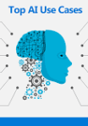
Technical Terms
AI Agents
Fine Tuning LLM – Lora and Qlora
Stable Diffusion
RAG Pipeline and Production Deployment
Deployment UI
Chainlit
Streamlit
This Photo by Unknown Author is licensed under CC BY-NC-ND

Slide 12
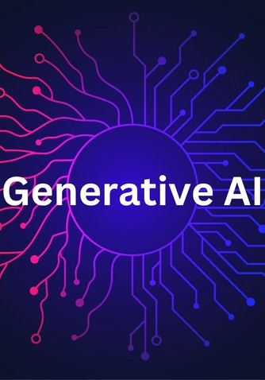
Management Terms
Responsibility with AI
AI Strategies to Tackle Problem
Generative AI for Business
This Photo by Unknown Author is licensed under CC BY-SA-NC

Slide 13
Capstone Assignment

Slide 14
PROBLEM STATEMENT
The scenario is that you are working for a company like ArXiv which has a repository of the latest and best papers around AI and Data Science. They want to build an intelligent chatbot which can help answer questions which people ask on popular topics based on research papers in Generative AI. Considering the limited time-frame of the project, we have limited the dataset to a few documents.

Slide 15
Breakdown
Experimenting WITH VARIOUS LLM MODELS
a) Open – ai
B) LITELLM
C) MISTRAL AI
D) ANTHROPIC (CLAUDE)
E) MISTRAL-7B
2. Experiment with various retrieval strategies
A) SENTENCEWINDOW_RETRIEVER
B) AUTOMERGING_RETRIEVER
C) HYBRIDFUSION_RETRIEVER
D) ElasticsearchBM25Retriever
E) OPENSEARCJ25RETRIEVER

Slide 16
Breakdown
Experimenting WITH VARIOUS EMBEDDINGS
a) text-embedding-3-small
B) text-embedding-3-large
C) text-embedding-ada-002
D) lmstudio-community/granite-embedding-125m-english-GGUF
E) RedHatAI/bge-large-en-v1.5-quant
F) jinaai/jina-reranker-v1-tiny-en
G) sentence-transformers/all-mpnet-base-v2

Slide 17
Pinnacle Program Extra Material

Slide 18
Pinnacle Program Extra Material
Reinforcement Learning
a) Reward Function
b) Q-Function
c) PPO
d) Bradly Terry Model
2) Stable Diffusion
a) Gaussian Noising d) Midjourney
b) Forward Diffusion and Backward Diffusion e) Pix2Pix Paper Review
c) Latents d) Dalle

Slide 19
Pinnacle Program Extra Material
Workshop Materials
a) NLP i) Recording Materials
b) Encoder Decoder Model j) PPT and PDF
c) Rag System With LLM k) Hands-On
d) Transformer
e) Hugging Face, Kaggle Dataset
f) Prompting and Prompting Techniques
g) Chain-of-Thought and Tree-of-Thought
h) EDA and Statistics

Slide 20
Pinnacle Program Extra Material
Assignments and Mentorship
a) Covered Every aspect of the module
b) Challenging enough
c) Made us review the concept multiple times
d) Mentorship made things streamline
e) Helped us to introduce to world of Data Scinece

Slide 21
Thank You
AVIRAL VERMA
aviralverma10092000@gmail.com

