Slide 1


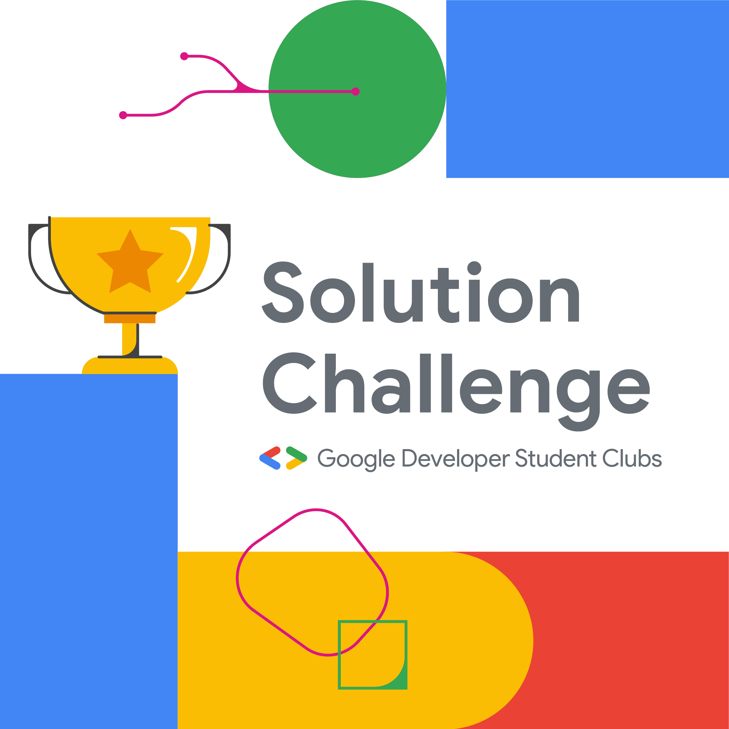

Food Distribution App:
Zero Hunger Solution
Team –
Love Bytes

Slide 2


Addressing Hunger Through Technology
1
In-depth Problem Analysis
About 30% food in weddings and other parties gets wasted due to over availability.
2
Collaborative Approach
It fosters collaboration between wedding halls and people who need food .
3
Efficient Resource Utilization
Utilizing technological tools for optimizing resource allocation and reducing food wastage is a key focus area.

Slide 3
Features and Functionality
Real-time Inventory and location
Volunteer Management System
Customized Donor Engagement
The app provides real-time visibility into inventory levels , using maps , shows location of available foods, enabling efficient management and distribution of food resources.
It includes a robust system for managing volunteer activities and coordinating efforts for maximum outreach and impact , in which anyone who want to donate food or money can register and give.
Tailored donor engagement strategies to increase contributions and enhance the sustainability of the program.

Slide 4
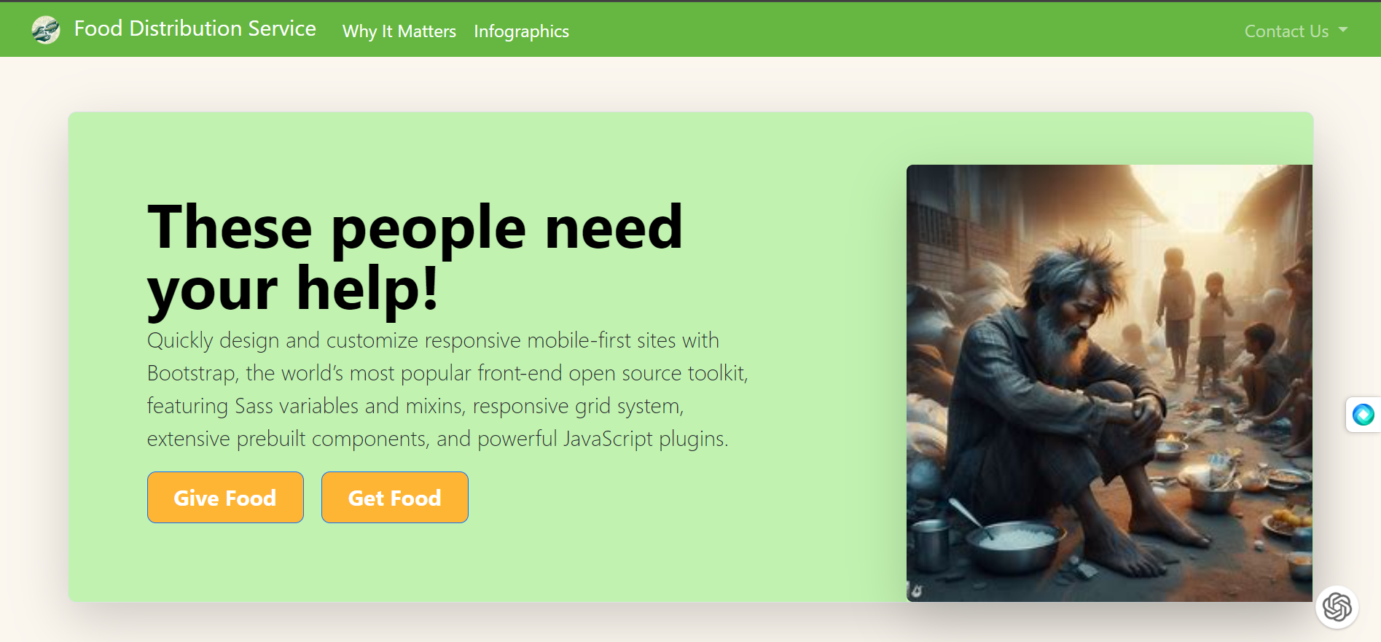
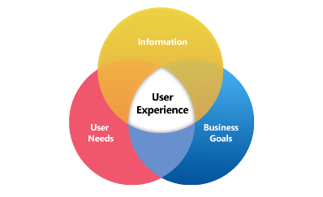
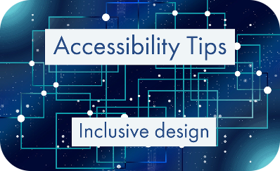
User Interface and Experience Design
Intuitive Interface
Enhanced User Experience
Accessibility Emphasis
The app boasts an intuitive and user-friendly interface, making it accessible to users of all demographics.
Design considerations ensure accessibility for users with diverse abilities and needs.
Focus on creating a seamless and engaging experience for both volunteers and beneficiaries.

Slide 5
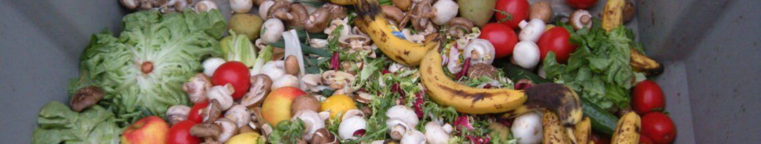
Impact on Reducing Food Waste
1
Optimized Distribution
2
Real-time Surplus Identification
3
Metrics-driven Solutions
Efficient resource management reduces the spoilage and wastage of food supplies, promoting sustainability.
Implementing data-driven measures to identify patterns and optimize distribution to minimize food waste.
Identification of surplus food in real-time allows for timely redistribution and minimizes wastage.

Slide 6



Conclusion and Next Steps
Continued Collaboration
Feedback Integration
Global Outreach Initiative
Collecting feedback for continuous improvement and evolution of the app to meet evolving needs.
Strengthening partnerships and collaborations for sustained impact and expansion of the solution.
Planning for global outreach programs to address hunger challenges beyond local boundaries.

Slide 7
Technology Used
HTML
CSS
Javascript
Tailwind css
Maps API
Github
Netlify

Slide 8
THANK
YOU

