Slide 1
Translating Classic Hindi Literature
into English using NLP / GenAI
Fine-Tuning Helsinki MarianMT with Samanantar & LaBSE Quality Filtering
Aviral Kumar Goyal · Scholar No.: 2025RCP9565 Deep Learning (21CST853) · CSE, Malaviya NIT Jaipur · 2026

Slide 2
Introduction & Motivation
Hindi, spoken by over 600 million people, is written in the Devanagari script. Despite its scale, most scientific and professional content exists only in English, creating a critical linguistic divide. This project addresses that gap by improving Hindi-to-English neural machine translation (NMT) through Domain-Adaptive Pre-Training (DAPT) on a large, quality-filtered parallel corpus.
Existing models (Helsinki MarianMT, Google Translate) struggle with literary Hindi — figurative language, Avadhi idioms, and rural dialects.
Standard corpora are dominated by parliamentary/legal text; domain coverage is narrow.
DAPT on Samanantar (47.7M pairs) — filtered via LaBSE cosine similarity — broadens vocabulary and improves fluency.
Evaluated on the fixed 3,000-pair IIT Bombay benchmark + two Premchand short stories (public-domain).
Fully reproducible: open Kaggle notebook, dual-T4 GPU, public datasets only.

Slide 3
Problem Statement & Objectives
Given a Hindi source sentence x = (x₁,…,xₘ), produce a fluent English translation ŷ = argmax ∏ Pθ(yₜ|y<t, x). The raw Helsinki baseline achieves SacreBLEU 12.01 — insufficient for literary text. The goal is to find improved parameters θ* via DAPT so that BLEU(θ*) > BLEU(θ₀).
Obj-1 Data Quality
Obj-2 DAPT
Obj-3 Benchmark
Obj-4 Literary Eval
Obj-5 Reproducibility
Filter 250K raw Samanantar pairs to 150K high-quality pairs using LaBSE cosine similarity ≥ 0.85.
Continue training opus-mt-inc-en on the filtered corpus to improve vocabulary coverage and domain generalisation.
Evaluate on fixed 3K-pair IIT Bombay test set; compare against three competing Helsinki variants.
Qualitatively assess translations of Premchand's Poos Ki Raat & Do Bailon Ki Katha.
Open, runnable Kaggle notebook with only public datasets and free compute (dual T4).

Slide 4
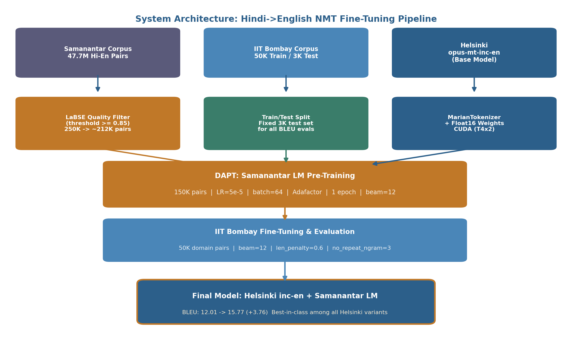
System Architecture — Hindi→English NMT Pipeline
The end-to-end pipeline combines three data sources with two training stages. Samanantar provides broad language coverage; IIT Bombay provides domain-specific supervision; the Helsinki base model contributes strong multilingual pre-training. LaBSE filtering removes ≈15% noisy pairs before DAPT.

Slide 5
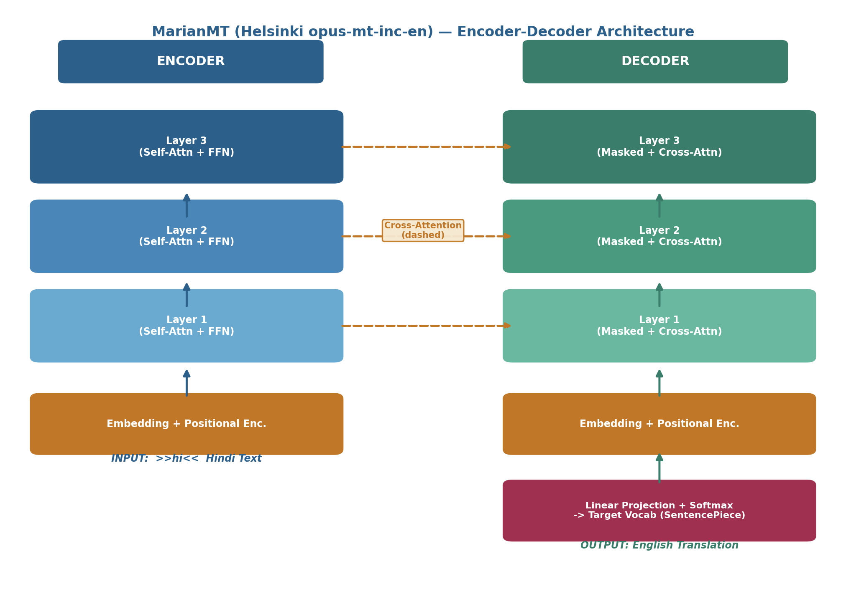
Base Model — Helsinki MarianMT (opus-mt-inc-en)
Helsinki-NLP/opus-mt-inc-en is a MarianMT encoder-decoder transformer trained on the OPUS parallel corpus covering the full Indic language family. It uses a SentencePiece BPE tokeniser and the Marian NMT framework. The >>hi<< source-language prefix activates the correct language pathway through the shared encoder.

Slide 6
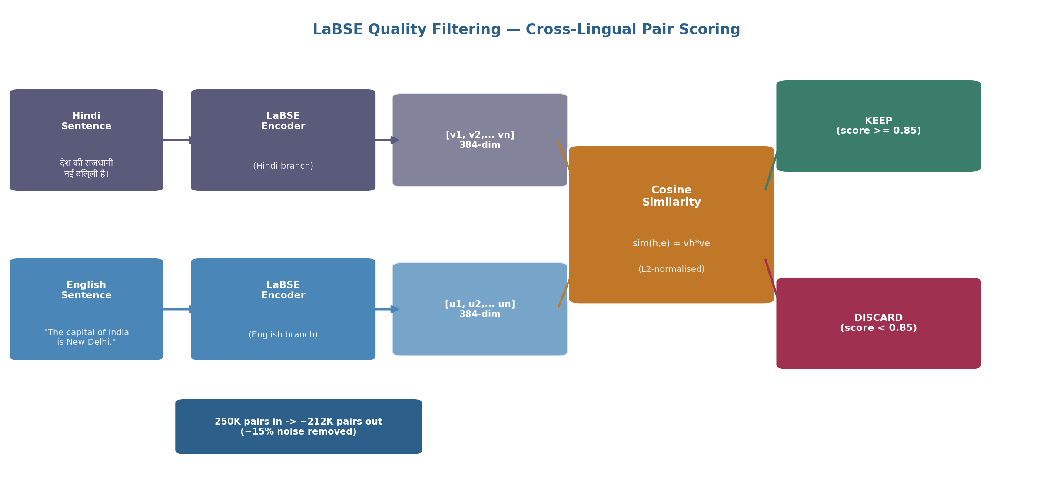
LaBSE Quality Filtering — Cleaning the Samanantar Corpus
Raw web-crawled parallel data contains misaligned or mistranslated pairs — "crawl noise" — which poisons gradient updates. LaBSE encodes each Hindi–English pair into a shared 384-dimensional space and computes cosine similarity. Pairs below τ = 0.85 are discarded, removing ≈15% noise and yielding a 212K high-quality pool.

Slide 7
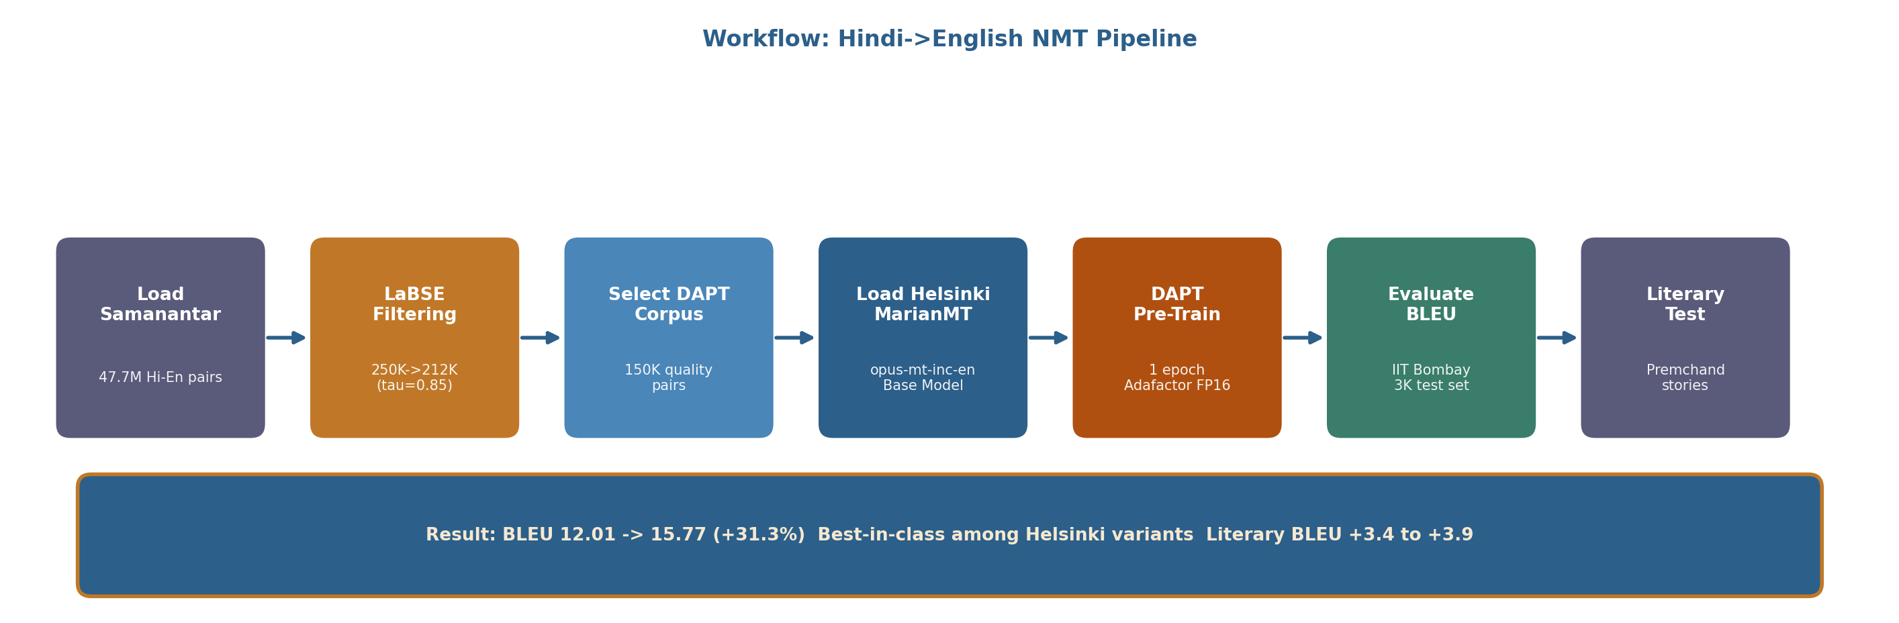
End-to-End Pipeline Workflow
The pipeline flows from raw corpus ingestion through quality filtering and DAPT pre-training to benchmark evaluation and literary qualitative testing. Key hyperparameters: LR = 5×10⁻⁵, Adafactor, FP16, batch = 64, 1 epoch, beam = 12, length penalty = 0.6, no-repeat n-gram = 3.

Slide 8
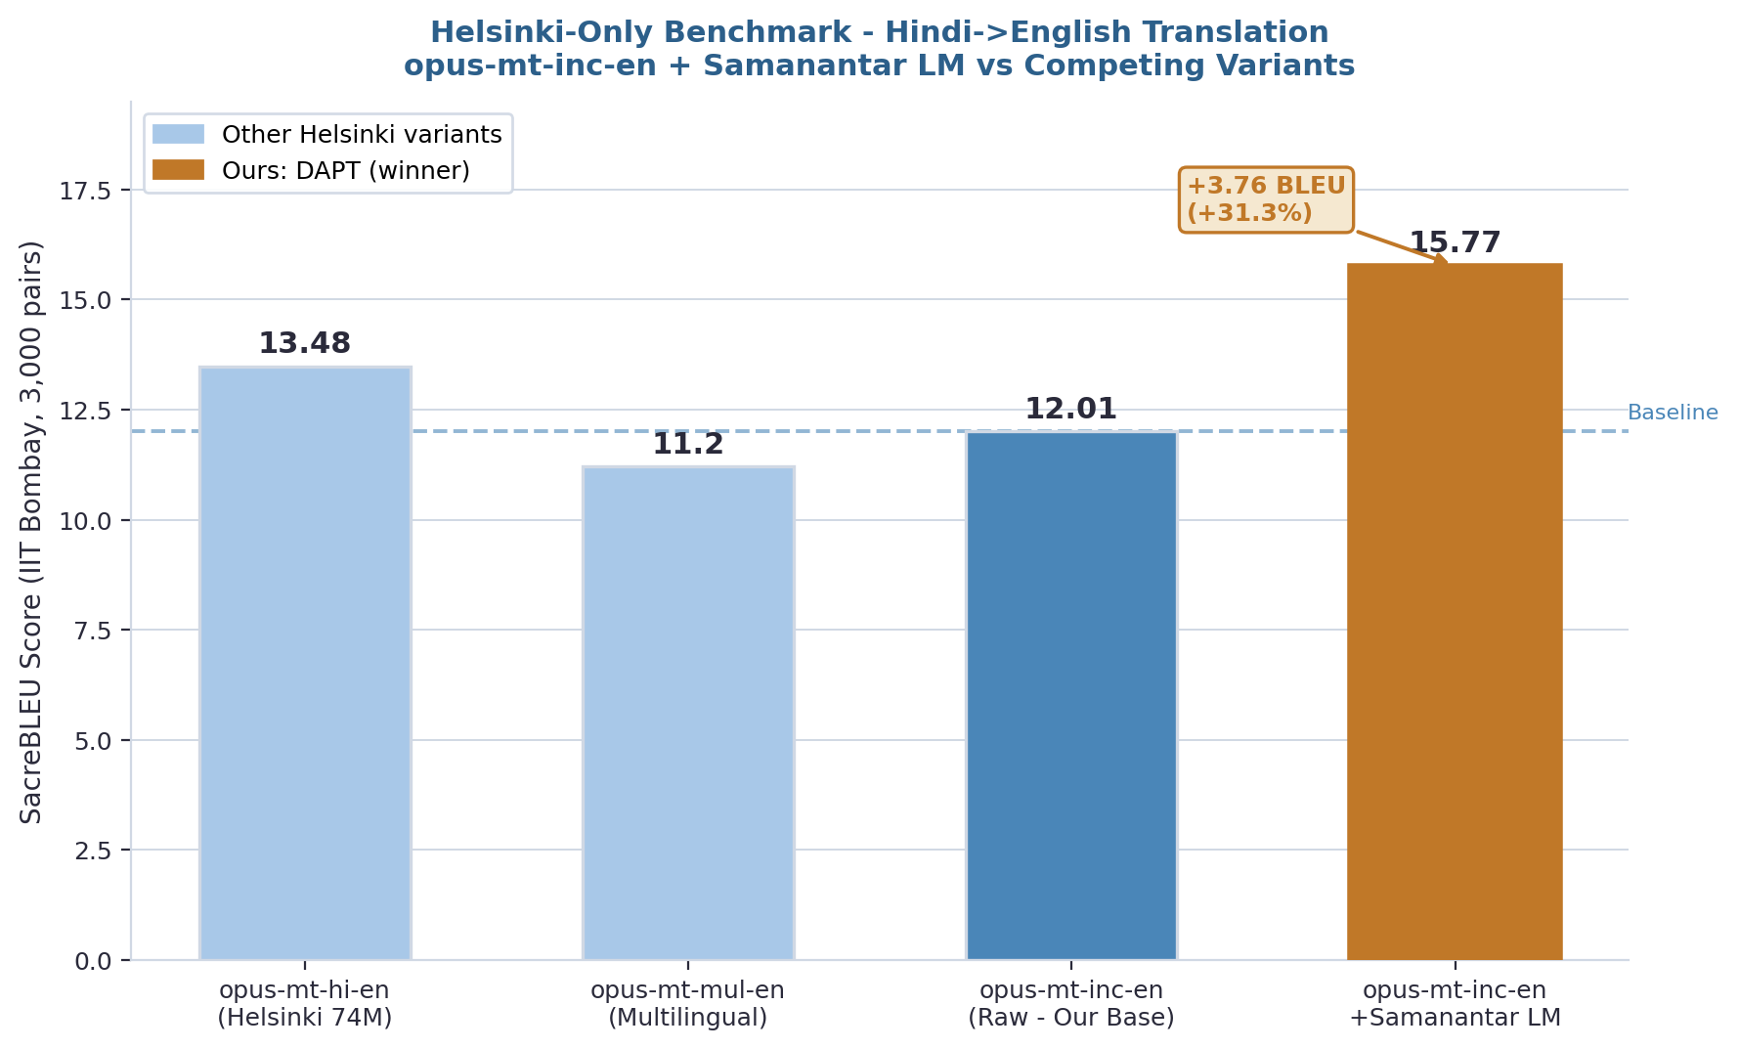
Quantitative Results — Helsinki-Only BLEU Benchmark
Baseline BLEU
12.01
Final BLEU
15.77
Absolute Gain
+3.76
Relative Gain
+31.3%
All models evaluated on fixed 3,000-pair IIT Bombay test set under identical inference conditions.

Slide 9
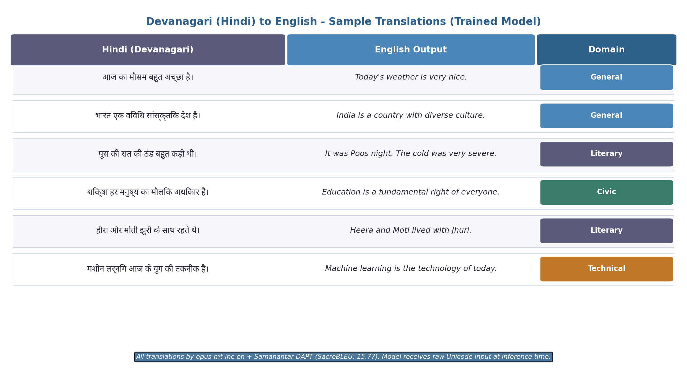
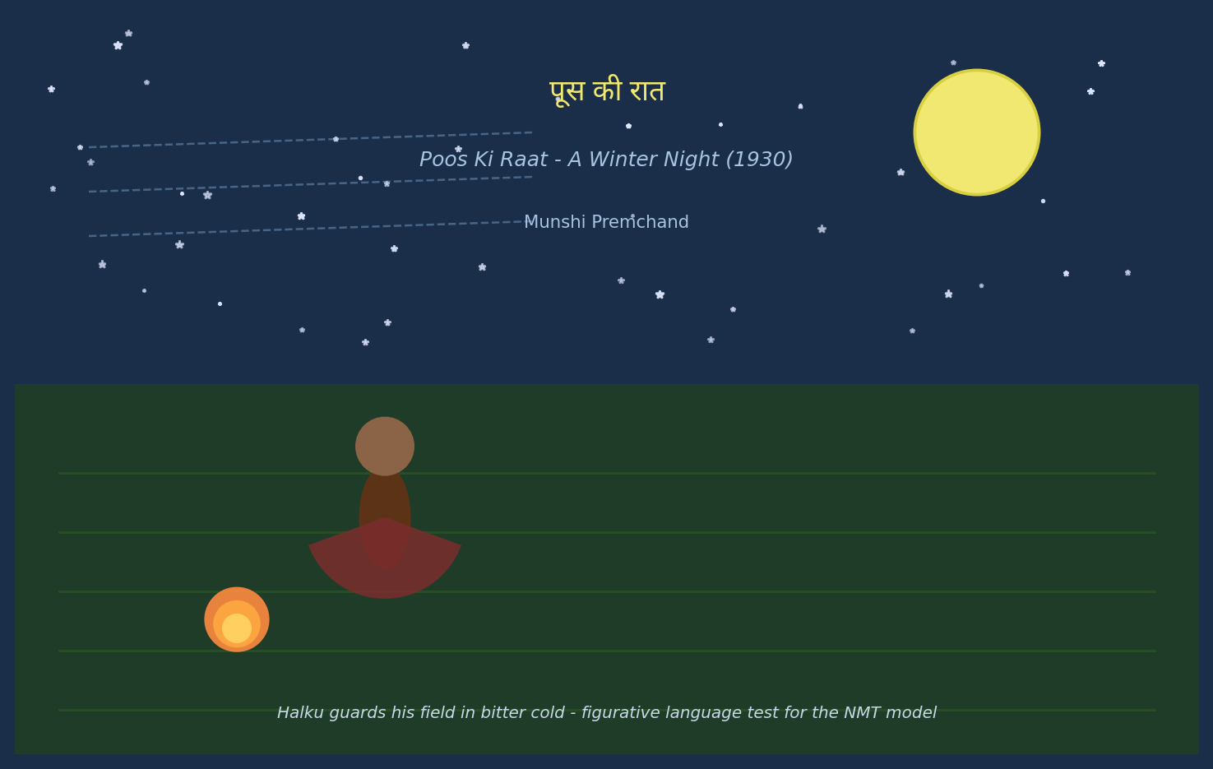
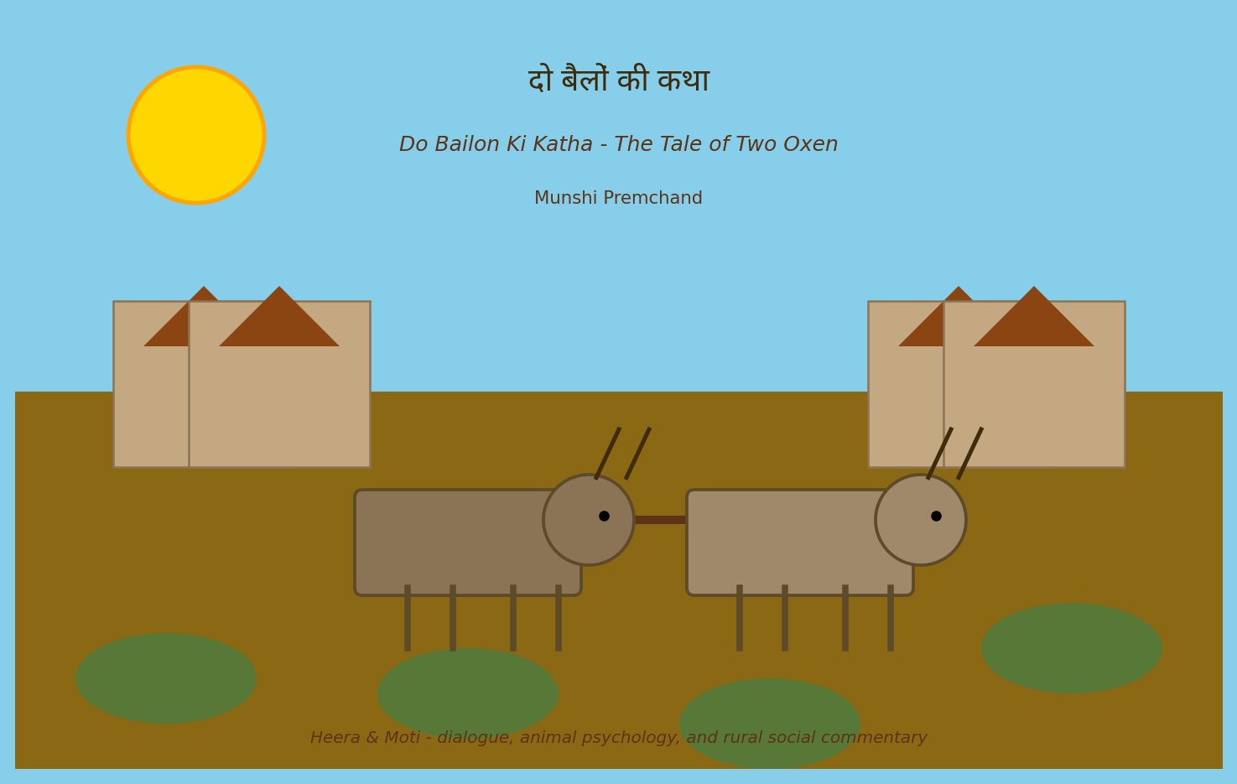
Sample Translations & Literary Evaluation

Slide 10
Conclusion & Future Scope
DAPT + LaBSE: BLEU 12.01 → 15.77 (+31.3%) · Best-in-class among Helsinki variants · Literary BLEU +3.4 to +3.9
Conclusion
Future Scope
A single DAPT epoch on 150K quality-filtered pairs yields +31.3% BLEU on a general-domain benchmark.
Gains are robust: they extend to classical Hindi literary texts (figurative language, dialogue, idioms).
Adafactor + FP16 keeps training feasible on free-tier Kaggle GPUs (dual T4, ≈3–4 h).
Multi-epoch DAPT with cosine LR decay may yield an additional +1–2 BLEU.
Task-specific fine-tuning on 50K IIT Bombay pairs + back-translation for diversity.
Extend to spoken/social-media Hindi; evaluate with TER and human judges.

