Slide 1
Language Detection using Spectral Analysis
Aviral Singh (21BCE1825)
Yug Agarwal (21BCE1069)
Digital Image Processing – (D1+TD1)
Dr. Geetha S.

Slide 2
Abstract
The identification of languages in daily life is an extremely important field of work due to the large number of languages that are used in the world today. Accurately determining a language through speech is a very tricky endeavour since various differences can be observed in the same language which are caused by variations in speech patterns. This project aims to identify the language being spoken in a given audio excerpt using its phonetic properties rather than using audio – to – text transcription. The mechanism that will be used will extract spectrograms from a given audio file. These spectrograms will be used to train a popular image detection deep learning model which will facilitate the detection of a language with high accuracy.

Slide 3
Problem Statement

Slide 4
In today's digital age, with the proliferation of multimedia content, there's a growing demand for robust language detection systems capable of accurately identifying spoken languages from audio data. Traditional methods often struggle to cope with the complexities of diverse accents, environmental noise, and linguistic variations. Therefore, there's an urgent need to develop deep learning models tailored for audio-based language detection that can effectively handle such challenges. These models must exhibit high accuracy across a wide range of languages and dialects, while also being computationally efficient for real-time or near-real-time processing. Addressing this requires the design of sophisticated deep learning architectures, extensive labeled audio datasets covering diverse linguistic contexts, and considerations for practical deployment in real-world scenarios, such as multimedia content analysis, voice-controlled applications, and language interpretation services.

Slide 5
Objectives

Slide 6
To introduce a new method of language detection without using existing speech – to – text methods.
To explore the research area of phonetic analysis and differentiate languages based on pronunciation styles rather than language structure.
To create an accurate mechanism of language detection which can be extended to work with various languages across the globe.

Slide 7
Proposed System

Slide 8
This project will aim to detect the spoken language in a given audio file. For an audio file input, various processing steps will take place to convert the audio file into a suitable numerical format. The preprocessing steps will be performed over every audio file in the dataset. After obtaining numerical arrays for the audio files, each audio file array will be converted into a corresponding spectrogram. A new dataset containing spectrograms will be created after preprocessing. This spectrogram image dataset will be fed into a CNN based deep-learning model, which will be trained to correctly classify the spoken language in the audio file.

Slide 9
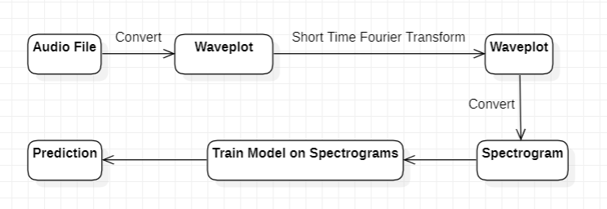
Block Diagram

Slide 10
Project Description

Slide 11
Modules and libraries required for the project
Numpy
Scikit – learn
Librosa
Seaborn
TensorFlow and TensorFlow Hub
Matplotlib
OpenCV

Slide 12
Pre-Processing Steps
1) Each audio file is converted into a numerical array using librosa.
2) Since the signal is in the time domain, it is transformed to its equivalent signal in the frequency domain using the Short Time Fourier Transform.
3) The obtained frequency graphs are then converted to Decibels using librosa, since the common unit for the measurement of sounds is Decibel.
4) These decibel graphs are then saved as spectrograms in a new image dataset.
5) The spectrogram images are cropped using OpenCV to avoid any unnecessary noise in the dataset.
6) The target classes present in the dataset are converted to Boolean arrays to facilitate prediction using probabilities.

Slide 13
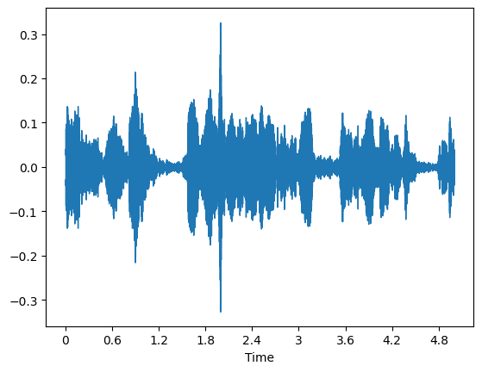
Visualizations
The image given on the right shows the initial time-signal graph of a random audio file in the dataset.

Slide 14
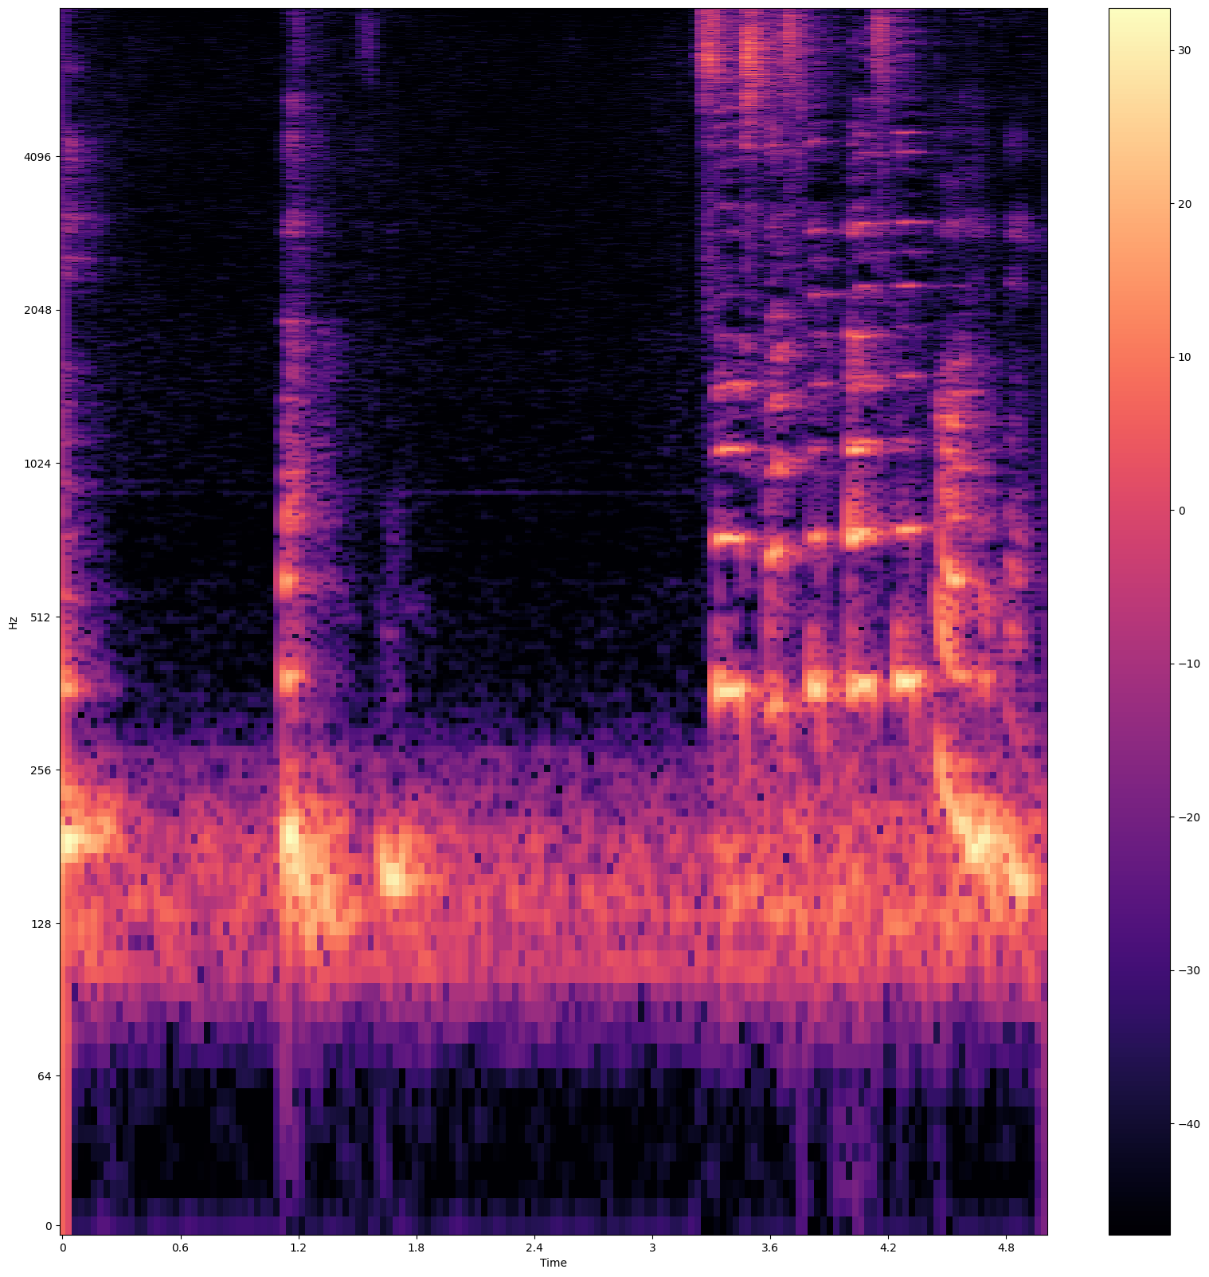
Visualizations
The image on the right shows an example spectrogram that will be used to create the new image dataset.

Slide 15
Model Selection
A transfer learning model known as MobileNet V2, which is publicly available on TensorFlow Hub, was employed for this task . This particular model is highly performant in object detection workloads. Such a model would work well in separating frequencies in different languages. The architecture for the model is given in the next slide:

Slide 16
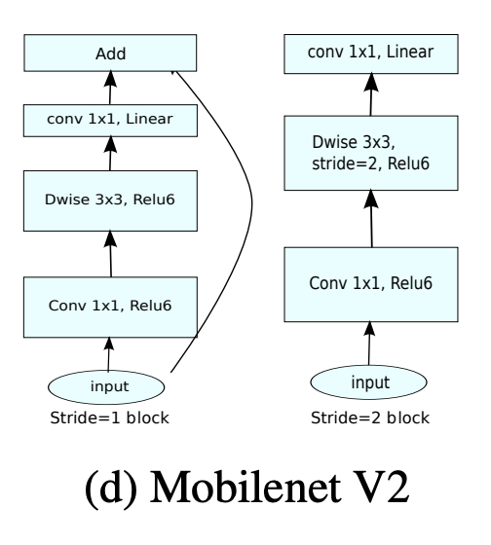
Model Architecture

Slide 17
Training Results
Training Loss: 0.2279
Training Accuracy: 0.9463

Slide 18
Results

Slide 19
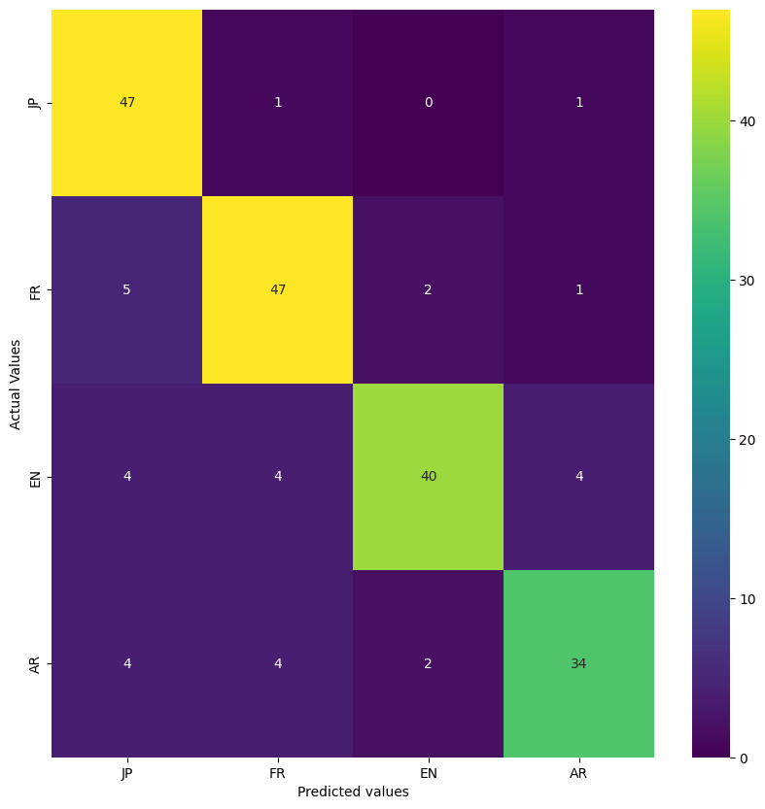
Confusion Matrix

Slide 20
Scoring Metrics
The following metrics will be used for evaluating the model:
F1 Score
Accuracy
Precision
Recall

Slide 21
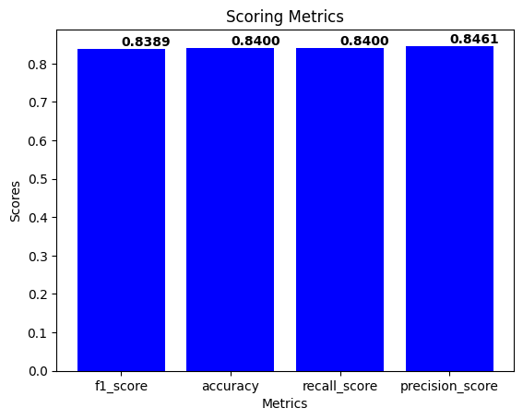
The scores obtained for the metrics in consideration are given beside:

Slide 22
The obtained results may be greatly improved if more training data was present. The model may also be trained for different languages and dialects.

Slide 23
References
1) Ashkan Moradi, Yasser Shekofteh (2023)
Spoken language identification using a genetic-based fusion approach to combine acoustic and universal phonetic results.
Computers and Electrical Engineering, Volume 105, 108549, ISSN 0045-7906.
2) Miller, Corey & Strong, Rachel & Jones, Evan & Vinson, Mark. (2014)
Employing Phonetic Speech Recognition for Language and Dialect Specific Search.
DOI:10.3115/v1/W14-5308
3) Riya Menon (2022)
Detectsy: A System for Detecting Language from the Text, Images, and Audio Files
4) Y. Rajanak, R. Patil and Y. P. Singh (2023)
Language Detection Using Natural Language Processing
9th International Conference on Advanced Computing and Communication Systems (ICACCS), Coimbatore, India, 2023, pp. 673-678, doi: 10.1109/ICACCS57279.2023.10112773.
5) Kotsakis, Rigas & Matsiola, Maria & Kalliris, George & Dimoulas, Charalampos. (2020)
Investigation of Spoken-Language Detection and Classification in Broadcasted Audio Content
Information 2020, 11(4), 211; https://doi.org/10.3390/info11040211

