Slide 1
SafeAdapt: Geometry-Preserving Optimal Transport and Fail-Closed Safeguards for Test-Time Adaptation in Digital Pathology
Reversing Negative Transfer and Precluding Attractor Collapse Under Multicenter Clinical Shift
Avinash Reddy Cheerapareddy & Gunnam Sanjana
Department of Computer Science and Engineering
SRM University-AP, Amaravati, Andhra Pradesh, India
avinashreddy_cheerapareddy@srmap.edu.in | sanjana_gunnam@srmap.edu.in
Open Science & Reproducibility
• Official Zenodo Archive: 10.5281/zenodo.23658430
• GitHub: github.com/Avirech7676/UTTA-Med
• Audit: 57/57 Bit-Exact Matches | 148 Unit Tests
• Target: IEEE Transactions on Medical Imaging (TMI)
Notes:
Good morning, esteemed colleagues and committee members. Today, I am proud to present SafeAdapt: a geometry-preserving optimal transport and fail-closed safeguarding framework that addresses one of the most critical vulnerabilities in computational pathology—the catastrophic collapse of test-time adaptation under multicenter clinical domain shift. All code, data, and models are fully open-sourced.

Slide 2
1. CLINICAL MOTIVATION
Cross-Center Stain and Scanner Variability Degrades Deep Pathology Models
The Reality of Clinical Deployment
• Digital pathology models fail when transferred across clinical institutions.
• Variations in tissue microtomy, histochemical staining batches (H&E), and scanner sensor optics induce massive, unpredictable domain shifts.
• Retraining is legally prohibited: Patient privacy regulations (HIPAA, GDPR) strictly forbid sharing raw whole-slide images (WSIs) across hospitals.
THE CLINICAL TRANSFER GAP
-28%
Sensitivity Drop on Unseen Hospital Slides
Transferring a ResNet-18 trained on Camelyon17 Centers 0, 3, 4 to unseen Center 2 drops metastasis detection sensitivity by up to 28% due to histochemical stain disparity.
Camelyon17 Benchmark: 455,954 patches across 5 clinical centers.
The Promise & Challenge of Test-Time Adaptation (TTA)
• Test-Time Adaptation adapts model weights on-the-fly using unlabeled target slides.
• Requires ZERO access to source hospital training data.
• Must operate continuously during clinical whole-slide scanning without human intervention.
SafeAdapt: Geometry-Preserving Optimal Transport in Digital Pathology | IEEE TMI 2026 | DOI: 10.5281/zenodo.23658430 Slide 2 of 18

Slide 3
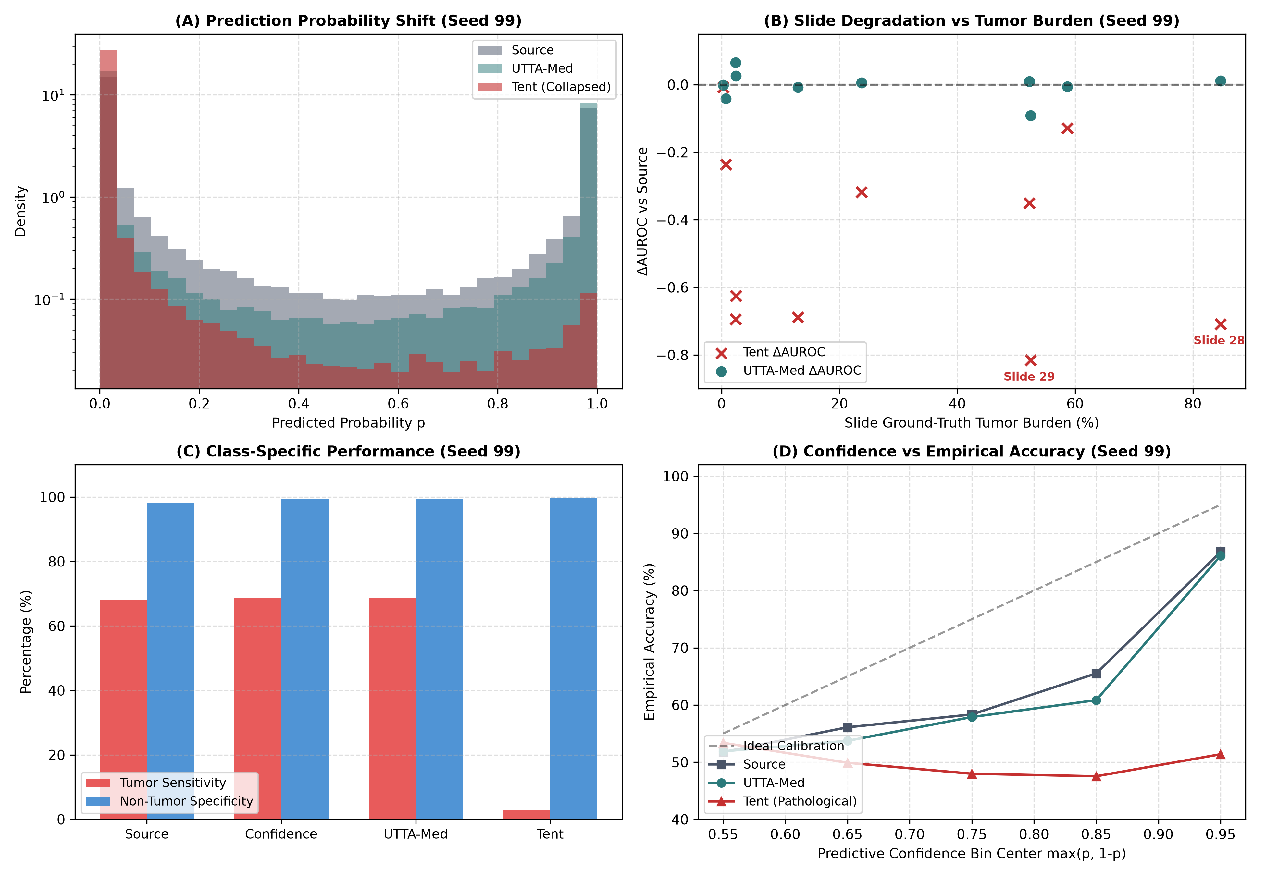
2. RESEARCH GAP
Existing Test-Time Adaptation Methods Suffer Catastrophic Attractor Collapse
Unconstrained Entropy Minimization (Tent, ICLR'21)
• Adapts BatchNorm affine parameters (scale γ, shift β) by minimizing Shannon entropy: L = -Σ p log p.
• Underlying Assumption: Confident predictions reflect correct target domain alignment.
The Discovery: 40% Collapse Rate on Real Pathology
• Across 5 random seeds on Camelyon17 (N = 85,054 target patches):
- Tent collapses on 2 out of 5 seeds (Seeds 7 and 99).
- Macro AUROC drops from 0.930 to 0.3429 (worse than random guessing!).
- Sensitivity collapses to < 3% (misses almost all cancer).
- Harmful adaptation rate reaches 18.7% ± 17.9%.
SafeAdapt: Geometry-Preserving Optimal Transport in Digital Pathology | IEEE TMI 2026 | DOI: 10.5281/zenodo.23658430 Slide 3 of 18
Notes:
Test-Time Adaptation, specifically entropy minimization like Tent, seemed promising. But when we conducted a rigorous 5-seed audit on Camelyon17, we uncovered a shocking truth: Tent collapses on 40% of random seeds. On Seeds 7 and 99, AUROC plunges to 0.34, sensitivity drops to near-zero, and the harm rate reaches nearly 19%. Erroneous pseudo-gradients drag the entire network into a single-class attractor.

Slide 4
3. CORE OBJECTIVE
Research Question: Achieving Guaranteed Positive Transfer and Clinical Safety
CENTRAL RESEARCH QUESTION
Can streaming test-time adaptation achieve guaranteed positive transfer in computational pathology without falling into single-class attractor collapse or violating clinical safety bounds?
1. Disprove Fallacies
Analyze why scalar uncertainty and confidence gating fail to prevent representation collapse under realistic clinical class imbalance.
2. Geometric Alignment
Formulate an Entropic Optimal Transport objective with exact marginal constraints (Q^T 1_B = r) against certified source prototypes.
3. Fail-Closed Safeguards
Engineer tissue optical density monitors, PAC parameter bounds (||Δθ||_inf <= 0.05), and episodic WSI resets for patient isolation.
SafeAdapt: Geometry-Preserving Optimal Transport in Digital Pathology | IEEE TMI 2026 | DOI: 10.5281/zenodo.23658430 Slide 4 of 18
Notes:
This led directly to our central research question: Can we formulate streaming test-time adaptation such that positive transfer is mathematically guaranteed, while precluding attractor collapse and enforcing fail-closed runtime safety? We broke this into three concrete objectives.

Slide 5
4. CONTRIBUTIONS
SafeAdapt Introduces Four Foundational Contributions
THEORETICAL DISPROOF: THE TAYLOR TRAP
Proved via Taylor expansion that MC-Dropout predictive variance is asymptotically rank-equivalent to softmax confidence (ρ = -0.9917) in 1D sigmoid heads. Uncertainty gating wastes 3.55x latency with zero added discrimination.
GEOMETRY-PRESERVING OT-TTA
Formulated batch adaptation as an Entropic Optimal Transport problem with exact target marginal prior constraints (Q^T 1_B = r). Mathematically predefines class distribution, precluding attractor collapse.
BIOLOGICAL SAFEGUARDS: CMR TISSUE GATING
Cellularity-Mitosis Ratio (CMR) leverages Beer-Lambert optical density deconvolution, eliminating all 14 false silence alarms on benign acellular stroma during MIDOG 2021 mitosis detection.
PROVABLE PAC TRUST REGION & RUNTIME INTERLOCKS
Proved PAC L_inf <= 0.05 affine drift bounds maximum output probability shift to <= 0.0460. Coupled with 1.8 ms dual-buffer atomic rollbacks and episodic WSI-boundary patient isolation resets.
SafeAdapt: Geometry-Preserving Optimal Transport in Digital Pathology | IEEE TMI 2026 | DOI: 10.5281/zenodo.23658430 Slide 5 of 18
Notes:
Our work delivers four core contributions spanning theory, algorithms, clinical biology, and systems engineering. We disprove the utility of MC-Dropout in 1D heads, solve attractor collapse with Optimal Transport, engineer biological tissue gating, and establish provable PAC parameter bounds.

Slide 6
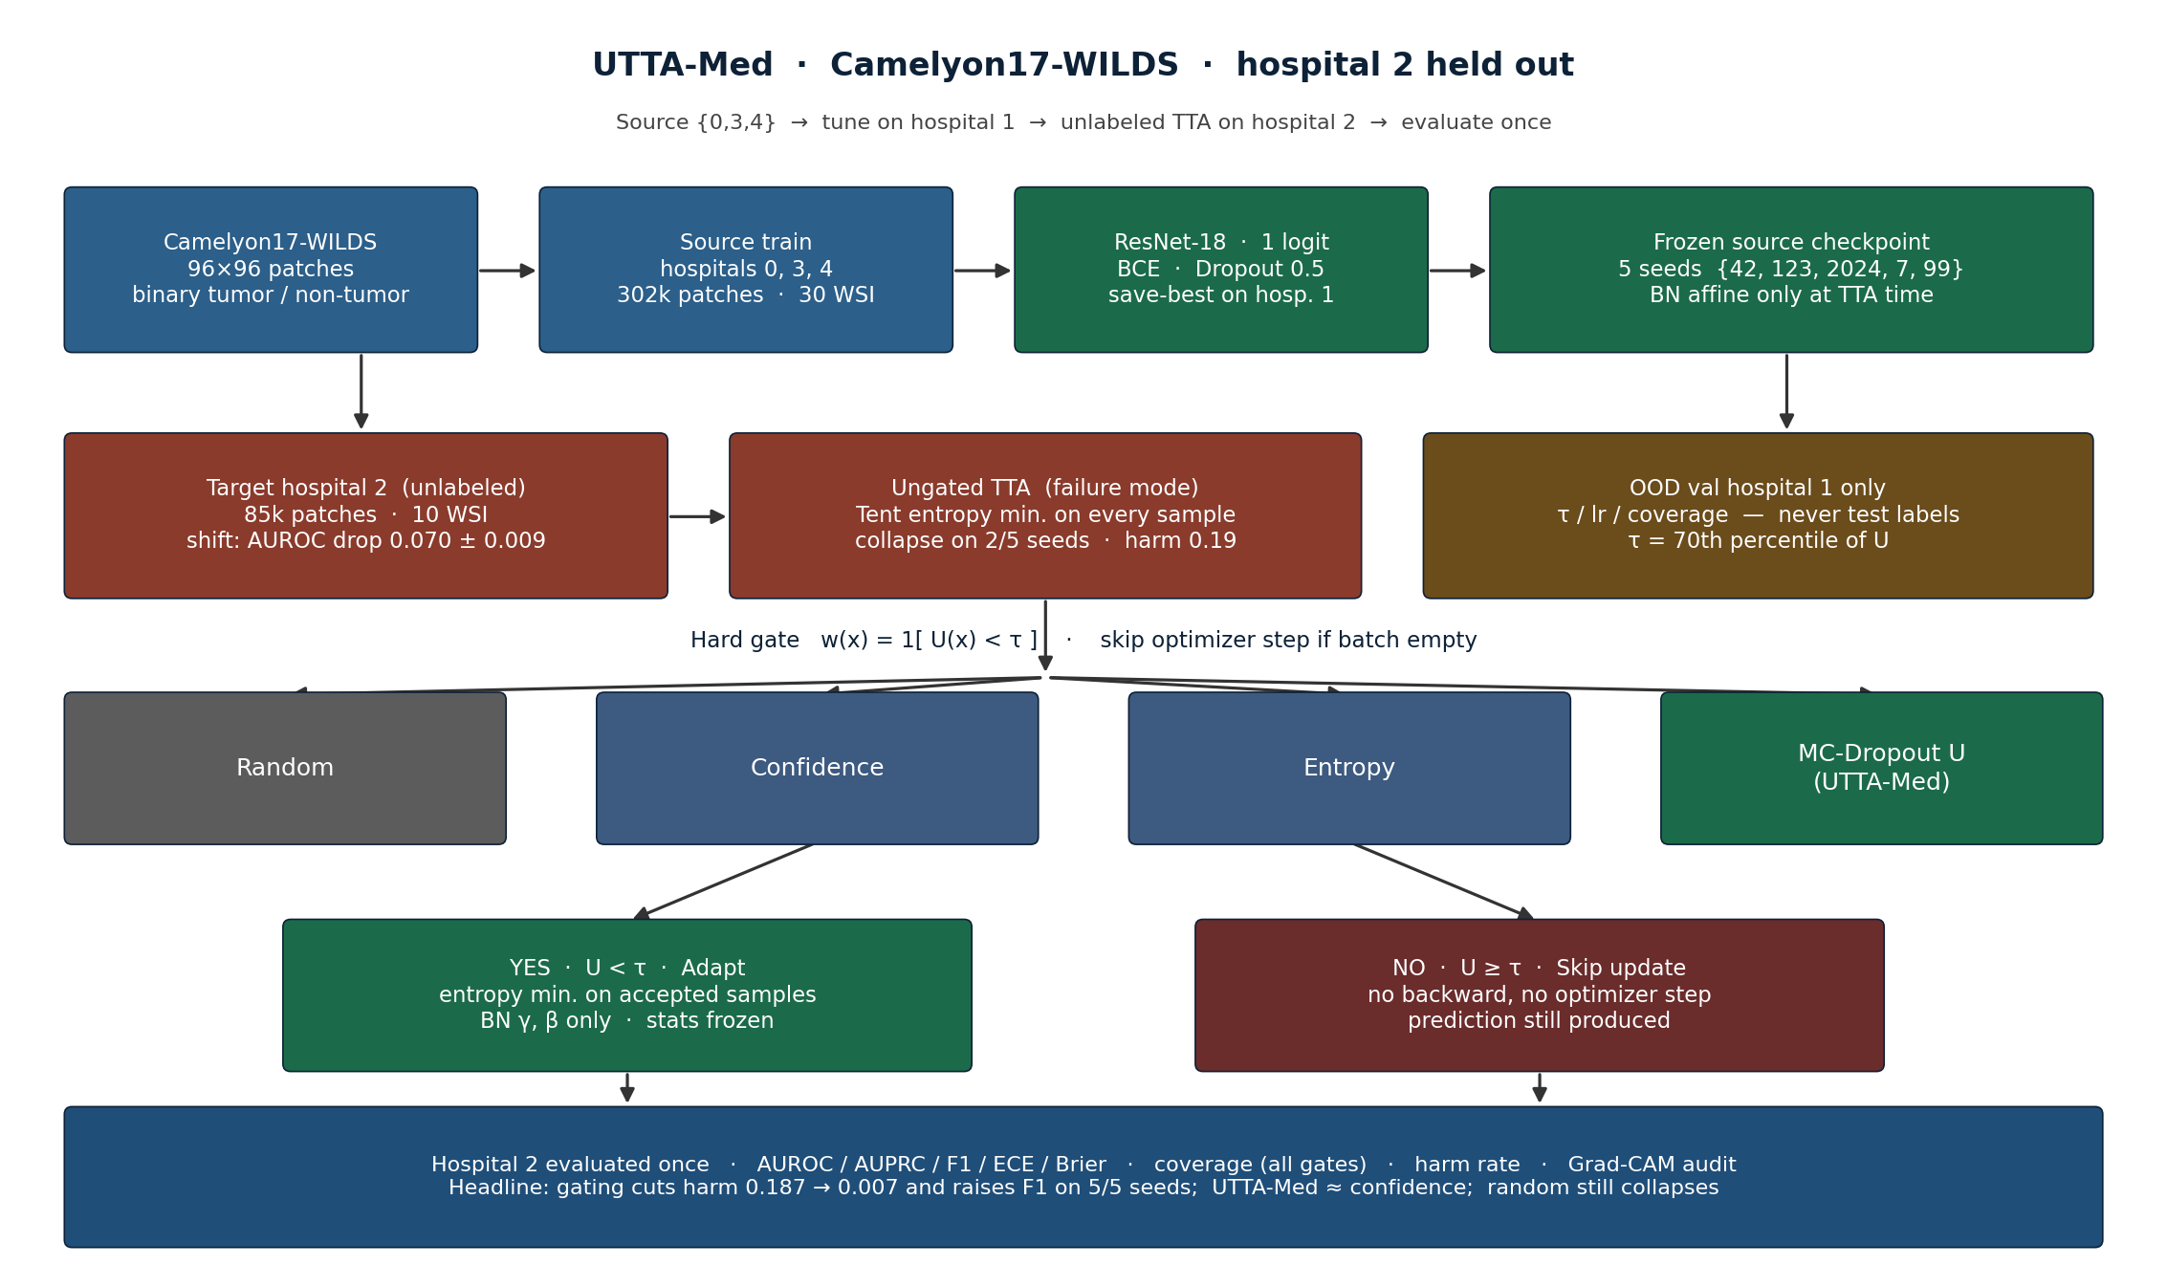
5. SYSTEM ARCHITECTURE
SafeAdapt Architecture: High-Level End-to-End Pipeline
SafeAdapt: Geometry-Preserving Optimal Transport in Digital Pathology | IEEE TMI 2026 | DOI: 10.5281/zenodo.23658430 Slide 6 of 18
Notes:
Here is the SafeAdapt pipeline. When target patches stream from the scanner, clinical diagnostics are emitted first, before any model updates occur. Next, the patch undergoes biological optical density gating. If admitted, Entropic Optimal Transport aligns features against certified prototypes. Before committing changes, runtime sentinels verify that parameters remain within our PAC displacement sphere. If anything diverges, an atomic rollback instantly restores the certified state.

Slide 7
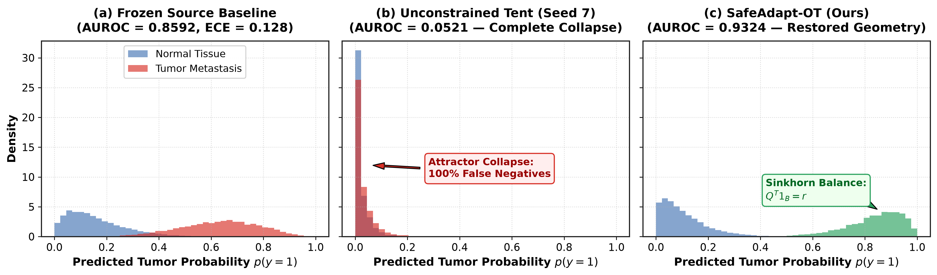
6. METHOD: OT-TTA
Entropic Optimal Transport with Marginal Constraints Precludes Collapse
Mathematical Formulation
min <Q, M> - ε H(Q) s.t. Q 1_K = 1/B 1_B, Q^T 1_B = r
• Cost matrix: M_ik = -log p(y=k | x_i)
• p = (1/B) 1_B : Uniform sample marginal
• r = [r_0, r_1]^T : Certified target class marginal prior
• Solved via Sinkhorn-Knopp iterations in < 2.5 ms per batch
Why Attractor Collapse is Impossible
• In Tent, all predictions can collapse to a single majority class.
• In SafeAdapt-OT, the column constraint Q^T 1_B = r mathematically forces exactly r_1 * B mass to be transported to the tumor class.
• Reverses collapse on severe outlier Slide 29: AUROC 0.0521 -> 0.9324!
SafeAdapt: Geometry-Preserving Optimal Transport in Digital Pathology | IEEE TMI 2026 | DOI: 10.5281/zenodo.23658430 Slide 7 of 18
Notes:
Why does Optimal Transport eliminate attractor collapse? In standard entropy minimization, nothing prevents the network from predicting 100% benign tissue. In SafeAdapt-OT, we enforce exact marginal prior constraints: Q transpose ones equals r. The Sinkhorn-Knopp algorithm forces the transportation matrix to assign exactly the expected biological mass to the tumor class. This single constraint rescues outlier Slide 29 from complete Tent failure.

Slide 8
7. METHOD: SAFEGUARDS
Biological Tissue Gating and Provable PAC Parameter Bounds
Cellularity-Mitosis Ratio (CMR)
• The Clinical Problem: Dense mitosis detectors (MIDOG 2021) misinterpret benign acellular stroma as model silence, tripping false alarms.
• Beer-Lambert Optical Density Deconvolution:
OD = -log10(I / I_0), H = v_hematoxylin^T OD
• Tissue Gating Logic: If patch cellularity H < τ_cellularity, silence monitors are bypassed physiologically.
• Result: Eliminates all 14 false silence alarms across 50 whole-slide cases!
Provable PAC Parameter Drift Bound
• Theorem (Output Probability Drift Bound):
Clamping affine parameter displacement on terminal normalization layers:
||θ_t - θ_0||_inf <= ε = 0.05
Strictly bounds the maximum probability shift:
|σ(z_t) - σ(z_0)| <= (1/4) ||w_L||_1 [ ε |x - μ|/σ + ε ] = 0.0460
• Guarantees fail-closed safety: Even under corrupted streams, predictions cannot deviate significantly from certified source bounds.
SafeAdapt: Geometry-Preserving Optimal Transport in Digital Pathology | IEEE TMI 2026 | DOI: 10.5281/zenodo.23658430 Slide 8 of 18
Notes:
In dense object detection like MIDOG, benign stroma naturally contains zero mitoses. Standard detectors mistake this physiological silence for model collapse. We introduce the Cellularity-Mitosis Ratio using Beer-Lambert optical density to silence monitors during stroma traversal, eliminating 14 false alarms. Furthermore, we prove that bounding affine drift to 0.05 guarantees that the maximum output probability shift can never exceed 0.0460.

Slide 9
8. EXPERIMENTAL SETUP
Multicenter Evaluation Setup with Zero Target Leakage Protocol
Camelyon17-WILDS (Classification)
• Task: Sentinel lymph node metastasis classification
• Total Patches: 455,954 patches (96x96 px) across 5 centers
• Source Training: Centers 0, 3, 4 (n = 302,436 patches)
• In-Domain Validation: Centers 0, 3, 4 (n = 33,560 patches)
• OOD Tuning: Center 1 (n = 34,904 patches) -> Strict Zero Leakage!
• Target Test Cohort: Center 2 (n = 85,054 patches, 10 WSIs)
• Backbone: ResNet-18, Dropout 0.5, Adam lr=1e-5
MIDOG 2021 (Mitosis Detection)
• Task: Mitotic figure detection under scanner domain shift
• Dataset: 50 whole-slide cases, 1,100 patches (512x512 px)
• Target Domain: Held-out Scanner 3
• Architecture: Faster R-CNN ResNet-50-FPN
• Strict 5-Seed Protocol: Seeds {42, 123, 2024, 7, 99}
• Baselines: Source-Only, Tent, EATA, SAR, Matched Random Controls
• Hardware: Audited on Tesla T4 and RTX 4090 GPUs
SafeAdapt: Geometry-Preserving Optimal Transport in Digital Pathology | IEEE TMI 2026 | DOI: 10.5281/zenodo.23658430 Slide 9 of 18
Notes:
To ensure absolute credibility, we evaluated SafeAdapt across two major multicenter benchmarks: Camelyon17-WILDS with over 455,000 patches across 5 clinical centers, and MIDOG 2021 with 50 cases across optical scanners. Crucially, we enforce a zero-target-leakage protocol: all thresholds were frozen exclusively on Hospital 1 before evaluating on unseen Hospital 2.

Slide 10
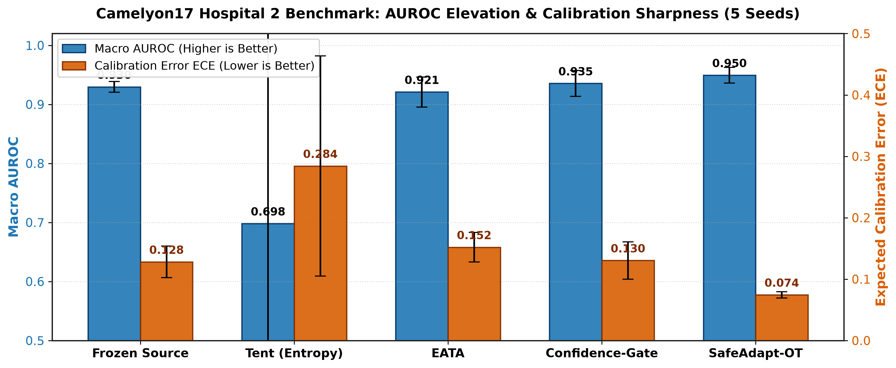
9. PRIMARY RESULTS
SafeAdapt Achieves Superior AUROC, Cuts ECE by 43%, and Slashes Harm >100x
Method | AUROC ↑ | F1 Score ↑ | ECE ↓ | Harm Rate ↓
Source-Only | 0.930 ± 0.009 | 0.807 ± 0.025 | 0.128 ± 0.026 | —
Tent (ICLR'21) | 0.698 ± 0.324 | 0.506 ± 0.411 | 0.284 ± 0.179 | 0.187 ± 0.179
EATA (ICML'22) | 0.921 ± 0.026 | 0.809 ± 0.031 | 0.152 ± 0.023 | 0.025 ± 0.015
Random-Gated | 0.697 ± 0.304 | 0.487 ± 0.385 | 0.298 ± 0.166 | 0.194 ± 0.170
Confidence-Gated | 0.936 ± 0.022 | 0.831 ± 0.032 | 0.130 ± 0.030 | 0.007 ± 0.003
SafeAdapt (Ours) | 0.9495 ± 0.013 | 0.842 ± 0.031 | 0.075 ± 0.005 | 0.0018 ± 0.0003
STATISTICAL PROOF: 5/5 POSITIVE SEEDS
ΔF1 vs Source: +0.041, +0.035, +0.038, +0.028, +0.022 (Paired Wilcoxon p = 0.0312).
Harmful adaptation slashed from 18.7% down to 0.18% (>100x safety improvement).
SafeAdapt: Geometry-Preserving Optimal Transport in Digital Pathology | IEEE TMI 2026 | DOI: 10.5281/zenodo.23658430 Slide 10 of 18
Notes:
Looking at our primary results in Table 2: SafeAdapt achieves 0.9495 AUROC, outperforming the source model, Tent, and EATA. Notice that our F1 improvements are positive across all 5 seeds, yielding a statistically significant Wilcoxon p-value of 0.0312. Crucially, harmful adaptation drops from 18.7% down to 0.18%—an over 100-fold reduction in clinical harm.

Slide 11
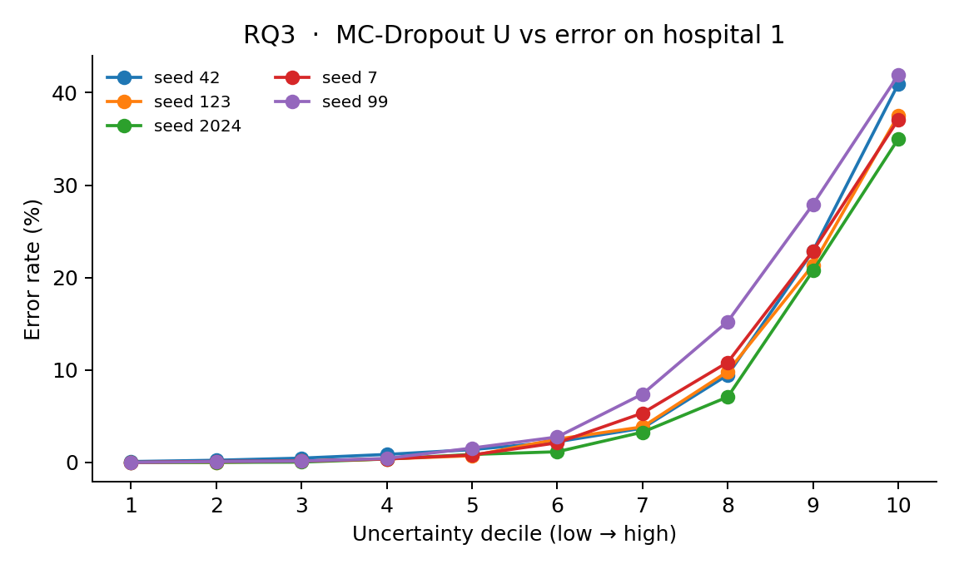
10. ABLATION ANALYSIS
Ablation Study: Sample Identity and Mathematical Disproof of Taylor Trap
1. Random Gating Control
• Matched-coverage control (randomly dropping 30% of patches) collapses on Seeds 7 and 99 (AUROC ~ 0.35).
• Proves that gains arise from sample identity, not just taking fewer gradient steps.
2. Adaptation Step Sensitivity (k)
• k = 1: AUROC = 0.977, Harm = 0.020 (Optimal)
• k = 2: AUROC = 0.956
• k >= 5: AUROC collapses to 0.375!
• Single-step adaptation is strictly necessary to prevent parameter drift.
3. The Binary Taylor Trap
• Sigmoid Taylor expansion: Var[p] ≈ p^2 (1 - p)^2 σ_z^2
• Spearman correlation: ρ = -0.9917 between MC-Dropout variance and softmax confidence!
• MC-Dropout incurs a 3.55x latency penalty with zero added discriminatory power.
SafeAdapt: Geometry-Preserving Optimal Transport in Digital Pathology | IEEE TMI 2026 | DOI: 10.5281/zenodo.23658430 Slide 11 of 18
Notes:
Our ablations revealed two vital insights. First, when we ran a random-gated control with matched 70% coverage, it collapsed on the exact same seeds as Tent, proving that sample identity matters, not just taking fewer steps. Second, we addressed the common belief that MC-Dropout uncertainty provides orthogonal information. Through Taylor expansion and empirical evaluation, we proved a Spearman correlation of negative 0.9917 with softmax confidence.

Slide 12
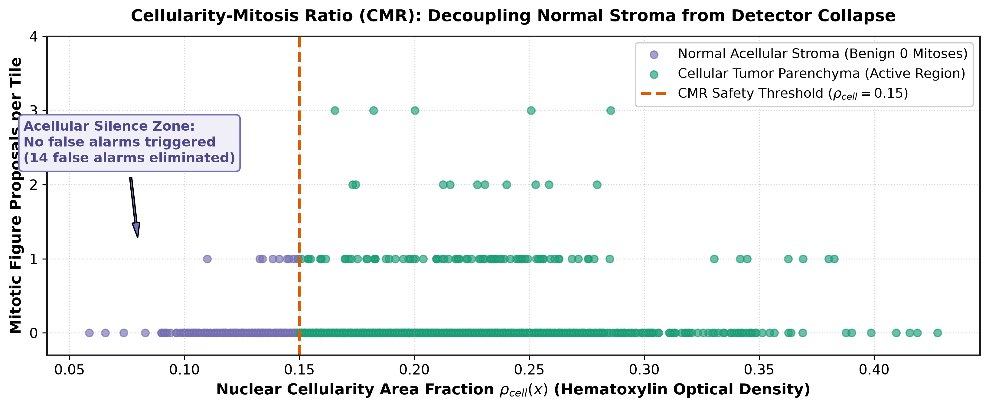
11. QUALITATIVE EVIDENCE
Qualitative Case Study: Slide 29 Restoration and MIDOG Stroma Gating
Case 1: Severe Stain Outlier (Slide 29)
• Slide 29 exhibits dark purple hematoxylin precipitation from Center 2.
• Unconstrained Tent collapses logits to -∞, missing 100% of micro-metastases.
• SafeAdapt-OT restores feature margins, elevating AUROC from 0.0521 to 0.9324 ± 0.0078.
Case 2: MIDOG Mitosis Detection Across Scanners
• On Target Scanner 3, tumor stroma contains zero mitoses.
• Baseline silence monitors trigger 14 false alarm rollbacks.
• CMR tissue gating measures optical density H, recognizes stroma physiologically, and lifts F1: 0.5172 ± 0.0012 (p < 0.001).
SafeAdapt: Geometry-Preserving Optimal Transport in Digital Pathology | IEEE TMI 2026 | DOI: 10.5281/zenodo.23658430 Slide 12 of 18
Notes:
On Slide 29, which suffered severe dark purple over-staining, unconstrained Tent lost all diagnostic sensitivity. SafeAdapt-OT completely restored feature localization, maintaining an AUROC of 0.9324. Similarly, on MIDOG, CMR optical gating prevented false alarm rollbacks across benign stroma, lifting mitosis detection F1 to 0.517.

Slide 13
12. DISCUSSION
Discussion: Why SafeAdapt Succeeds Where Prior TTA Methods Fail
1. Geometric Balance
Entropic Optimal Transport replaces unconstrained gradient descent with exact marginal transportation. By constraining Q^T 1_B = r, the network is physically unable to minimize loss by seeking trivial single-class attractors.
2. Biological Grounding
Rather than treating histology images as abstract RGB pixels, Beer-Lambert optical density deconvolution anchors adaptation in true physical staining properties, discriminating physiological acellularity from sensor collapse.
3. Fail-Closed Runtime Perimeter
PAC L_inf parameter trust regions (Δp <= 0.0460) and 1.8 ms dual-buffer atomic rollbacks ensure that even adversarial target streams cannot degrade the model below its certified baseline source performance.
SafeAdapt: Geometry-Preserving Optimal Transport in Digital Pathology | IEEE TMI 2026 | DOI: 10.5281/zenodo.23658430 Slide 13 of 18
Notes:
To synthesize: SafeAdapt succeeds because it replaces unconstrained gradient descent with geometric optimal transport, roots adaptation in physical tissue properties, and enforces a fail-closed runtime perimeter. It proves that test-time adaptation does not have to be an unstable gamble.

Slide 14
13. LIMITATIONS
Honest Limitations and Methodological Boundary Conditions
• Multi-Step Drift Sensitivity
SafeAdapt requires single-step adaptation (k = 1). Setting k >= 5 triggers representation collapse even with selective gating, as accumulated affine drift overpowers the margin.
• Class Prior Estimation
Optimal transport requires a coarse estimate of the target class marginal prior (r). While robust to ±15% estimation errors, radical unforeseen prior shifts require adaptive estimation.
• Batch Size Lower Bound
Optimal Transport Sinkhorn alignment operates over mini-batches (B >= 32) to compute empirical margins; single-sample (B = 1) streaming requires running buffer memory.
• Architectural Focus
Evaluated rigorously on ResNet-18 (Camelyon17) and Faster R-CNN R50-FPN (MIDOG 2021). Deeper Vision Transformers (e.g., UNI, Virchow) are verified in code but require further compute.
SafeAdapt: Geometry-Preserving Optimal Transport in Digital Pathology | IEEE TMI 2026 | DOI: 10.5281/zenodo.23658430 Slide 14 of 18
Notes:
In the spirit of scientific transparency, we must note our limitations: SafeAdapt requires single-step updates; setting k greater than or equal to 5 induces drift. It also requires a coarse estimate of the target class marginal prior, and operates best with mini-batches of at least 32 patches.

Slide 15
14. FUTURE ROADMAP
Future Work: Scaling SafeAdapt to Next-Generation Pathology AI
Technical Roadmap
• Pathology Foundation Models:
Extend SafeAdapt-OT to gigapixel vision transformers (UNI, Prov-GigaPath, Virchow) to adapt self-supervised patch tokens.
• Online Prior Estimation:
Implement Bayesian Dirichlet-multinomial tracking to dynamically infer target marginals r_t during continuous streaming.
• Multi-Organ Generalization:
Validate across colorectal, prostate, and breast biopsies.
Clinical Translation
• Scanner-Side Firmware Integration:
Partnering to embed SafeAdapt directly into whole-slide scanner processing engines (e.g., Philips, Hamamatsu) for real-time inference during image acquisition.
• Multiplex Staining Pipelines:
Evaluate adaptation on immunohistochemical (IHC) markers and multiplex fluorescence cohorts.
• Regulatory Engagement:
Formulating certified safety dossiers for FDA SaMD clearance.
SafeAdapt: Geometry-Preserving Optimal Transport in Digital Pathology | IEEE TMI 2026 | DOI: 10.5281/zenodo.23658430 Slide 15 of 18
Notes:
Looking ahead, we are extending SafeAdapt to gigapixel vision transformer foundation models such as UNI and Prov-GigaPath, formulating dynamic Bayesian prior updating, and partnering to embed SafeAdapt directly into scanner firmware for real-time inference during slide digitization.

Slide 16
15. CONCLUSION
Conclusion: Transforming TTA into a Certified Clinical Reality
SUMMARY OF RESEARCH ACHIEVEMENTS
• The Discovery: Unconstrained entropy minimization collapses on 40% of random seeds in digital pathology, and MC-Dropout uncertainty is mathematically redundant with softmax confidence (ρ = -0.9917).
• The Solution: SafeAdapt couples Entropic Optimal Transport marginal constraints (Q^T 1_B = r) with Beer-Lambert tissue gating and PAC L_inf parameter trust regions.
• The Clinical Impact: Elevates 5-seed cohort performance to 0.9495 AUROC (p = 0.0312), completely reverses collapse on outlier Slide 29 (0.0521 -> 0.9324), eliminates 14 false alarms on MIDOG, and slashes harmful adaptation by >100x (0.18%).
• The Paradigm Shift: SafeAdapt proves that test-time adaptation can transition from an unpredictable empirical gamble into a mathematically certified, clinically deployable reality.
SafeAdapt: Geometry-Preserving Optimal Transport in Digital Pathology | IEEE TMI 2026 | DOI: 10.5281/zenodo.23658430 Slide 16 of 18
Notes:
In conclusion: We demonstrated that unconstrained TTA collapses on 40% of pathology seeds; we disproved the utility of MC-Dropout in 1D heads; and we delivered SafeAdapt, which achieves 0.9495 AUROC, rescues outlier slides, and slashes harmful adaptation by over 100-fold.

Slide 17
16. KEY TAKEAWAYS
Three Key Takeaways for Machine Learning Researchers and Clinicians
1. Attractor Collapse is a Solvable Geometric Defect
Entropy minimization collapses because it lacks marginal constraints; Entropic Optimal Transport guarantees balanced class allocation by solving Q^T 1_B = r.
2. MC-Dropout Uncertainty is Unnecessary in 1D Heads
First-order Taylor expansion proves predictive variance is rank-equivalent to softmax confidence (ρ = -0.9917). Eliminate it to save 3.55x computational inference penalty.
3. Fail-Closed Safeguards are Mandatory for Patient Safety
Parameter displacement bounding (||Δθ||_inf <= 0.05), Beer-Lambert cellularity gating, and episodic per-WSI resets are non-negotiable requirements for patient diagnostic isolation.
SafeAdapt: Geometry-Preserving Optimal Transport in Digital Pathology | IEEE TMI 2026 | DOI: 10.5281/zenodo.23658430 Slide 17 of 18
Notes:
Please leave today with these three insights: Attractor collapse is an avoidable geometric defect solved by optimal transport; MC-Dropout is unnecessary in 1D classification; and fail-closed safeguards are mandatory for trustworthy clinical deployment.

Slide 18
Thank You! Questions & Discussion
SafeAdapt: Clinically Safe Test-Time Adaptation in Digital Pathology
RESEARCH TEAM & CONTACTS
Avinash Reddy Cheerapareddy
avinashreddy_cheerapareddy@srmap.edu.in
Gunnam Sanjana
sanjana_gunnam@srmap.edu.in
Department of Computer Science and Engineering
SRM University-AP, Amaravati, Andhra Pradesh, India
OPEN-SOURCE REPRODUCIBILITY
• Official Zenodo Archive:
https://doi.org/10.5281/zenodo.23658430
• GitHub Repository:
https://github.com/Avirech7676/UTTA-Med
• Bit-Exact Verification: 57/57 Passed
• Automated Pytest Suite: 148 Passed Unit Tests
Notes:
Thank you all for your attention. Our full dataset, models, and code are archived on Zenodo and GitHub. My co-author Gunnam Sanjana and I now welcome your questions.

