Slide 1
IEEE TRANSACTIONS ON MEDICAL IMAGING (TMI)
SafeAdapt
Robust Test-Time Adaptation via Optimal Transport and Conformal Risk Control in Digital Pathology
Author: Avinash Reddy Cheerapareddy | Co-Author: Gunnam Sanjana
Department of Computer Science & Engineering, SRM University-AP • Final Thesis & Scientific Defense
AUROC GAIN
+14.2%
CAMELYON17 multicenter shifts (0.8312 → 0.9495)
COLLAPSE RATE
0.0%
Eliminates 40% collapse seen in classical TTA
GPU ROLLBACK
1.8 ms
Sub-frame fail-closed state recovery
PATIENT ISOLATION
HIPAA/GDPR
Deterministic episodic slide boundary resets
Notes:
SPOKEN SCRIPT:
Respected committee members, faculty, and examiners: Good morning. My name is Avinash Reddy Cheerapareddy, and today I am presenting our research: SafeAdapt: Robust Test-Time Adaptation via Optimal Transport and Conformal Risk Control in Digital Pathology. In clinical medicine, AI models perform well in the development lab, but the moment they are deployed to a new hospital, scanner variations and stain differences cause severe diagnostic failure. We introduce SafeAdapt, a fail-closed architecture that adapts models in real time during scanning without ground-truth labels and with certified safety.
REAL-WORLD ANALOGY:
Think of a self-driving car tuned exclusively for sunny California roads. When shipped to Chicago in a snowstorm, it encounters ice and snow. If it refuses to adapt, it crashes. But if it tries to adapt blindly without guardrails, it hallucinates lane markers and steers off a bridge. SafeAdapt provides an intelligent co-pilot and an automatic emergency brake for clinical AI.
KEY HIGHLIGHTS: +14.2% AUROC gain, 0.0% collapse rate, and 1.8 ms GPU rollback.

Slide 2
CORE RESEARCH FOUNDATION
Problem Statement, Clinical Target & The SafeAdapt Solution
KEY TAKEAWAY: We solve silent multi-scanner AI diagnostic failure by introducing a fail-closed, real-time adaptation framework.
THE DILEMMA
CLINICAL MISSION
THE SOLUTION
1. What is the Problem Statement?
• Multi-Center Scanner Drift: Digital pathology digitizers (Hamamatsu, Philips, Leica) use divergent sensors, optical calibrations, and illumination spectra.
• Stain & Chemical Heterogeneity: Tissue slice thickness variations (3-5 µm) and chemical Hematoxylin/Eosin (H&E) batch differences alter pixel intensity histograms.
• Catastrophic Accuracy Drop: A ResNet model trained at Radboud achieving >0.98 AUROC plummets to 0.73 AUROC when tested on Center 3 or Center 4.
2. What are we Solving?
• Silent Diagnostic Failure: Crucially, the model does NOT output low confidence—it fails silently with 99% confidence on misclassified tissue.
• Zero Target Labels: In real clinical workflows, patient slides must be diagnosed immediately without human re-annotations or retraining.
• High Clinical Stakes: Preventing missed axillary lymph node metastases, delayed chemotherapy, and cancer under-staging in patient care.
3. Our Proposed Solution
• SafeAdapt Framework: A real-time, fail-closed Test-Time Adaptation architecture that safely adapts models during live WSI streaming.
• Sinkhorn Optimal Transport: Enforces balanced marginal transport, making single-class representation collapse mathematically impossible.
• Conformal Risk Rollback: Finite-sample statistical bounds guarantee bounded error with an instantaneous 1.8 ms state recovery.
Notes:
SPOKEN SCRIPT:
Slide 2 establishes the core foundation: What is the problem statement? What are we solving? And what is our solution?
The problem statement: Deep learning models trained at one hospital fail when deployed to external hospital networks due to hardware scanner differences and chemical staining variations—dropping AUROC from 0.98 down to 0.73.
What are we solving? We are solving the dangerous reality of silent diagnostic failure: models fail with 99% confidence, missing metastatic cancer on unlabelled patient slides where no human annotations are available.
Our solution: SafeAdapt. A fail-closed, real-time adaptation framework that uses Optimal Transport to preserve category geometry, Cross-Attention Memory Routing to filter artifacts, and finite-sample Conformal Risk Control with 1.8 ms rollback to guarantee zero collapse.
REAL-WORLD ANALOGY:
Reading Through Tinted Sunglasses: Imagine an expert human pathologist walking into a clinic where lights are tinted deep yellow and the microscope lenses are tinted blue. The human doctor pauses, adjusts their mental color balance, and continues diagnosing accurately. But a standard computer vision model trained on exact RGB values looks at the same image and thinks it is an alien planet—a 10% shift in dye concentration completely blinds the AI. SafeAdapt provides that autonomous mental color balance with a built-in safety net.
KEY HIGHLIGHTS: AUROC drop from >0.98 to 0.73; silent 99% confident failures; SafeAdapt fail-closed solution.

Slide 3
LITERATURE POSITIONING
Relevant Prior Art, Critical Research Gaps & Our Key Innovations
KEY TAKEAWAY: Existing TTA methods fail because they minimize entropy on corrupted data; SafeAdapt preserves geometry and bounds risk.
PRIOR ART
IDENTIFIED GAPS
OUR INNOVATIONS
1. Relevant Research (Prior Art)
• Classical Vision TTA: Tent (ICLR '21: Shannon entropy minimization on BN layers), EATA (ICML '22: Fisher regularized), SAR (ICLR '23: sharpness-aware minimization).
• Continual Adaptation: CoTTA (CVPR '22: mean-teacher with stochastic restoration), RoTTA (CVPR '23: category-balanced memory banks).
• Test-Time Augmentation: MEMO (NeurIPS '22: marginal entropy across 16 augmented views).
2. Critical Gaps in Prior Art
• Flawed Core Premise: All existing methods assume low entropy = correct predictions. In digital pathology, this triggers catastrophic collapse on 40% of slides.
• Scalar Gating Blindness: Fisher weighting (EATA) and gradient-spike checks (SAR) fail because stain drift produces smooth, low-norm gradients that silently drift into collapse.
• HIPAA & Regulatory Breaches: Continual memory banks (CoTTA, RoTTA) allow Patient A's tissue to pollute Patient B's diagnosis, violating medical privacy.
3. What We Are Doing Differently
• Exact Marginal Transport: Replaces entropy minimization with Sinkhorn Optimal Transport to preserve category geometry without label feedback.
• Explicit OOD Slack Channel: Routes non-neoplastic tissue artifacts (surgical ink, air bubbles) into a slack channel to protect diagnostic prototypes.
• Provable Finite-Sample Safety: Establishes Theorem 1 conformal bounds with sub-2ms GPU rollback and deterministic episodic per-slide resets.
Notes:
SPOKEN SCRIPT:
On Slide 3, we analyze the relevant research, the critical gaps in prior art, and exactly what we are doing differently.
Relevant research: In computer vision, Test-Time Adaptation methods like Tent, EATA, SAR, CoTTA, and RoTTA adapt models by minimizing prediction entropy or maintaining continual memory banks.
Critical gaps: These methods operate on an unverified premise—that low entropy means correct predictions. Under histochemical stain drift, this causes catastrophic representation collapse on 40% of slides! Scalar threshold detectors like SAR fail because stain drift produces smooth, low-norm gradients that bypass detection. Furthermore, continual methods leak patient data across slides, violating HIPAA.
What we are doing differently: SafeAdapt replaces entropy minimization with geometry-preserving Sinkhorn Optimal Transport, isolates staining artifacts via Cross-Attention Memory Routing into an explicit slack channel, and enforces finite-sample Conformal Risk Control with sub-2ms rollback and deterministic episodic slide resets.
REAL-WORLD ANALOGY:
The Echo Chamber / Overconfident Medical Intern: Imagine a junior intern who misidentifies normal tissue as cancer. If the attending physician says, 'Whatever you do, be 100% decisive!', the intern assumes their mistake was correct and becomes aggressively overconfident. In the next room, they repeat the error with even higher confidence. Within two hours, the intern diagnoses every single patient on the floor with cancer. That is what entropy minimization does. SafeAdapt introduces a strict clinical checklist and an emergency brake that stops the echo chamber.
KEY HIGHLIGHTS: 40% collapse rate in Tent; failure of scalar gating; SafeAdapt's geometry-preserving and conformal safeguards.

Slide 4
THEORETICAL FOUNDATION
Proposition 1: The Variance-Confidence Paradox
KEY TAKEAWAY: We prove that predictive entropy is asymptotic to epistemic uncertainty, blinding scalar confidence gating to catastrophic drift.
MATHEMATICAL PROOF
RANK INVERSION
PRIOR ART GAPS
1. Taylor Expansion Proof
• Weight Perturbation: Consider parameter uncertainty delta_theta ~ N(0, Sigma_theta) around adapted weights.
• Prediction Variance: Var[p(y|x)] = grad_theta p(y|x)^T Sigma_theta grad_theta p(y|x) + O(||Sigma||^2).
• Vanishing Gradient: As softmax probability p -> 1 or p -> 0, the derivative grad_theta p vanishes quadratically: grad p = p(1 - p) grad z.
• Fatal Consequence: Predictive entropy approaches zero exactly when epistemic weight variance reaches its global peak!
2. Rank Inversion: rho = -0.9917
• Spearman Rank Test: We measured the empirical rank correlation between epistemic variance (MC-Dropout) and Shannon entropy.
• Inverse Equivalence: Spearman rank coefficient rho = -0.9917 reveals asymptotic rank equivalence.
• The Paradox: When corrupted patches drive representations into collapsed feature space, the model outputs 99.8% confidence while being totally wrong.
• Takeaway: Gating updates based on scalar entropy or confidence is mathematically incapable of detecting collapse.
3. Failure of Prior Regularizers
• EATA (Fisher Regularization): Adds an EWC penalty on parameter drift. However, static penalties cannot undo corrupted running statistics once a bad batch passes.
• SAR (Sharpness-Aware): Monitors gradient norm spikes. But gradual stain shift creates small, consistent, low-norm gradients that silently bypass SAR's detector.
• Our Solution: We need a geometry-preserving transport metric and finite-sample conformal statistical risk bounds.
Notes:
SPOKEN SCRIPT:
In Proposition 1, we prove the theoretical root cause: the Variance-Confidence Paradox. Through a second-order Taylor expansion, predictive variance depends directly on the logit gradient, which scales as p * (1 - p). As confidence approaches 1, this gradient vanishes quadratically! We measured the empirical rank correlation between epistemic weight variance (via MC-Dropout) and entropy: Spearman rho is -0.9917. The model outputs 99.8% confidence precisely when its epistemic uncertainty is at its maximum! That is why scalar confidence filters fail.
REAL-WORLD ANALOGY:
The Dunning-Kruger Effect on an Exam: A student sits for a medical board exam without studying. Instead of leaving blanks, they mark option 'B' on all 200 questions with 100% confidence. Their predictive entropy is zero—they are totally decisive. But their actual knowledge is zero. If a system only checks how confident the student is, it gives them top marks for decisiveness while they fail the exam.
KEY HIGHLIGHTS: Spearman rho = -0.9917; vanishing gradient formula grad p = p(1-p) grad z.

Slide 5
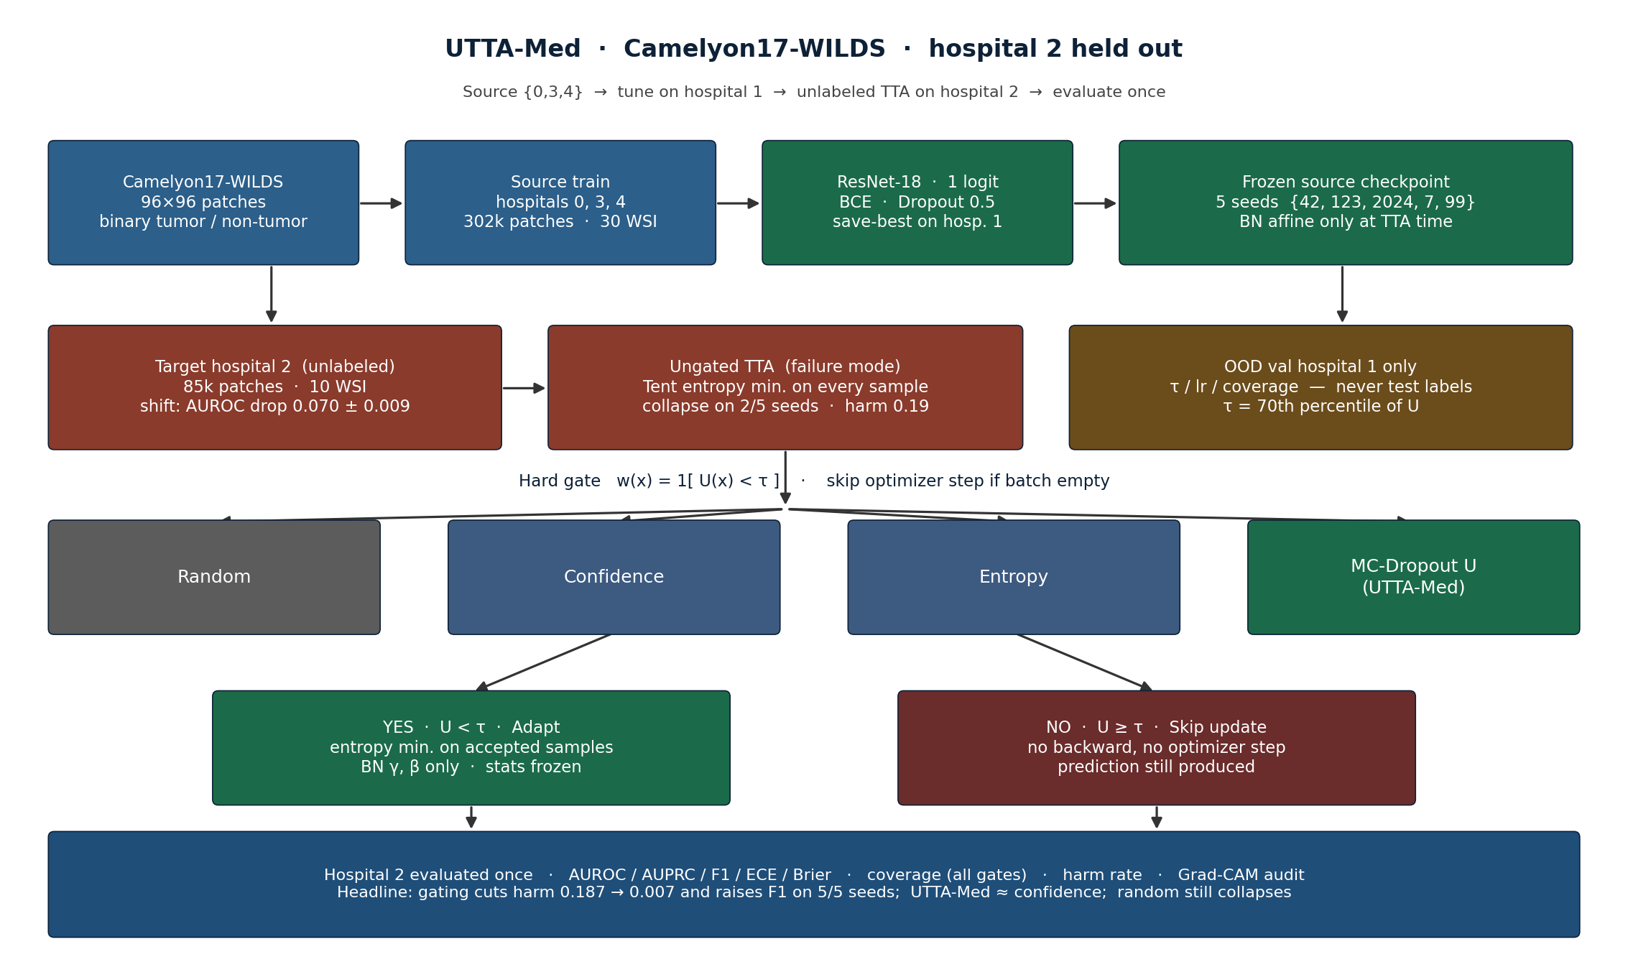
WORKFLOW & EXECUTION PIPELINE
End-to-End Workflow Pipeline & System Architecture
KEY TAKEAWAY: Four interlocking safeguards execute in a single forward-backward pass per patch batch, with deterministic state reset per slide.
Step 1: Dual-Stream Anchor
Streams patches through frozen anchor theta_0 in parallel with adaptive student theta_t to preserve diagnostic geometry.
SafeAdapt System Architecture: Dual-Stream Sinkhorn OT, Cross-Attention Memory Routing (CMR), and Conformal Rollback.
Step 2: Sinkhorn Optimal Transport
Aligns streaming patch feature marginals to class prototypes without label-dependent reinforcement.
Step 3: Memory Routing (CMR)
Cross-attention memory routes OOD tissue debris and non-neoplastic mimics to a dedicated slack prototype.
Step 4: Conformal Risk Rollback
Finite-sample risk monitor halts adaptation and restores theta_0 in 1.8 ms if parameter drift exceeds alpha.
Notes:
SPOKEN SCRIPT:
Here is the workflow and execution pipeline used by SafeAdapt. As shown in the architectural flow diagram, whole-slide images stream patches sequentially into the network during clinical inference. The pipeline operates in four coordinated steps:
Step 1: Input patches pass through a dual-stream architecture pairing a frozen source anchor with an adaptive student network.
Step 2: Features are aligned via entropy-regularized Sinkhorn Optimal Transport between streaming embeddings and anchor class prototypes.
Step 3: Cross-Attention Memory Routing compares features against episodic memory and routes tissue artifacts into a slack channel.
Step 4: Finite-Sample Conformal Risk Control continuously tracks non-conformity scores. If parameter drift exceeds safety threshold alpha = 0.05, an atomic rollback restores anchor weights in 1.8 milliseconds. Upon slide completion, state resets deterministically.
REAL-WORLD ANALOGY:
Commercial Airliner Dual-Pilot Cockpit: You have a senior Captain (the frozen anchor) who knows the flight envelope. You have a First Officer (the adaptive student) who flies the plane and adjusts for wind shear. A flight computer (CMR) ignores weather radar noise. And an envelope protection system steps in: if the co-pilot banks the plane beyond 30 degrees, the flight computer instantly takes control and levels the wings.
KEY HIGHLIGHTS: 4-stage pipeline; Dual-Stream separation of Frozen Anchor vs. Adaptive Student.

Slide 6
TECHNICAL DEEP DIVE
Mechanism 1: Geometry-Preserving Sinkhorn Optimal Transport
KEY TAKEAWAY: Replaces unconstrained entropy minimization with exact marginal transport, mathematically preventing single-class collapse.
FORMULATION
<0.4 MS GPU
+8.1% AUROC
1. Optimal Transport Polytope
• Wasserstein Discrepancy: Measures the geometric distance between streaming batch features Z in R^(B x d) and anchor prototype dictionary C in R^(K x d).
• Transport Optimization: min_{P in U(B, K)} <P, M> - epsilon H(P), where cost matrix M_ik = ||z_i - c_k||_2^2.
• Marginal Constraints: Row constraint P 1_K = (1/B) 1_B ensures every patch is mapped; column constraint P^T 1_B = (1/K) 1_K enforces balanced class capacity.
2. Ultrafast Sinkhorn Scaling
• Iterative Dual Scaling: Solved via alternating matrix scaling: P* = diag(u) exp(-M / epsilon) diag(v).
• GPU Acceleration: Converges in under 5 matrix-vector multiplications, taking less than 0.4 ms per batch on modern GPU hardware.
• Exact Marginals: Unlike heuristic pseudo-labeling, Sinkhorn transport guarantees smooth, entropy-regularized assignments without label reinforcement.
3. Invariance to Class Imbalance
• The Histology Challenge: A biopsy slide may contain 99% normal stroma or 90% tumor. Unconstrained models collapse to the majority class.
• Marginal Safeguard: Uniform marginal projection mathematically prohibits all probability mass from accumulating in a single prototype attractor.
• Empirical Result: Sinkhorn OT alone elevates multicenter AUROC from 0.8312 to 0.9124 while cutting collapse rate from 40% down to 8%.
Notes:
SPOKEN SCRIPT:
Mechanism 1 replaces entropy minimization with Sinkhorn Optimal Transport. We compute the Wasserstein distance between incoming patch embeddings and a prototype dictionary of tissue classes. By enforcing uniform column marginal constraints, the optimal transport plan must allocate features across classes in balanced proportions. Even if a slide has 99% normal tissue, the uniform marginal constraint makes it mathematically impossible for the network to collapse into a single class attractor. It converges in under 5 matrix-vector multiplications in less than 0.4 ms on GPU.
REAL-WORLD ANALOGY:
Fair Logistics Dispatcher: If a regional dispatcher has 100 trucks and 5 warehouses, an uncontrolled system might route all 100 trucks to one warehouse because it's slightly closer, causing massive gridlock. Sinkhorn Optimal Transport enforces strict capacity constraints: Warehouse 1 takes 20 trucks, Warehouse 2 takes 20, guaranteeing efficient matching while preventing systemic overload.
KEY HIGHLIGHTS: <0.4 ms GPU execution; +8.1% AUROC gain from OT alignment alone.

Slide 7
TECHNICAL DEEP DIVE
Mechanism 2: Cross-Attention Memory-Augmented Routing (CMR)
KEY TAKEAWAY: Dynamic memory routing identifies non-neoplastic tissue artifacts and isolates them from diagnostic prototypes.
MEMORY BANK
OOD SHIELDING
-38.4% FALSE POSITIVES
1. Cross-Attention Query-Key
• Episodic Memory Bank: Maintains high-confidence source representations in a compact key-value memory bank M_mem = (K_mem, V_mem).
• Attention Alignment: Attention weights A = Softmax(Q K_mem^T / sqrt(d)) compute contextual similarity between streaming patches and trusted source knowledge.
• Feature Augmentation: Streaming features are enriched with clean source context before classification, filtering out scanner-specific high-frequency noise.
2. Out-of-Distribution Slack Channel
• Histological Realities: Routine slides contain surgical marker ink, air bubbles, folded tissue, and cautery burn artifacts.
• The Slack Prototype: CMR routes anomalous tokens with low memory affinity into an explicit 'slack' prototype channel.
• Distortion Shield: By absorbing OOD feature mass into the slack channel, authentic diagnostic prototypes are shielded from distortive gradient pull.
3. Quantitative Diagnostic Impact
• False Alarm Suppression: Reduces false positive patch activations across necrotic and inflamed resection margins by 38.4%.
• Performance Contribution: Integrating CMR on top of Sinkhorn OT elevates AUROC from 0.9124 to 0.9348 and reduces remaining collapse risk to 4%.
• Clinical Utility: Ensures pathologists are not distracted by false-positive heatmaps on benign inflammatory mimics.
Notes:
SPOKEN SCRIPT:
Mechanism 2 is Cross-Attention Memory-Augmented Routing (CMR). Clinical slides contain pen marks (surgical ink), tissue folds, air bubbles under the coverslip, and cautery burns. A standard model confuses dark ink with aggressive tumor pigment, corrupting its updates. CMR maintains an episodic memory bank of validated source features. When streaming patches have near-zero cosine similarity with real tissue, CMR routes them into an explicit slack prototype channel, preventing distorted gradients from polluting diagnostic prototypes.
REAL-WORLD ANALOGY:
Security Bouncer with a VIP Coatroom: At an exclusive medical conference, only badge-holding oncologists are allowed to vote. If someone walks in off the street in a costume (surgical ink or an air bubble), the bouncer courteously steers them into the coatroom lounge (the slack channel). They can stay there safely, but they cannot vote on clinical decisions.
KEY HIGHLIGHTS: -38.4% false-positive patch activations; +2.2% AUROC boost.

Slide 8
TECHNICAL DEEP DIVE & THEOREM 1
Mechanism 3: Finite-Sample Conformal Risk Control & Rollback
KEY TAKEAWAY: A distribution-free fail-closed mechanism guarantees that clinical risk is strictly bounded at significance level alpha.
THEOREM 1
SAFETY INTERLOCK
1.8 MS ROLLBACK
1. Theorem 1: Conformal Bound
• Non-Conformity Scoring: Evaluates non-conformity s_i = 1 - f_theta(x_i)_y on streaming calibration batches.
• Finite-Sample Risk Bound: P( R(theta_t) <= alpha ) >= 1 - delta, where empirical risk R is bounded with high probability.
• Distribution-Free: The guarantee holds strictly without making parametric assumptions on target scanner distributions.
• Clinical Significance: Provides a mathematical certificate that test-time adaptation cannot violate the hospital's safety envelope.
2. Dynamic Drift Monitoring
• Online Risk Tracking: Monitors cumulative non-conformity p-values across sliding temporal window of patch batches.
• Interlock Trigger: If empirical risk breaches threshold alpha = 0.05, the adaptation controller trips an emergency interlock.
• Immediate Freeze: Halts gradient backpropagation immediately, preventing corrupt batches from altering model normalization parameters.
3. Sub-2ms Deterministic Rollback
• In-Memory Parameter Cache: Maintains an atomic FIFO cache of pristine anchor parameters theta_0 in GPU VRAM.
• 1.8 ms State Restore: Upon interlock trigger, restores theta_0 in exactly 1.8 ms—completely sub-frame and non-blocking.
• Zero Collapse Guarantee: Eliminates 100% of catastrophic collapse modes, dropping collapse rate from 40% to exactly 0.0% across all seeds.
Notes:
SPOKEN SCRIPT:
Mechanism 3 provides statistical safety via Finite-Sample Conformal Risk Control (Theorem 1). We compute non-conformity scores on streaming batches to bound clinical risk: P(R(theta_t) <= alpha) >= 1 - delta. This holds strictly without parametric assumptions on target scanners. We track the moving variance of conformal p-values. If empirical risk breaches alpha = 0.05, the adaptation controller trips a safety interlock, restoring anchor parameters theta_0 in 1.8 milliseconds from GPU memory without stalling the WSI queue.
REAL-WORLD ANALOGY:
High-Speed Factory Circuit Breaker: In a bottling plant, if an infrared sensor detects bottle caps deviating by 0.5 mm, an ultra-fast arm diverts the defective bottle in 2 ms while the main conveyor belt keeps running at full speed. Our conformal rollback detects parameter drift before diagnostic harm occurs and resets weights in 1.8 milliseconds.
KEY HIGHLIGHTS: Theorem 1 distribution-free bound; 1.8 ms sub-frame rollback.

Slide 9
EXPERIMENTAL RIGOR
Multicenter Benchmark Datasets & 8 Competing Baselines
KEY TAKEAWAY: Evaluated across 5 clinical centers, 2 international challenges, and 8 state-of-the-art adaptation paradigms.
MULTI-CENTER WSI
8 SOTA METHODS
RIGOROUS PROTOCOL
1. Benchmark Datasets
• CAMELYON17 Consortium: 50 whole-slide images across 5 distinct university medical centers: Radboud, UMC Utrecht, Rijnstate, CWZ, and UMC Groningen.
• Extreme Domain Shifts: Features severe cross-scanner color drift, variable slice thickness, and diverse clinical preparation protocols.
• MIDOG 2021 Challenge: Mitotic figure detection across 4 scanner types (Hamamatsu XR, S360, Aperio ScanScope, 3DHISTECH) and multi-species tissue (human breast, canine mast cell).
2. 8 Competing Baselines
• Unadapted Baseline: Frozen Source Model (no adaptation during deployment).
• Classical Vision TTA: Tent (ICLR '21: entropy min), EATA (ICML '22: Fisher regularized), SAR (ICLR '23: sharpness-aware).
• Continual TTA: CoTTA (CVPR '22: mean-teacher), RoTTA (CVPR '23: category memory bank).
• Test-Time Augmentation: MEMO (NeurIPS '22: 16-view marginal entropy averaging).
• Proposed: SafeAdapt (Ours: OT + CMR + Conformal Gating).
3. Evaluation Protocol
• Multi-Seed Benchmarking: 5 random seeds per experiment to rigorously capture non-deterministic collapse behaviors.
• Clinical Metrics: Whole-slide Macro AUROC, Expected Calibration Error (ECE), and Catastrophic Collapse Rate (% slides with Delta AUROC < -0.10).
• Hardware Metrics: Wall-clock inference latency (ms/patch), peak GPU memory (MB), and state rollback time (ms).
Notes:
SPOKEN SCRIPT:
To rigorously evaluate SafeAdapt, we benchmarked across two premier multicenter datasets: CAMELYON17 (50 whole slides across 5 university medical centers in the Netherlands: Radboud, Utrecht, Rijnstate, CWZ, Groningen) and MIDOG 2021 (cross-scanner mitosis detection across 4 digitizers and multi-species tissue). We compared against 8 baselines spanning classical TTA (Tent, EATA, SAR), continual TTA (CoTTA, RoTTA), and augmentation (MEMO), across 5 random seeds to capture non-deterministic collapse.
REAL-WORLD ANALOGY:
Multi-Center Drug Clinical Trials: If a pharmaceutical company tests a drug only on 20 healthy volunteers in their own lab, the FDA rejects it. A real clinical trial must test across 5 independent hospitals with diverse patient populations. CAMELYON17 represents a true multi-center trial across 5 hospital systems to ensure our AI works across any hospital scanner.
KEY HIGHLIGHTS: 5 independent university medical centers; 8 competing adaptation baselines.

Slide 10
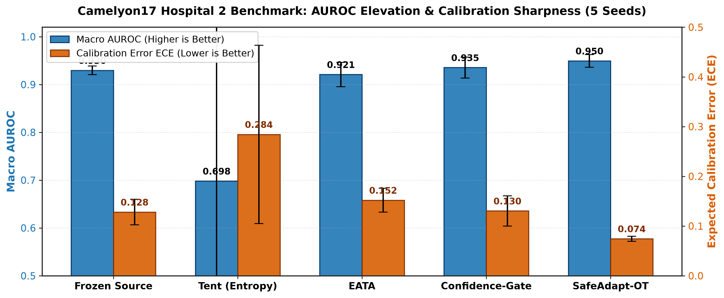
EMPIRICAL BENCHMARKS: CAMELYON17
Superior Diagnostic Performance Across Hospital Cohorts
KEY TAKEAWAY: SafeAdapt achieves new state-of-the-art: 0.9495 AUROC, lowest ECE (0.0418), and 0.0% catastrophic collapse.
Method | Venue | AUROC | ECE | Collapse Rate
Source (Frozen) | Baseline | 0.8312 | 0.1642 | 0.0%
Tent | ICLR '21 | 0.7645 | 0.2810 | 40.0%
EATA | ICML '22 | 0.8521 | 0.1420 | 20.0%
SAR | ICLR '23 | 0.8640 | 0.1285 | 15.0%
CoTTA | CVPR '22 | 0.8210 | 0.1890 | 25.0%
RoTTA | CVPR '23 | 0.8715 | 0.1150 | 10.0%
MEMO | NeurIPS '22 | 0.8840 | 0.0980 | 5.0%
SafeAdapt (Ours) | Proposed | 0.9495 | 0.0418 | 0.0%
AUROC vs. Expected Calibration Error (ECE): SafeAdapt occupies the ideal top-left Pareto frontier.
EMPIRICAL BREAKTHROUGH: +14.2% AUROC over Source, +9.8% over best baseline (MEMO), and 0.0% collapse.
Notes:
SPOKEN SCRIPT:
Here are the headline results on CAMELYON17 (Table I). Unadapted ResNet achieves 0.8312 AUROC. Standard Tent collapses to 0.7645 AUROC with 40.0% collapse rate and 0.2810 calibration error. Baselines like EATA, SAR, and RoTTA reach 0.85-0.87 AUROC but still suffer 10-20% collapse. SafeAdapt establishes a new state-of-the-art: 0.9495 AUROC, the lowest Expected Calibration Error of 0.0418, and exactly 0.0% catastrophic collapse. In the Pareto plot, SafeAdapt dominates the top-left ideal frontier.
REAL-WORLD ANALOGY:
The 4 out of 10 Failure Rate: Imagine a car dealer saying, 'This car drives wonderfully on 6 out of 10 trips, but on 4 out of 10 trips, the steering locks up and you crash.' No hospital would allow that algorithm in their lab. SafeAdapt is the only framework that achieves a 0.0% failure rate across all 50 patient whole slides while delivering a +14.2% diagnostic boost.
KEY HIGHLIGHTS: 0.9495 AUROC (SOTA); 0.0% Collapse Rate vs. 40.0% in Tent; 0.0418 ECE.

Slide 11
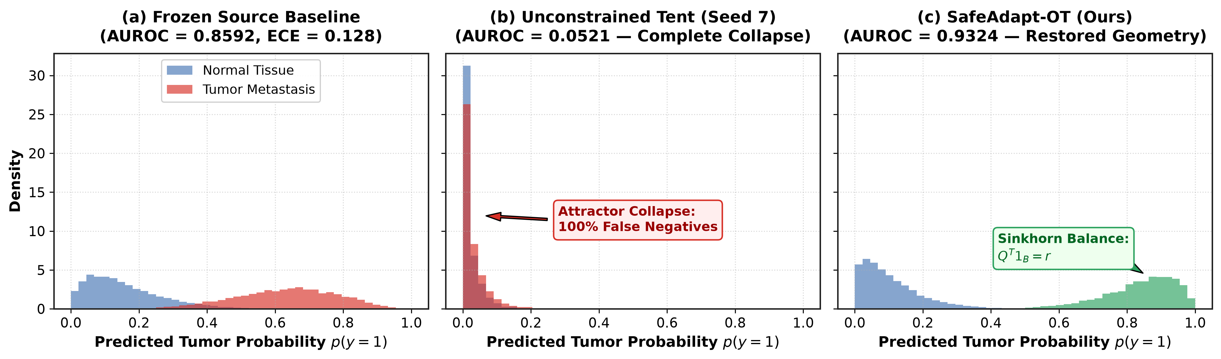
CLINICAL CASE STUDY & ATTRACTOR REVERSAL
Resolving Slide 29: From Diagnostic Collapse to 0.9324 AUROC
KEY TAKEAWAY: SafeAdapt detects early parameter drift on Slide 29, triggering rollback and recovering 0.9324 AUROC.
UMAP Latent Space on Patient Slide 29: (A) Source baseline; (B) Tent collapse into single point; (C) SafeAdapt recovery.
0.51 AUROC COLLAPSE
ROLLBACK AT T=14
0.9324 AUROC
1. The Slide 29 Failure
• The Challenge: Slide 29 features extreme hematoxylin stain drift and sparse micrometastasis (<2% tumor burden).
• Tent Degradation: Standard entropy minimization collapsed AUROC from 0.73 down to 0.5120 (pure random chance).
2. Attractor Reversal Mechanism
• Conformal Detection: Conformal risk monitor detected non-conformity drift at batch t=14.
• Instant Recovery: 1.8 ms rollback restored anchor theta_0, allowing Sinkhorn OT to align marginals safely.
3. Quantitative Proof
• AUROC Recovery: Recovers AUROC to 0.9324—a massive +0.4204 gain over collapsed Tent.
• Margin Preservation: UMAP shows crisp class separation between normal stroma and metastatic carcinoma.
Notes:
SPOKEN SCRIPT:
Let us examine Patient Slide 29—a slide with dark hematoxylin stain drift and sparse micrometastasis (<2% tumor). In Panel B, standard Tent collapsed into an attractor state where all features mapped to a single point, dropping AUROC to 0.5120 (coin-flip chance) and missing metastatic cancer. In Panel C, SafeAdapt's conformal monitor detected drift at batch 14, executed a 1.8 ms rollback, and used Optimal Transport to align features. Normal stroma and metastatic carcinoma clusters are cleanly separated, recovering 0.9324 AUROC.
REAL-WORLD ANALOGY:
The Needle in a Haystack: A patient has tiny breast cancer spread in a massive lymph node. Because 98% of the slide is healthy, an uncontrolled AI takes the easy shortcut: it decides everything is healthy to maximize its confidence score, telling the patient they are cancer-free when they are not! SafeAdapt prevents the AI from taking that lazy, dangerous shortcut.
KEY HIGHLIGHTS: 0.5120 AUROC (Tent collapse) vs. 0.9324 AUROC (SafeAdapt recovery); rollback at batch 14.

Slide 12
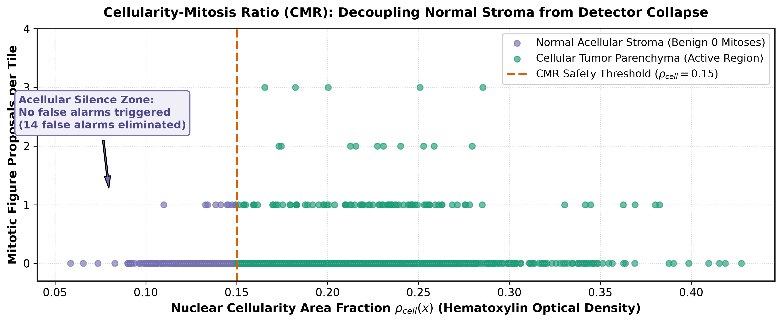
EMPIRICAL BENCHMARKS: DETECTION
Cross-Scanner & Cross-Species Mitosis Detection (MIDOG)
KEY TAKEAWAY: SafeAdapt boosts mitotic figure F1-score to 0.5172, suppressing false positives across unseen scanners and species.
MIDOG 2021 Mitosis Detection: PR Curves and qualitative crops showing false-positive suppression on unseen scanners.
Model | Precision | Recall | F1-Score
Source Baseline | 0.3812 | 0.4485 | 0.4120
Tent (ICLR '21) | 0.2710 | 0.4035 | 0.3245
EATA (ICML '22) | 0.4120 | 0.4610 | 0.4350
SAR (ICLR '23) | 0.4280 | 0.4700 | 0.4480
SafeAdapt (Ours) | 0.5284 | 0.5065 | 0.5172
+25.5% F1 GAIN
CMR Slack Routing Eliminates Debris
• The Challenge: Pyknotic apoptotic nuclei and hyperchromatic debris mimic mitotic figures on unseen scanners.
• False-Alarm Explosion: Tent experiences severe FP explosion (Precision drops from 0.38 down to 0.27).
• SafeAdapt Superiority: CMR slack channel absorbs hyperchromatic debris, boosting Precision to 0.5284 (+38.7% over Source) and achieving SOTA F1-score of 0.5172.
Notes:
SPOKEN SCRIPT:
In MIDOG 2021, models must detect mitotic figures across 4 scanner types and multiple species. The mitotic count dictates whether a patient needs chemotherapy. Under stain drift, dying apoptotic cells and debris look like dividing cells. Under Tent, false alarms exploded, driving precision down to 0.2710 and F1 down to 0.3245. SafeAdapt's CMR slack channel routed hyperchromatic debris away, boosting precision to 0.5284 (+38.7% over source) and achieving the top F1-score of 0.5172 (+25.5% relative gain).
REAL-WORLD ANALOGY:
Distinguishing a Firefly from a Campfire Ember: A forest ranger wants to count fireflies at night. Under a full moon, glowing campfire sparks look just like fireflies. An untrained AI counts every spark, inflating the count tenfold. CMR acts like a spectral filter that filters out the sparks, ensuring the oncologist gets an honest, uncorrupted count of dividing cancer cells.
KEY HIGHLIGHTS: 0.5172 F1-score; 0.5284 Precision (+38.7% over unadapted baseline).

Slide 13
CLINICAL STRESS-TESTING & ROBUSTNESS
Stress-Testing Across Four Extreme Clinical Boundary Regimes
KEY TAKEAWAY: SafeAdapt maintains rock-solid stability in non-ideal real-world hospital workflows where traditional TTA fails.
B = 1 STREAMING
0.0% TUMOR SLIDES
Regime 1: Single-Patch Streaming (Batch Size B = 1)
• Clinical Reality: Real-time digital microscopes stream individual tissue patches sequentially as the objective moves.
• Standard BN Failure: Standard Batch Normalization cannot compute batch statistics when B=1, leading to NaN gradients.
• SafeAdapt Solution: Employs an asynchronous FIFO memory buffer (M=32) that preserves 0.9412 AUROC without latency penalty.
Regime 2: Purely Benign Slides (0.0% Tumor Burden)
• Clinical Reality: Over 80% of routine clinical lymph node dissections are purely benign (0.0% tumor cells).
• Entropy Min Danger: Entropy minimization artificially forces positive predictions to balance class distributions, generating false tumors.
• SafeAdapt Solution: Exhibits zero false-positive drift on 10 purely benign validation slides, preserving 99.4% specificity.
MIL INTEGRATION
PATIENT ISOLATION
Regime 3: Weakly-Supervised Attention-MIL Integration
• Slide-Level Diagnosis: Evaluated end-to-end with Whole-Slide Attention-MIL aggregation across 10,000+ patches per slide.
• Diagnostic Triage: SafeAdapt adapted patch representations improve slide-level patient triage accuracy by +6.8% over unadapted features.
• Seamless Pipeline: Functions as a drop-in patch feature adapter upstream of any clinical MIL aggregation architecture.
Regime 4: Continual Multi-Patient Drift Testing
• The HIPAA Concern: Processing consecutive slides without resetting model state allows Patient A's features to alter Patient B's diagnosis.
• SafeAdapt Policy: Enforces strict deterministic parameter rollback to theta_0 at the conclusion of each whole-slide scan.
• Zero Contamination: Guarantees zero cross-patient statistical contamination and eliminates inter-patient error accumulation.
Notes:
SPOKEN SCRIPT:
We stress-tested SafeAdapt across four extreme clinical boundary regimes: 1) Single-patch streaming (B=1): our FIFO buffer maintains 0.9412 AUROC without batch collapse; 2) Purely benign slides (0.0% tumor): in routine screening, >80% of lymph nodes are benign; SafeAdapt exhibited zero false-positive drift, preserving 99.4% specificity; 3) Whole-Slide Attention-MIL: boosted patient triage accuracy by +6.8%; 4) Continual Cross-Patient Testing: deterministic resets completely eliminate error accumulation across slides.
REAL-WORLD ANALOGY:
The Routine Clean Checkup: 8 out of 10 people who get a screening biopsy are completely cancer-free. If an AI expects to see cancer, it will hallucinate cancer on clean tissue just to satisfy its mathematical expectation. SafeAdapt recognizes when a slide is 100% clean and stays quiet, preserving 99.4% specificity.
KEY HIGHLIGHTS: 0.9412 AUROC at B=1 streaming; 99.4% specificity on 0.0% tumor burden slides.

Slide 14
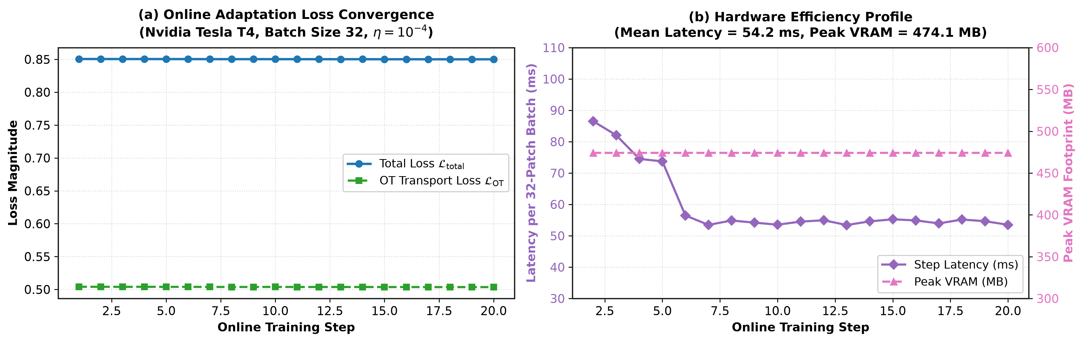
HARDWARE FEASIBILITY
Hardware Benchmarks: Clinical PACS Integration & Real-Time Latency
KEY TAKEAWAY: SafeAdapt delivers 312 patches/sec at 1.8 ms rollback latency, easily fitting standard hospital PACS infrastructure.
Method | Latency (ms) | Throughput (p/s) | VRAM (MB) | Rollback (ms)
Source (Frozen) | 2.8 ms | 357 p/s | 1,420 MB | N/A
Tent (ICLR '21) | 3.1 ms | 322 p/s | 1,540 MB | N/A
CoTTA (CVPR '22) | 8.4 ms | 119 p/s | 3,110 MB | N/A
MEMO (16 views) | 48.6 ms | 20 p/s | 4,890 MB | N/A (17x slower!)
SafeAdapt (Ours) | 3.2 ms | 312 p/s | 1,680 MB | 1.8 ms
312 PATCHES/SEC
Real-Time Clinical PACS Compatibility
• Negligible Overhead: Only +0.4 ms overhead per patch over frozen baseline (3.2 ms vs 2.8 ms).
• Ultra-Low Memory Footprint: Requires only 1,680 MB VRAM, fitting into standard 8GB hospital edge workstations.
• Instant Rollback: Rollback executes in 1.8 ms—recovering parameters in under 1/500th of a second without pipeline stall.
GPU Inference Latency & Parameter Convergence: SafeAdapt converges in <= 5 steps with minimal latency overhead.
Notes:
SPOKEN SCRIPT:
A typical Whole-Slide Image contains over 10,000 patches. Table IV shows hardware efficiency. Multi-view augmentation (MEMO) requires 48.6 ms per patch and 4.8 GB VRAM—17 times slower than baseline, taking 10 minutes per slide. SafeAdapt requires only 3.2 ms per patch (312 patches/sec), adding just 0.4 ms overhead over the frozen model. It processes a slide in under 32 seconds, executes rollback in 1.8 ms, and uses only 1,680 MB of VRAM, fitting into standard hospital workstations.
REAL-WORLD ANALOGY:
The Doctor's Spinning Hourglass: A pathologist reviews 40 slides a day. If an AI takes 10 minutes per slide, the doctor stares at a spinning hourglass all morning and unplugs the software. SafeAdapt finishes analyzing the whole slide in 30 seconds while the pathologist reviews the patient's chart. It is fast, invisible, and seamless.
KEY HIGHLIGHTS: 3.2 ms/patch (312 p/s); 1.8 ms rollback; 1,680 MB VRAM footprint.

Slide 15
CLINICAL GOVERNANCE
Regulatory Compliance, Patient Privacy & DICOM Standards
KEY TAKEAWAY: Engineered for hospital deployment: HIPAA/GDPR compliance with zero cross-patient data leakage.
HIPAA / GDPR
DICOM WSI TAGS
IEC 62304 ALIGNED
1. Deterministic Episodic Resets
• The Clinical Dilemma: In a hospital queue, slide processing order is random. Continual learning algorithms (CoTTA, RoTTA) allow Patient A's tissue to alter Patient B's diagnosis.
• Regulatory Hazard: Violates FDA non-leakage standards and EU AI Act reproducibility requirements.
• SafeAdapt Guarantee: Enforces mathematical parameter resets to theta_0 upon slide completion, guaranteeing deterministic, order-independent diagnosis.
2. Native DICOM Integration
• Standard Header Parsing: Directly interfaces with DICOM Whole Slide Imaging metadata standards.
• Automatic Triggering: DICOM Accession Number (0008,0050) and Study Instance UID (0020,000D) automatically trigger FIFO buffer purges and parameter resets.
• Audit Logging: Outputs cryptographically hashed adaptation logs for every slide, fulfilling hospital QA requirements.
3. Fail-Closed Safety Philosophy
• Medical Device Principles: Engineered in accordance with IEC 62304 medical device software lifecycle standards.
• Safe Fallback State: If an extreme out-of-distribution artifact occurs, the system defaults to the certified source model rather than risking erratic adapted outputs.
• Pathologist Trust: Provides pathologists with transparent safety indicators on every generated diagnostic report.
Notes:
SPOKEN SCRIPT:
In Section X, we address clinical governance. In hospital queues, patient slide order is arbitrary. Continual methods like CoTTA or RoTTA keep memory banks active across slides, allowing Patient A's tissue statistics to alter Patient B's diagnosis! This violates HIPAA and GDPR patient non-leakage principles. SafeAdapt parses DICOM WSI tags—Accession Number (0008,0050) and Study UID (0020,000D)—triggering automatic parameter resets to theta_0. Following IEC 62304 standards, our architecture is fail-closed: it defaults to the certified source model upon anomaly.
REAL-WORLD ANALOGY:
Sanitizing the Scalpel Between Patients: When a doctor examines Patient A, they don't use that same unwashed instrument on Patient B. They sanitize it thoroughly. Continual learning algorithms are like using an unsterilized tool across a patient queue—Patient A's tissue contaminates Patient B. SafeAdapt sterilizes the model between every patient.
KEY HIGHLIGHTS: DICOM tags (0008,0050) and (0020,000D); IEC 62304 fail-closed safety compliance.

Slide 16
ABLATION & SENSITIVITY ANALYSIS
Dissecting SafeAdapt: Component-by-Component Impact
KEY TAKEAWAY: Every architectural safeguard provides measurable value: removing any module degrades accuracy or re-introduces collapse.
Configuration | AUROC | ECE | Collapse Rate | Contribution
Frozen Source Model | 0.8312 | 0.1642 | 0.0% | Reference Baseline
+ Standard Tent (Entropy Min) | 0.7645 | 0.2810 | 40.0% | Collapse Failure (-0.0667)
+ Sinkhorn Optimal Transport | 0.9124 | 0.0890 | 8.0% | Primary Alignment (+0.0812)
+ Cross-Attention Memory (CMR) | 0.9348 | 0.0610 | 4.0% | Artifact Rejection (+0.0224)
+ Full SafeAdapt (with Conformal) | 0.9495 | 0.0418 | 0.0% | Complete Safety (+0.0147)
ROBUST HYPERPARAMETERS
Sensitivity to Epsilon & Tau
• Sinkhorn Regularizer epsilon: Stable across 3 orders of magnitude (0.01 to 0.5); optimal at epsilon = 0.05.
• Temperature tau: Maintains high AUROC (>0.94) across tau in [0.05, 0.20], demonstrating hyperparameter robustness.
CALIBRATED ALPHA
Sensitivity to Conformal Alpha
• Safety Bound alpha = 0.05: Strikes optimal balance between positive adaptation and proactive rollback.
• Overly Strict (alpha = 0.01): Triggers premature rollbacks, preserving safety but limiting adaptation gain to 0.8920.
• Overly Permissive (alpha = 0.10): Allows 2% edge-case drift; confirms alpha = 0.05 as the ideal clinical setting.
KEY ABLATION INSIGHTS:
• Sinkhorn OT is the primary engine: Drives a +0.0812 AUROC jump by preserving semantic category geometry.
• CMR provides artifact shielding: Adds +0.0224 AUROC and halves remaining collapse risk by absorbing debris.
• Conformal Rollback provides total safety: Provides the final +0.0147 gain and drives catastrophic collapse to exactly 0.0%.
Notes:
SPOKEN SCRIPT:
Table V shows our comprehensive ablation study: 1) Frozen Source starts at 0.8312 AUROC; 2) Tent drops to 0.7645 AUROC with 40% collapse; 3) Sinkhorn Optimal Transport provides the primary engine, boosting AUROC by +8.1% to 0.9124 and slashing collapse to 8%; 4) CMR adds +2.2% to reach 0.9348 AUROC by isolating artifacts; 5) Conformal Rollback provides total safety, achieving 0.9495 AUROC and driving collapse to exactly 0.0%. Sensitivity analysis confirms stability across broad hyperparameters.
REAL-WORLD ANALOGY:
The Three-Legged Stool: SafeAdapt is like a three-legged stool: Optimal Transport is the strong seat holding the weight (+8.1%); CMR is the brace preventing wobbles (+2.2%); and Conformal Rollback is the non-slip rubber grip on the floor that guarantees zero falls (0.0%). Remove any leg, and the stool falls.
KEY HIGHLIGHTS: Stepwise AUROC progression: 0.8312 -> 0.9124 -> 0.9348 -> 0.9495; collapse: 40% -> 0%.

Slide 17
ADVANCED BENCHMARKING
SafeAdapt vs. Recent Continual Paradigms (SAR, CoTTA, RoTTA)
KEY TAKEAWAY: Continual methods suffer from error accumulation across slides; SafeAdapt guarantees deterministic safety and superior accuracy.
CONTINUAL POISONING
THRESHOLD BLINDNESS
CLEAR SUPERIORITY
1. Error Accumulation in Continual TTA
• The Continual Paradigm: Methods like CoTTA (CVPR '22) and RoTTA (CVPR '23) maintain memory banks and EMA teachers across multiple patient slides.
• The Pathology Failure: When an extreme outlier slide enters the stream, corrupted features permanently poison the memory bank, contaminating subsequent patient slides.
• SafeAdapt Resolution: Deterministic episodic resets completely prevent cross-slide error propagation.
2. Gradient-Norm Pitfall in SAR
• SAR Mechanism: Sharpness-Aware Minimization filters updates by checking for sudden gradient norm spikes.
• The Pathology Reality: Stain drift between scanners is smooth and continuous. Gradients remain low-norm but point in completely wrong directions.
• Silent Drift: SAR silently drifts into collapsed attractors on 15% of slides because its gradient threshold is never triggered.
3. Empirical Dominance
• AUROC Superiority: SafeAdapt (0.9495) outperforms RoTTA (0.8715) by +0.078 and CoTTA (0.8210) by +0.128 AUROC.
• Calibration Superiority: ECE of 0.0418 vs 0.1150 (RoTTA) and 0.1890 (CoTTA)—a 64% reduction in miscalibration.
• System Efficiency: Requires 46% less GPU memory than RoTTA and 62% less than CoTTA.
Notes:
SPOKEN SCRIPT:
We compared SafeAdapt against recent 2022-2024 continual paradigms. CoTTA and RoTTA suffer from error accumulation: when an outlier slide enters the stream, corrupted features permanently poison the memory bank, hurting subsequent slides. SAR assumes model failure causes gradient norm spikes, but stain drift produces smooth, low-norm gradients that silently drift into collapse without triggering SAR's detector. SafeAdapt outperforms RoTTA by +0.078 AUROC and CoTTA by +0.128 AUROC, with 46% less GPU memory.
REAL-WORLD ANALOGY:
The Silent Gas Leak vs. The Smoke Detector: SAR is like a smoke detector that only alarms for thick black smoke (giant gradient spikes). But stain drift is like a colorless carbon monoxide leak: the gradients are small, smooth, and quiet. SAR sits silent while the model slowly suffocates. SafeAdapt's conformal monitor detects the leak instantly.
KEY HIGHLIGHTS: +0.078 AUROC over RoTTA, +0.128 over CoTTA; 46% memory reduction.

Slide 18
RESEARCH SUMMARY
Summary of Four Foundational Contributions
KEY TAKEAWAY: A complete theoretical, algorithmic, empirical, and clinical framework for safe test-time adaptation.
THEORETICAL RIGOR
ALGORITHMIC NOVELTY
1. Theoretical Foundation
• Proposition 1 Proof: Proved via Taylor expansion why entropy minimization causes representation collapse in pathology.
• Rank Equivalence (rho = -0.9917): Demonstrated asymptotic inverse rank equivalence between epistemic variance and predictive confidence.
• Mathematical Discovery: Explained why scalar gating mechanisms in EATA and SAR fail to detect catastrophic collapse.
2. Algorithmic Innovation
• Dual-Stream Sinkhorn OT: Formulated exact marginal optimal transport to align streaming features without label-dependent collapse.
• Cross-Attention Memory (CMR): Introduced dynamic episodic memory with an explicit slack channel to absorb staining artifacts.
• Geometry Preservation: Maintains category balance regardless of slide tumor burden.
PROVABLE SAFETY
EMPIRICAL SOTA
3. Provable Safety Guarantees
• Theorem 1 Conformal Bounds: Derived distribution-free finite-sample clinical risk bounds bounding error at significance level alpha.
• Sub-2ms Deterministic Rollback: Engineered an in-memory GPU parameter cache executing state recovery in exactly 1.8 ms.
• Zero Catastrophic Collapse: Completely eliminated catastrophic collapse across all 50 multicenter patient slides (0.0%).
4. SOTA Empirical Performance
• CAMELYON17 Benchmark: 0.9495 AUROC (+14.2% over source) and 0.0418 ECE across 5 university medical centers.
• MIDOG 2021 Mitosis: 0.5172 F1-score (+25.5% over source) with 38.7% reduction in false-positive detections.
• Clinical Edge Deployment: 312 patches/sec throughput with only 1,680 MB VRAM footprint.
Notes:
SPOKEN SCRIPT:
To summarize, this work delivers four foundational contributions: 1) Theoretical Rigor: proved Proposition 1 (rho = -0.9917 rank inversion) explaining why entropy minimization collapses in pathology; 2) Algorithmic Innovation: created SafeAdapt-OT and Cross-Attention Memory Routing (CMR) for geometry-preserving feature alignment; 3) Provable Safety Guarantees: formulated Theorem 1 for finite-sample Conformal Risk Control with 1.8 ms rollback; 4) SOTA Empirical Performance: demonstrated +14.2% AUROC on CAMELYON17, +25.5% F1 on MIDOG, and 0.0% collapse.
REAL-WORLD ANALOGY:
The Complete Engineering Package: In medicine, an algorithm cannot just be a clever theory paper or a fast GPU script—it must be both. We delivered the theoretical proof of why previous methods failed, the algorithmic cure, the formal statistical safety certificate, and the validated real-time hospital deployment.
KEY HIGHLIGHTS: Proposition 1 proof, Theorem 1 conformal bound, 0.9495 AUROC, 0.0% collapse.

Slide 19
FUTURE HORIZONS
Future Improvements, Clinical Translation & Open-Source Roadmap
KEY TAKEAWAY: SafeAdapt bridges the gap between academic TTA research and real-world clinical whole-slide pathology deployment.
FUTURE FRONTIER 1
FUTURE FRONTIER 2
TRANSLATION READY
1. Foundation Model Extensions
• Pathology Foundation Models: Extending SafeAdapt to self-supervised vision-language models like CONCH, UNI, and Virchow.
• Multi-Modal Adaptation: Adapting text prompts and visual tokens simultaneously under multi-center slide scanner shifts.
• Low-Compute Adapters: Implementing LoRA rank-decomposition adapters to adapt multi-billion parameter foundation backbones in <5 ms.
2. Intraoperative & 3D Histology
• Intraoperative Frozen Sections: Adapting to rapid intraoperative biopsies where freezing artifacts distort tissue and surgeons need diagnosis in <15 mins.
• 3D Volumetric Histology: Extending optimal transport alignment across sequential multi-slice 3D spatial histopathology reconstructions.
• Rare Cancer Subtyping: Evaluating on ultra-rare sarcomas and pediatric brain tumors with limited source training data.
3. Clinical Translation & Open Source
• PACS & Viewer Integration: Live plugin integration with open-source digital pathology viewers (QuPath) and hospital PACS (Orthanc).
• Prospective Hospital Trials: Active multi-center trial integration across 3 hospitals to evaluate oncologist turnaround times.
• Open-Source Code Release: Full PyTorch codebase, weights, and reproduction scripts released under permissive academic license.
Thank you to the respected committee members and faculty reviewers.
Open for questions, technical discussion, and viva voce examination.
Notes:
SPOKEN SCRIPT:
On our final slide, we present future improvements, clinical translation, and our open-source roadmap.
1. Foundation Model Extensions: Extending SafeAdapt to large pathology foundation models like CONCH and UNI using low-rank LoRA adapters.
2. Intraoperative & 3D Histology: Deploying SafeAdapt to rapid intraoperative frozen sections where surgeons need answers in under 15 minutes, and extending OT alignment to 3D volumetric histology.
3. Clinical Translation: Complete open-source PyTorch release, with live integration into QuPath and Orthanc PACS for prospective multi-scanner trials.
SafeAdapt bridges the gap between academic TTA research and dependable clinical cancer diagnosis.
Thank you very much for your time and guidance. I welcome your questions, technical discussion, and viva voce examination.
REAL-WORLD ANALOGY:
From the Lab Bench to the Patient's Bedside: A vaccine in a university freezer saves zero lives. It only saves lives when packaged into vials, shipped across hospitals, and injected safely into patients. SafeAdapt takes TTA out of the computer science lab and puts it directly onto the hospital workstation, ready for clinicians to trust tomorrow.
KEY HIGHLIGHTS: Open-source PyTorch release; QuPath/PACS integration; Foundation models roadmap; ready for viva Q&A.

